Slide 1

De-Confinement in pp Collisions at LHC Energies
Brijesh K Srivastava
Department of Physics & Astronomy
Purdue University, USA
in collaboration with
A. S. Hirsch & R. P. Scharenberg ( Purdue University)
C. Pajares (Universidale de Santiago de Compostela)
XIII Workshop on Particle Correlations & Femtoscopy
WPCF2018
The Henryk Niewodniczański Institute of Nuclear Physics PAN, Krakow, Poland
May 22 – May 26, 2018

Slide 2
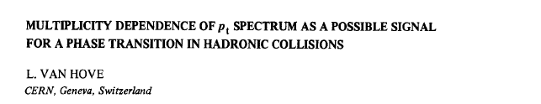

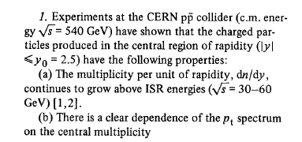
UA5
UA1

Slide 3
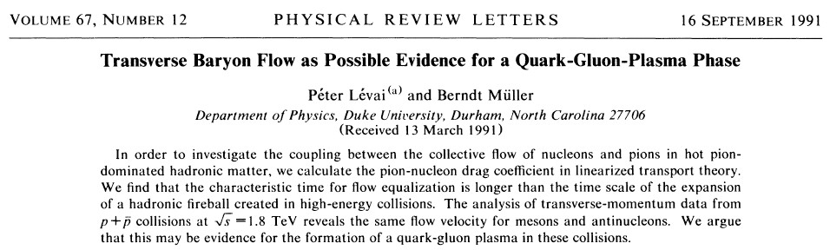
E-735 Experiment

Slide 4
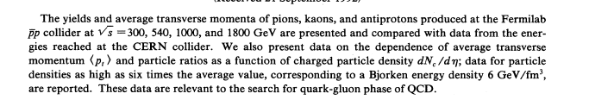
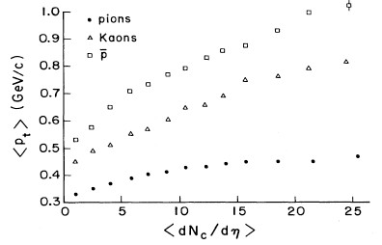
E735 data
T. Alexopoulos, PRD48, 984 (1993)

Slide 5
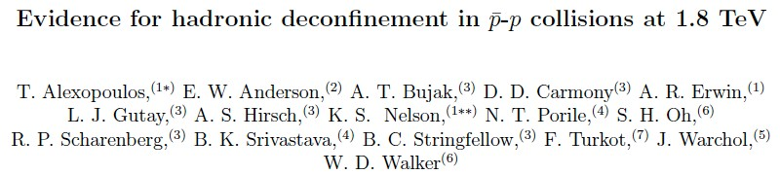
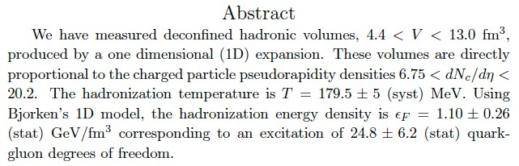
E735 : QGP ?

Slide 6
De-Confinement and Clustering of Color Sources
In
Nuclear Collisions

Slide 7
Color Strings
Multiparticle production at high energies is currently described
in terms of color strings stretched between the projectile and target.
These strings decay into new ones by production and subsequently hadronize to produce the observed hadrons. Particles are produced by the Schwinger 2D mechanism.
As the no. of strings grow with energy and or no. of participating nuclei they start to interact and overlap in transverse space as it happens for disks in the 2-D percolation theory
In the case of a nuclear collisions, the density of disks –elementary strings
N^{s} = # of strings
S₁ = Single string area
S_{N} = total nuclear overlap area

Slide 8
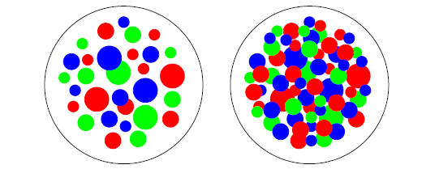
Clustering of Color Sources
De-confinement is expected when the density of quarks and gluons becomes so
high that it no longer makes sense to partition them into color-neutral hadrons,
since these would overlap strongly.
We have clusters within which color is not confined : De-confinement is thus
related to cluster formation very much similar to cluster formation in
percolation theory and hence a connection between percolation and
de-confinement seems very likely.
Parton distributions in the
transverse plane of nucleus-nucleus
collisions
In two dimensions, for uniform string density, the percolation threshold for overlapping discs is:
H. Satz, Rep. Prog. Phys. 63, 1511(2000).
H. Satz , hep-ph/0212046
Critical Percolation Density

Slide 9
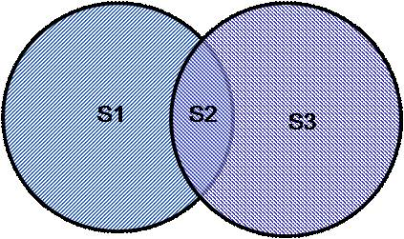
Color Sources
S_{n}
The transverse space occupied by a cluster of overlapping strings split into
a number of areas in which different no of strings overlap, including areas
where no overlapping takes place.
A cluster of n strings that occupies an area S_{n} behaves as a single color
source with a higher color field corresponding to vectorial sum of color
charges of each individual string
If strings are fully overlap
Partially overlap

Slide 10
Schwinger mechanism for the
Fragmentation
Multiplicity and <p_{T}² > of particles produced by a cluster of n strings
Multiplicity (μ_{n})
Average Transverse Momentum
= Color suppression factor
(due to overlapping of discs).
N^{s} = # of strings
S₁ = disc area
S_{N} = total nuclear overlap area
ξ is the string density parameter
M. A. Braun and C. Pajares, Eur.Phys. J. C16,349 (2000)
M. A. Braun et al, Phys. Rev. C65, 024907 (2002)

Slide 11
Percolation and Color Glass Condensate
Both are based on parton coherence phenomena.
Percolation : Clustering of strings
CGC : Gluon saturation
Many of the results obtained in the framework of percolation of strings
are very similar to the one obtained in the CGC.
In particular , very similar scaling laws are obtained for the product and
the ratio of the multiplicities and transverse momentum.
Both provide explanation for multiplicity suppression and <p_{t}>
scaling with dN/dy.
Momentum Q_{s} establishes the scale in CGC with the corresponding
one in percolation of strings
The no. of color flux tubes in CGC and the effective
no. of clusters of strings in percolation have the same
dependence on the energy and centrality.
This has consequences in the Long range rapidity
correlations and the ridge structure.
For large value of ξ
CGC : Y. V. Kovchegov, E. Levin, L McLerran, Phys. Rev. C 63, 024903 (2001).

Slide 12
Color String Percolation Model for Nuclear Collisions
from
SPS-RHIC-LHC
Elementary partonic collisions
Formation of Color String
SU(3) random summation of charges
Reduction in color charge
Increase in the string tension
String breaking leads to formation of secondaries
Probability rate ->Schwinger
Fragmentation proceeds in an iterative way
Multiplicity
pt distribution
Particle ratios
Elliptic flow
Suppression of high pt particles R_{AA}
J/ψ production
Forward-Backward Multiplicity Correlations at RHIC

Slide 13
Thermodynamic and Transport Properties
Determination of the Color Suppression Factor F(ξ)
from the Data
Thermodynamics
Temperature
Energy Density
Shear viscosity to
Entropy density ratio
Equation of State

Slide 14
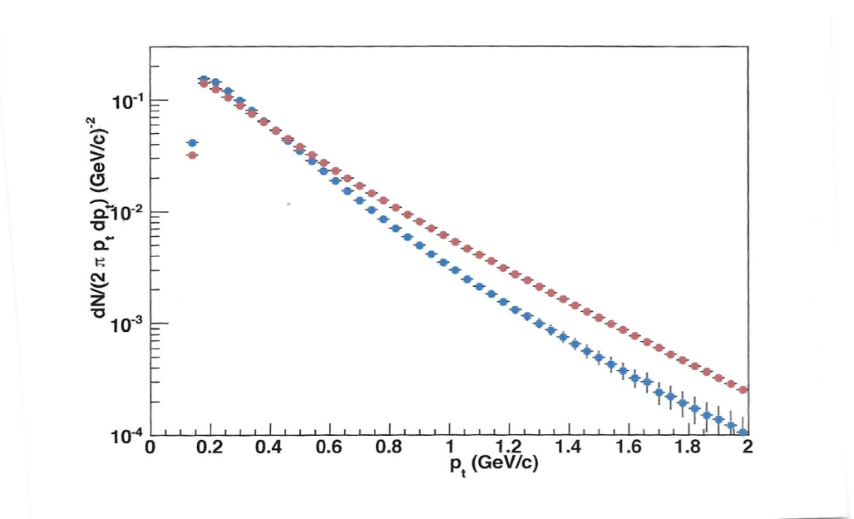
Data Analysis
Using the p_{T} spectrum to extract F(ξ)
The experimental p_{T} distribution from pp data is used
Parametrization of UA1 data
from 200, 500 and 900 GeV
ISR 53 and 23 GeV pp
p₀ = 1.71 and n = 12.42
a, p₀ and n are parameters
fit to the data.
Nucl. Phys. A698, 331 (2002)
This parameterization can be used for nucleus-nucleus collisions to account for the clustering :
Au+Au@200 GeV
0-10%
pp@200 GeV

Slide 15
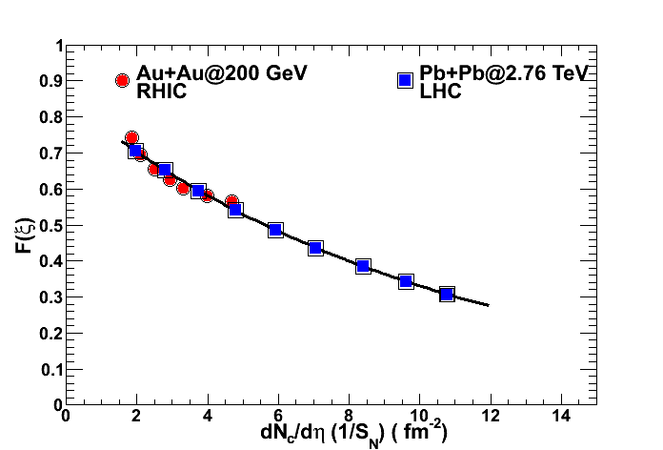
Color Suppression Factor F(ξ)
Au+Au @200 GeV
STAR data
Phys. Rev. C 79, 034909(2009)
Using ALICE charged particle multiplicity
Phys. Rev. Lett. , 106, 032301 (2011).
Extrapolation
Now the aim is to connect F(ξ) with Temperature and Energy density

Slide 16
Schwinger : p_{t} distribution of the produced quarks
Thermal Distribution
The Schwinger formula can be reconciled with the thermal distribution if the
String tension undergoes fluctuations
which gives rise to thermal distribution
Initial temperature

Slide 17
Thermalization
The origin of the string fluctuation is related to the stochastic
picture of the QCD vacuum . Since the average value of color
field strength must vanish, it cannot be constant and must
vanish from point to point. Such fluctuations lead to the
Gaussian distribution of the string.
H. G. Dosch, Phys. Lett. 190 (1987) 177
A. Bialas, Phys. Lett. B 466 (1999) 301
The fast thermalization in heavy ion collisions can occur
through the existence of event horizon caused by rapid
deceleration of the colliding nuclei. Hawking-Unruh effect
encountered in black holes and for accelerated objects.
D. Kharzeev, E. Levin , K. Tuchin, Phys. Rev. C75, 044903 (2007)
H.Satz, Eur. Phys. J. 155, (2008) 167

Slide 18
Temperature
At the critical percolation density
PHENIX:
Temperature from direct photon
Exponential (consistent with thermal)
Inverse slope = 220 ± 20 MeV
PRL 104, 132301 (2010)
= 167 MeV
For Au+Au@ 200 GeV
0-10% centrality ξ = 2.88 T ~ 195 MeV
Pb+Pb @ 2.76TeV for 0-5%
T =262 ± 13 MeV
Temperature has increased by 35% from Au+Au @ 0.2 TeV
First Results from Pb+Pb Collisions@ 2.76 TeV at the LHC
Muller, Schukraft and Wyslouch, Ann. Rev. Nucl. Sci. Oct. 2012
ALICE : Direct Photon Measurement
T = 304 ± 51 MeV QM2 2012
T = 297 ± 12 ± 41MeV Phys. Lett. B 754 , 235 (2016)

Slide 19
Summary : Heavy Ion
The Clustering of Color Sources leading to the Percolation Transition
may be the way to achieve de-confinement in High Energy collisions.
This picture provide us with a microscopic partonic structure which explains the early thermalization. The relevant quantity is transverse
string density
A further definitive test of clustering phenomena can be made at
LHC energies by comparing h-h and A-A collisions.
Braun, Dias de Deus, Hirsch, Pajares, Scharenberg and Srivastava
Phys. Rep. 599 (2015) 1-50

Slide 20
Application of Clustering Picture to Small System
at 1.8 TeV E-735 experiment at FNAL
pp at LHC energies 0.9, 2.76, 7 and 13 TeV
Determination of the Color Suppression Factor F (ξ) using transverse
momentum spectra of pions in high multiplicity events
Temperature
Comparison between AA and pp

Slide 21

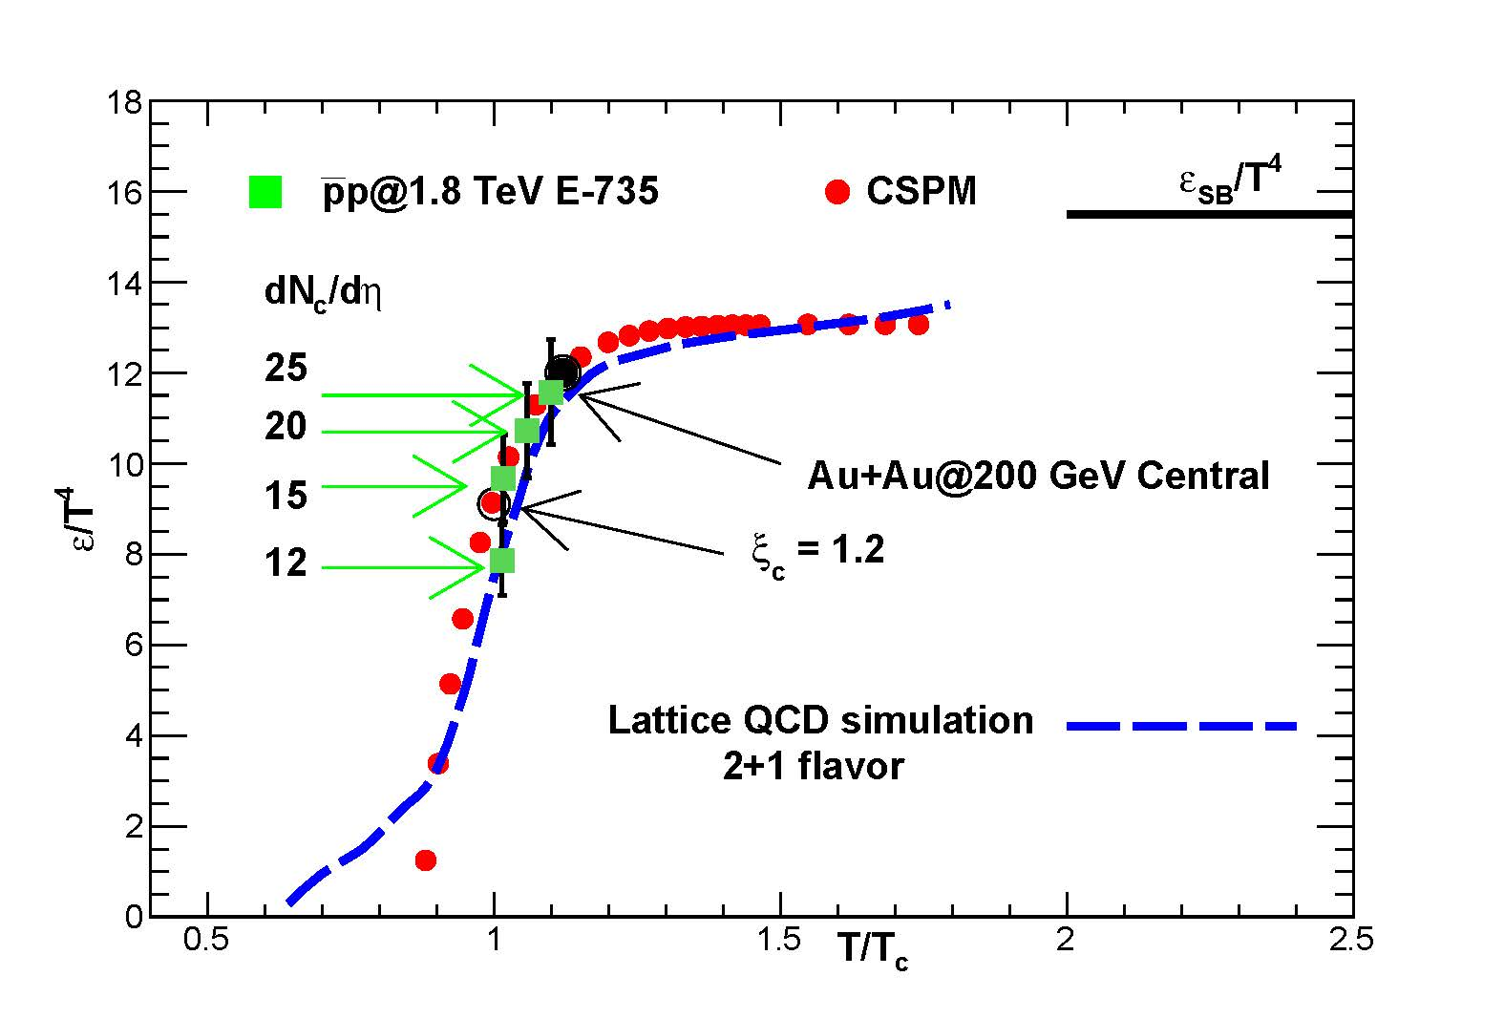

and
A further definitive test of clustering phenomena can be made at
LHC energies

Slide 22
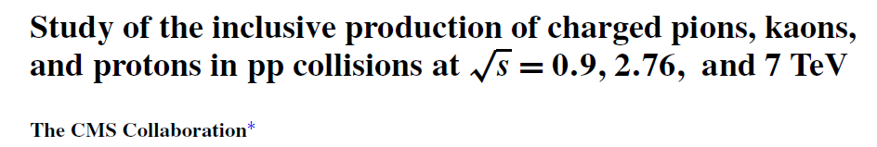
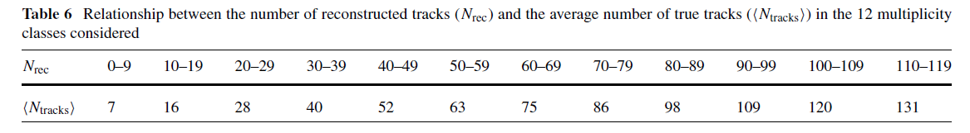

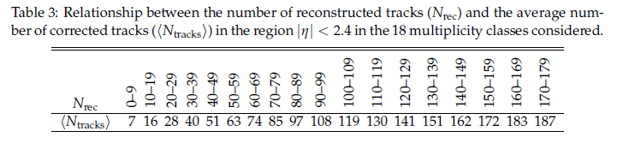
CMS Collaboration
arXiv:1706.10194 , Phys. Rev. D 96 (2017) 112003

Slide 23
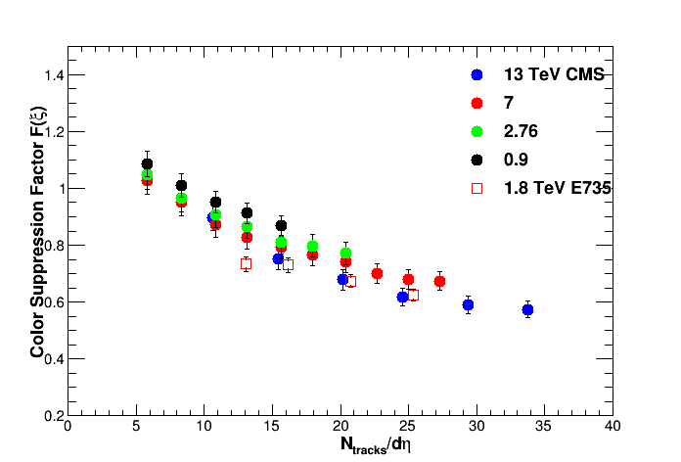
Analysis of CMS data to extract Color Suppression Factor F(ξ)
from the transverse momentum spectra of pions at
0.9, 2.76 , 7 and 13 TeV as a function of multiplicity (N_{track})
Pseudorapidity coverage for CMS : |η| < 2.4
E735: |η| < 3.25

Slide 24
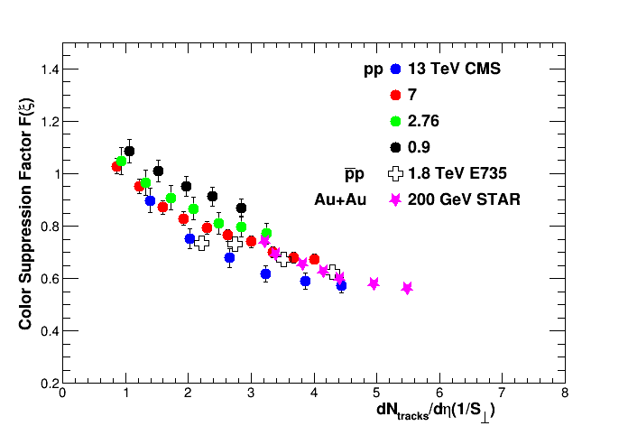
F(ξ) from AA and pp
Fixed interaction cross section for all multiplicities in pp

Slide 25
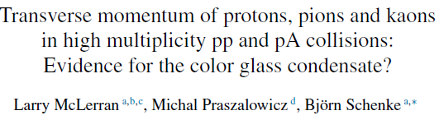
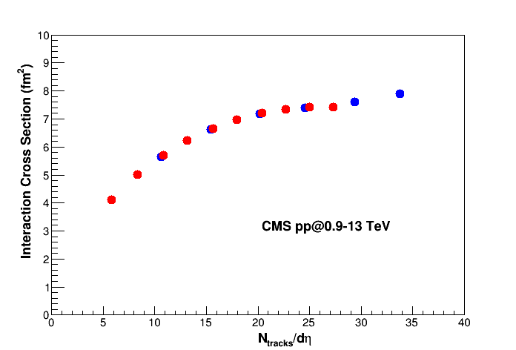
Interaction area is computed: IP-Glasma model
The gluon multiplicity can be
approx. related to the no of
tracks seen in the CMS
experiment
Transverse area :

Slide 26
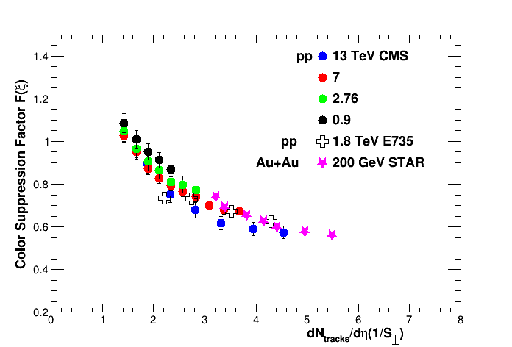
Scaling with the transvers interaction area S┴
S┴ varies with the multiplicity and is obtained using the methodology
Described by CGC
E735 and Au+Au at 200 GeV are also shown in the plot. It scales with the
Transverse overlap area.

Slide 27
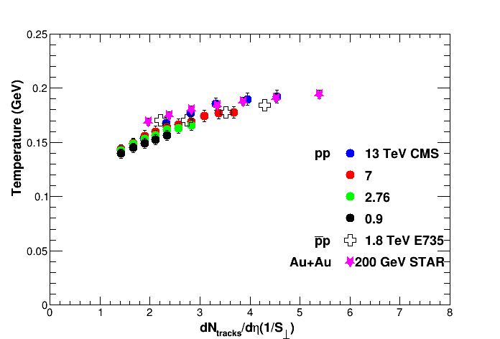
Temperature
Universal hadronization temperature
Eur. Phys. J C66, 377 (2010)
Becattini et al.

Slide 28
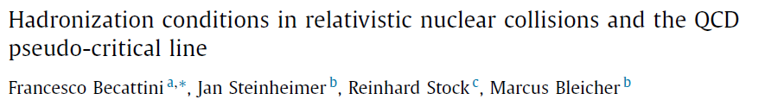
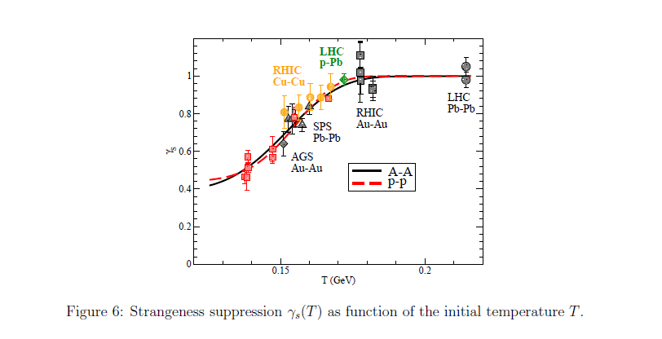
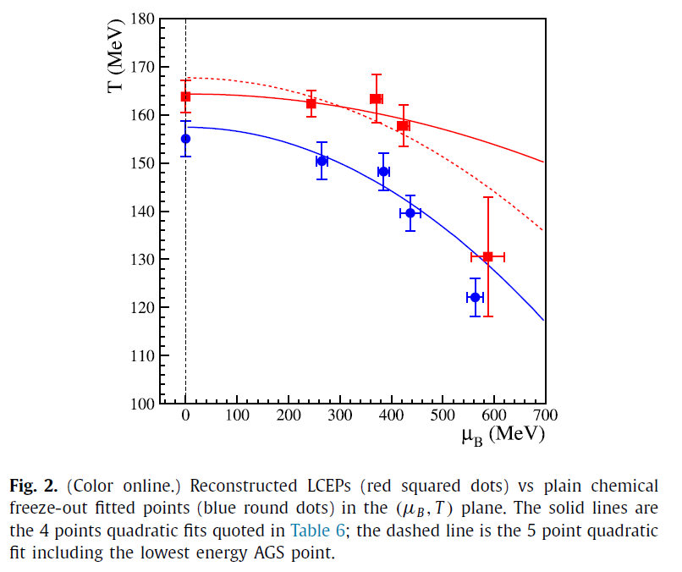

Phys. Lett. B764, 241 (2017)
arXiv:1709.02706 [nucl-th]

Slide 29
The viscosity can be estimated from
kinetic theory to be
ε
Energy density
s Entropy density
n the number density
Mean free path
Transport cross section
Average transverse momentum of the single string
L is Longitudinal extension of
the source 1 fm
Hirano & Gyulassy, Nucl. Phys. A769, 71(2006)

Slide 30
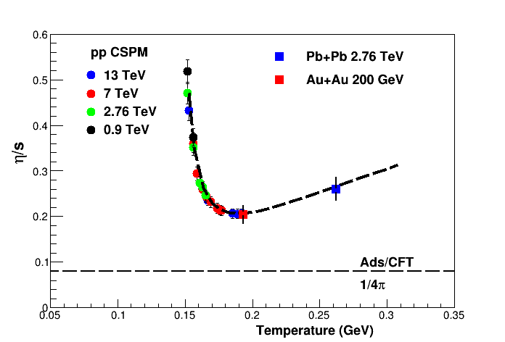
Shear viscosity to entropy density ratio
η/s as a function of temperature for pp collisions at 0.9, 2.76, 7 and 13 TeV.
The lower bound is given by the Ads/CFT

Slide 31
Summary
The Clustering of Color Sources produced by overlapping strings has been applied to both A-A and pp collisions.
The most important quantity in this picture is the multiplicity dependent interaction area in the transverse plane
The temperature both from AA and pp scales as
Quantum tunneling through color confinement leads to thermal hadron production in the form of Hawking-Unruh radiation. In QCD we have string interaction instead of gravitation.
Question ?
Is Clustering of Color Sources the new Paradigm for producing QGP
both in pp and A-A in high energy collisions ?
Thank You

Slide 32
Extras

Slide 33
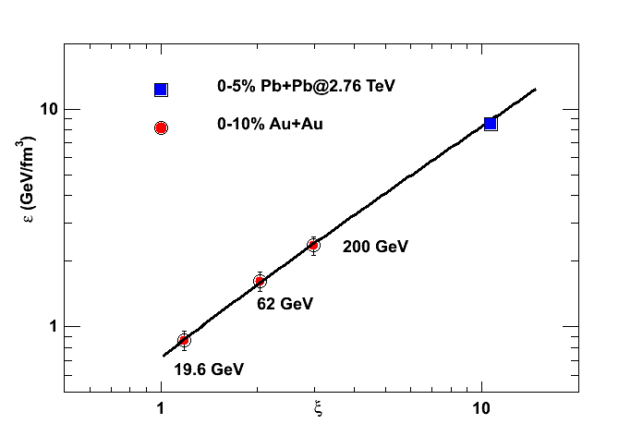
Energy Density
Bjorken Phys. Rev. D 27, 140 (1983)
Transverse overlap area
Proper Time
is the QED production time for a
boson which can be scaled from
QED to QCD and is given by
STAR Coll., Phys. Rev. C 79, 34909 (2009)
Introduction to high energy
heavy ion collisions
C. Y. Wong
J. Dias de Deus, A. S. Hirsch, C. Pajares , R. P. Scharenberg , B. K. Srivastava
Eur. Phys. J. C 72, 2123 ( 2012)

Slide 34
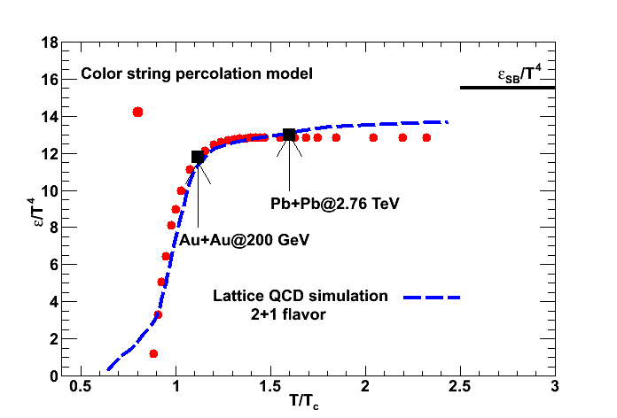
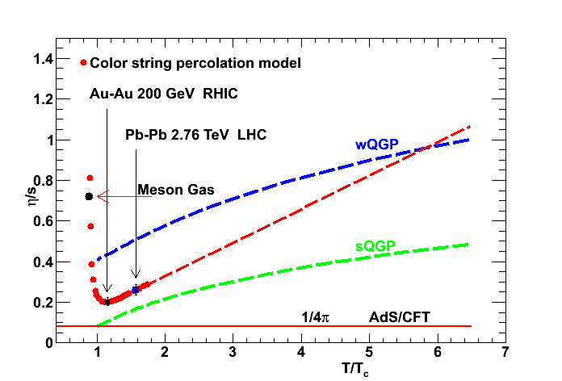
Having determined the initial temperature of the system from the data one obtains the thermodynamic and transport properties of QCD matter
Energy Density
Shear viscosity to entropy density ratio
Scharenberg , Srivastava, Hirsch
Eur. Phys. J. C 71, 1510( 2011)
Dias de Deus, Hirsch, Pajares, Scharenberg , Srivastava, Eur. Phys. J. C 72, 2123 ( 2012)

