Slide 1




Accelerating hydrodynamic description of pseudorapidity density and the initial energy density at RHIC and LHC
Ze-Fang Jiang¹, Tamás Csörgő^{2,3},
C. B. Yang¹, Máté Csanád⁴ .
¹ Central China Normal University, Wuhan, China
² Wigner RCP, Budapest, Hungary
³ EKU KRC, Gyöngyös, Hungary
⁴ Eötvös University, Budapest, Hungary
Presented at “WPCF 2018”, May 23th 2018.
Many thanks to:
Xin-Nian Wang, T.S. Biró, M. I. Nagy.

Slide 2
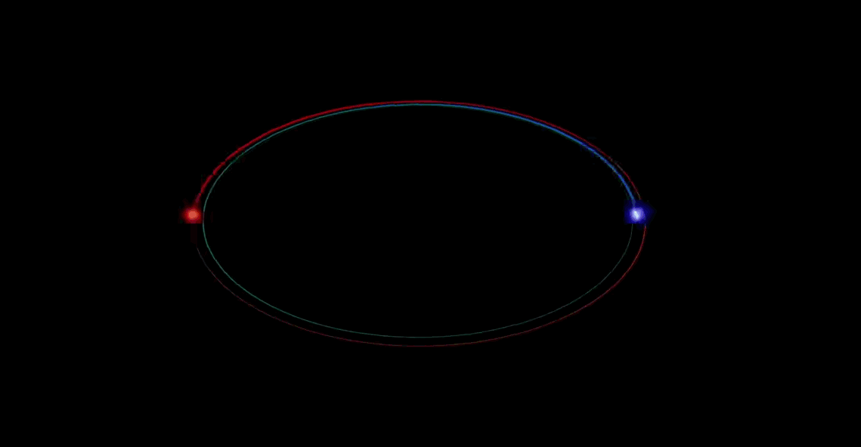
Motivation
hydro
--The frontiers of nuclear science, a long range plan
- What is the initial temperature and thermal evolution of the produced matter?
- What is the viscosity of the produced matter? ...
http://www.bnl.gov/physics/rhiciiscience/
Outline
Accelerating ideal solution of hydrodynamics and results
(perfect flow for fitting p+p, Cu+Cu, Au+Au, Pb+Pb data).
  Csörgő, Nagy, Csanád (CNC) arXiv: 0605070, 0710.0327, 0805.1562,
  Csanád, et. arXiv:1609.07176. Z. F. Jiang, et. arXiv: 1711.10740.
New perturbative solutions of viscous hydrodynamics.
Summary and outlook.

Slide 3
Motivation
The next phase … will focus on detailed investigations of the QGP, “both to quantify its properties and to understand precisely how they emerge from the fundamental properties of QCD”
-- The frontiers of nuclear science, a long range plan
- What is the initial temperature and thermal evolution of the produced matter?
- What is the viscosity of the produced matter? ...
http://www.bnl.gov/physics/rhiciiscience/
Outline
Accelerating solution of ideal hydrodynamics and results
(perfect flow for fitting p+p, Cu+Cu, Au+Au, Pb+Pb data).
  Csörgő, Nagy, Csanád (CNC) arXiv: 0605070, 0710.0327, 0805.1562,
  Csanád, et. arXiv:1609.07176. Z. F. Jiang, et. arXiv: 1711.10740.
New perturbative solution of viscous hydrodynamics.
Summary and outlook.

Slide 4
CNC solutions of relativistic hydrodynamics
Hydrodynamics can be a universal tool to study the QGP. In Rindler coordinate, 4 different sets of the parameters λ, d, κ and ϕ for 5 possible cases as follows (λ is the accelerate parameter.):
Csörgő, Nagy, Csanád(CNC) arXiv: 0605070,
0710.0327, 0805.1562,....
Case | λ | d | κ | ϕ
a.) | 2 | R | d | 0
b.) | 1/2 | R | 1 | (κ+1)/κ
c.) | 3/2 | R | (4d-1)/3 | (κ+1)/κ
d.) | 1 | R | R | 0
e.) | R | R | 1 | 0
accelerating, d dimension
d dimensional ( T. S. Biró)
Hwa-Bjorken, Buda-Lund type
Special EoS, but general velocity
In all ideal cases, the velocity field and the pressure is expressed as :

Slide 5
The initial energy density estimation
Rapidity distribution:
Pseudorapidity distribution:

Slide 6
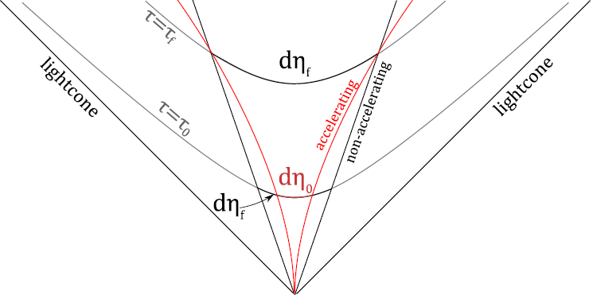
The initial energy density estimation
Rapidity distribution:
Pseudorapidity distribution:
J. D. Bjroken, Phys. Rev. D 27, 140 (1983)
For an accelerating flow,
Two main modifications for Initial conditions: y ≠ η; η_{final} ≠ η_{initial} .
Flow element's motion path
BRAHMS 200 GeV Au+Au data
arXiv: 0805.1562
For more recent, exact results that include the work done by pressure,
see G.Kasza's talk at WPCF2018

Slide 7
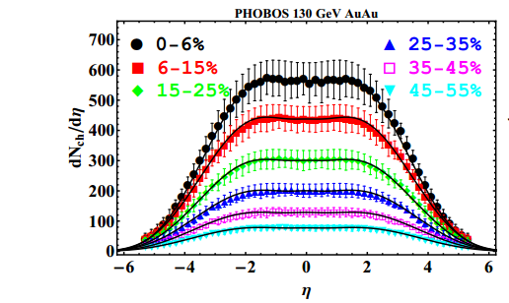
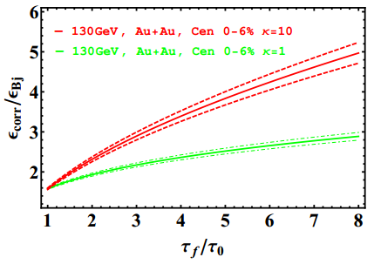
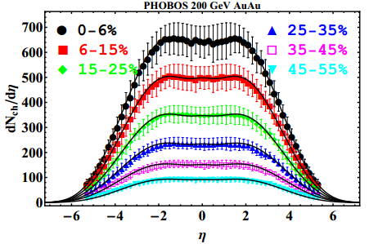
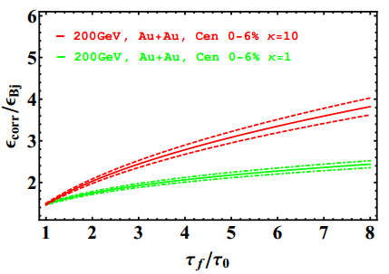
The pseudorapidity distributions
Results for 130 GeV Au+Au and 200 GeV Au+Au collisions
correction ratio
correction ratio
(See Z.F. Jiang, C.B. Yang, M. Csanád, T. Csörgő, arXiv:1711.10740)

Slide 8
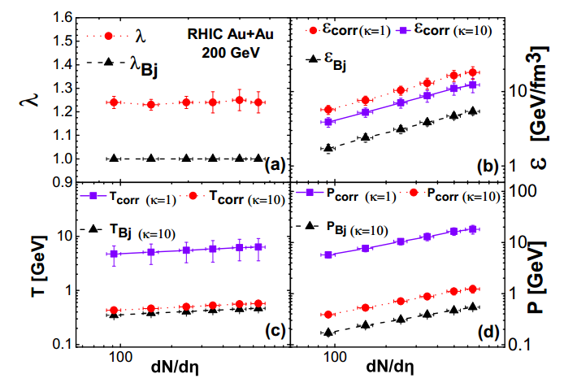
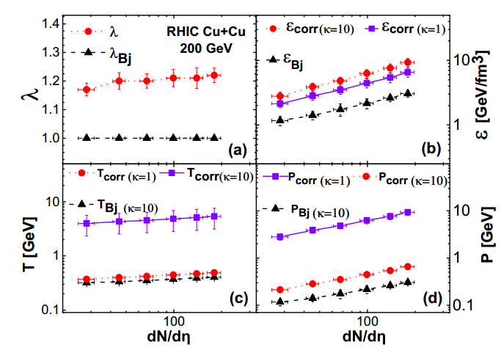
The initial energy density estimation
Results for 130 GeV Au+Au and 200GeV Au+Au collisions
Acceleration parameter
Initial energy density
Initial temperature
Initial pressure
(See Z.F. Jiang, C.B. Yang, M. Csanád, T. Csörgő, arXiv:1711.10740)

Slide 9
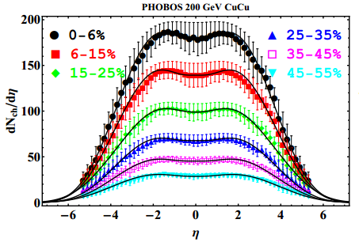
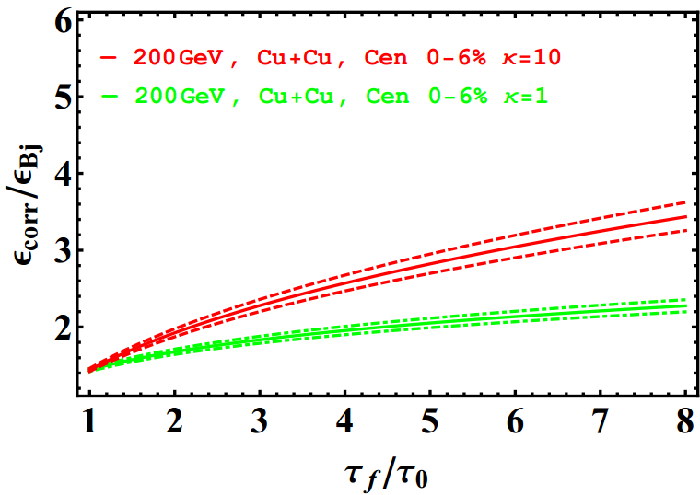
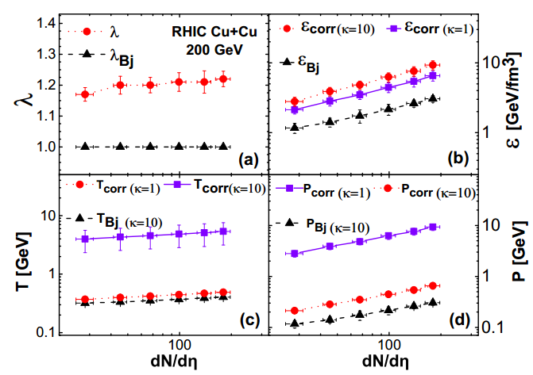
The initial energy density estimation
Results for 200 GeV Cu+Cu collisions
correction ratio
(See Z.F. Jiang, C.B. Yang, M. Csanád, T. Csörgő, arXiv:1711.10740)

Slide 10
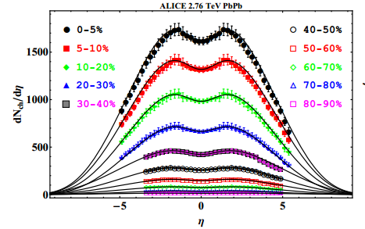
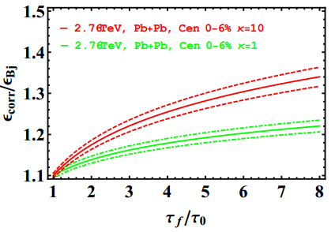
The initial energy density estimation
Results for 2.76 TeV Pb+Pb collisions
correction ratio
(See Z.F. Jiang, C.B. Yang, M. Csanád, T. Csörgő, arXiv:1711.10740)

Slide 11
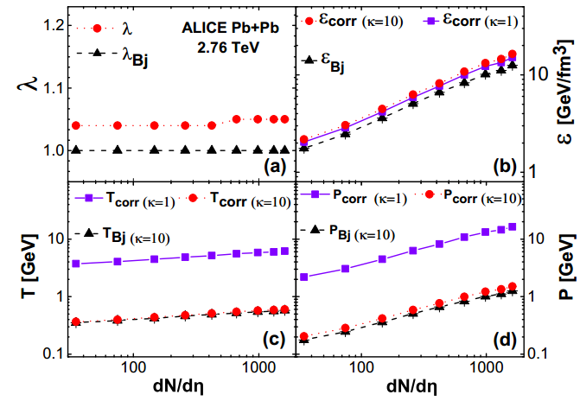
The initial energy density estimation
Results for 2.76 TeV Pb+Pb collisions
(See Z.F. Jiang, C.B. Yang, M. Csanád, T. Csörgő, arXiv:1711.10740)
- Hydro can be used to estimate the initial ε₀ . (J. D. Bjorken, Phys. Rev. D27 (1983) 140-151. Gyulassy M, Matsui T. 1984. Phys. Rev. D29: 419)
- The larger the center of mass energy, the smaller the acceleration parameter λ. The bigger <N_{part}>, the bigger λ.
- From the fits, the initial energy density, initial temperature and initial pressure are reconstructed.
11

Slide 12
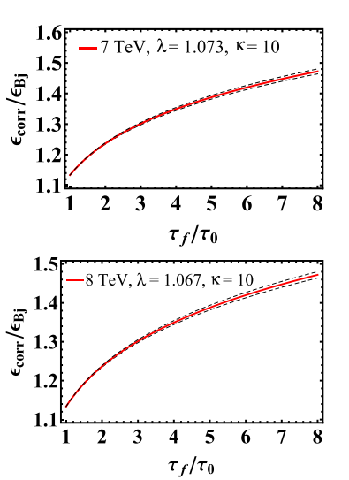
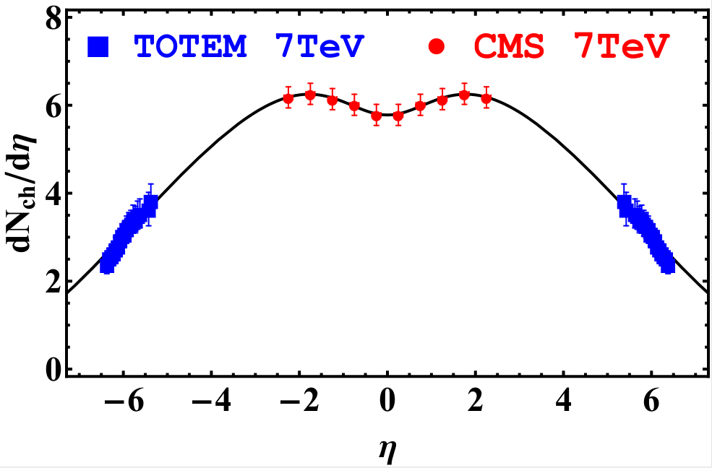
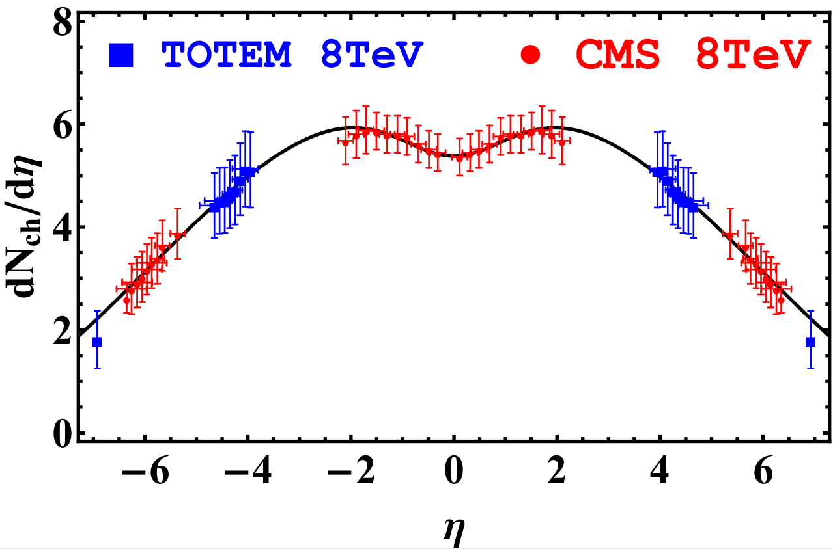
The pseudorapidity distributions
Results for 7 TeV & 8 TeV p+p collisios:
correction ratio
correction ratio
(M. Csanád, T. Csörgő, Z.F. Jiang. C.B. Yang, Universe. vol 3(2017). pp 1-9.)
 |  |  |  | λ
7 TeV | 0.507 | 1.262 | 0.640 | 1.073 | 0.10 | 5.895(NSD)
8 TeV | 0.500 | 1.240 | 0.644 | 1.067 | 0.10 | 5.38(Inelastic)
12

Slide 13
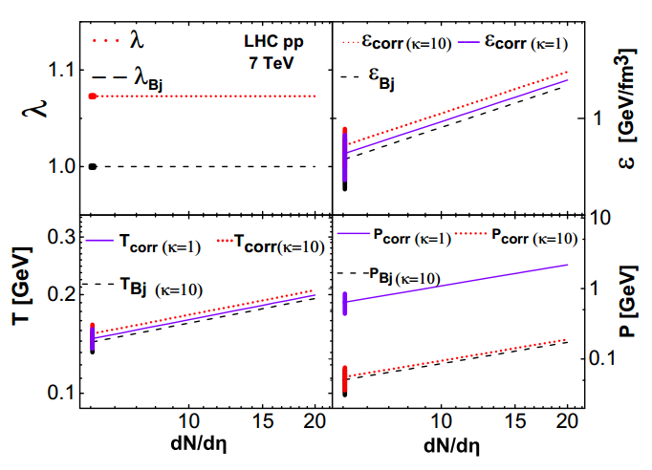
The initial energy density estimation
Results for 7 TeV & 8 TeV p+p collisions:
(M. Csanád, T. Csörgő, Z.F. Jiang. C.B. Yang, Universe. vol 3(2017). pp 1-9.)
 |  |  |  | λ
7 TeV | 0.507 | 1.262 | 0.640 | 1.073 | 0.10 | 5.895(NSD)
8 TeV | 0.500 | 1.240 | 0.644 | 1.067 | 0.10 | 5.38(Inelastic)
13

Slide 14
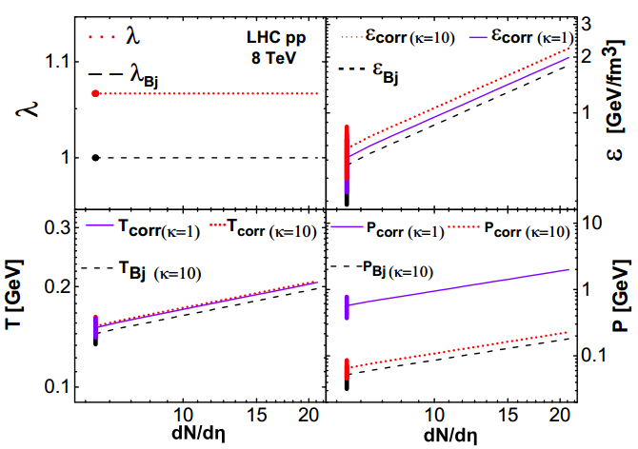
The initial energy density estimation
Results for 7 TeV & 8 TeV p+p collisios:
(M. Csanád, T. Csörgő, Z.F. Jiang. C.B. Yang, Universe. vol 3(2017). pp 1-9.)
 |  |  |  | λ
7 TeV | 0.507 | 1.262 | 0.640 | 1.073 | 0.10 | 5.895(NSD)
8 TeV | 0.500 | 1.240 | 0.644 | 1.067 | 0.10 | 5.38(Inelastic)
14

Slide 15
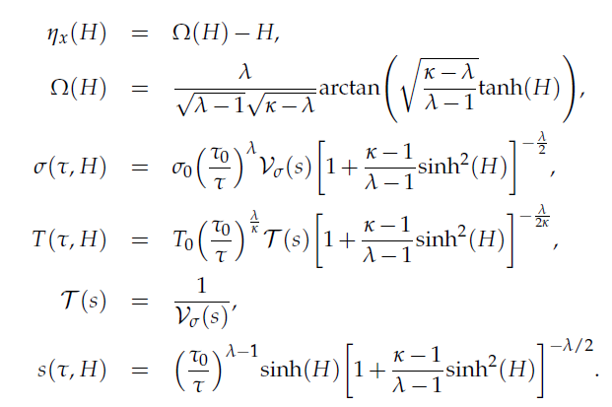
The CKCJ solutions
The new CKCJ family of exact hydro solutions
T. Csörgő, G. Kasza, M. Csanád, Z.F. Jiang, CKCJ solutions: arXiv: 1805.01427
For more details, see T. Csörgő’s talk at WPCF2018 on a new family of exact solutions of relativistic hydrodynamics.

Slide 16

The CKCJ solutions
Final state observables:
T. Csörgő, G. Kasza, M. Csanád, Z.F. Jiang, CKCJ solutions: arXiv: 1805.01427
For more details, see T. Csörgő’s talk at WPCF2018 on a new family of exact solutions of relativistic hydrodynamics.

Slide 17
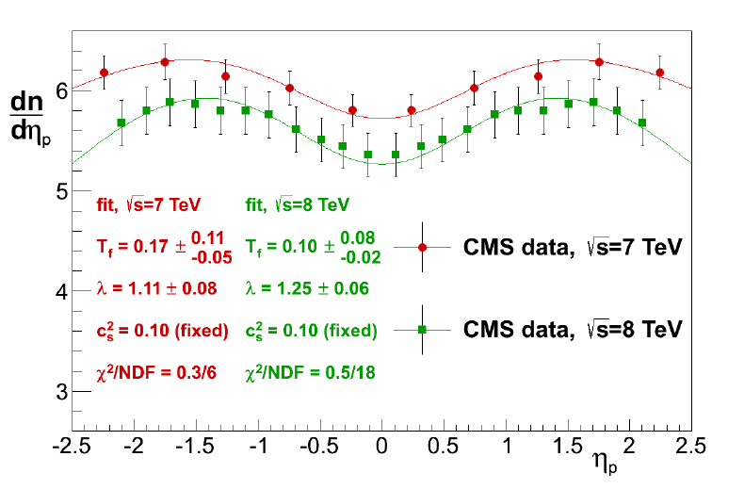
The CKCJ solutions
Results for 7 TeV & 8 TeV p+p collisios at CMS:
For a new method to estimate the initial energy density from the CKCJ solution: see G.Kasza's talk at WPCF 2018.
See May 22th, G.Kasza's talk talk: Initial energy density from new, exact solutions of relativistic hydrodynamics.

Slide 18
Relativistic accelerating viscous hydrodynamics
Longitudinal acceleration effect makes the fluid cooling faster,
The viscosity will creating heat and makes the fluid cooling slower.
shear viscosity
The energy-momentum tensor ( viscous hydro):
Shear viscosity tensor:
Bulk viscosity:
bulk viscosity
Shear tensor:
The fundamental equations of viscous fluid:
Assume:

Slide 19
Equations of viscosity hydrodynamic
The second law of thermodynamics:
Israel-Stewart
equations.
viscous hydro: near-equilibrium system

Slide 20
Equations of viscosity hydrodynamic
The second law of thermodynamics:
Israel-Stewart
equations.
viscous hydro: near-equilibrium system
The Navier-Stokes approximation,
The shear viscosity and bulk viscosity,
Strongly coupled AdS/CFT prediction:
D.T. Son, et,al. 05
Via lattice calculation:
H.B. Meyer, et,al. 07 10.3717

Slide 21
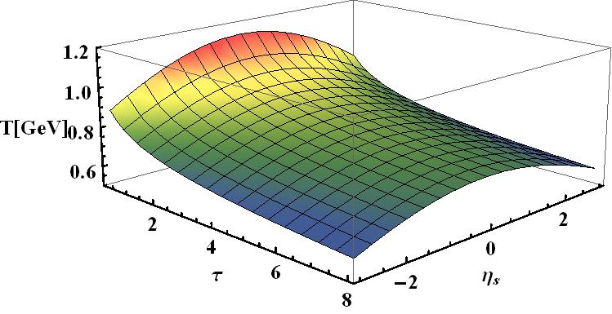
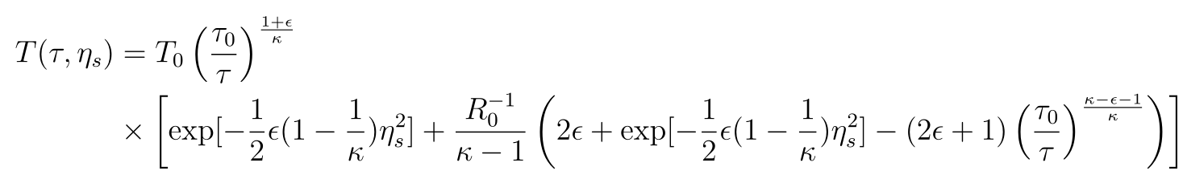
Solutions form viscous hydrodynamics
The temperature profile:

Slide 22
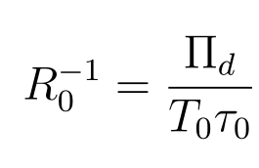


Solutions form hydrodynamic equations
The temperature profile:
Contribution from ideal terms.
One special case of our recent work.
Contribution from viscous effect
Reynolds number
[A. Muronga, arXiv: 0309055 ]
A non-zero Reyonlds numbers makes cooling rate smaller,
A non-vanishing acceleration makes the colling rate is larger.
Open question: setting viscosity as the perturbative term.

Slide 23
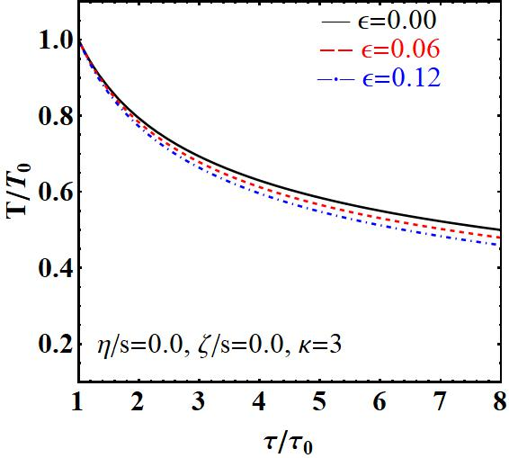
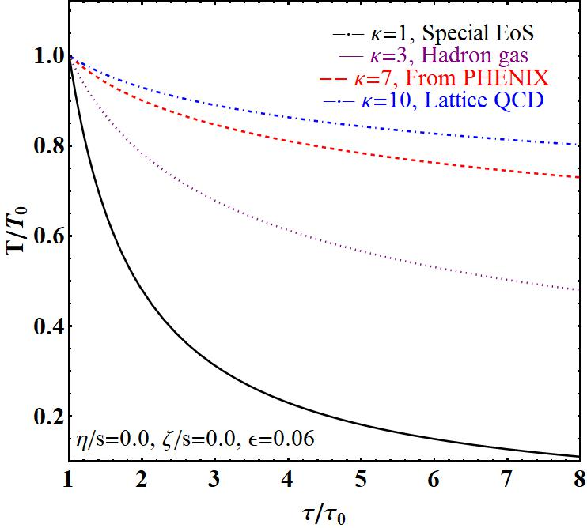
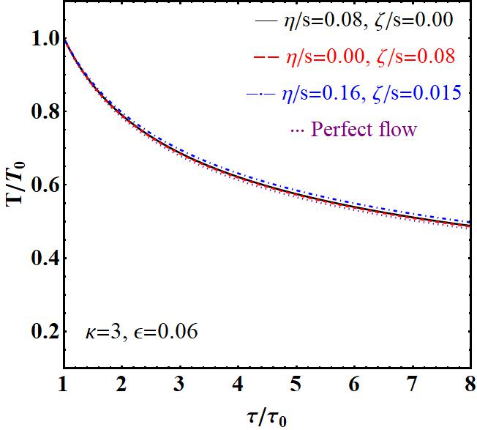
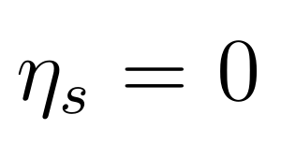
Temperature evolution
Acceleration Dependence
EoS Dependence
Viscosity Dependence
- Acceleration effect comes from the pressure gradient, makes the cooling ratio larger than non-acceleration flow.
[M. Nagy, T. Csorgo, M. Csanád: arXiv:0709.3677v1]
- EoS is an important modified factor.
κ=1 a very special case, CNC solution.
κ=7 comes from [ PHENIX, arXiv:nucl-ex/0608033v1] .
- Viscosity effect make the cooling rate samller. [H. Song, S. Bass, U. Heinz. et, PRL2011]
The acceleration effect is almost fully compensated by the viscous contribution.

Slide 24
A brief summary and outlook
Summary:
1. By using exact accelerating solutions of perfect flow, the initial thermodynamics quantities are estimated.
2. The perturbative solution with viscous correction are obtained.
Outlook:
1. 2rd I-S problem, rotation, CLVisc 3+1D code;
2. Jet/heavy quarkonium disturbance evolution on accelerating medium background...

Slide 25

Thank you for your attention
arXiv: 1609.07176, 1711.10740, 1805.01427…

