Slide 1


Two-particle correlations in
Z-Boson tagged events
Sasha Milov
FOR the ATLAS Collaboration

Slide 2
OUTLINE
Why do we measure hadron-hadron correlations in events with Z-boson?
Analysis
  Event samples
  Pileup background and Mixed event technique
  Measuring 2PC in presence of pileup
  Systematic uncertainties
Results
Summary
Talk is based on ATLAS-CONF-2017-068
2

Slide 3
Motivation
Recent studies in small systems show effects similar to those seen in A+A
Does it really mean onset of QGP in pp?
Understanding the 2PC in small systems is extremely interesting
JHEP 1009:091,2010
EPJC 77 (2017) 428
Similarity in magnitude of v_{n} is offset by different dependence on the system size.
Strong variation is observed in larger systems, while fluctuations are flat in pp.
In A+A the system size and the geometry of the collisions are linked together.
3

Slide 4
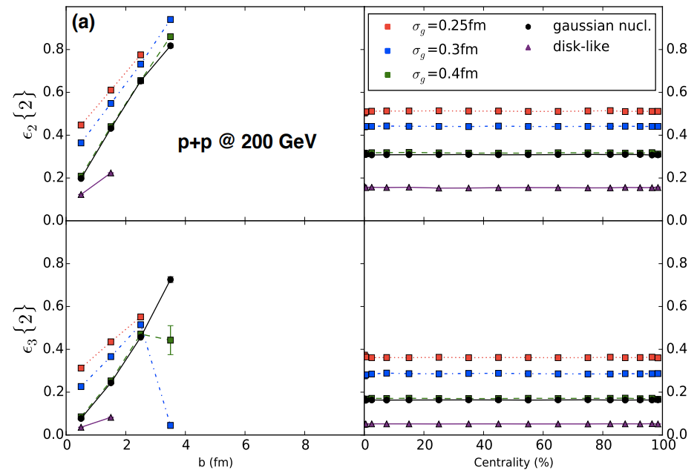
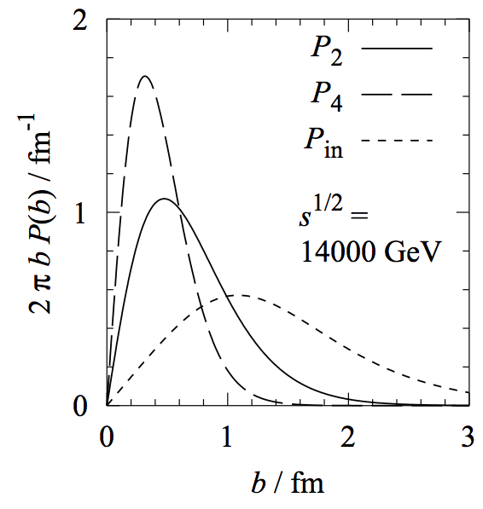
Motivation
PRC94 (2016) no.2, 024919
In pp, relation between b & n_{ch} can be washed out, but it may remain strong between b & ε₂ [K.Welsh et. al.]
To make the step forward we need an independent handle on the pp collisional geometry.
In this studies, we hope that selecting events with high-Q² helps us to constraint the b.
Measure 2PC in the events with the Z boson:
Well understood process
Clean event sample
Fewer tracks with short range correlations, compared to multijet events
PRD69:114010,2004
4

Slide 5
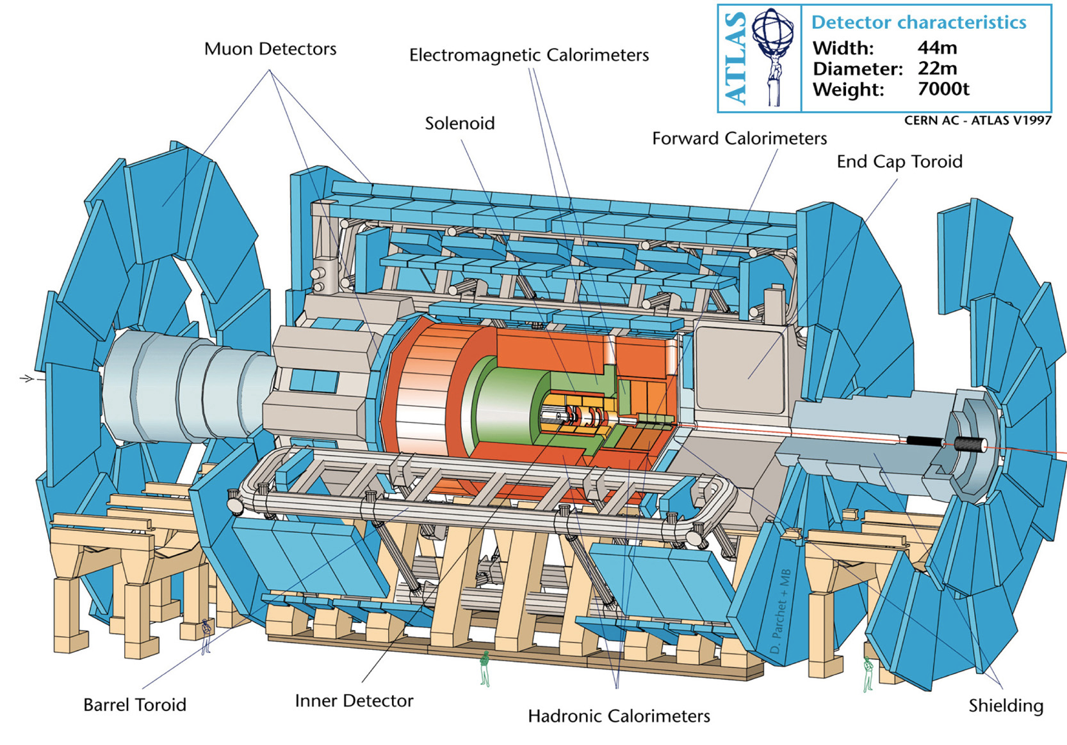

ATLAS detector
Data sample: 2012 8TeV pp data, taken with muon triggers, 19.4 fb⁻¹
Signature: 80 < m_{μμ} < 100 GeV, opposite charged muons
Size: 6.2M candidates, very clean sample
Tracks: Standard quality cuts,
p_{T}>0.4 GeV, |η|<2.5, tracks from Z muons are removed.
  pointing to vertex in transverse plane $\left|d_{0}\right|<1.5$mm
Average number of intersection per bunch crossing: μ ~ 20
Average number of tracks, satisfying cuts: n_{trk} ~ 180
!!!
5

Slide 6
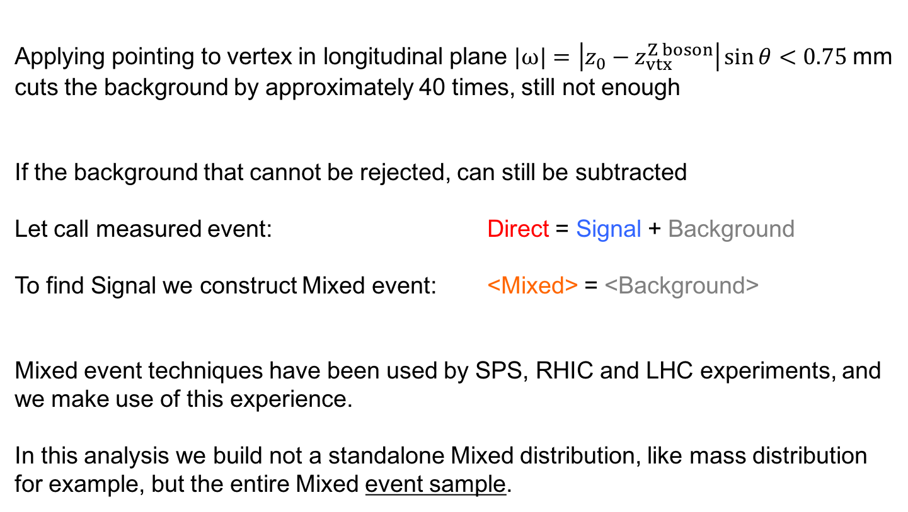
Data samples
  Applying pointing to vertex in longitudinal plane $|ω|=\left|z_{0}−z_{vtx}^{Z boson}\right|\sin{θ}<0.75$mm
cuts the background by approximately 40 times, still not enough
If the background that cannot be rejected, can still be subtracted
Let call measured event: Direct = Signal + Background
To find Signal we construct Mixed event: <Mixed> = <Background>
Mixed event techniques have been used by SPS, RHIC and LHC experiments, and we make use of this experience.
In this analysis we build not a standalone Mixed distribution, like mass distribution for example, but the entire Mixed event sample.
6

Slide 7
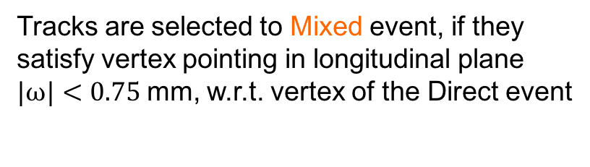

Random selection procedure
We start with the events sample and isolate one event in it, called Direct
vertex rejection cut
track acceptance cut
In the same run we search for events taken at the same instantaneous luminosity μ.
  Tracks are selected to Mixed event, if they satisfy vertex pointing in longitudinal plane $|ω|<0.75$mm, w.r.t. vertex of the Direct event
  If the vertex in the other events is within 15mm of the Direct, it’s not considered
  Procedure repeats N=20 times for each Direct event to increase statistics
events
  $$ω=\left(z_{0}−z_{vtx}\right)\sin{θ}$$
7

Slide 8
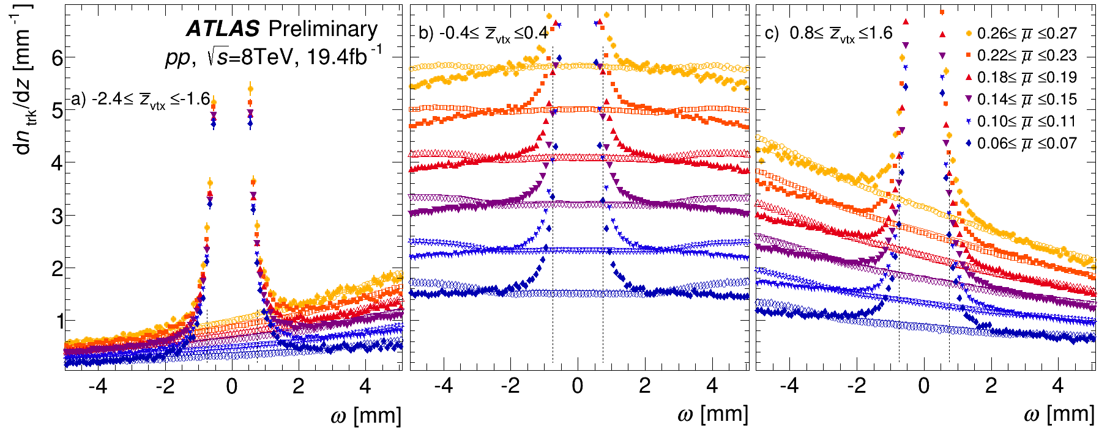
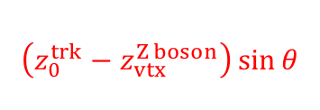
Properties of Mixed events
Mixed events accurately reproduce the substrate.
Average number of Mixed track = average number of Background tracks
Analysis uses reduced variables that take care of possible run-by-run variations.
$$\left(z_{0}^{trk}−z_{vtx}^{Z boson}\right)\sin{θ}$$
8

Slide 9
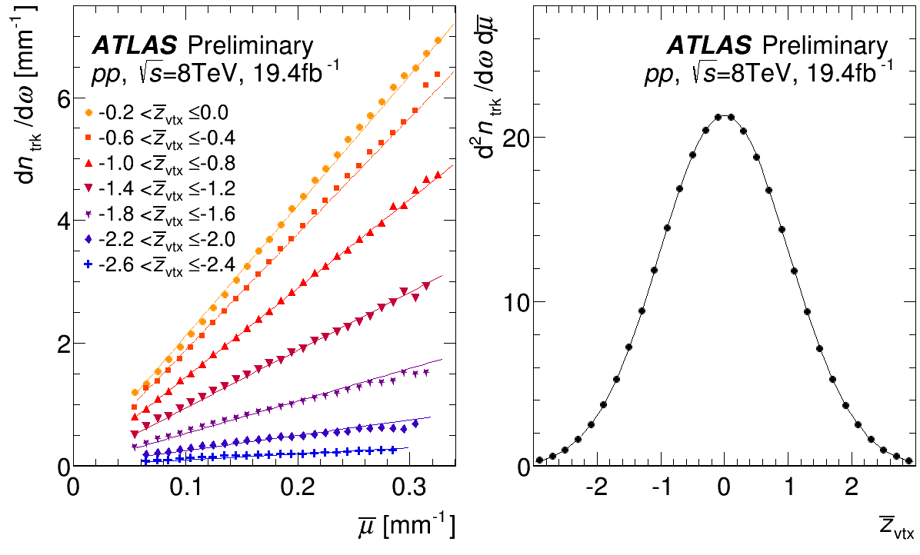

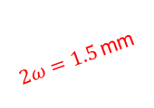
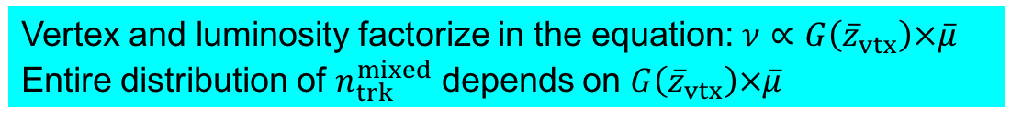
Background estimator
  $2ω=1.5$mm
$ν≡\left\langle n_{trk}^{background}\right\rangle =2ω\frac{d^{2}n_{trk}}{dωd\overline{μ}}G\left({\overline{z}}_{vtx}\right)$ $\overline{μ}$
Vertex and luminosity factorize in the equation: $ν∝G\left({\overline{z}}_{vtx}\right)×\overline{μ}$
Entire distribution of $n_{trk}^{mixed}$ depends on $G\left({\overline{z}}_{vtx}\right)×\overline{μ}$
9

Slide 10
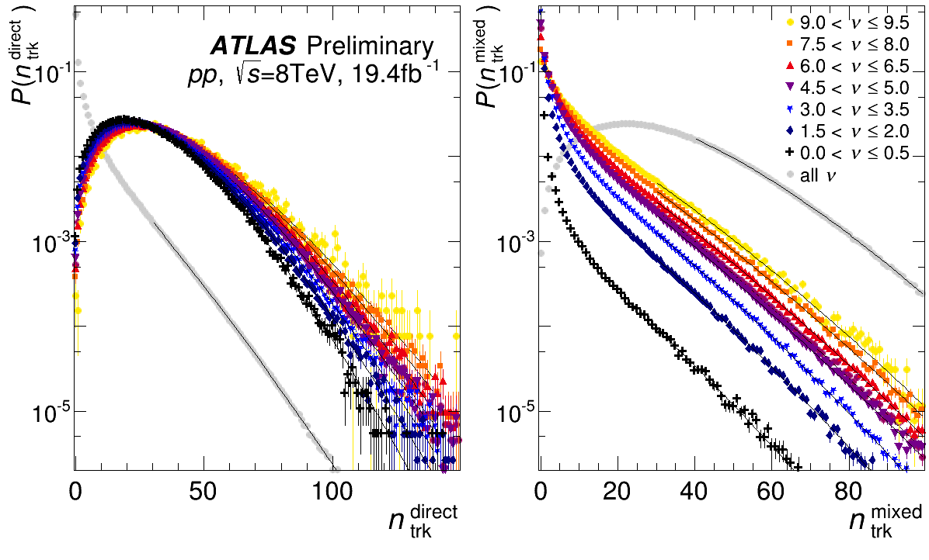
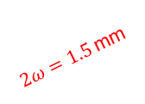
Background distributions
Re-think analysis
in terms of 𝜈
Data sample
Direct
Mixed
Due to pileup
Nearly pileup free
Same slope
In Direct Background depends on n_{trk}
One can decide to restrict range of 𝜈
In Mixed there are
tail and peak
p_{T}, η-distributions and 2PC depend on n_{trk}
  $2ω=1.5$mm
tail
peak
10

Slide 11
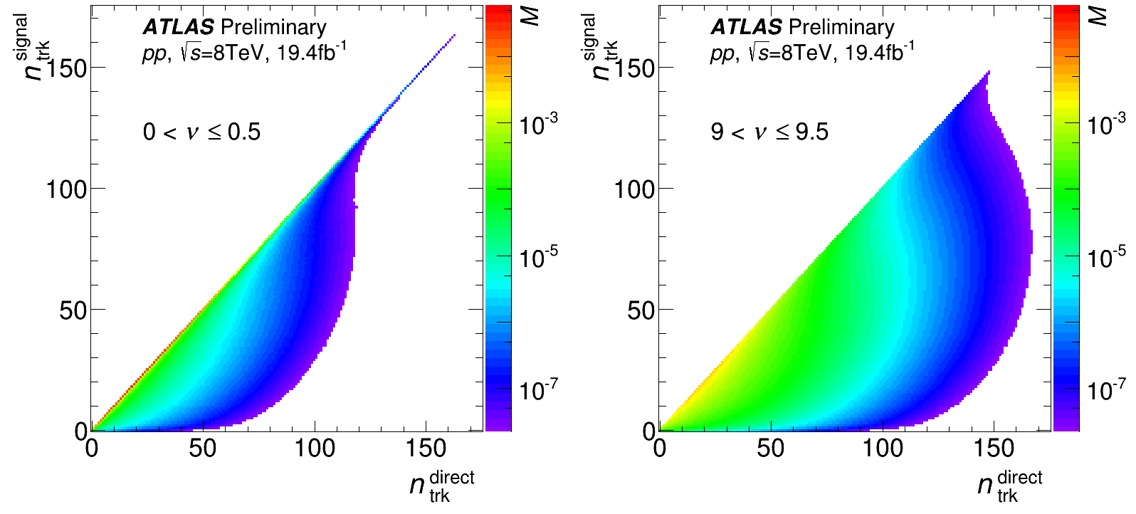
Correction for background
This analysis does not use
𝜈 > 7.5
At very high 𝜈, high-n_{trk}^{direct} events get dominant contribution from
n_{trk}^{signal} ~70
One can build data-driven transition matrices with very high precision. They can be used in the unfolding to restore correct n_{trk}^{signal}.
However, this is not done in the scope of this analysis, as the goal is different.
11

Slide 12
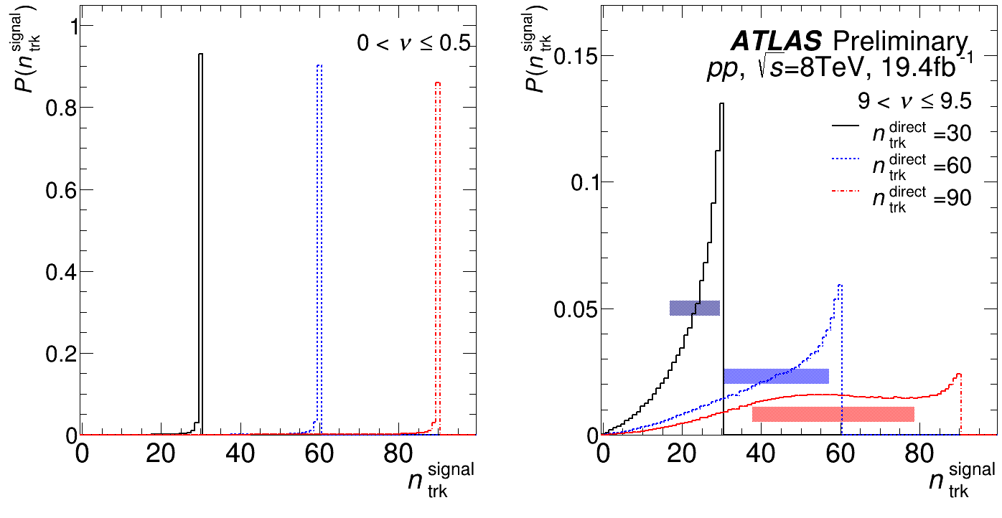
Events redistribution
With increasing pileup, events are superposition of a range of events with lower n_{trk}
90
60
This analysis does not use
𝜈 > 7.5
30
Curves are used to redistribute measurements done in Direct to Signal
n_{trk}^{direct} → n_{trk}^{signal}
12

Slide 13
Subtracting background
Direct event has contributions from both Signal and Background tracks.
Directª×Direct^{b} = Signalª×Signal^{b} + Signalª×Bkg^{b} + Bkgª×Signal^{b} + Bkgª×Bkg^{b}
Rearranging we get:
Signalª×Signal^{b} = Directª×Direct^{b} – Bkgª×Bkg^{b} – Signalª×Bkg^{b} – Bkgª×Signal^{b}
Averaging over the sample,
and using fact that <Background> ≡ <Mixed>
<Signalª×Signal^{b}> = <Directª×Direct^{b}> – <Mixª×Mix^{b}> –
<Signalª×Mix^{b}> – <Mixª×Signal^{b}>
Since tracks in two different events, Signal and Mixed cannot be correlated
<Signalª×Signal^{b}> = <Directª×Direct^{b}> – <Mixª×Mix^{b}> –
<Signalª>×<Mix^{b}> – <Mixª>×<Signal^{b}>
13

Slide 14
Subtracting background
< × > – correlations between tracks within the same event
< > × < > – correlations between tracks of different event
Formula hat to be applied in slices of 𝜈
Number of tracks chosen such that: n_{trk}^{signal} = n_{trk}^{direct} – n_{trk}^{mixed}
Weighting coefficients are taken from the distributions on the right
<Signalª×Signal^{b}> = <Directª×Direct^{b}> – <Mixª×Mix^{b}> –
<Directª>×<Mix^{b}> – <Mixª>×<Direct^{b}> +
2 <Mixª>×<Mix^{b}>
<Signalª×Signal^{b}> = <Directª×Direct^{b}> – <Mixª×Mix^{b}> –
<Signalª>×<Mix^{b}> – <Mixª>×<Signal^{b}>
<Direct> – <Mixed>
<Direct> – <Mixed>
14

Slide 15
Correlations in Different events
Sum over all 𝜈 conditions,
and over n_{trk}^{direct} in 70-80
Plots are for |Δη|>2 and
0.5 < p_{T}ª,p_{T}^{b} < 5 GeV.
<Direct×Direct>
<Mix×Mix>
<Direct>×<Mix>
<Mix>×<Mix>
<Signal×Signal>
<Direct×Direct>
<Signal×Signal>
15

Slide 16
TEMPLATE FITTING METHOD
The correlations are corrected for Pileup and summed for all conditions of 𝜈.
One can proceed with the template fitting analysis
like in PRL116 172301 (2016), PRC96 (2017) 024908
Plots show example fits to extract the Fourier Coefficients
Measured 2PC = F*(Low multiplicity 2PC) + G*(1+2v_{n,n}cos(nΔφ))
16

Slide 17
Background removal and systematics
Source | Range | Uncertainty %
Choice of peripheral bin | 30-70 | 7-3
 | 70-100 | 3
Tracking efficiency | 30-100 | 0.5
Pair acceptance | 30-100 | 1
Mixed and Background equivalence | 30-100 | 2
Accuracy of background estimator | 30-100 | 1
Uncertainties in transition matrices | 30-100 | 2
Pileup correction procedure | 30-100 | 3.5
Total | 30-100 | 6
2PC
related
Pileup
related
17

Slide 18
Results
No multiplicity dependence, similar to inclusive.
No indication of lower v₂ w.r.t. inclusive, as would be (naively) expected.
Results are 8±6% higher than inclusive
18

Slide 19
Summary
Measurement of 2PC in Z-tagged events showed that n_{ch} dependence is (at most) weak.
v₂ extracted from 2PC is 1.08 ± 0.06 with respect to inclusive 13 and 5 TeV results, consistent with them within uncertainties.
Possibility to analyze high-pileup samples is demonstrated.
Method can be applied to other measurements, which greatly increases volume of data samples available for future HI analyses and opens up opportunity to carry out new measurements (not only) in pp.
19

Slide 20
THANK YOU!
20

Slide 21
bkps
21

