Slide 1
Tests of the Supernova Equation of State using Heavy Ion Collisions
K. Hagel
WPCF 2018
Krakow, Poland
23-May-2018

Slide 2
Outline
Motivation
  Heavy Ion Collision studies and their implications on the description of core collapse supernovae.
  Challenges in comparison
Experiment
  Coalescence analysis
  Results
Systematic comparison to Astrophysical models
Calculations of neutrinos from Black Hole accretion disks

Slide 3
Core-collapse supernovae (SN)
  Explosions of massive stars that radiate 99% of their energy in neutrinos
  Birth places of neutron stars
  Wide range of densities range from much lower than normal nuclear density to much higher
Neutrinosphere
  Last scattering site of neutrinos in proto-neutron star: ~10¹² g/cm³ (~6x10⁻⁴ fm⁻³), T~5 MeV
  A thermal surface from which around 10⁵³ ergs (10³⁷ MeV) are emitted in all neutrino species during the explosion
Core Collapse Supernovae dynamics and the neutrino signals can be sensitive to the details of neutrino interactions with nucleonic matter.
  Details of neutrino heating depend both on matter properties of low density nuclear matter and the conditions at the neutrinosphere
  Detailed information on the composition and other thermodynamic properties of nucleonic matter are important to evaluate role of neutrino scattering.

Slide 4
Relevance of heavy ion collisions to core collapse supernovae
  Allow to probe the lower densities in the lab
  Comparisons of heavy ion data to supernovae calculations may help discriminate between different models.
Equation of state (EOS)
  Many fundamental connections between the equation of state and neutrino interactions
  Crucial input for understanding proto-neutron star evolution

Slide 5
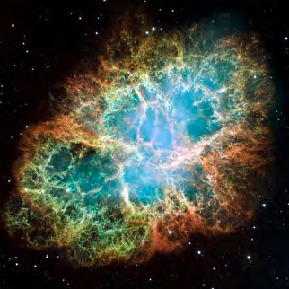
Crab Nebula, HST Image
Supernova
Mass: 4.6 ± 1.8 M☉. (~9.2x10³⁰kg)
V⊥
TLF
PLF
Nuclear Reaction from
Heavy Ion Collision
IV
IV Source femtonova
~ ½v_{p}
~v_{p}
V‖
Mass: 20-30 amu (~3.3x10⁻²⁶ kg)

Slide 6
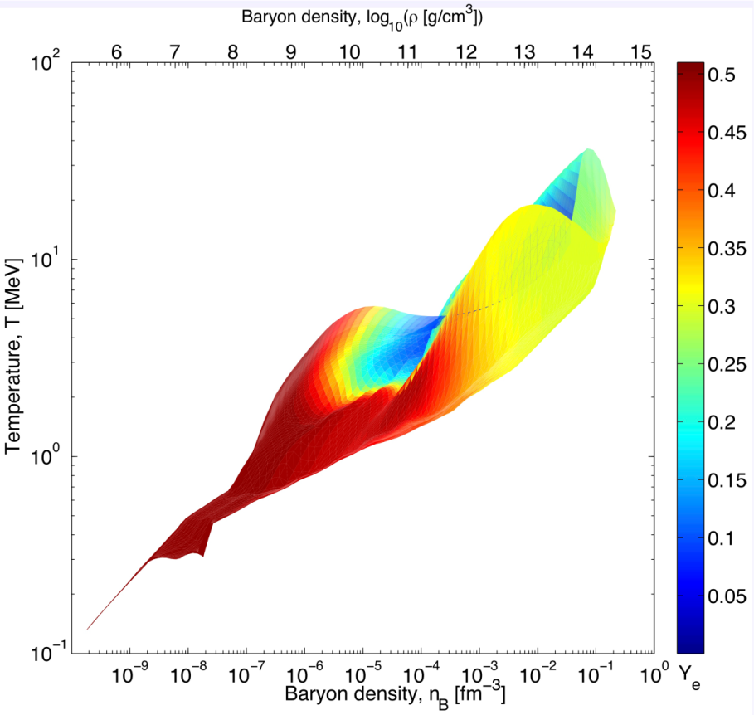
Core collapse supernova simulation
T. Fischer et al., ApJS 194, 39 (2011)
 | Supernova | Heavy Ion Nuclear reaction
Density (nuc/fm³) | 10⁻¹⁰ < ρ < 2 | 2x10⁻³ < ρ < 3x10⁻²
Temperature (MeV) | ~0 < T < 100 | 5 < T < 11
Electron fraction | 0 < Y_{p} < 0.6 | Y_{p} ~0.41
Challenges in comparisons
Lower proton fraction, Y_{p}
SN are “infinite”, but HIC are finite
The “infinite” matter in SN is charge neutral, but HIC has a net charge
Composition of nuclear matter in calculations
  Different calculations include different species which are probably different from the SN

Slide 7
Experiment Analysis
47 MeV/u Ar + ^{112,124}Sn
Select the most violent collisions
Identify the femtonova
  Intermediate velocity source
    nucleon-nucleon collisions early in the reaction
  Choose light particles at 45 deg because moving source fits suggest that most products at that angle originate from that source.
Use coalescence analysis to estimate density
Temperature from Albergo model
Time scale from velocity of products from intermediate velocity source
t_{avg}, fm/c
v_{surf}, cm/ns
PRC 72 (2005) 024603

Slide 8
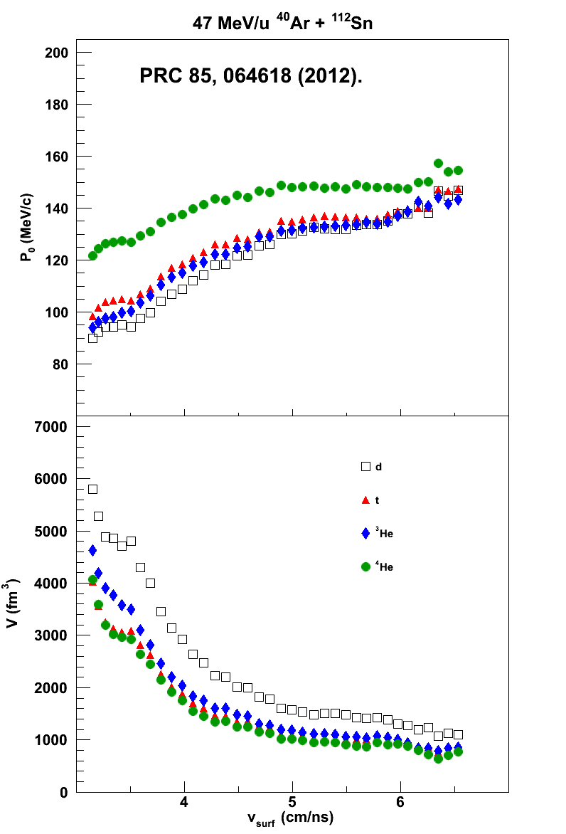
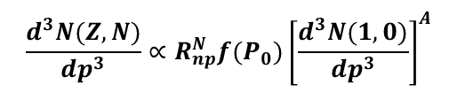
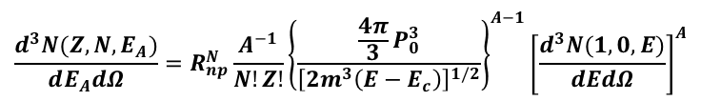

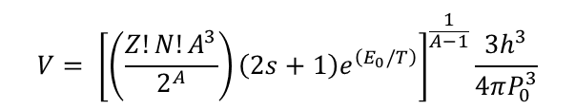
Coalescence Parameters
Awes et al., PRC 24, 89 (1981).
$$\frac{d^{3}N(Z,N)}{dp^{3}}∝R_{np}^{N}f(P_{0}){\left[\frac{d^{3}N(1,0)}{dp^{3}}\right]}^{A}$$
$$\frac{d^{3}N(Z,N,E_{A})}{dE_{A}dΩ}=R_{np}^{N}\frac{A^{−1}}{N!Z!}{\left\{\frac{\frac{4π}{3}P_{0}^{3}}{{\left[2m^{3}\left(E−E_{c}\right)\right]}^{1/2}}\right\}}^{A−1}{\left[\frac{d^{3}N(1,0,E)}{dEdΩ}\right]}^{A}$$
Mekjian et al., PRC 17, 1051 (1978).
$$\frac{d^{3}N(Z,N)}{dp^{3}}=R_{np}^{N}\frac{A^{3}\left(2s+1\right)e^{\left(E_{0}/T\right)}}{2^{A}}{\left(\frac{h^{3}}{V}\right)}^{A−1}{\left[\frac{d^{3}N(1,0)}{dp^{3}}\right]}^{A}$$
$$V= {\left[\left(\frac{Z!N!A^{3}}{2^{A}}\right)\left(2s+1\right)e^{\left(E_{0}/T\right)}\right]}^{\frac{1}{A−1}}\frac{3h^{3}}{4πP_{0}^{3}}$$

Slide 9
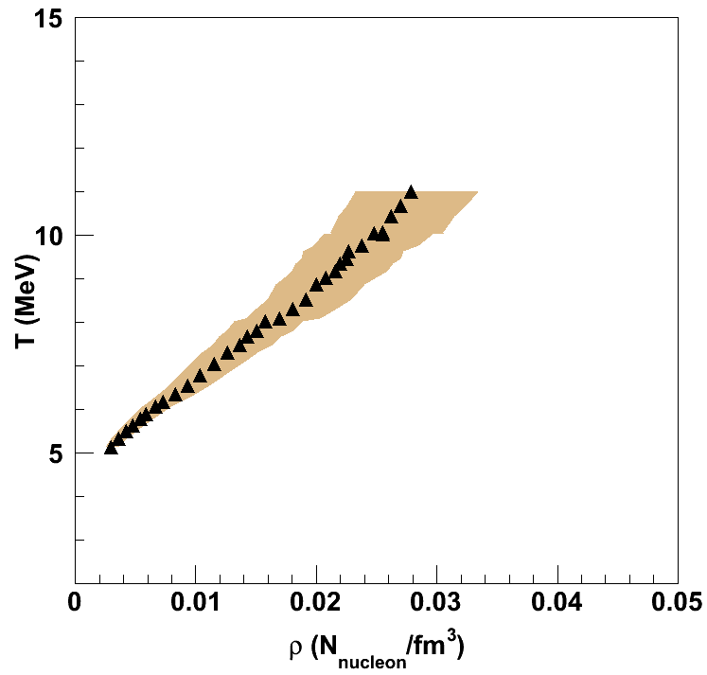

Temperatures and Densities
Recall v_{surf} vs time calculation
System starts hot and expands as it cools
47 MeV/u ⁴⁰Ar + ¹¹²Sn
Core collapse supernova simulation

Slide 10
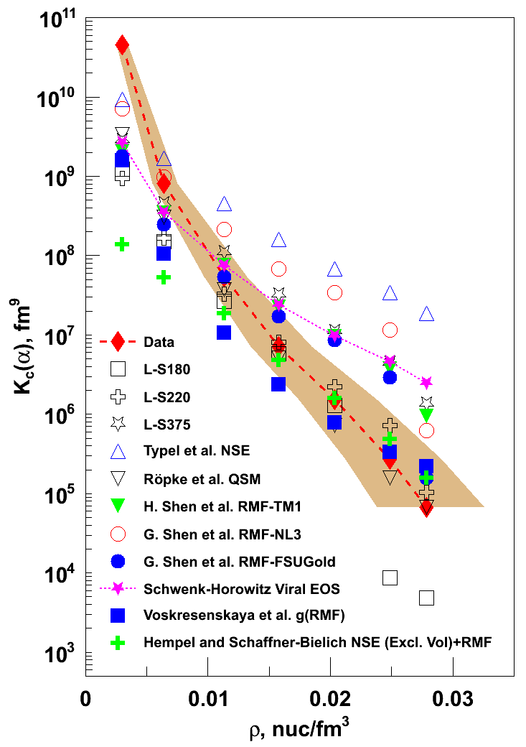
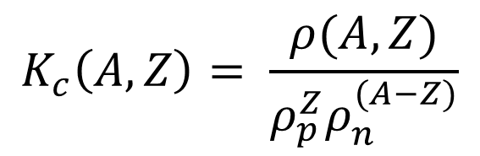
Equilibrium constants from α-particles model predictions
$$K_{c}\left(A,Z\right)= \frac{ρ(A,Z)}{ρ_{p}^{Z}ρ_{n}^{(A−Z)}}$$
Many tests of EOS are done using mass fractions and various calculations include various different competing species.
If any relevant species are not included, mass fractions are not accurate.
Equilibrium constants should be more robust with respect to the choice of competing species assumed in a particular model if interactions are the same
Differences in the equilibrium constants may offer the possibility to study the interactions
Models converge at lowest densities, but are significantly below data
PRL 108 (2012) 172701.

Slide 11
Further Study
M. Hempel et al., Phys. Rev. C 91, 045805 (2015).
Dependence of Equilibrium constants on various quantities
  Asymmetry of system
  Coulomb effects
  Particle degrees of freedom
Include comparison where possible to other particle types observed in experiment (d, t, ³He)
Other EOS models

Slide 12
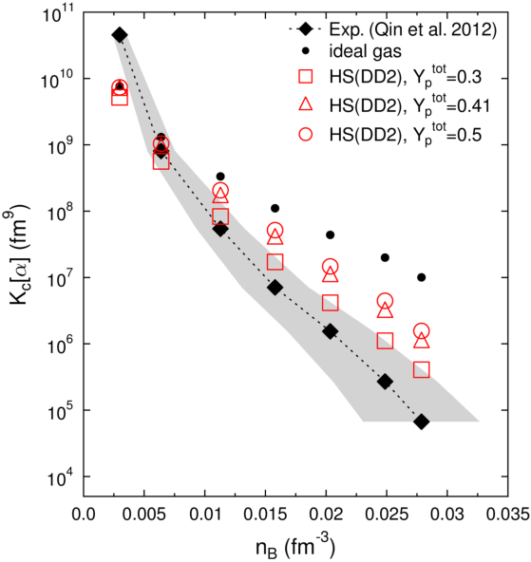
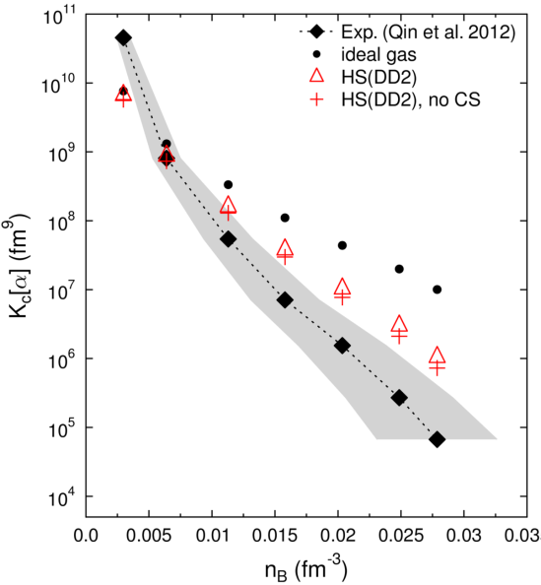
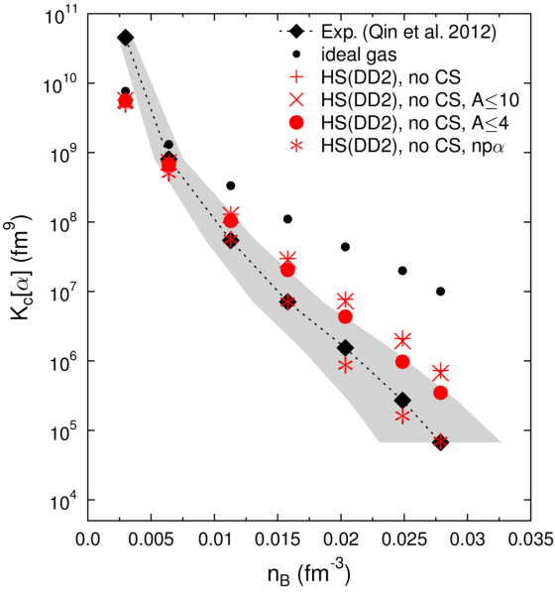
Ideal gas
  Chemical potentials cancel in the case of equilibrium
  Function of temperature only.
  no ρ or Y_{p} dependence.
When interaction is present
  Composition dependent
  Values converge to ideal gas at low densities
  Increase in K_{eq} with increasing Y_{p} at as density increases.
Use Y_{p} = 0.41 in remainder of calculations since that is what was extracted from experiment.
Composition
(a)
In SN matter, coulomb interactions screened by surrounding electrons in contrast to matter in heavy ion collisions
Small effect in calculations when screening is turned off.
Coulomb Effects
(b)
Almost no dependence when constraining to A ≤ 10.
Larger dependence when constraining to A ≤ 4
  Production of A>4 very small in experiment
Best agreement when only n,p,α included
  Coincidence
  Not realistic since significant d, t, ³He observed in experiment.
  Indicates importance of considering all experimental data
Particle Degrees of Freedom
(c)

Slide 13
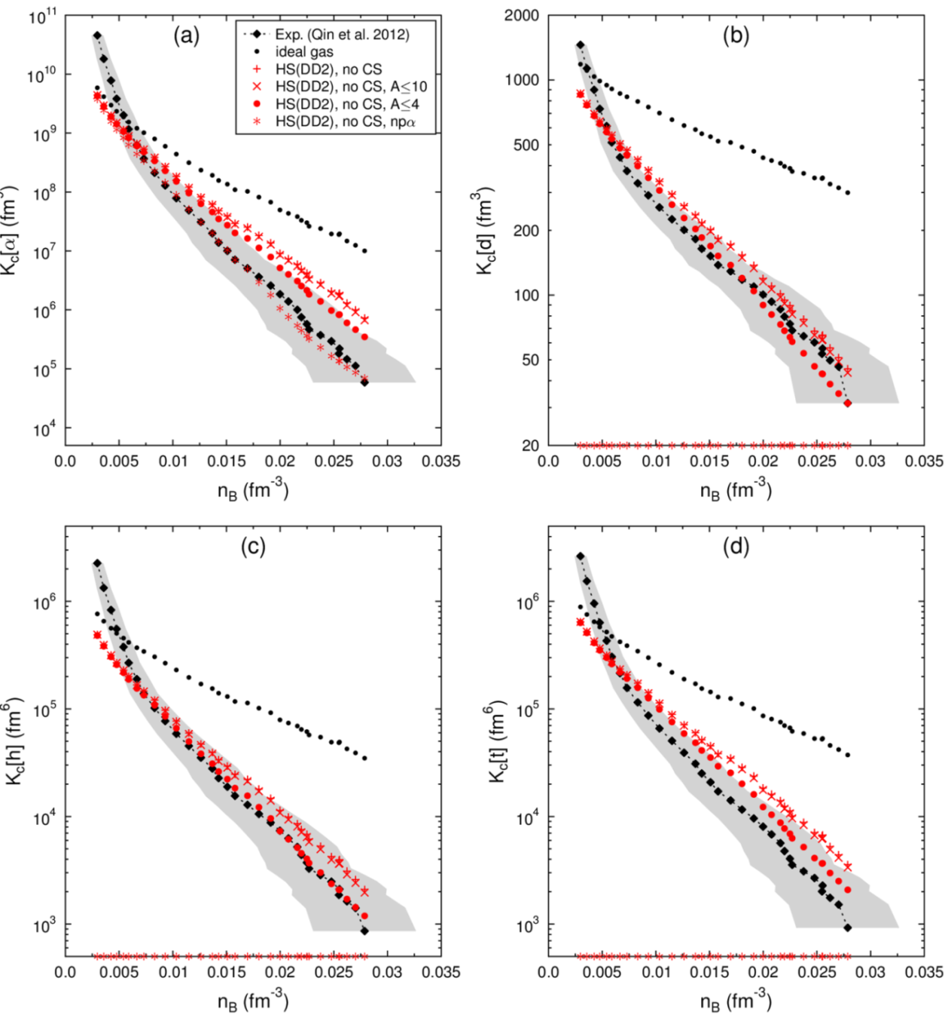
All reaction products considered
Species not included have K_{eq} = 0 which does not match data
Including all reaction products and constraining to A ≤ 4 yields good agreement with data within error bars.

Slide 14
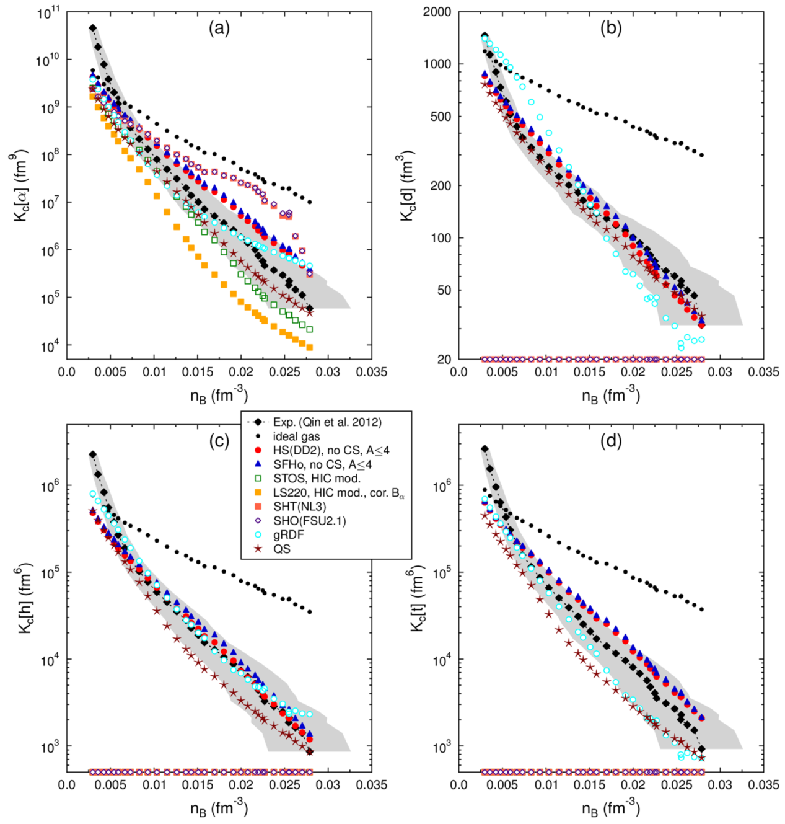
Comparison of all models together
Two groups of calculations
  n, p, α calculations which predict K_{eq}(α), but cannot predict other species.
  Models with n, p, d, t, ³He, α
Low densities
  All K_{eq}(α) converge to ideal gas
  They are below experimental data which result from the very late stages of the reaction
Models that treat all light particles are generally within error bars

Slide 15
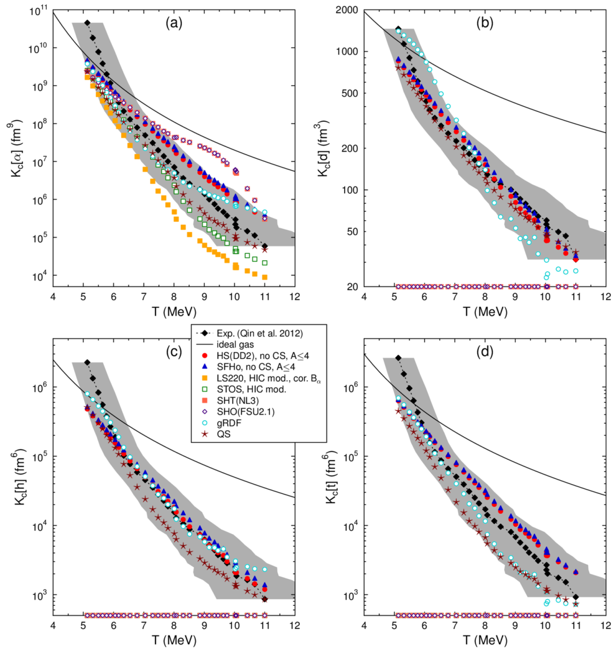
K_{eq}(T)
Keq(T)
Uncertainity in temperature measurement including at low density
Ideal gas Keq is function of T only.
Keq(T) for models that treat all particles are within experimental error bars.

Slide 16
Summary
Heavy ion collisions are used to create femtoscale objects having similar temperatures and densities of objects that are 56 orders of magnitude heavier in mass.
    Femtonova and supernova
Density and temperatures achieved in the range of those expected at the neutrinosphere
Further study of properties and behavior of equilibrium constants
  Importance of including “important” ingredients in model calculations
  Importance of taking into account all available experimental data.

Slide 17
Collaborators
M. Hempel, J. B. Natowitz, G. Röpke, S. Typel, K. Hagel, R. Wada, S. Wuenschel, M. Barbui, L. Qin, S. Shlomo, A. Bonasera, Z. Chen, M. Huang, J. Wang, H. Zheng, S. Kowalski, M. R. D. Rodrigues, K. Schmidt, G. Giuliani, D. Fabris, M. Lunardon, S. Moretto, G. Nebbia, S. Pesente, V. Rizzi, G. Viesti, M. Cinausero, G. Prete, T. Keutgen, Y. El Masri, Z. Majka, and Y. G. Ma,

Slide 18
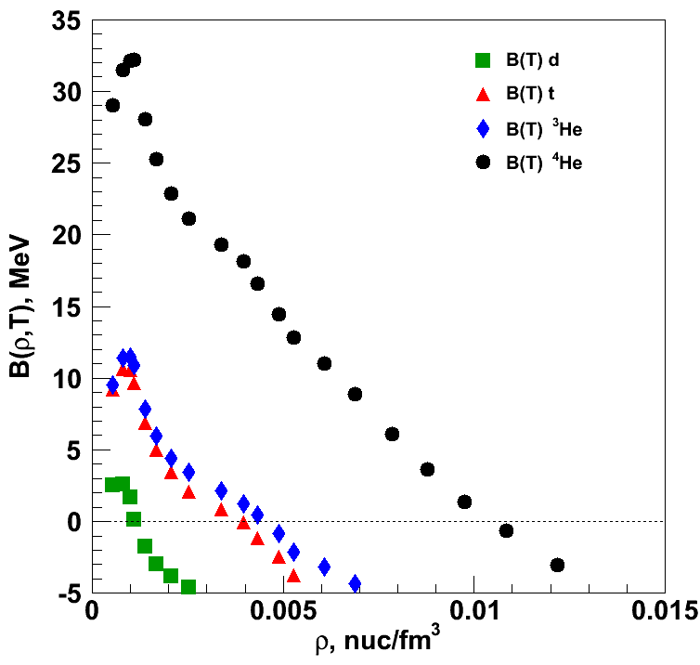
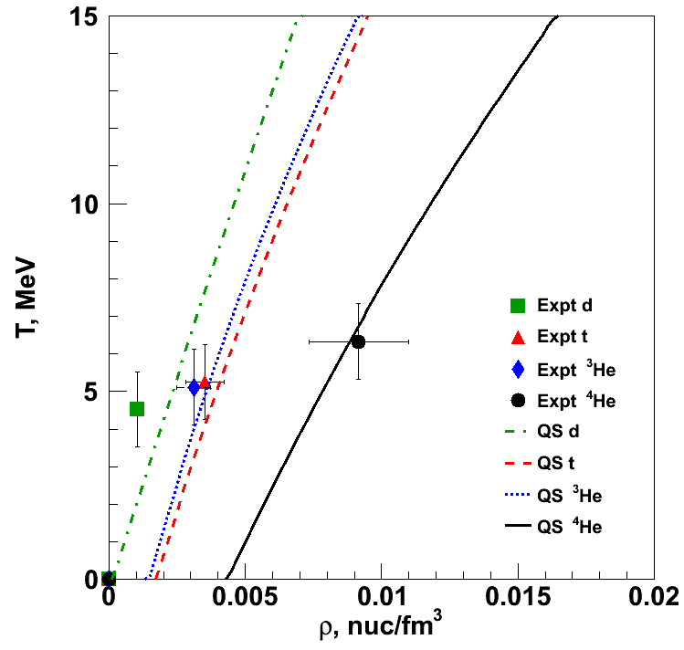

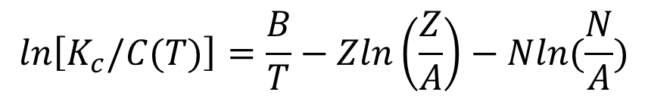
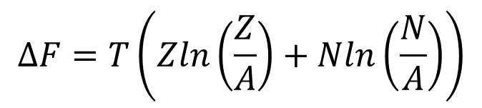
Density dependent binding energies
$$K_{c}(A,Z)=C\left(T\right)e^{\left(\frac{B(A,Z)}{T}\right)}$$
From Albergo, recall that
Invert to calculate binding energies
Entropy mixing term
$$ΔF=T\left(Zln\left(\frac{Z}{A}\right)+Nln\left(\frac{N}{A}\right)\right)$$
$$ln\left[K_{c}/C(T)\right]=\frac{B}{T}−Zln\left(\frac{Z}{A}\right)−Nln(\frac{N}{A})$$
PRL 108 (2012)
062702

Slide 19
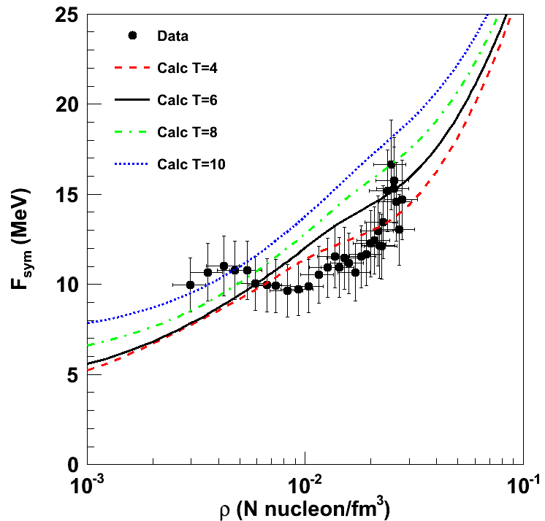
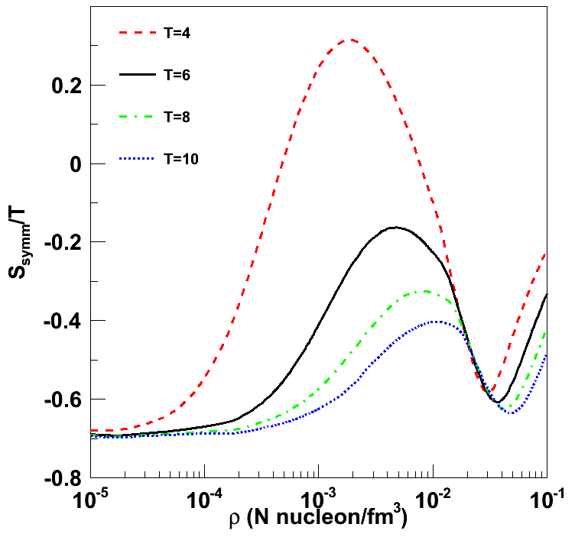
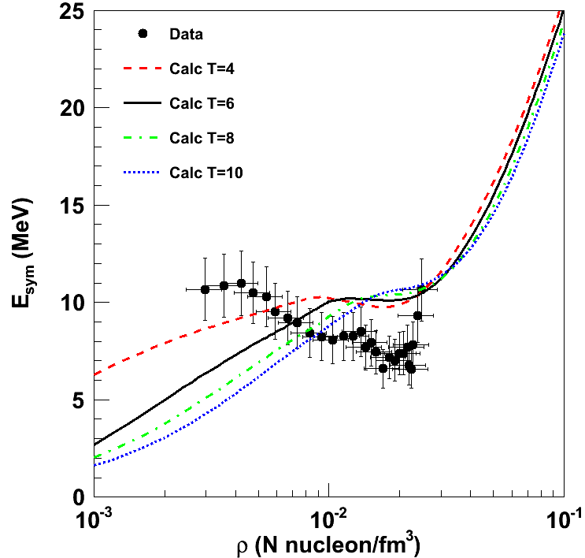
Symmetry energy
S. Typel et al., Phys. Rev. C 81, 015803 (2010).
Symmetry Free Energy
  T is changing as ρ increases
  Isotherms of QS calculation that includes in-medium modifications to cluster binding energies
Entropy calculation (QS approach)
Symmetry energy (E_{sym} = F_{sym} + T∙S_{sym})

Slide 20
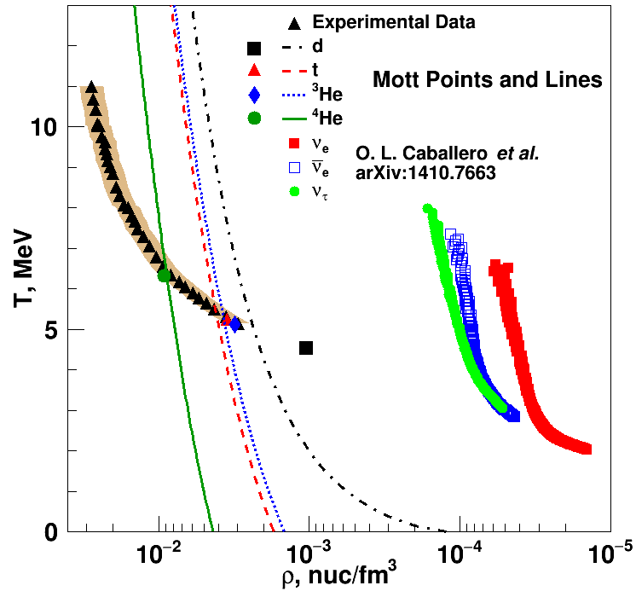
PRL 108, 172701 (2012).
PRL 108, 062702 (2012).
Neutrinosphere

