Slide 1

Probing the equation of state of neutron stars
via heavy ion collisions
Zbigniew Chajęcki
Western Michigan University

Slide 2
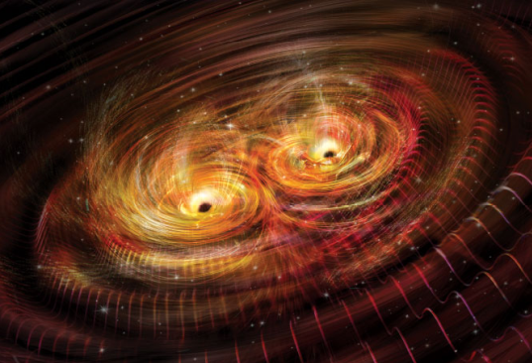
Neutron star mergers
2017 Nobel Prize
in Physics –
Awarded to LIGO/VIRGO researchers for observation of gravitation caused by the neutron star merger.
Artist rendition of gravity waves as two heavy masses merge.

Slide 3
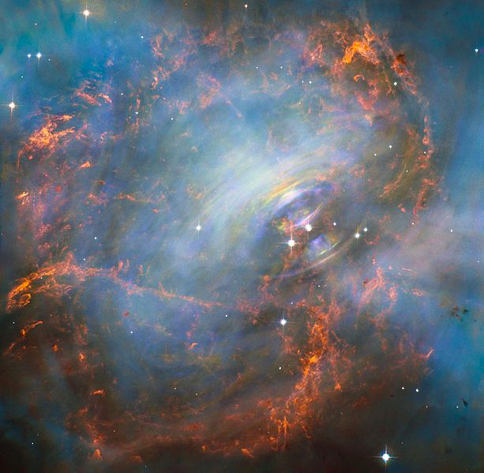
Neutron Stars
Neutron stars result from the supernova explosion of a massive star, combined with gravitational collapse
  Mass – 1-2 solar masses
  Radius – ONLY ~11km
normal-sized matchbox containing neutron-star material would have a mass of approximately 13 million tons
the very heart of the Crab Nebula including the central neutron star

Slide 4
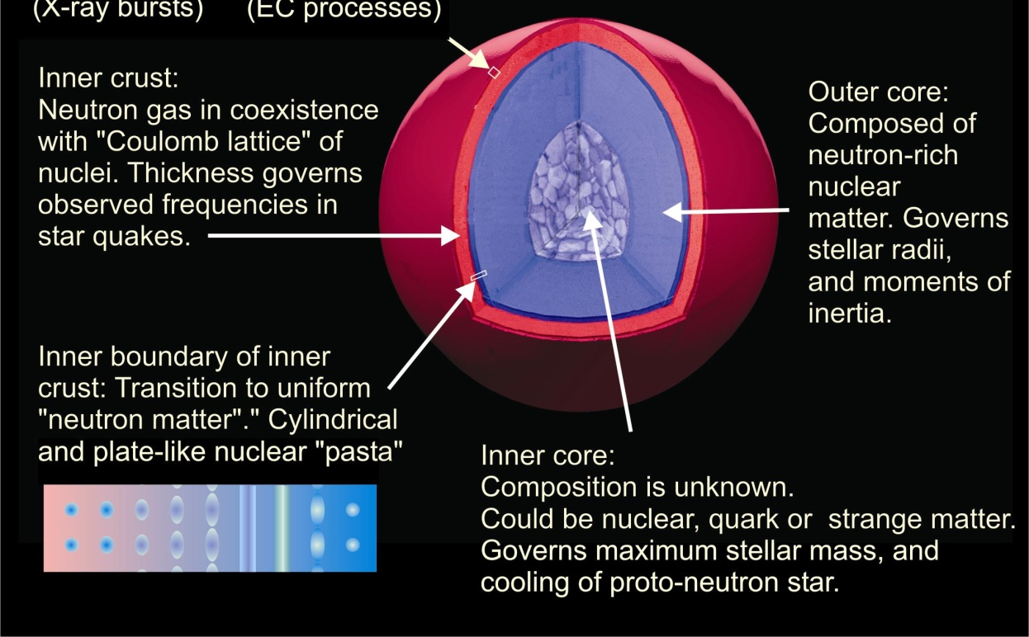
Anatomy of Neutron Stars
ρ > ρ₀
ρ < ρ₀

Slide 5
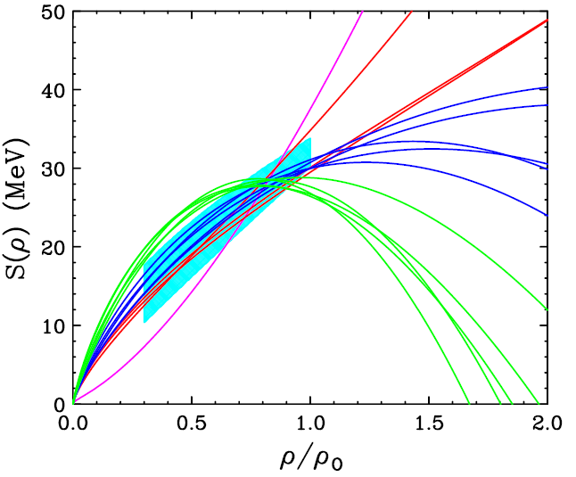
Equation of state, symmetry energy
E/A (ρ,δ) = E/A (ρ,0) + δ²⋅S(ρ)
δ = (ρ_{n}- ρ_{p})/ (ρ_{n}+ ρ_{p}) = (N-Z)/A
δ →1
Stiff
Soft

Slide 6
EoS, Symmetry Energy and Neutron Stars
The EoS influences:
ANATOMY OF
A NEUTRON STAR
Neutron star stability against gravitational collapse
Stellar density profile
Internal structure: occurrence of various phases.
Observational consequences:
  Cooling rates of proto-neutron stars
  Cooling rates for X-ray bursters
  Frequencies of crustal vibrations; thickness of inner crust
  Stellar masses, radii
  and moments of inertia
ρ < ρ₀
ρ > ρ₀
(mainly the Symmetry Energy)

Slide 7
Equation of state of nuclear matter
E/A (ρ,δ) = E/A (ρ,0) + δ²⋅S(ρ)
δ = (ρ_{n}- ρ_{p})/ (ρ_{n}+ ρ_{p}) = (N-Z)/A
δ →1
To probe the EOS of asymmetric nuclear matter (neutron stars) we need to be able to study the nuclear matter at higher densities and asymmetries
Stiff
Soft

Slide 8
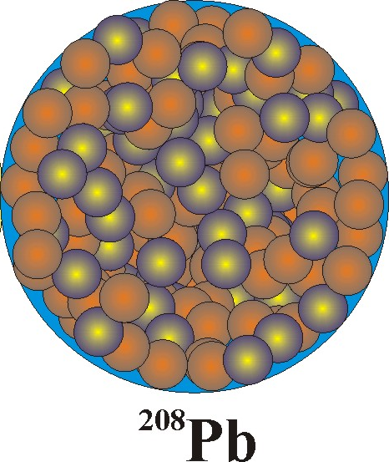
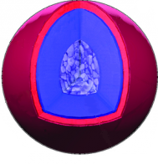
Symmetry energy
Symmetry energy on vastly differing length scales
~10⁻¹⁵ m
~10⁴ m
²⁰⁸Pb
Neutron Star
 | n-star | HI collisions
ρ/ρ₀ | ~ 0.1 - 10 | ~ 0.1-5
y_{e} | ~0.1 | ~0.38-0.5
T(MeV) | ~1 | ~ 4-50
extrapolation from ²⁰⁸Pb radius to n-star radius
C.J. Horowitz, J. Piekarewicz, Phys. Rev. Lett. 86 (2001) 5647

Slide 9
Equation of state of nuclear matter
E/A (ρ,δ) = E/A (ρ,0) + δ²⋅S(ρ)
δ = (ρ_{n}- ρ_{p})/ (ρ_{n}+ ρ_{p}) = (N-Z)/A
δ →1
To probe the EOS of asymmetric nuclear matter (neutron stars) we need to be able to study the nuclear matter at higher densities and asymmetries
The only way we can do it in the laboratory is via heavy ion collisions:
nucleus – nucleus collisions at higher densities ⇒ require higher beam energies and new detectors
Increase sensitivity to symmetry energy by increasing δ (asymmetry between the # of neutrons and protons)
Stiff
Soft
NSCL

Slide 10
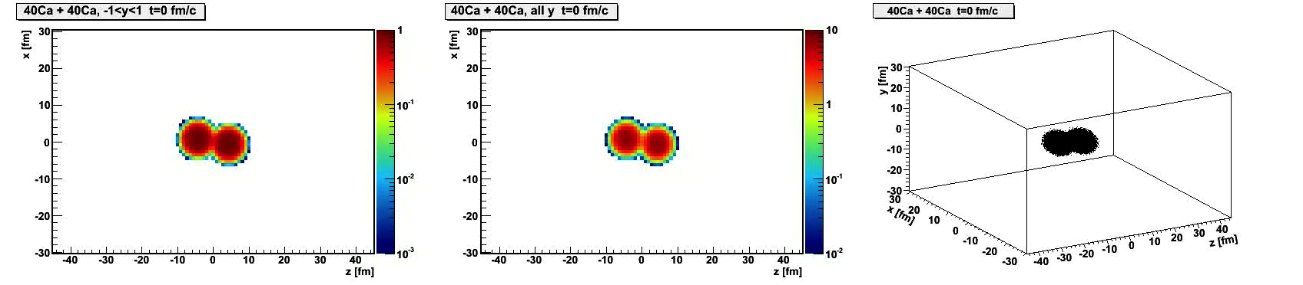
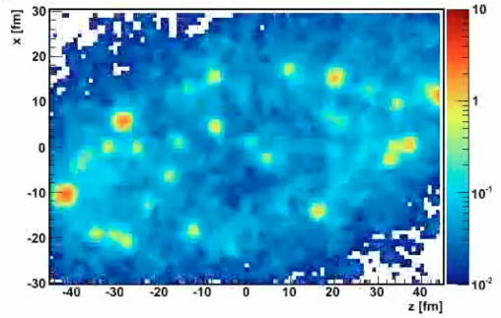
Modeling heavy ion collisions
Our tool: Transport models
BUU – Boltzmann-Uehling-Uhlenbeck
QMD – Quantum Molecular Dynamics
AMD – Antisymmetrized Molecular Dynamics
Simulates the time-dependent evolution of the collision
Main ingredients
Nucleons in mean-field
Symmetry energy
Momentum-dependent nuclear interaction
➔effective mass
In-medium cross section
Cluster production
Danielewicz, Acta. Phys. Pol. B 33, 45 (2002)
Danielewicz, Bertsch, NPA533 (1991) 712

Slide 11
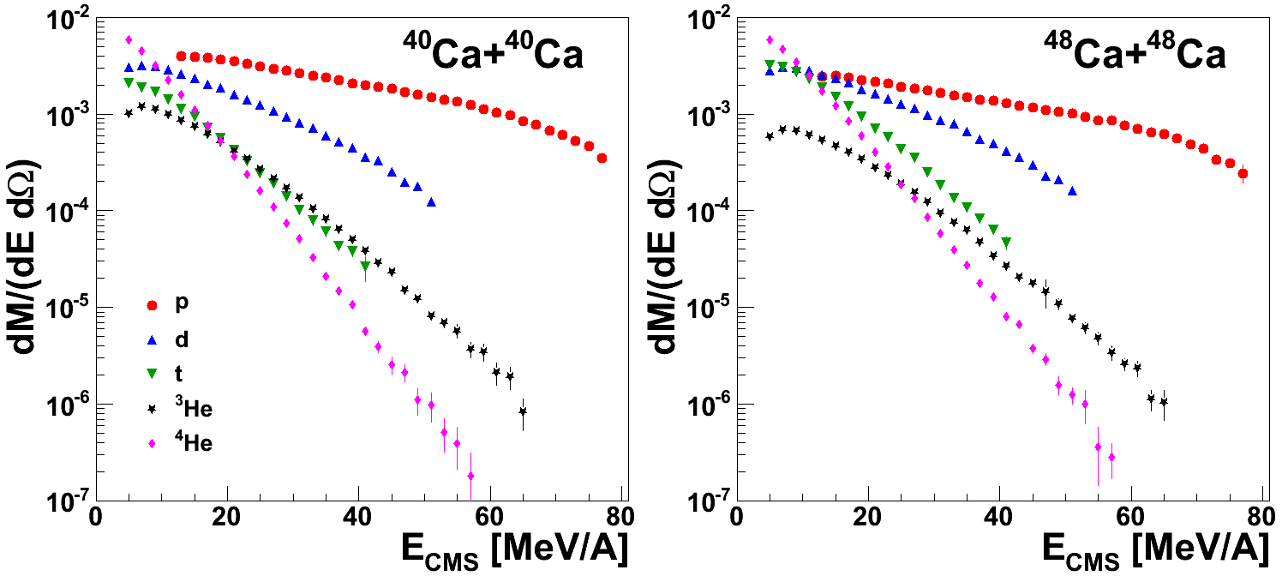
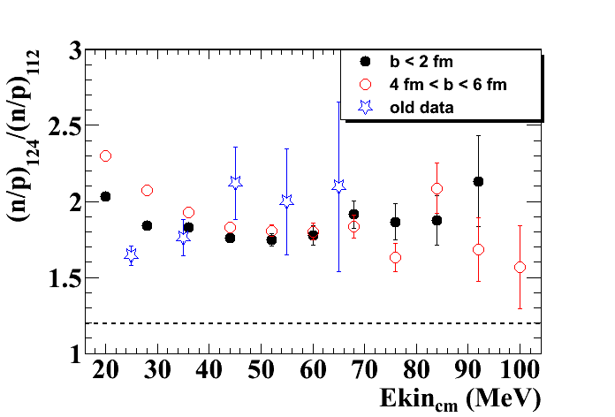
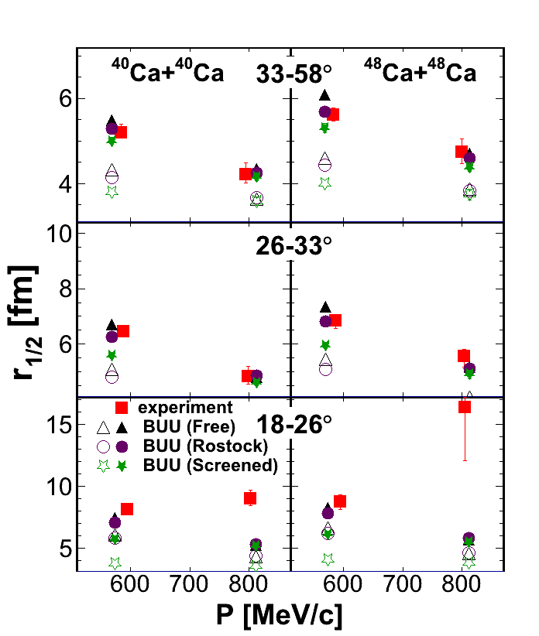
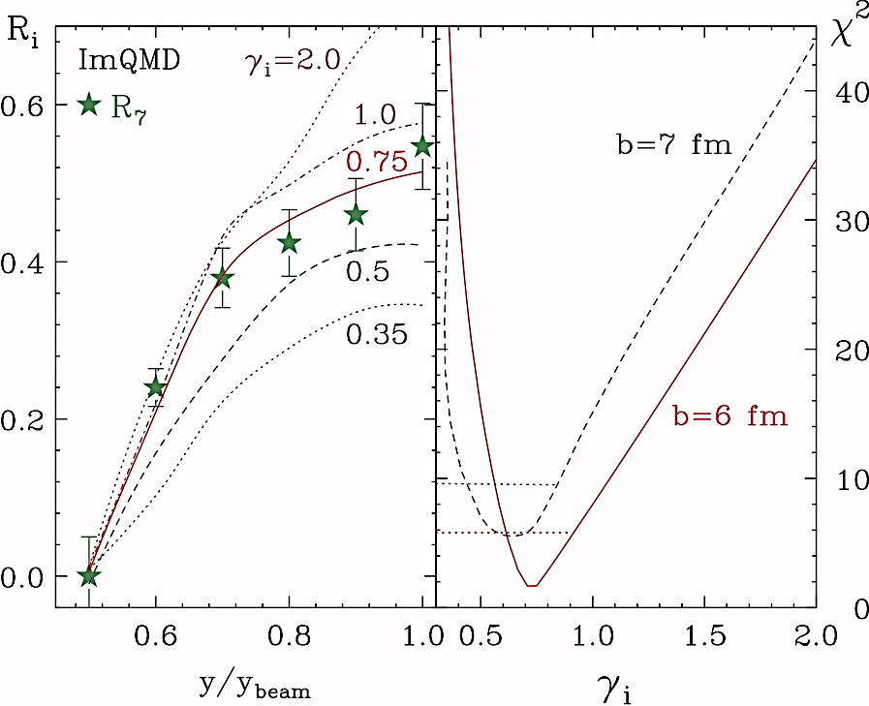
What we hope to learn?
(Double-)
ratios
Isospin diffusion
Spectra
Femtoscopy
Flow
Transport model ingredients
Symmetry energy |  | ✔ | * |  | ✔
In-medium x-section | ✔ | ✔ | ✔ | ✔ | ✔
Cluster production | ✔ | ✔ | ✔ | ✔ | ✔
Effective mass | ✔ | ✔ | ? | ? | ?
Our approach:
Use different isotopes (fix Z of your initial system and vary N) and vary nuclear density (through the energy of the collisions*)

Slide 12
#1
Symmetry energy
How does the potential energy of nuclear matter depend on density and momentum?

Slide 13
Symmetry Energy: n, p potentials
δ=0.3
E/A (ρ,δ) = E/A (ρ,0) + δ²⋅S(ρ)
δ = (ρ_{n}- ρ_{p})/ (ρ_{n}+ ρ_{p}) = (N-Z)/A
stiff
soft
U_{asy} (MeV)
Stiff
Soft
u =

Slide 14
Symmetry Energy: n, p potentials
δ=0.3
E/A (ρ,δ) = E/A (ρ,0) + δ²⋅S(ρ)
δ = (ρ_{n}- ρ_{p})/ (ρ_{n}+ ρ_{p}) = (N-Z)/A
stiff
n and p potentials have opposite signs and slightly different density dependence
soft
U_{asy} (MeV)
Observables:
n vs p and t vs ³He emission
and flow
Pion production
Correlations
Isospin transport ratios
….
u =

Slide 15
Reaction probes: Isospin multiplets
Y_{n}(E_{CM})
Y_{p}(E_{CM})
δ=0.3
R_{n/p}(E_{CM})=
stiff
PLB 664 (2008) 145
soft
U_{asy} (MeV)
Soft
Stiff
E_{CM} (MeV)
repulsive (attractive) potential for neutrons (protons) enhances (suppresses)
the neutron (proton) emission
u =
¹²⁴Sn: 50 protons, 74 neutrons δ~0.20

Slide 16
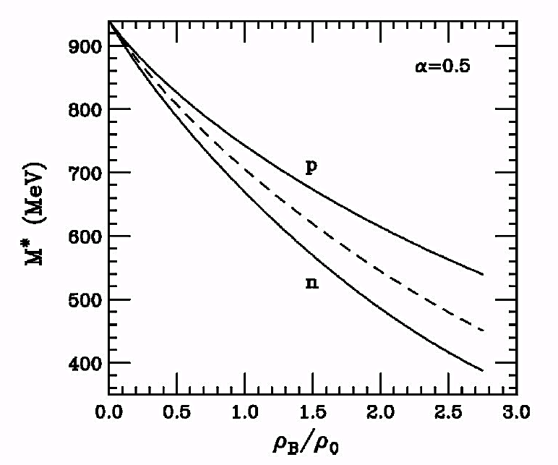
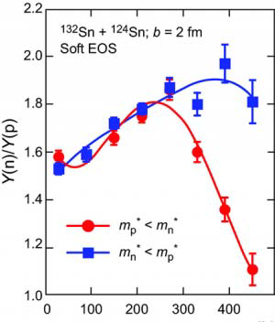
Influence of effective mass
Transport simulations: ¹³²Sn+¹²⁴Sn
J. Rizzo et al, Phys. Rev. C72, 064609 (2005)
m*_{n}<m*_{p} - more neutrons accelerated to high energies
B. Liu et al. PRC 65(2002)045201
p_{T} [MeV/c]
acceleration:
m*_{p}<m*_{n} - more protons accelerated to high energies
High energy sensitive to effective mass

Slide 17
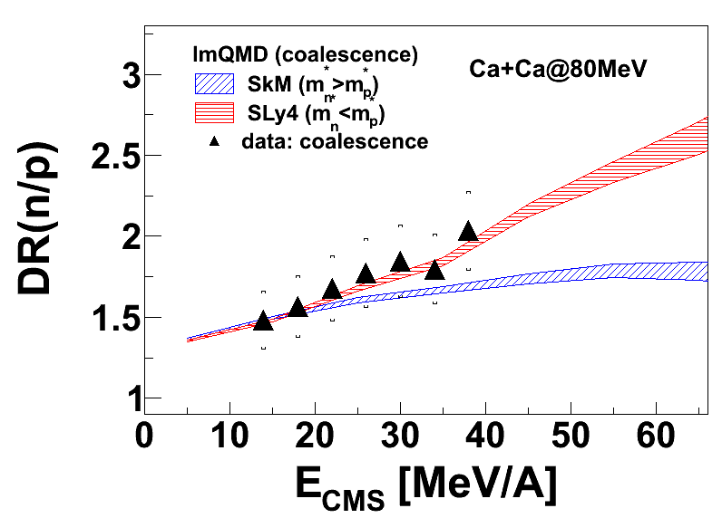
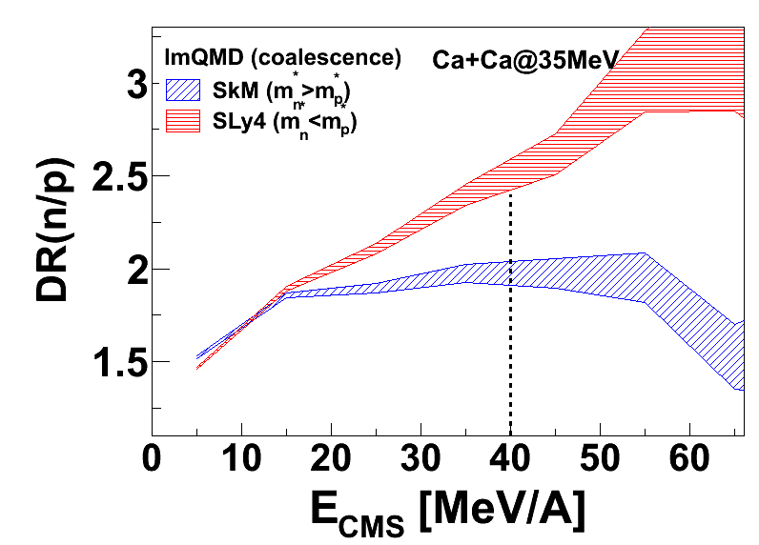
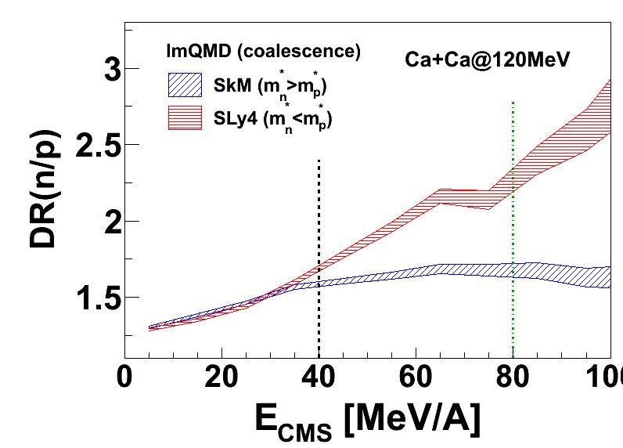
Effective mass in Ca+Ca
Motivation for recent experiment
Need to measure particles at energies > 40MeV/A to constrain the effective mass of n and p.
- requires a detector upgrade.

Slide 18
What we hope to learn?
(Double-)
ratios
Isospin diffusion
Spectra
Femtoscopy
Flow
Transport model ingredients
Symmetry energy |  | ✔ | * |  | ✔
In-medium x-section | ✔ | ✔ | ✔ | ✔ | ✔
Cluster production | ✔ | ✔ | ✔ | ✔ | ✔
Effective mass | ✔ | ✔ | ? | ? | ?

Slide 19
#2
In-medium cross section
& cluster production

Slide 20
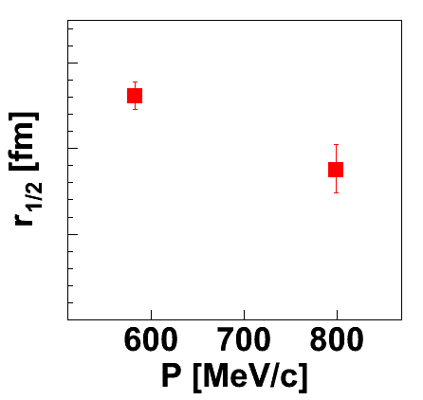
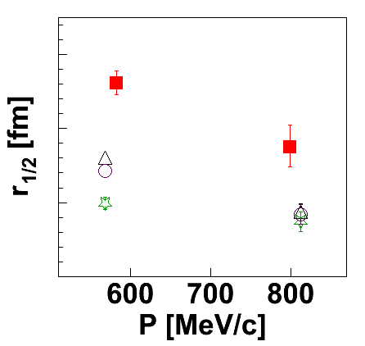
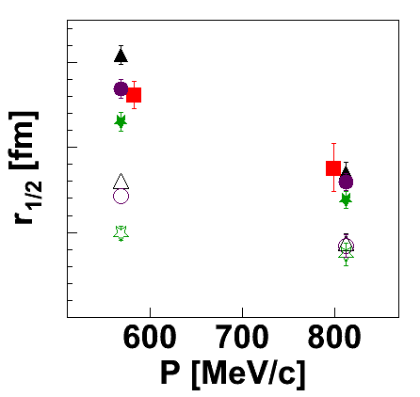
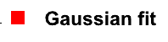
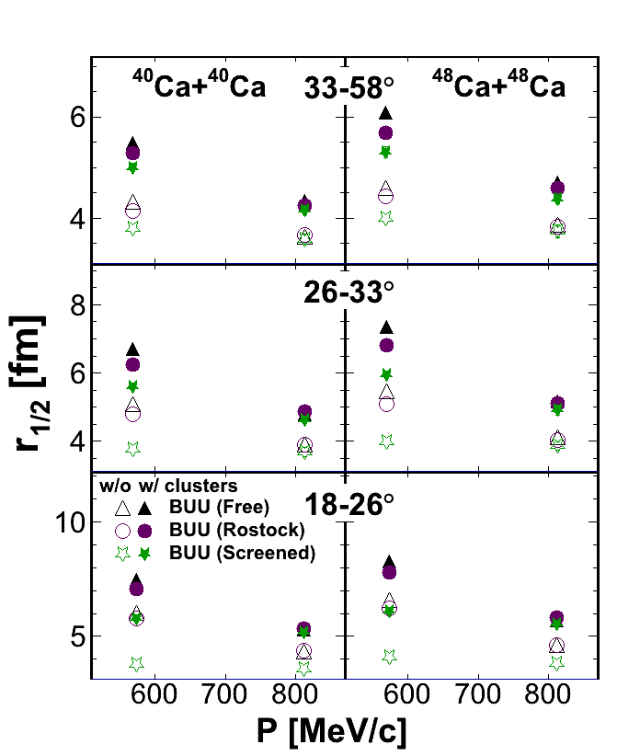
Two-particle correlations
Proton femtoscopy in ⁴⁸Ca+⁴⁸Ca@80AMeV
6
5
4
3
Importance of cluster production and in-medium cross section
Henzl et al., Phys.Rev. C85 (2012) 014606

Slide 21
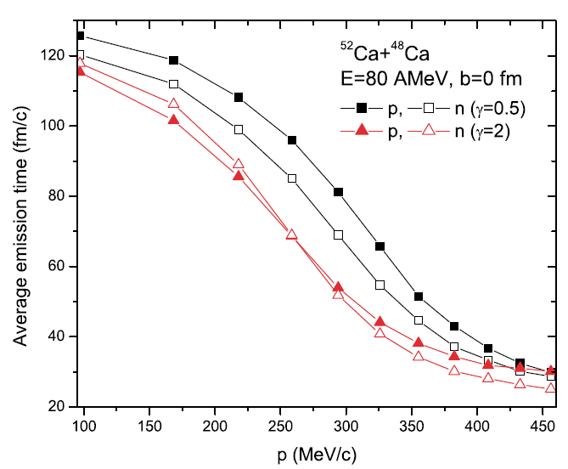
Emission of p’s and n’s
⁵²Ca
⁴⁸Ca
Stiff EoS
L-W Chen et al., PRL90 (2003) 162701
Soft EoS
Stiff EoS (γ=2)
Soft EoS (γ=0.5)
p’s and n’s emitted at similar time
faster emission times
p’s emitted after n’s
later emission times

Slide 22
What we hope to learn?
(Double-)
ratios
Isospin diffusion
Spectra
Femtoscopy
Flow
Transport model ingredients
Symmetry energy |  | ✔ | * |  | ✔
In-medium x-section | ✔ | ✔ | ✔ | ✔ | ✔
Cluster production | ✔ | ✔ | ✔ | ✔ | ✔
Effective mass | ✔ | ✔ | ? | ? | ?

Slide 23
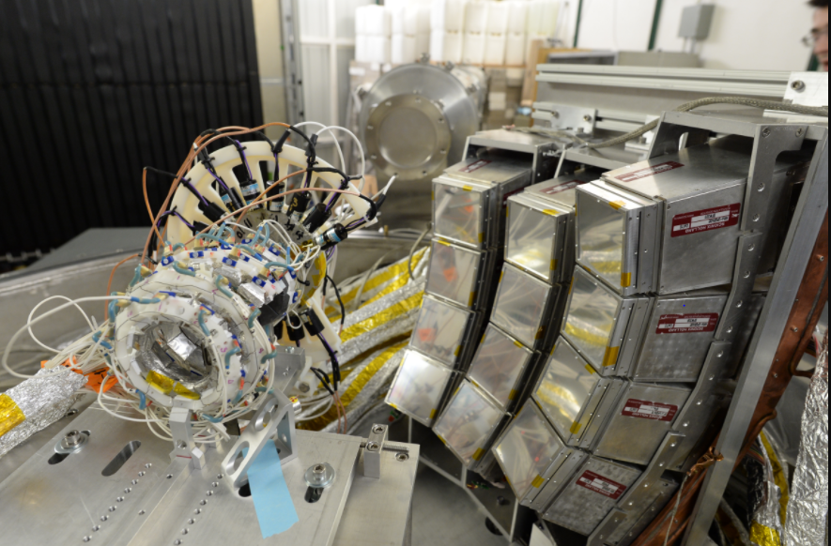
Recent experiment at NSCL (Feb-Apr 2018)
NW
VW
HiRA
FA
Beam
Microball

Slide 24
Recent experiment at NSCL (Feb-Apr 2018)
E/A (ρ,δ) = E/A (ρ,0) + δ²⋅S(ρ)
δ = (ρ_{n}- ρ_{p})/ (ρ_{n}+ ρ_{p}) = (N-Z)/A
Stiff
δ →1
Soft
^{40,48}Ca + ^{56,64}Ni
^{40,48}Ca +^{112,124}Sn
at 56 and 140 MeV/A
Notes:
Ni 28-28, 36,28
124,50-112,50

Slide 25

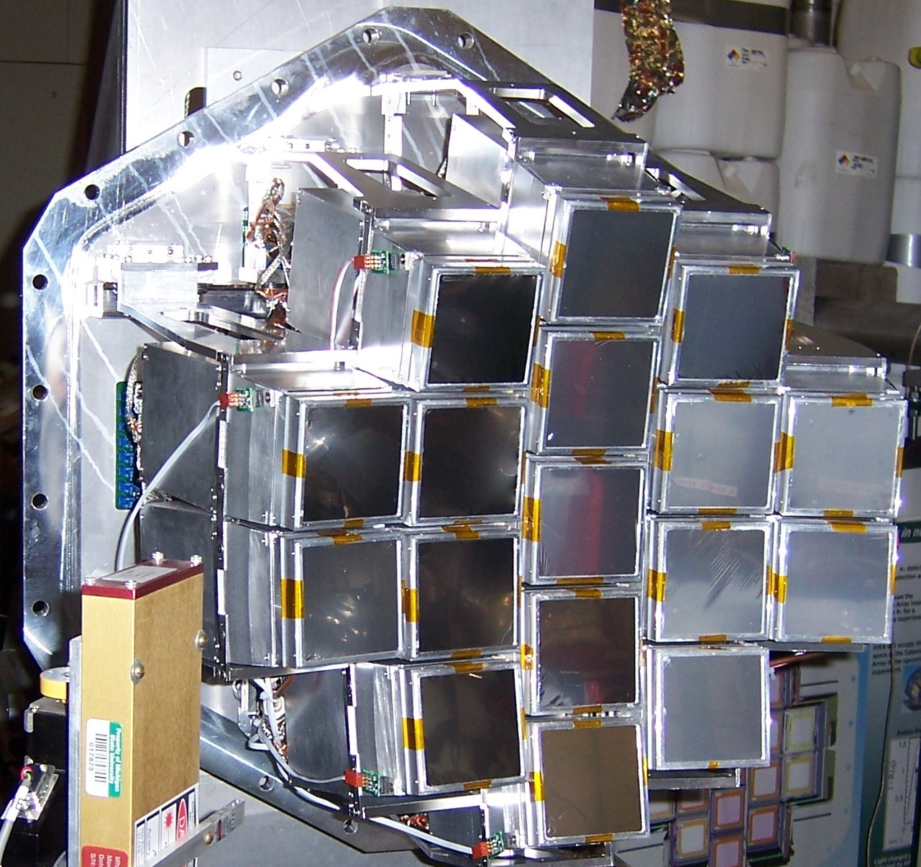
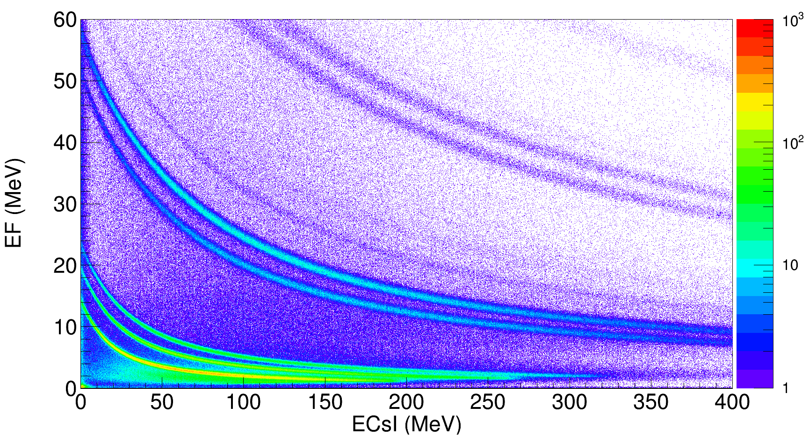
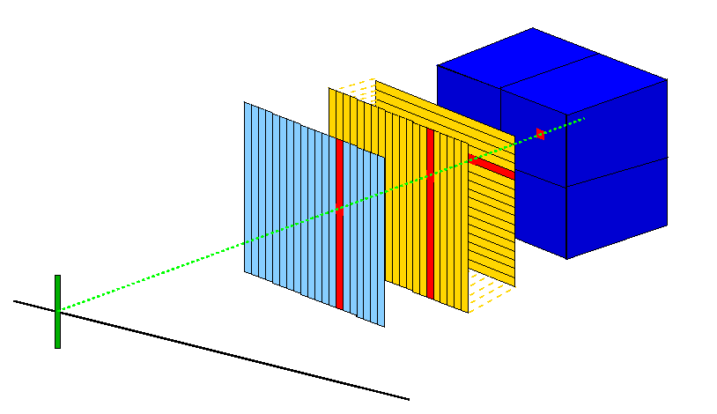
Charged particle identification
= High Resolution Array
Particle identification
⁷Li
⁷Be
⁶Li
⁴He
³He
t
Si-E 500 μm
4x CsI(Tl)
d
p
Si-ΔE 65 μm

Slide 26
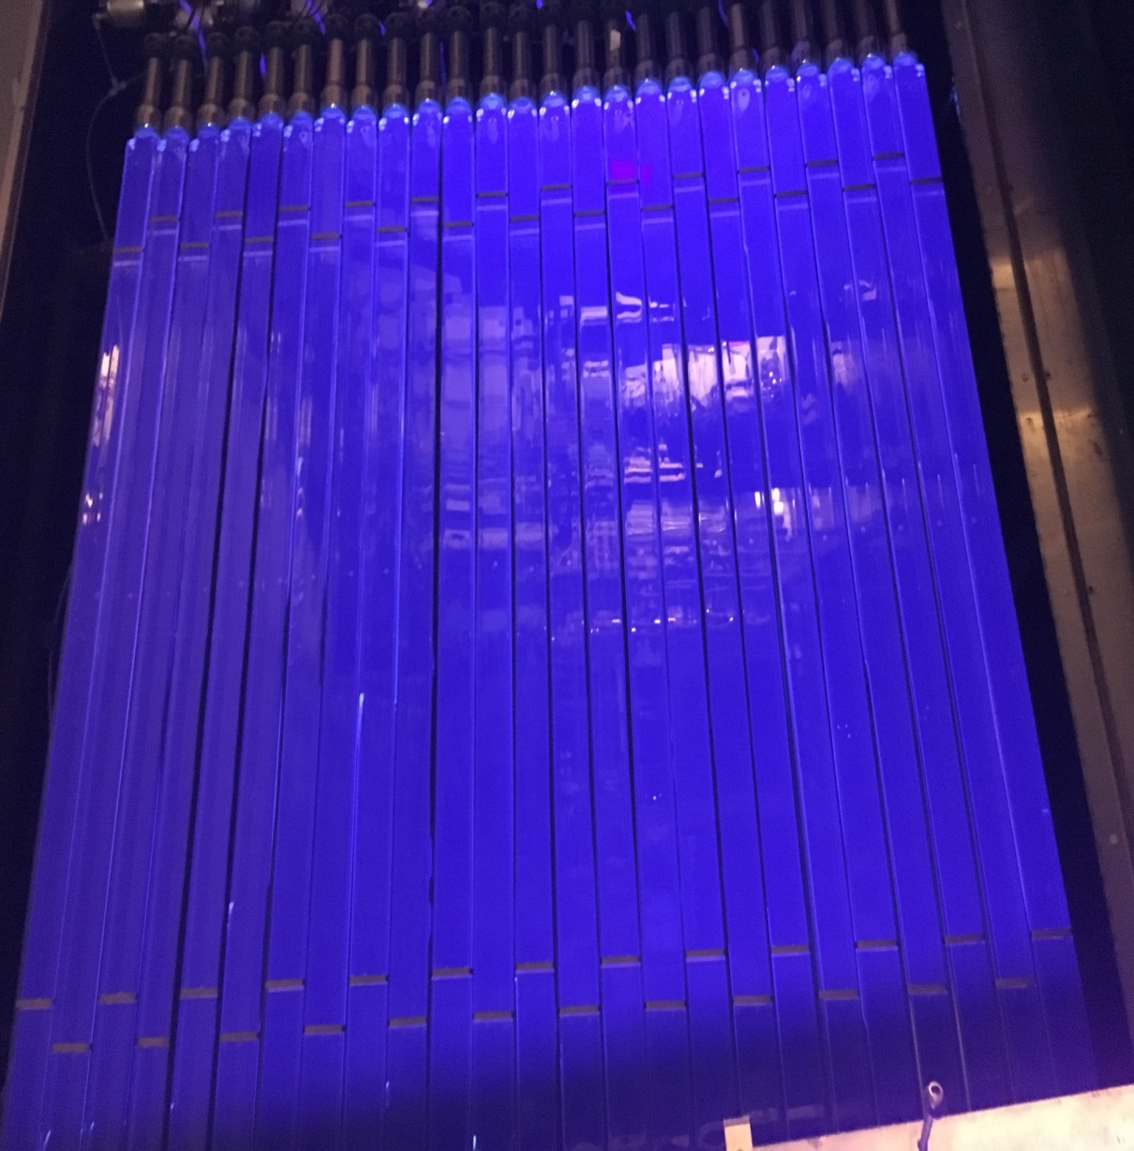
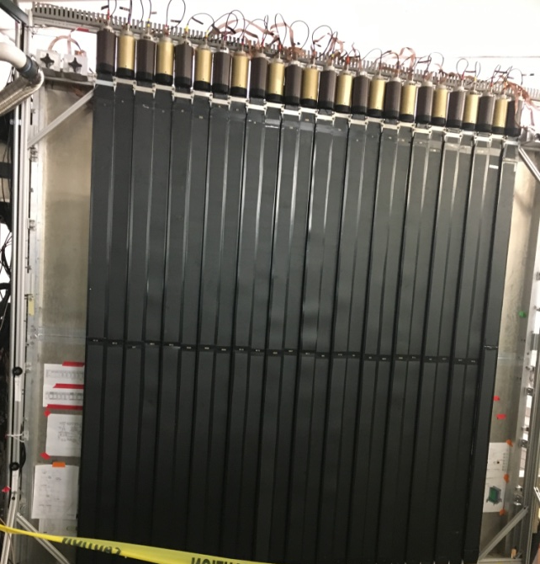
Neutron detection

Slide 27
What we hope to learn?
(Double-)
ratios
Isospin diffusion
Spectra
Femtoscopy
Flow
Transport model ingredients
Symmetry energy |  | ✔ | * |  | ✔
In-medium x-section | ✔ | ✔ | ✔ | ✔ | ✔
Cluster production | ✔ | ✔ | ✔ | ✔ | ✔
“effective mass” | ✔ | ✔ | ? | ? | ?

Slide 28
International Collaboration
E/A (ρ,δ) = E/A (ρ,0) + δ²⋅S(ρ)
δ = (ρ_{n}- ρ_{p})/ (ρ_{n}+ ρ_{p}) = (N-Z)/A
RIBF
FRIB
GSI
NSCL
FAIR
0.0 1 2 3

Slide 29
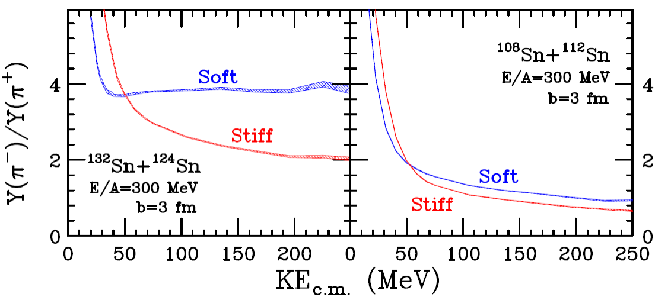
Symmetry energy at large ρ₀
Neutron star radii and deformability most sensitive at 2ρ₀
Observables predicted by pBUU Transport Model (PhysRevC.90.024605)by P. Danielewicz
Transport model that relates motion through mean field and collisions
Simple parameterization of symmetry energy (SE)
Production of pions via Δ resonances
- π⁻/π⁺ ratio biggest sensitivity to SE
and for more neutron rich systems
Tsang et al., PhysRevC.95.044614

Slide 30
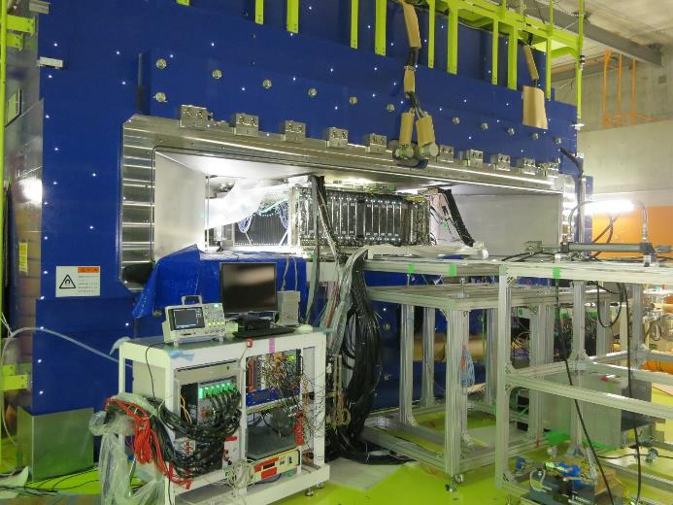
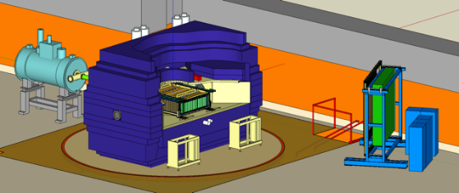
Experimental setup @ RIKEN
Primary | Beam | Target | E_{beam}/A [MeV] | δ_{sys} | Evt (M)
¹²⁴Xe | ¹⁰⁸Sn | ¹¹²Sn | 269 | 0.09 | 8
 | ¹¹²Sn | ¹²⁴Sn | 270 | 0.15 | 5
²³⁸Ｕ | ¹³²Sn | ¹²⁴Sn | 269 | 0.22 | 9
 | ¹²⁴Sn | ¹¹²Sn | 270 | 0.15 | 5
Z=1,2,3 |  | 100, 200 |  | 0.6
E/A (ρ,δ) = E/A (ρ,0) + δ²⋅S(ρ)
δ = (ρ_{n}- ρ_{p})/ (ρ_{n}+ ρ_{p}) = (N-Z)/A
Shane et al., j.nima.2015.01.026
Easiest thing is spectrometer for pions

Slide 31
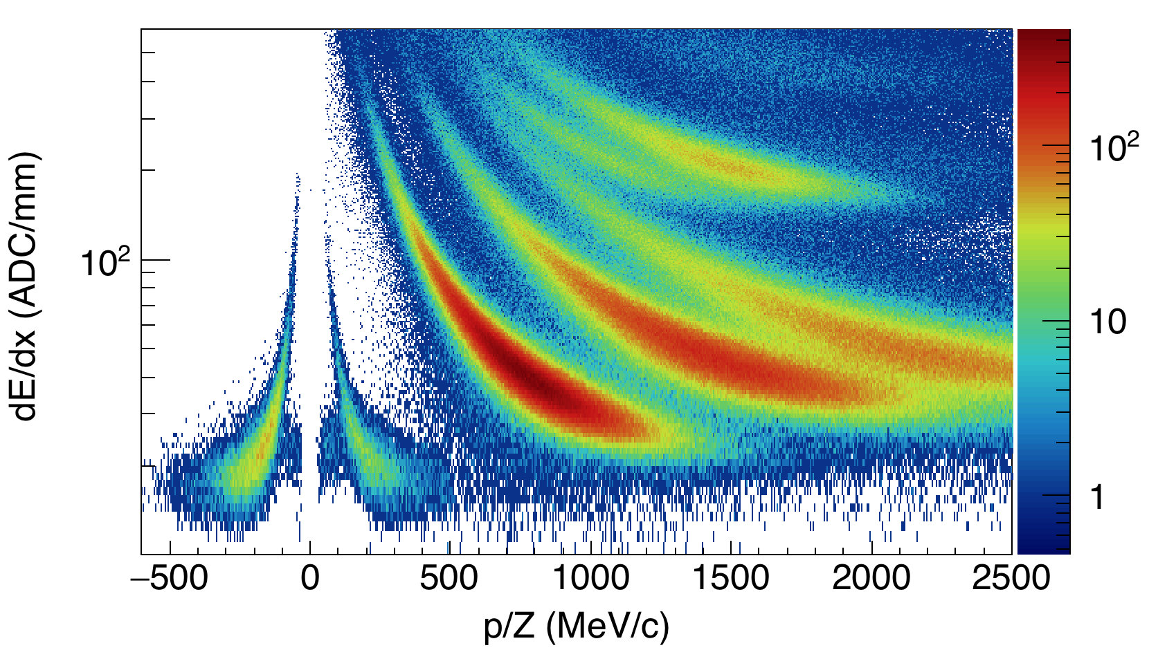
Outline
Good PID spectra. Need to understand background and efficiencies.
Analysis to extract Y(π⁻)/Y(π⁺) momentum spectral ratios is underway.
¹³²Sn+¹²⁴ Sn
p
d
⁴He
t
³He
π⁻
π⁺
Tsang et al., PhysRevC.95.044614

Slide 32
Summary
Heavy ion collisions provide a unique probe to study the physics of neutron stars - Symmetry energy
Additionally, HIC allow us to further constrain the EOS of nuclear matter (in-medium cross-section, importance of the clusters)
New experiments will allows further constraints of symmetry energy at various densities of nuclear matter and also to validate theoretical models
Some of the conclusions are model-dependent
  Predictions are model dependent
Collaboration between theorists and experimentalists beneficial
for both sides

Slide 33
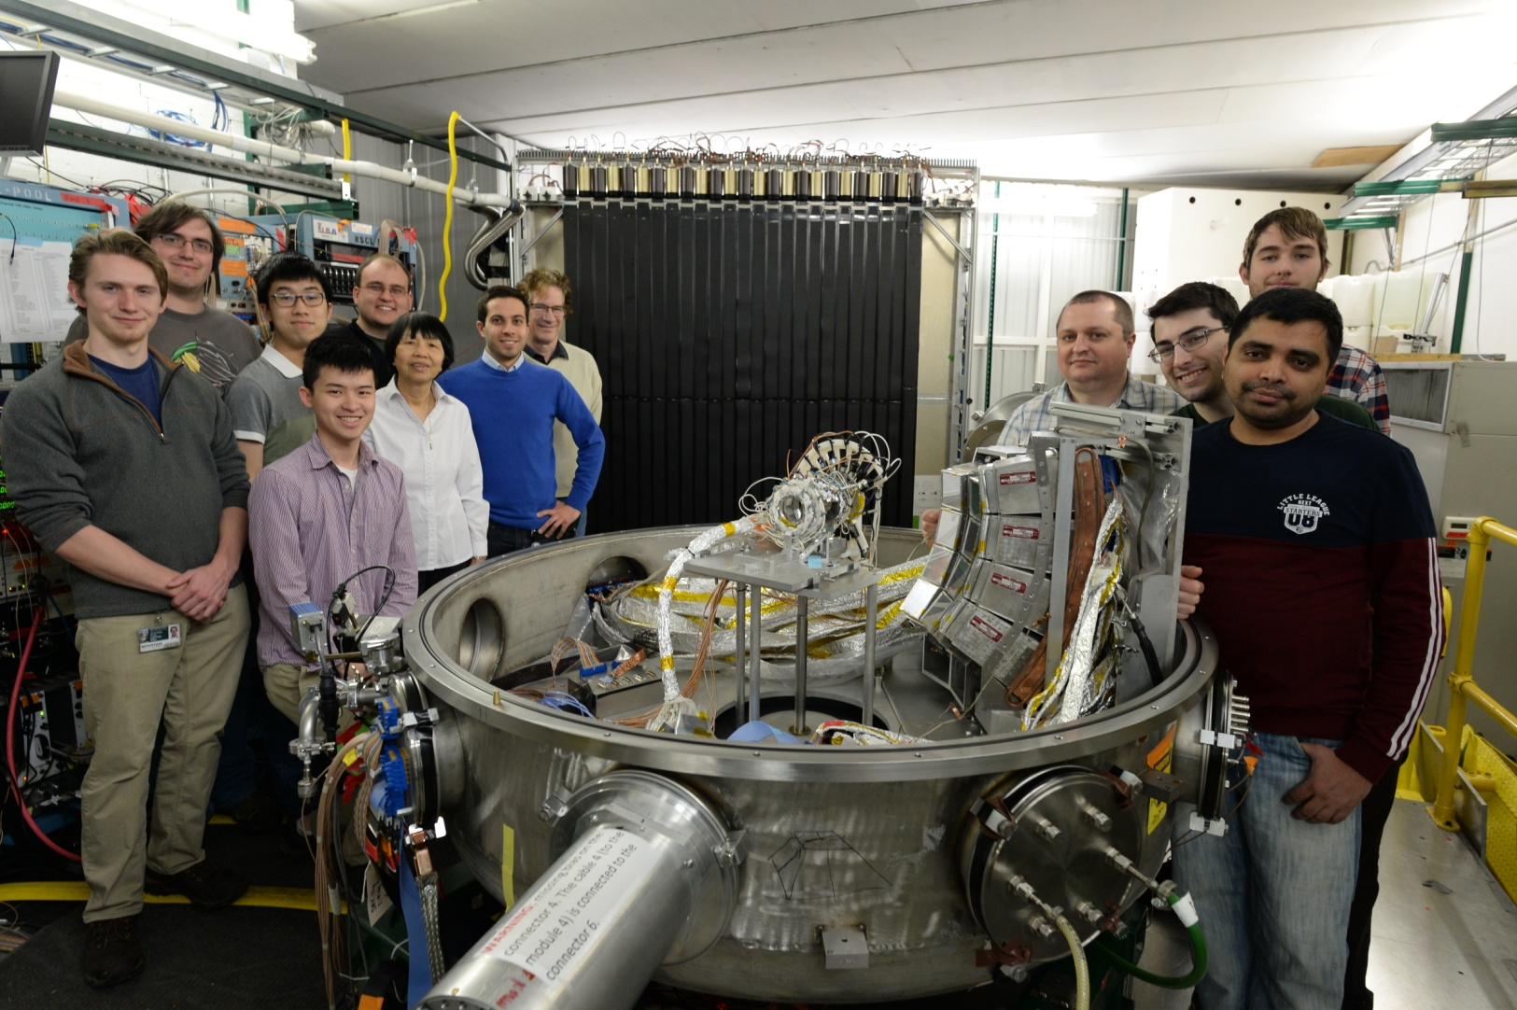
Thank you

Slide 34
Transverse flow
pBUU transport model simulations for ⁴⁸Ca+⁴⁸Ca@80AMeV

Slide 35
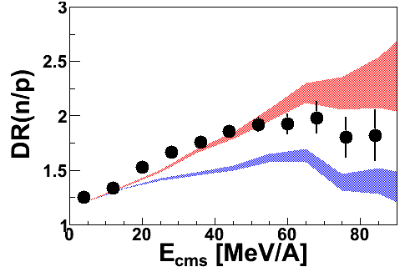
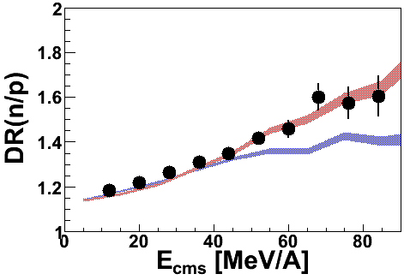
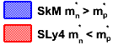
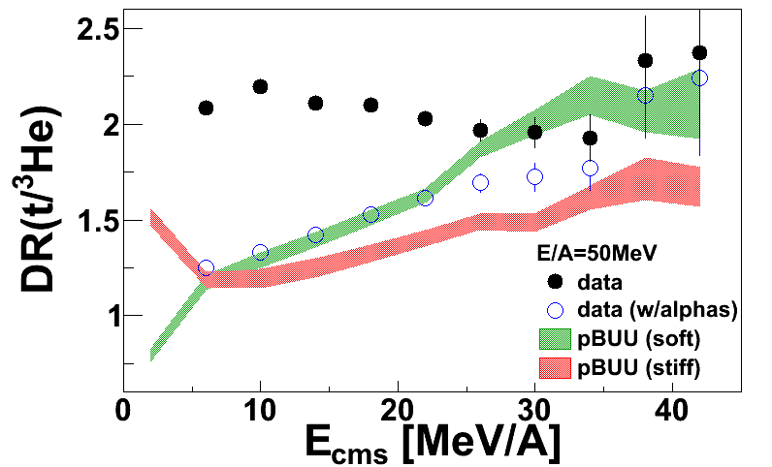
ImQMD – effective mass
Energy dependence
E/A=50MeV
E/A=120MeV
ImQMD05_sky: incorporate Skyrme interactions
Y. Zhang (2013) Private Communication
Tsang (2013) Private Communication
Coalescence ratios

Slide 36
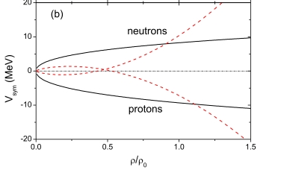
Emission of p’s and n’s: Sensitivity to SymEn
adapted from
M.B. Tsang, Prog. Part.Nucl.Phys. 66, 400 (2011)
Brown, Phys. Rev. Lett. 85, 5296 (2001)
Stiff
⁵²Ca
⁴⁸Ca
Soft
Stiff EoS
L-W Chen et al., PRL90 (2003) 162701
Soft EoS
Super soft
Soft
Stiff EoS (γ=2)
Soft EoS (γ=0.5)
p’s and n’s emitted
at similar time
faster emission times
p’s emitted
after n’s
later emission times
Stiff

Slide 37
Emission of p’s and n’s: Sensitivity to SymEn
⁵²Ca
⁴⁸Ca
Stiff EoS
L-W Chen et al., PRL90 (2003) 162701
Soft EoS
Stiff EoS (γ=2)
Soft EoS (γ=0.5)
p’s and n’s emitted at similar time
faster emission times
p’s emitted after n’s
later emission times

Slide 38
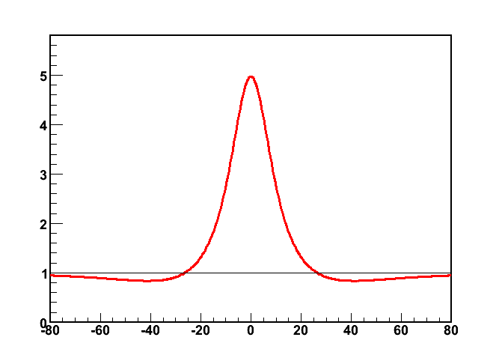
Possible emission configurations (stiff EOS)
Catching up
Catching up
n
p
p
n
q_{x}<0
q_{x}>0
Moving away
Moving away
p
p
n
n
q_{x}<0
q_{x}>0
Δq=0.5(p_{p} –p_{n}) =(q_{x}, q_{y}=0, q_{z}=0); r =(x, y=0,z=0)
(n,p) correlation function
q_{x}<0
q_{x}>0
S(x)
0
x
q = 0.5(p_{p} - p_{n})
Notes:
Effective interaction time longer, Stronger correlation
Effective interaction time shorter,Weaker correlation

Slide 39
Emission of p’s and n’s
⁵²Ca
⁴⁸Ca
Stiff EoS
L-W Chen et al., PRL90 (2003) 162701
Soft EoS
Stiff EoS (γ=2)
Soft EoS (γ=0.5)
p’s and n’s emitted at similar time
faster emission times
p’s emitted after n’s
later emission times
Notes:
More interesting case, where particles emitted at different times

Slide 40
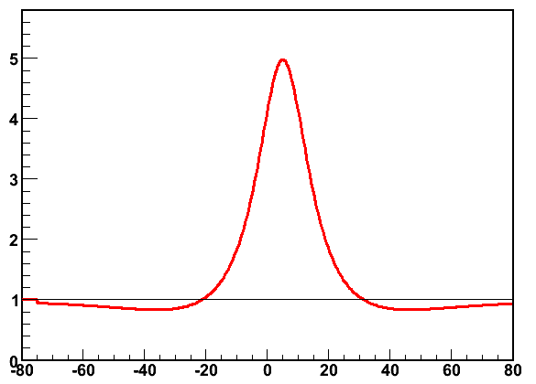
Sensitivity to particle emission (soft EOS)
Moving away
Catching up
p
p
n
n
q_{x}<0
q_{x}>0
(n,p) correlation function
q_{x}<0
q_{x}>0
S(x)
x
0
Δq=0.5(p_{p} –p_{n})=(q_{x}, q_{y}=0, q_{z}=0); r =(x, y=0,z=0)
q_{x} = 0.5(p_{x,p} - p_{x,n})

Slide 41
Relating asymmetry in the CF to space-time asymmetry
(n,p) correlation function
q_{x}<0
q_{x}>0
Stiff EoS
S(x)
Soft EoS
<x>
x
0
q_{x} = 0.5(p_{x,p} - p_{x,n})
Classically, average separation b/t protons and neutrons
Not expected if n,p emitted from the same source
(no n-p differential flow)
=0
Protons emitted later
Voloshin et al., PRL 79:4766-4769,1997
Lednicky et al., PLB 373:30-34,1996

