Slide 1
A new family of exact solutions of relativistic hydrodynamics
T. Csörgő^{1,2} , G. Kasza², M. Csanád³ and Z. Jiang^{4,5}
¹Wigner Research Center for Physics, Budapest, Hungary
²EKE GYKRC, Gyöngyös, Hungary
³Eötvös University, Budapest, Hungary
⁴Key Laboratory of Quark and Lepton Physics, Wuhan, China
⁵IoPP, CCNU, Wuhan, China
Introduction and motivation
A New Family of Exact Solutions of Relativistic Hydro
Rapidity and pseudorapidity distributions
R_{long} HBT radius
Outlook to other presentations
Conclusions, summary
Partially supported by NKTIH FK 123842 and FK123959
and EFOP 3.6.1-16-2016-00001

Slide 2




A new family of exact solutions of relativistic hydrodynamics
T. Csörgő^{1,2} , G. Kasza², M. Csanád³ and Z. Jiang^{4,5}
Introduction and motivation
A New Family of Exact Solutions of Relativistic Hydro
Rapidity and pseudorapidity distributions
R_{long} HBT radius
Outlook to other presentations
Conclusions, summary
Partially supported by NKTIH FK 123842 and FK123959
and EFOP 3.6.1-16-2016-00001
arXiv.org:1805.01427 +

Slide 3
Context
Renowned exact solutions, reviewed in arXiv:1805.01427
  Landau-Khalatnikov solution: dn/dy ~ Gaussian
  Hwa solution (1974) – Bjorken: same solution + ε₀ (1983)
  Chiu, Sudarshan and Wang: plateaux, Wong: Landau revisited
  Revival of interest: Zimányi, Bondorf, Garpman (1978)
  Buda-Lund model + exact solutions (1994-96)
  Biró, Karpenko, Sinyukov, Pratt (2007)
  Bialas, Janik, Peschanski, Borsch+Zhdanov (2007)
  CsT, Csanád, Nagy (2007-2008)
  CsT, Csernai, Grassi, Hama, Kodama (2004)
  Gubser (2010-11)
  Hatta, Noronha, Xiao (2014-16)
New simple solutions Evaluation of measurables (Jiang’s talk)
Rapidity distribution Advanced initial energy density (Kasza)
HBT radii Advanced life-time estimation (here)

Slide 4
Goal
Need for solutions that are:
  explicit
  simple
  accelerating
  relativistic
  realistic / compatible with the data:
  lattice QCD EoS
  ellipsoidal symmetry (spectra, v₂, v₄, HBT)
  finite dn/dy
  Generelization of a class that satisfies each of these criteria
  but not simultaneously
  T. Cs, M. I. Nagy, M. Csanád, arXiv:nucl-th/0605070, PLB (2008)
  M.I. Nagy, T. Cs., M. Csanád, arXiv:0709.3677 , PRC77:024908 (2008)
  M. Csanád, M. I. Nagy, T. Cs, arXiv:0710.0327 [nucl-th] EPJ A (2008)
  New family of exact solutions:
  CsT, Kasza, Csanád, Jiang, arXiv.org:1805.01427

Slide 5



Perfect fluid hydrodynamics
Energy-momentum
tensor:
Relativistic
  Euler equation:
  Energy conservation:
  Charge conservation:
  Consequence is entropy conservation:

Slide 6

Self-similar, ellipsoidal solutions
Publication (for example):
T. Cs, L.P.Csernai, Y. Hama, T. Kodama, Heavy Ion Phys. A 21 (2004) 73
3D spherically symmetric HUBBLE flow:
No acceleration:
Define a scaling variable for self-similarly expanding ellipsoids:
EoS: (massive)
ideal gas
Scaling function ν(s) can be chosen freely.
Shear and bulk viscous corrections in NR limit: known analytically.

Slide 7
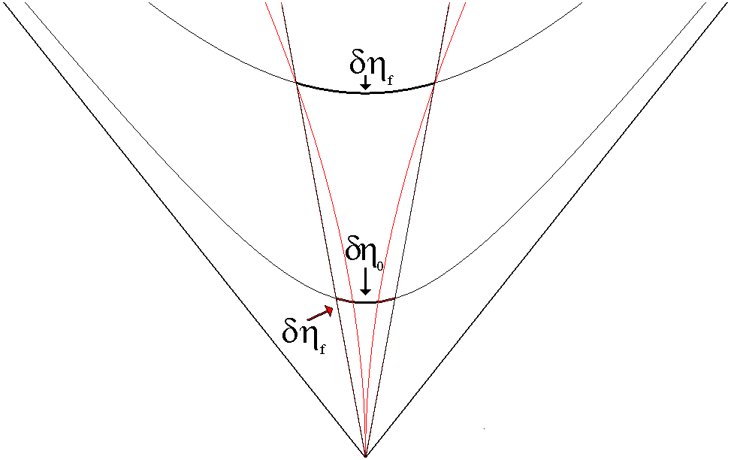
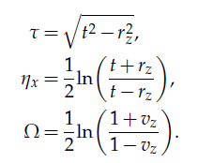
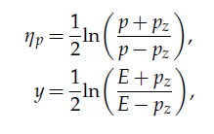

Auxiliary variables: η_{x}, τ, Ω , η_{p}, y
Consider a 1+1 dimensional, finite, expanding fireball
Assume: Ω=Ω(η_{x})
Notation T. Cs., G. Kasza, M. Csanád, Z. Jiang, arXiv.org:1805.01427

Slide 8





Hydro in Rindler coordinates, new sol
Assumptions of TCs, Kasza, Csanád and Jiang, arXiv.org:1805.01427 :
For the entropy density, the continuity equation is solved.
From energy-momentum conservation, the
Euler and temperature equations are obtained:

Slide 9
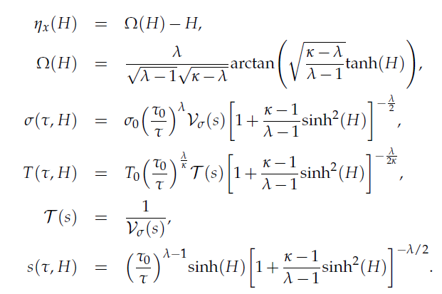

A New Family of Exact Solutions of Hydro

Slide 10
A New Family of Exact Solutions of Hydro
New: not discovered before,
as far as we know …
Family:
For each positive scaling function τ(s), a different solution, with same T₀, s₀, κ, λ
Not self-similar:
Coordinate dependenc NOT on scaling variable s ONLY, butadditional dependence on
H = H(η_{x}) too.
Explicit and Exact:
Fluid rapidity, temperature, entropy density explicitly given by formulas
New feature:
Solution is given
as parametric curves of H in η_{x} :
(η_{x}(H),Ω(H,τ))
Simlification, for now:
limit the solution in η_{x}
where parametric curves
correspond to functions

Slide 11
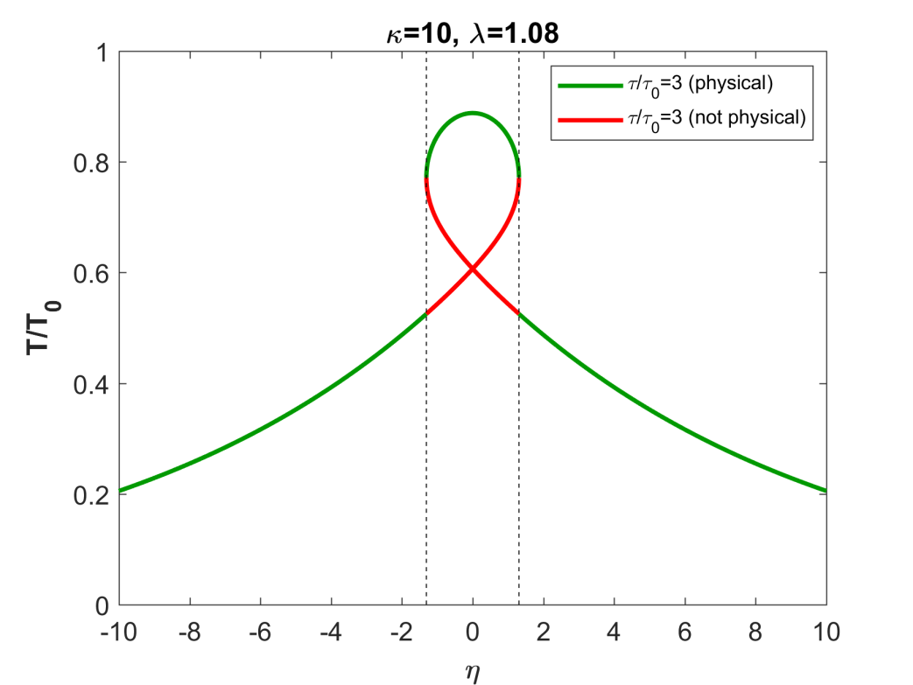
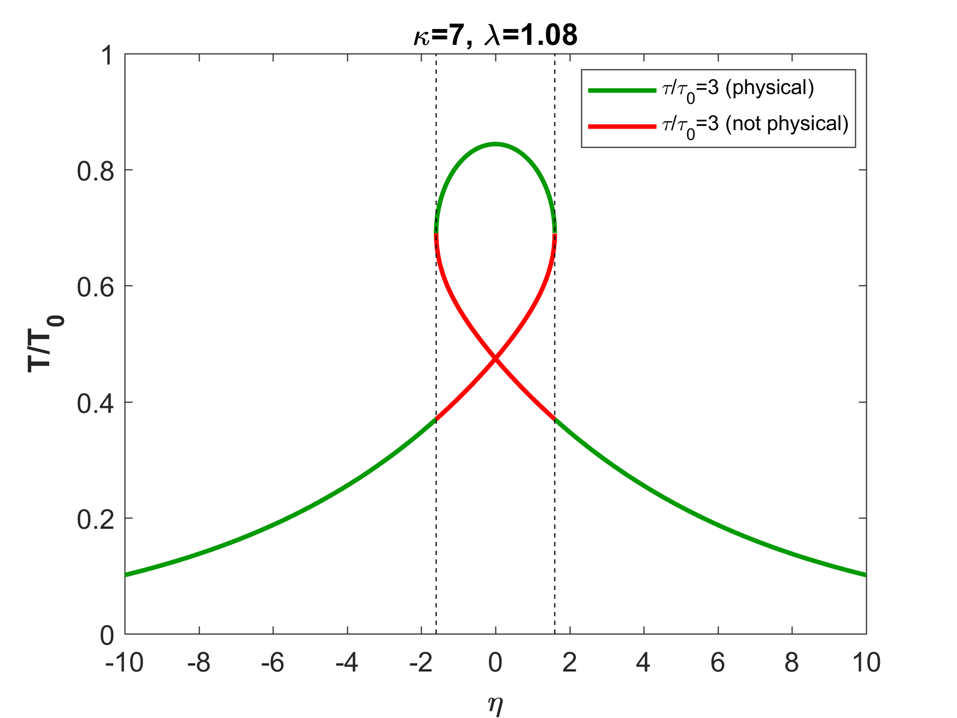

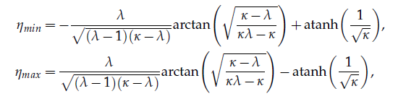

Limited in space-time rapidity η_{x}

Slide 12
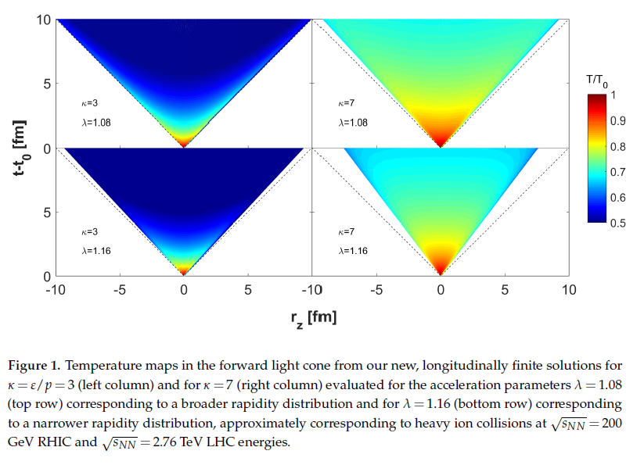
Illustration: results for T

Slide 13
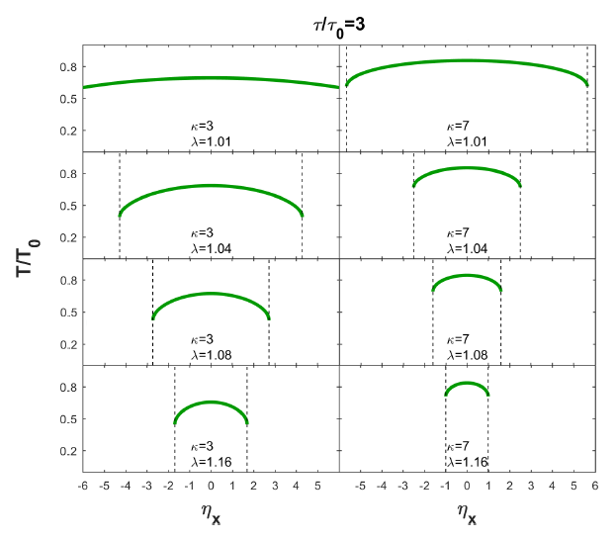
Limited in space-time rapidity η_{x}

Slide 14
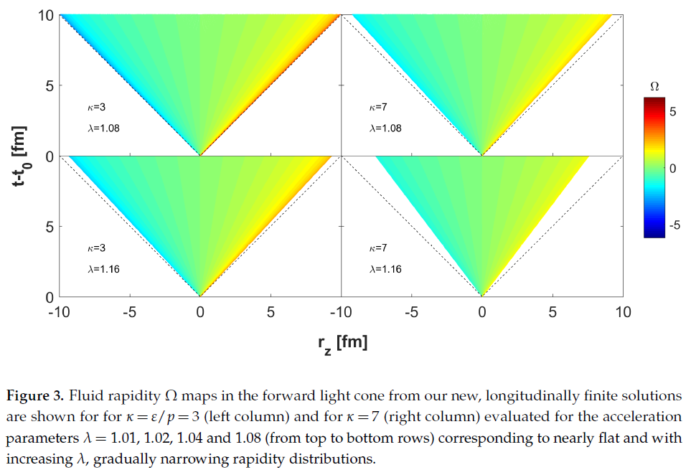
Illustration: results for fluid rapidity Ω

Slide 15
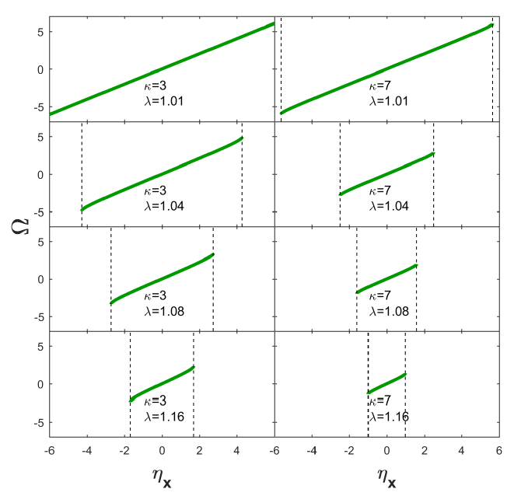
Limited in space-time rapidity η_{x}
arXiv.org:1805.01427 : Ω ≈ λ η _{x}

Slide 16
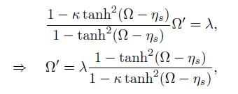


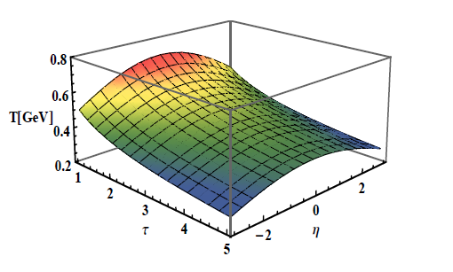


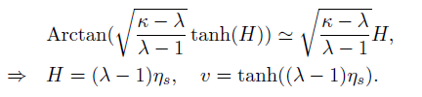
Approximations near midrapidity

Slide 17



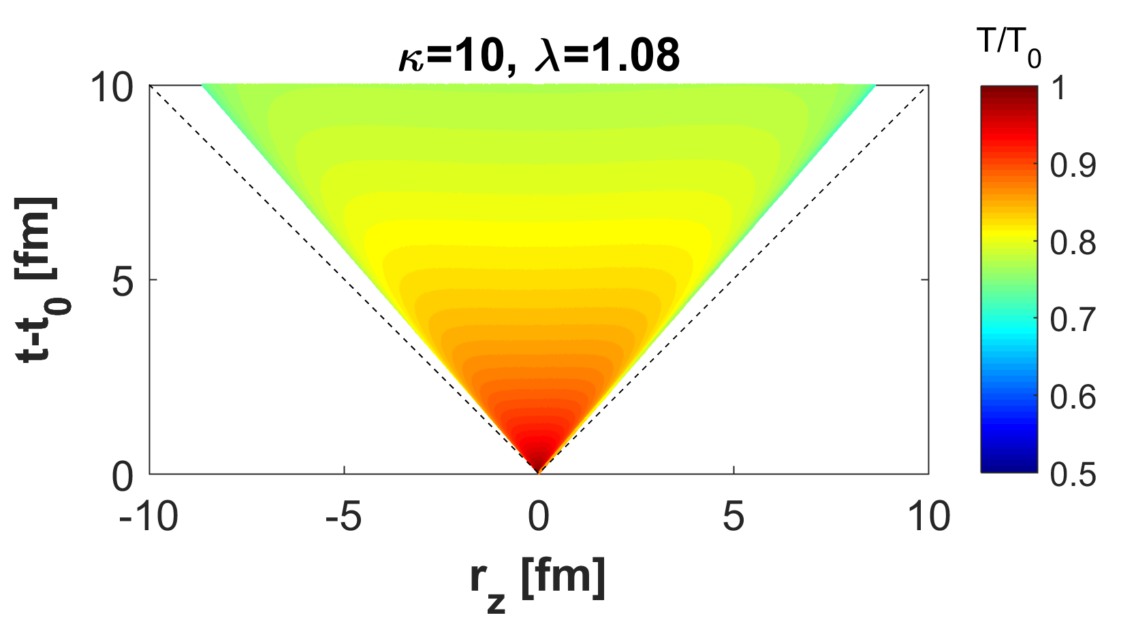


Observables: rapidity distribution
dn/dy evaluated
analytically,
in a saddle-point approximation

Slide 18
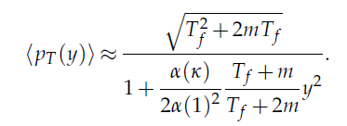
Pseudorapidity distribution
dn/dη evaluated
analytically,
in an advanced saddle-point approximation
An important by-product:
⟨p_{T} ⟩ = ⟨p_{T} (y)⟩ is rapidity dependent, a Lorentzian
just as in Buda-Lund model

Slide 19
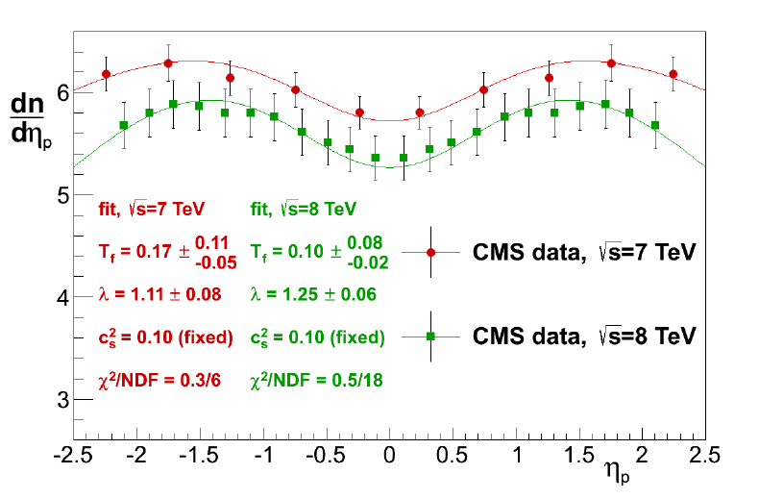
Pseudorapidity distribution
arXiv.org:1805.01427

Slide 20
Advanced life-time estimate
Life-time estimation: for Hwa-Bjorken type of flows
  Makhlin & Sinyukov, Z. Phys. C 39, 69 (1988)
Underestimates lifetime (Renk, CsT, Wiedemann, Pratt, …)
Advanced CNC life-time estimate: arXiv:0710.0327
width of dn/dy related to acceleration and work
At RHIC energies: correction is about +20%
EoS dependence = ?

Slide 21
Conjectured CNC life-time estimate
CNC exact result (κ = 1):
CNC conjecture (for c_{s}²= 1/κ < 1)

Slide 22
New life-time estimate, exact result
Life-time estimation: for Hwa-Bjorken type of flows
  Makhlin & Sinyukov, Z. Phys. C 39, 69 (1988)
Underestimates lifetime (Renk, CsT, Wiedemann, Pratt, …)
New CKCJ solution → new life-time estimate
up to leading order, the EoS dependence cancels!
Lack of κ dependence:
At mid-rapidity, the approximate flow profile is v_{z} ~ λ η_{x}

Slide 23




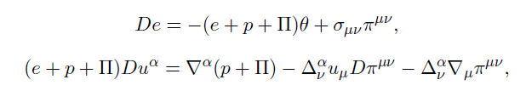

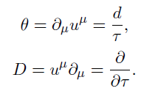





New, exact solutions: bulk viscosity

Slide 24


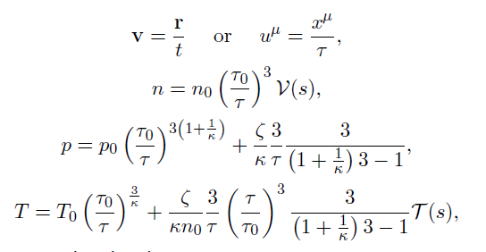
New, exact solution with bulk viscosity

Slide 25
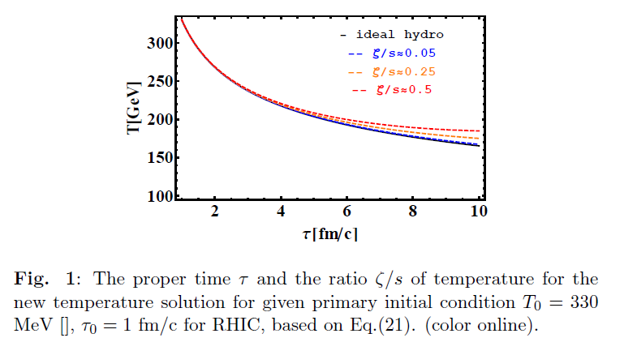
New viscous solution in 1+3 dim
Bulk viscosity important at late stage, heats up
Shear viscosity effects cancel for asymptotically Hubble flows

Slide 26
Conclusions
Explicit solutions of a very difficult problem
New estimates of initial energy density
New exact solution
for arbitrary EOS with const e/p
after 10 years, finally
For asymptotically Hubble flows
shear effects cancel at late time
bulk viscosity heats up matter
A lot to do …
  more general EoS
  less symmetry, ellipsoidal solutions
  Rotating viscous solutions

Slide 27
Thank you for your attention
Questions and Comments ?

