Slide 1
JOINT INSTITUTE FOR NUCLEAR RESEARCH

Slide 7
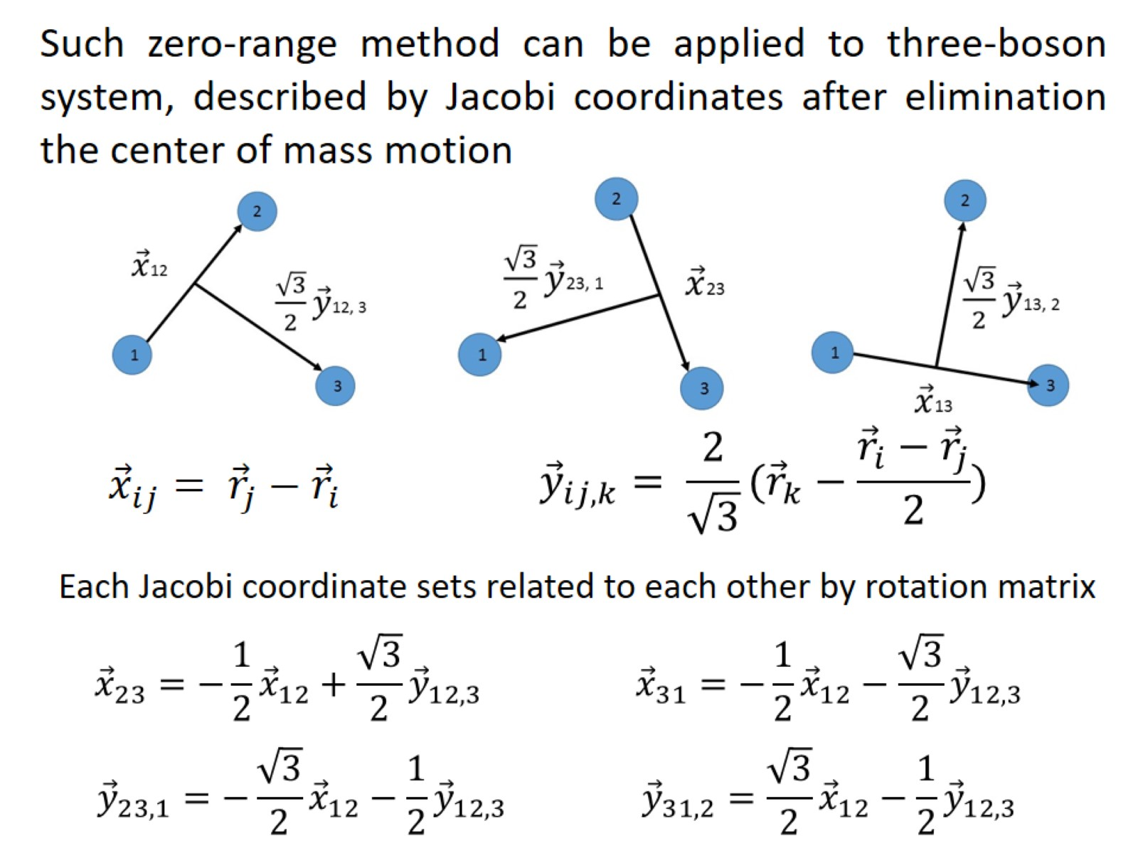

Slide 9
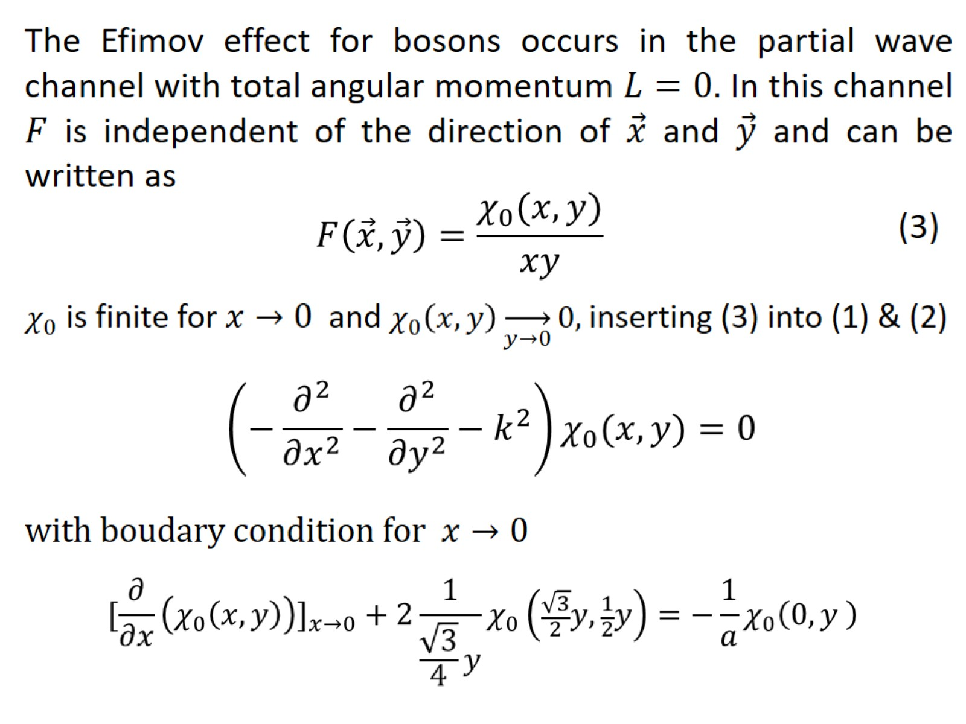

Slide 12
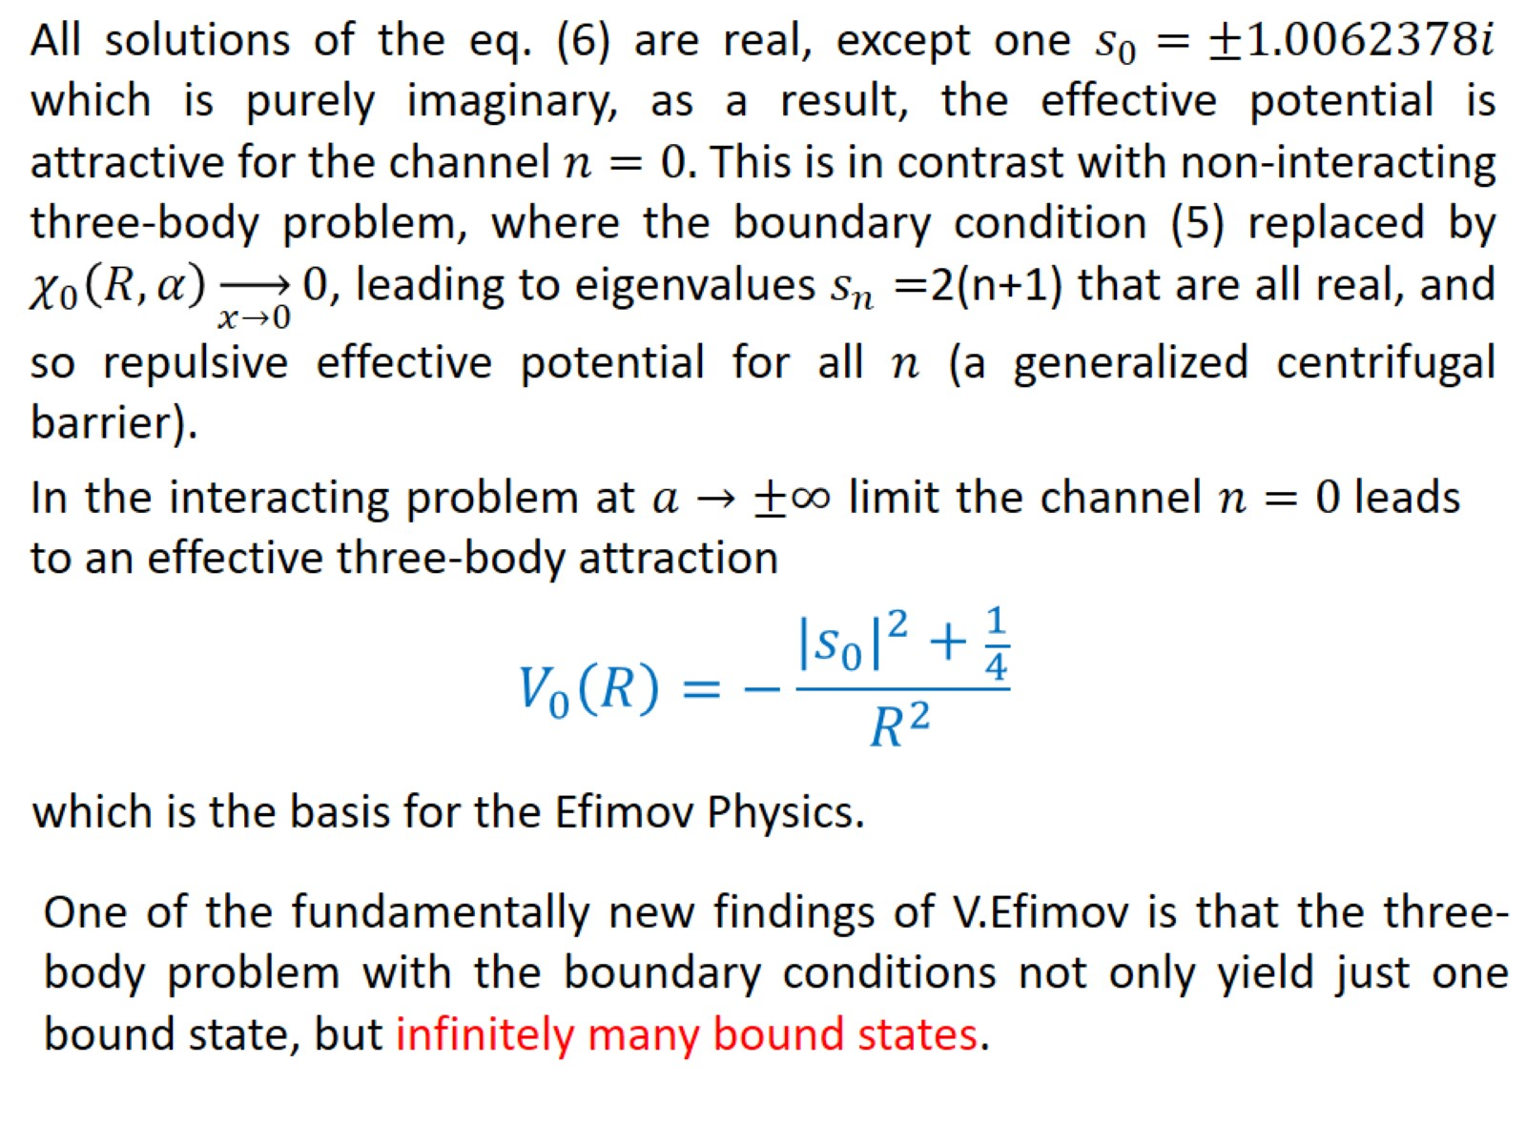

Slide 14
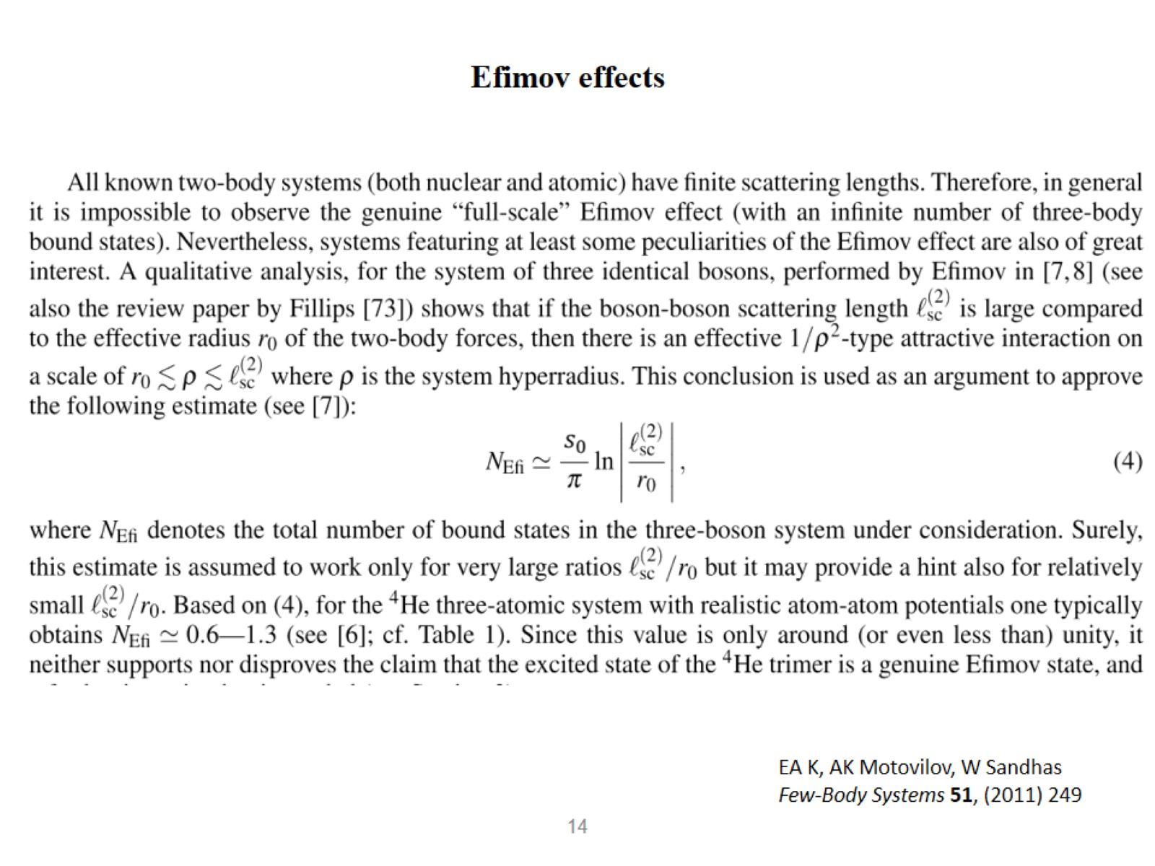

Slide 17
Experimental observations

Slide 19
Experimental observations

Slide 25
