Slide 1



High Level Trigger for rare decays at LHCb
Kim Vervink
On behalf of the LHCb collaboration
17th of July 2009

Slide 2
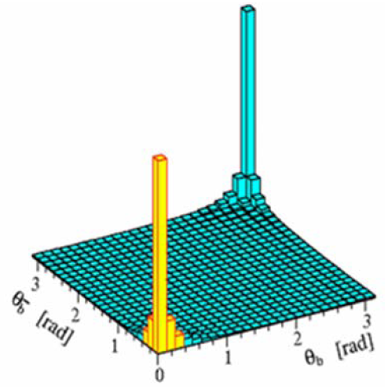
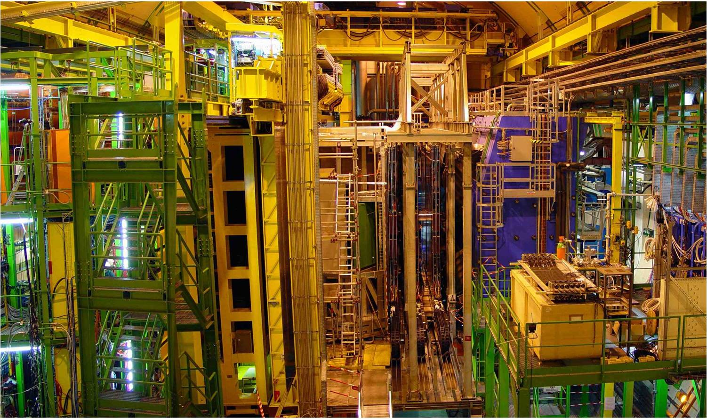
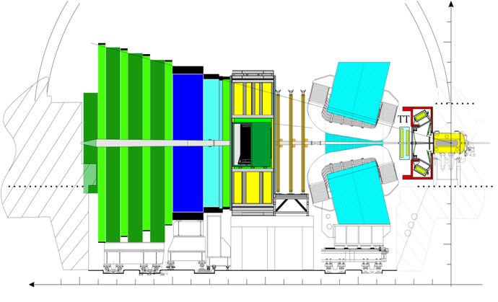
LHCb detector
K. Vervink
Muon Stations
M2-M5
Calorimeters
IT
OT
TT
B decays mainly produced in the forward or backward direction
VELO
Sub detectors used in the first level of the trigger.
M1
RICH-2
Magnet
RICH-1
Detector fully equipped and commissioned.
Physics goal: search for New Physics in B decays in LHCb.
See also talk at plenary by A. Golutvin ”LHCb”
  – Wednesday 22nd at 14h30

Slide 3
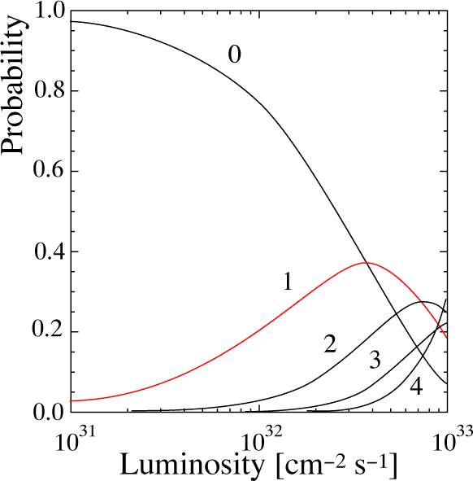
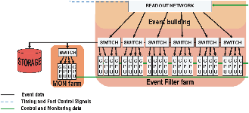
LHCb trigger environment
K. Vervink
Tune luminosity: most probable is 1 interaction/X’ing
10¹² bb per year or 10⁵ per s.
Corresponds to: 40MHz
Both bunches filled: 30MHz
>2 tracks in acceptance: 10MHz
15kHz of B decays with at least 1B in the acceptance
BR of interesting B decays: typically < 10⁻⁵ O(1)Hz
General strategy
First level hardware trigger (L0)
→ Readout netwerk
2) CPU farm (High Level Trigger):
→ Monitoring and storage
Production:
pp-collisions
2-5×10³²cm⁻²s⁻¹
Trigger is essential!!!

Slide 4
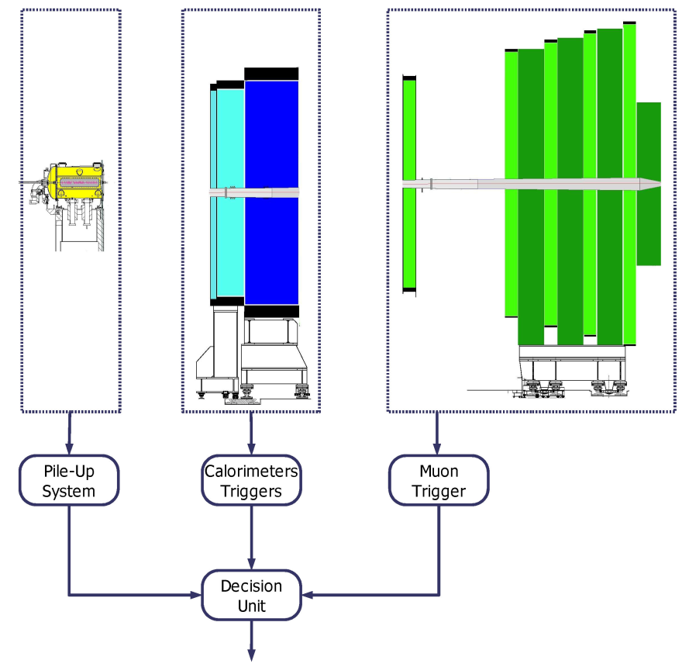
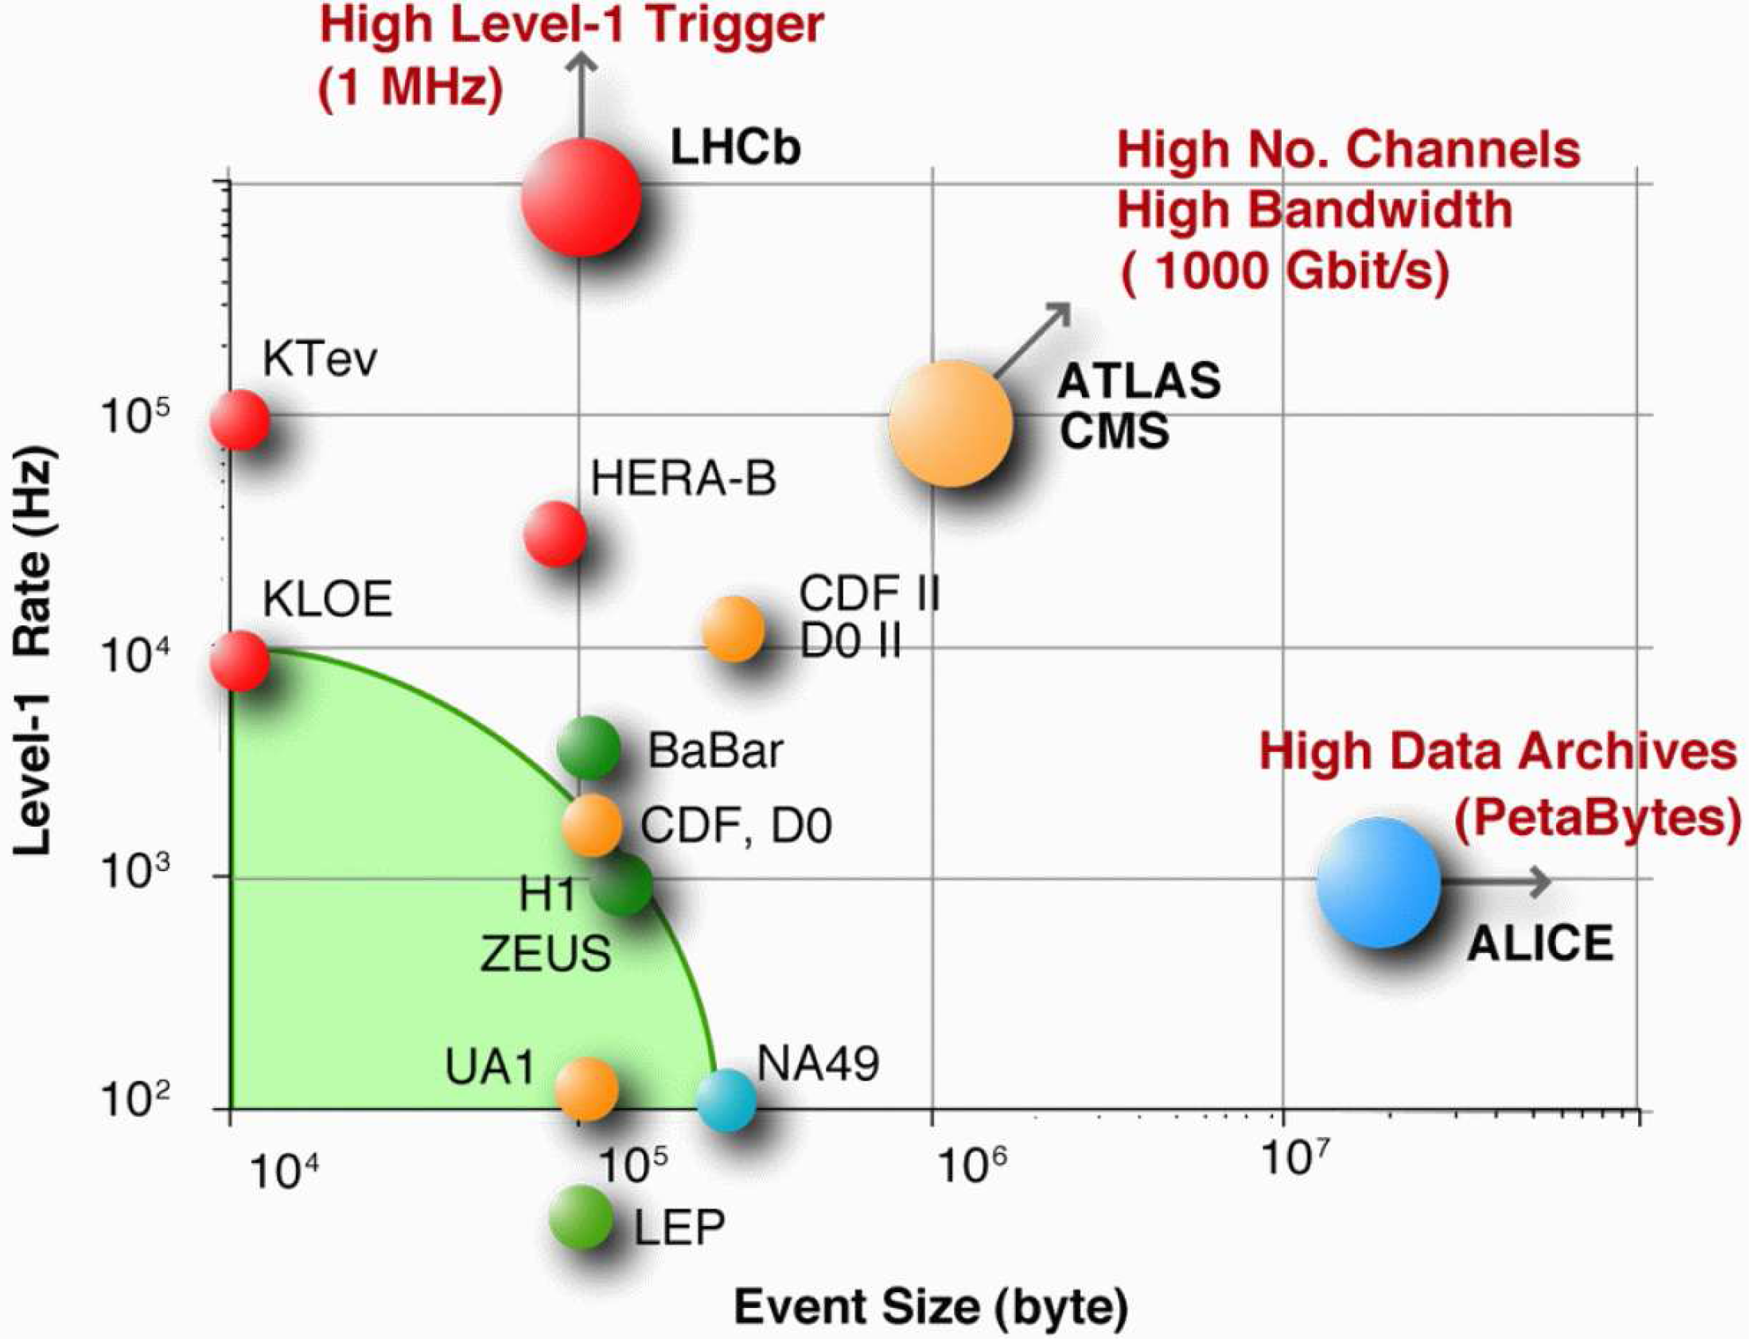
L0 trigger
SPD+PRS+
ECAL+HCAL
Custom Electronics
  4 subdetectors read out and provide L0 trigger
Velo: Pile-up system
Ecal: single e/γ with p_{T} > 2.5 GeV → 200kHz
Hcal: single hadron with p_{T} > 3.5 GeV → 700kHz
Muon: single μ with p_{T} > 1.0 GeV → 200kHz
MUON
VELO
  4 μs fixed latency
LHCb looks for B-mesons, lower mass (and p_{T}) than particles searched for by GPD’s
L0 output is large:
1 MHz
First trigger level rate (Hz)

Slide 5
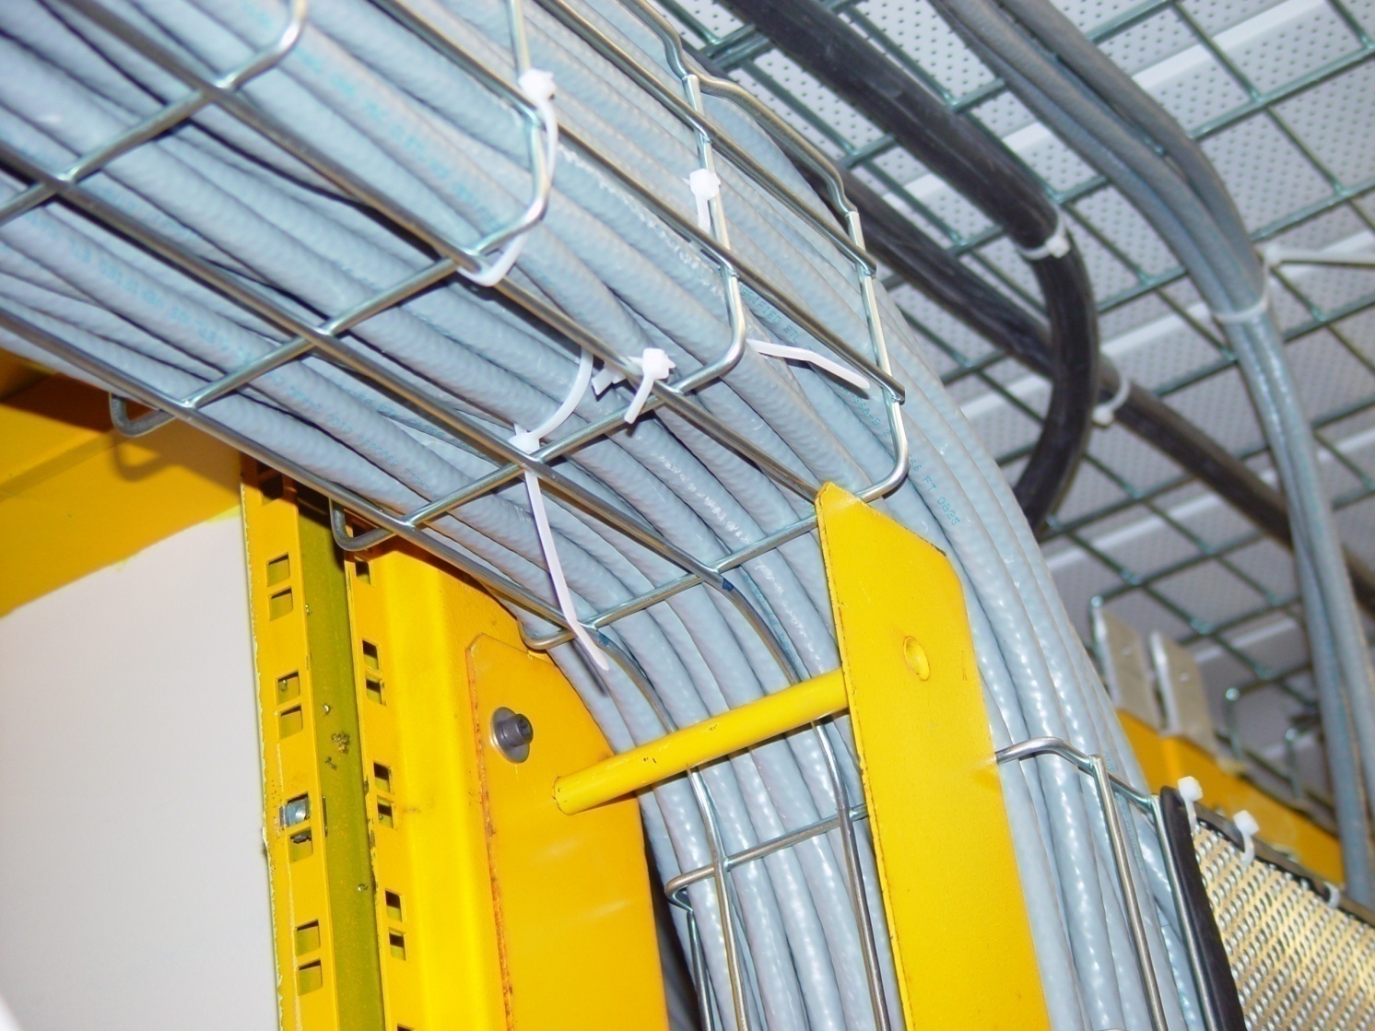
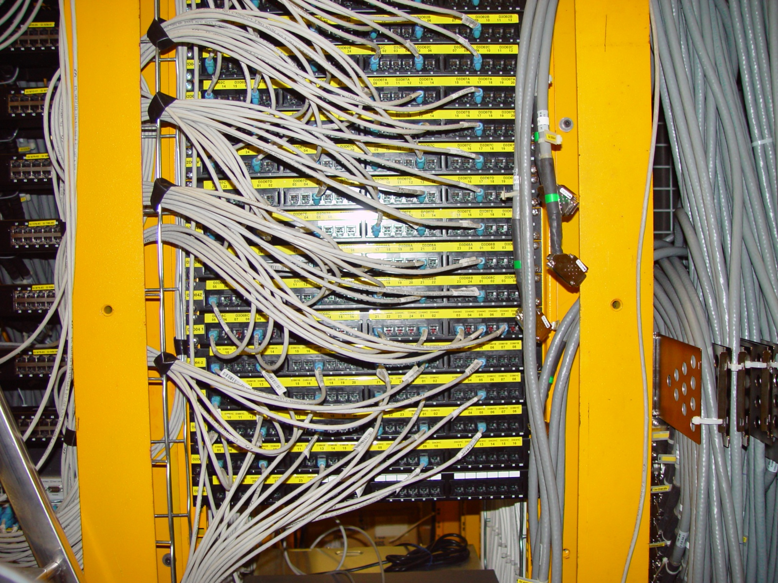
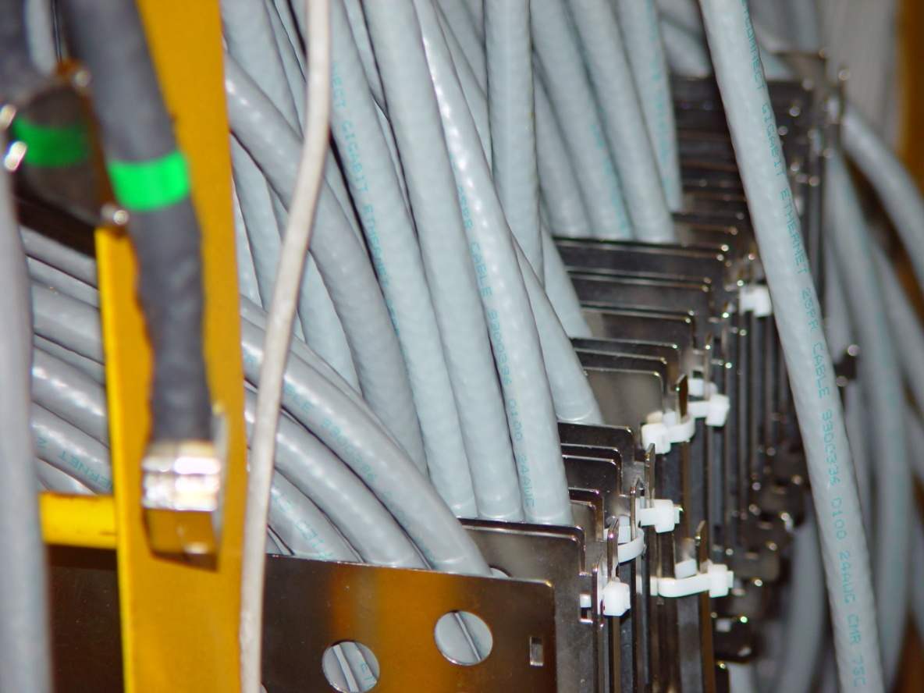
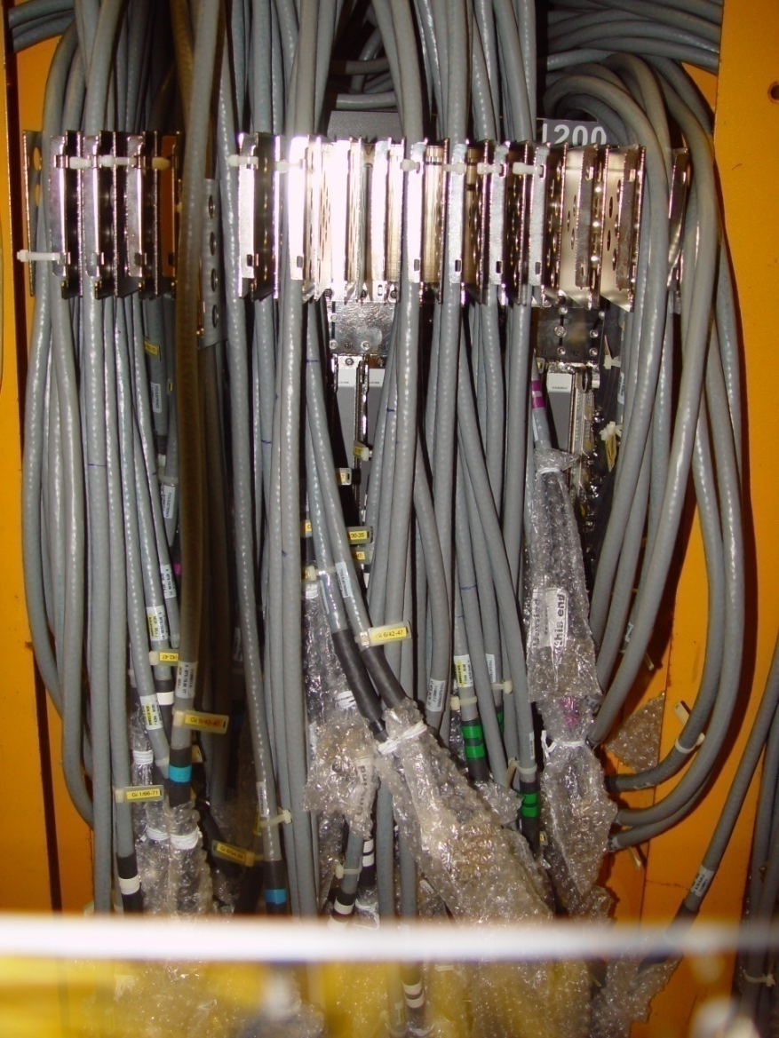
Pictures: Readout Network (Switch)
Glossy-Print
Real Life

Slide 6
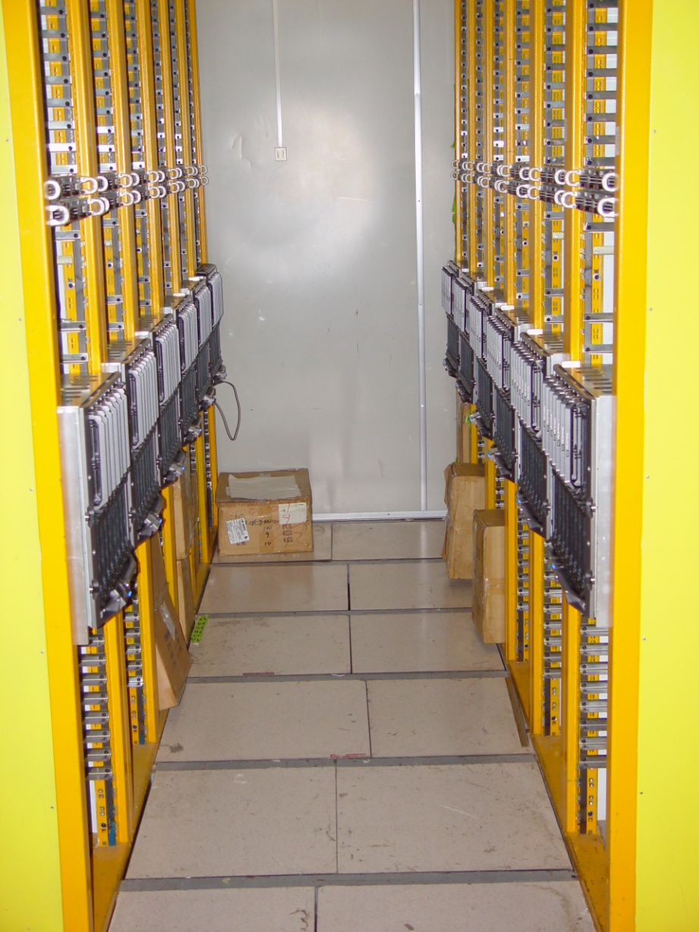
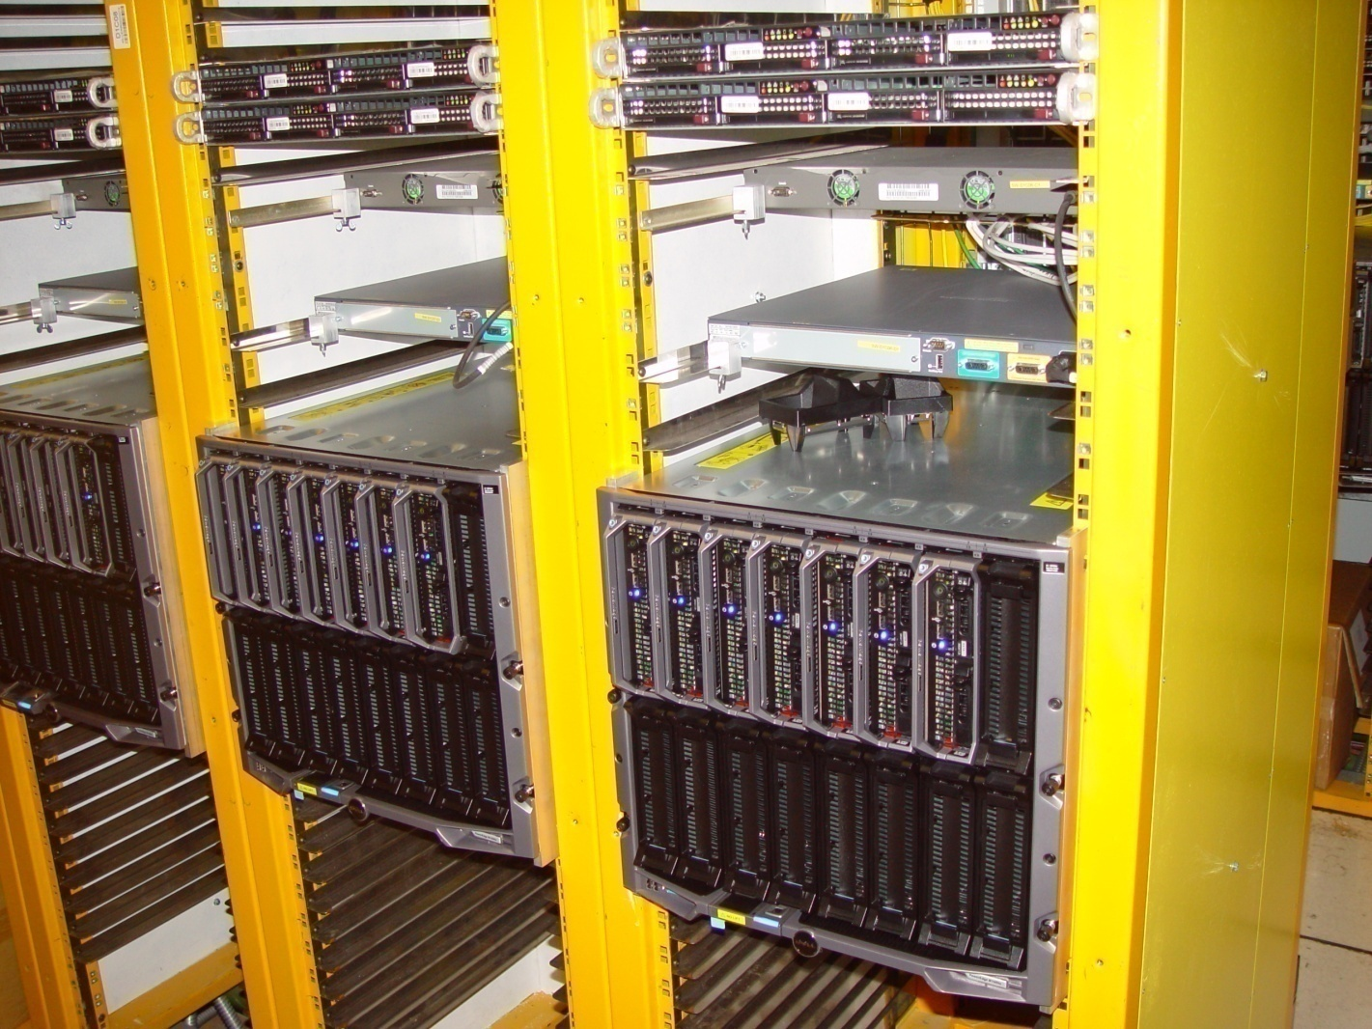
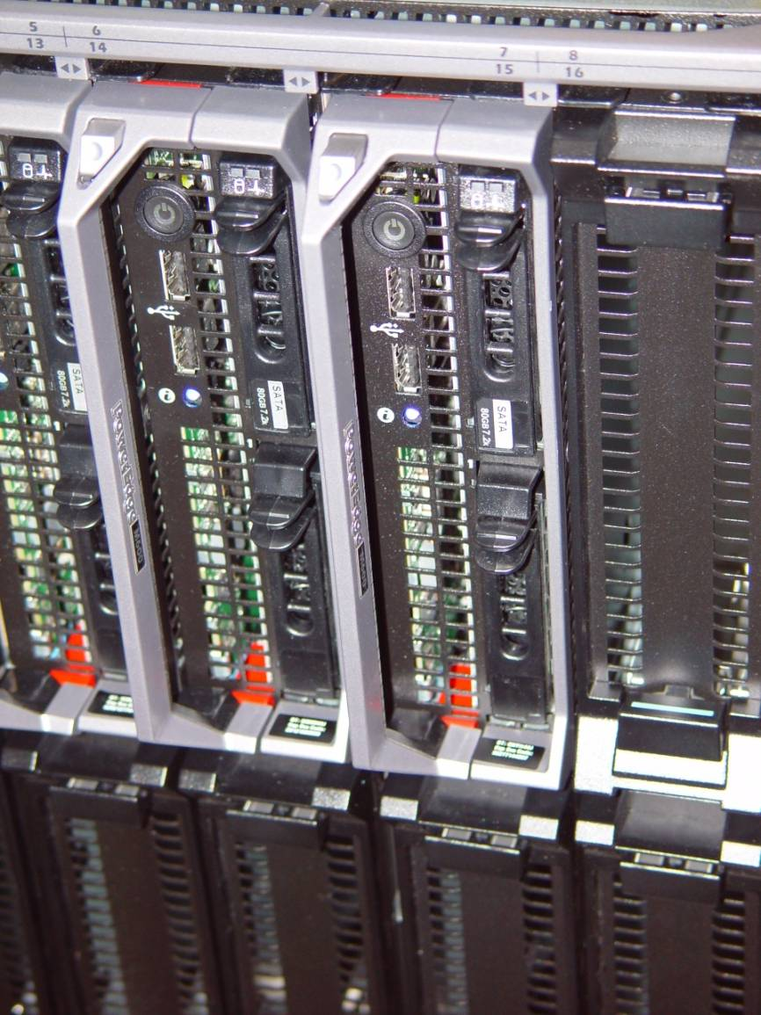
Pictures: CPU Farm (Processors)

Slide 7
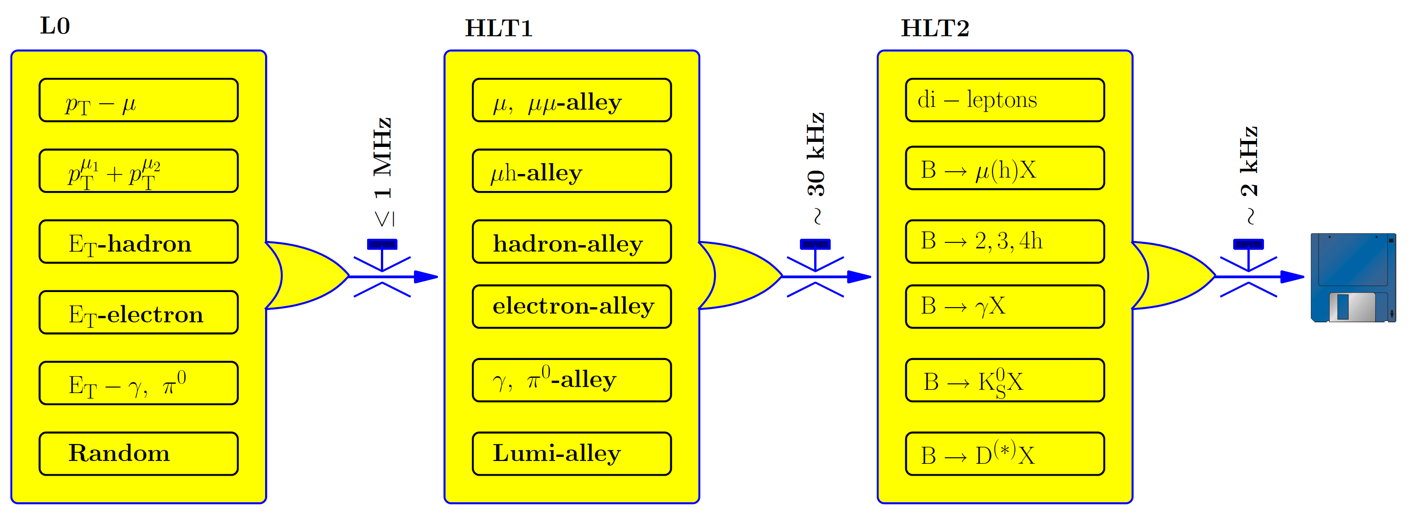
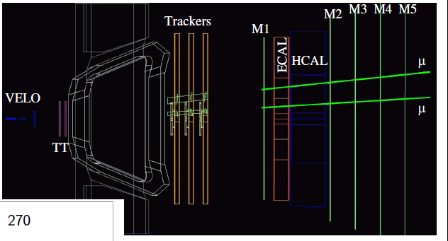
Hlt trigger: 2 layers
7
K. Vervink
L0 alley structure is maintained in Hlt1 and extended in Hlt2
Signal selected by several triggers
optimize robustness
~1 MHz
Hlt1:
confirmation of the L0 object
add information of T stations and Velo search for tracks only in small window
~30 kHz
Hlt2: some additional inclusive trigger streams (K_{s}, φ) and a handful of exclusive selections (ex. B_{s} -> φγ).
~2 kHz

Slide 8
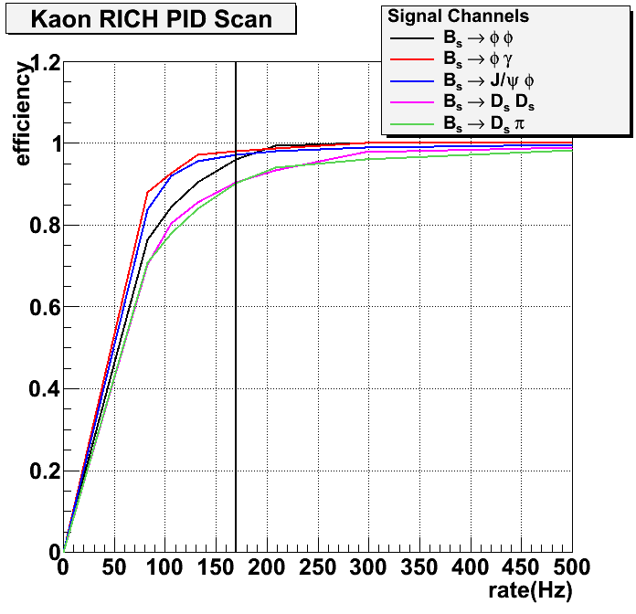
Hlt2 trigger example: the inclusive φ alley
K. Vervink
~30 kHz
tracks from pattern recognition
(no fitting) - apply “robust” cuts: P_{T},
distance to IP, φ mass...
2000 Hz
2. fancier tracking algorithm applied on reduced rate: Kalman fit tracks and apply cuts on track and vertex resolutions.
800 Hz
3. Now with a reduced rate below 1000 Hz,
we can apply the PID algorithm
<200 Hz
Hlt2 Incl. φ efficiency on offline selected events.
75%
45%
55%
82%
40%
25%
Optimized cut
Eff. w.r.t step 2
Rate (Hz)
Channels will also be triggered
by other incl. trigger lines

Slide 9
Trigger performance on rare decays:
1.) B⁰ → K* μμ
2.) B_{s} → φγ .
See also: Search for New Physics at LHCb:
CP violation in Charm sector and rare decays of B hadrons
(M. H. Schune)
II Flavour Physics – Friday 17th at 10h00
NOTE: trigger efficiencies quoted for offline selected events.

Slide 10
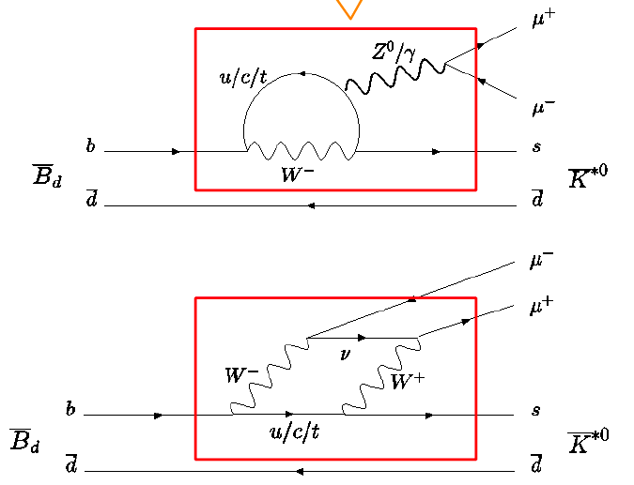
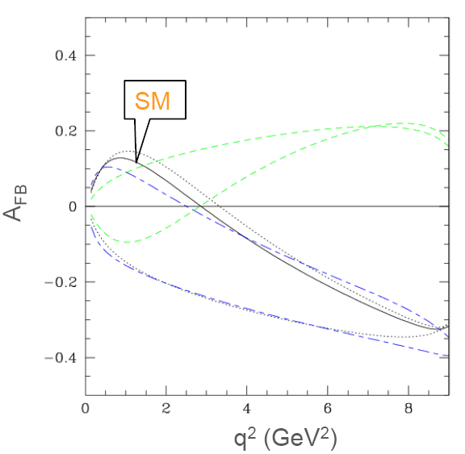
B⁰ → K*μμ
FCNC decay which proceeds through a b→s transition. New Physics can enter in the loops of the diagram.
Decay described by three angles (θ_{l}, φ, θ_{K}) and di-μ invariant mass q².
By measuring angular distribution asymmetries, the uncertainty from B⁰→K*μμ transition form-factors cancel.
Start with forward-backward asymmetry A_{FB} of θ_{l} distribution and compare with the SM prediction.
Analysing simultaneously the three angular distributions as function of q² gives sensitivity to each of its Wilson coefficient.
0-xing point
Ali et al, Phys. Rev. D61:074024, 2000

Slide 11
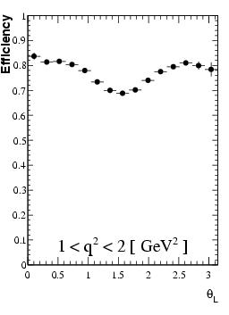
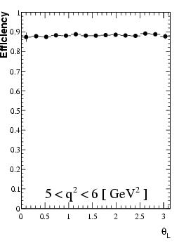
K*μμ through the trigger: μ and hadron alley
The muon alleys are main trigger line but beware of soft muon signal.
Cuts on P_{T} affects the angular distribution.
Single muon: - P_{T} muon > 1.3 GeV
- only required for 1 muon
Di-muon: - P_{T} of each > 0.1 GeV
- sum of P_{T}>1.0 GeV
Hadron
L0 efficiency: ~90%
Level 0
μ p_{T} > 1.3GeV
Hlt1 Hlt2t
(Di) Muon alley: - P_{T} cut, IP (and di-muon mass) eff: ~83% eff: 80%
Muon + track alley: - 2nd μ can have low p_{T} eff: ~80% eff: 85%
Hadron alley: eff: ~20% eff: 80%
Hlt 1 + 2
L0 x Hlt1 x Hlt2 efficiency on offline selected events: 80%.

Slide 12
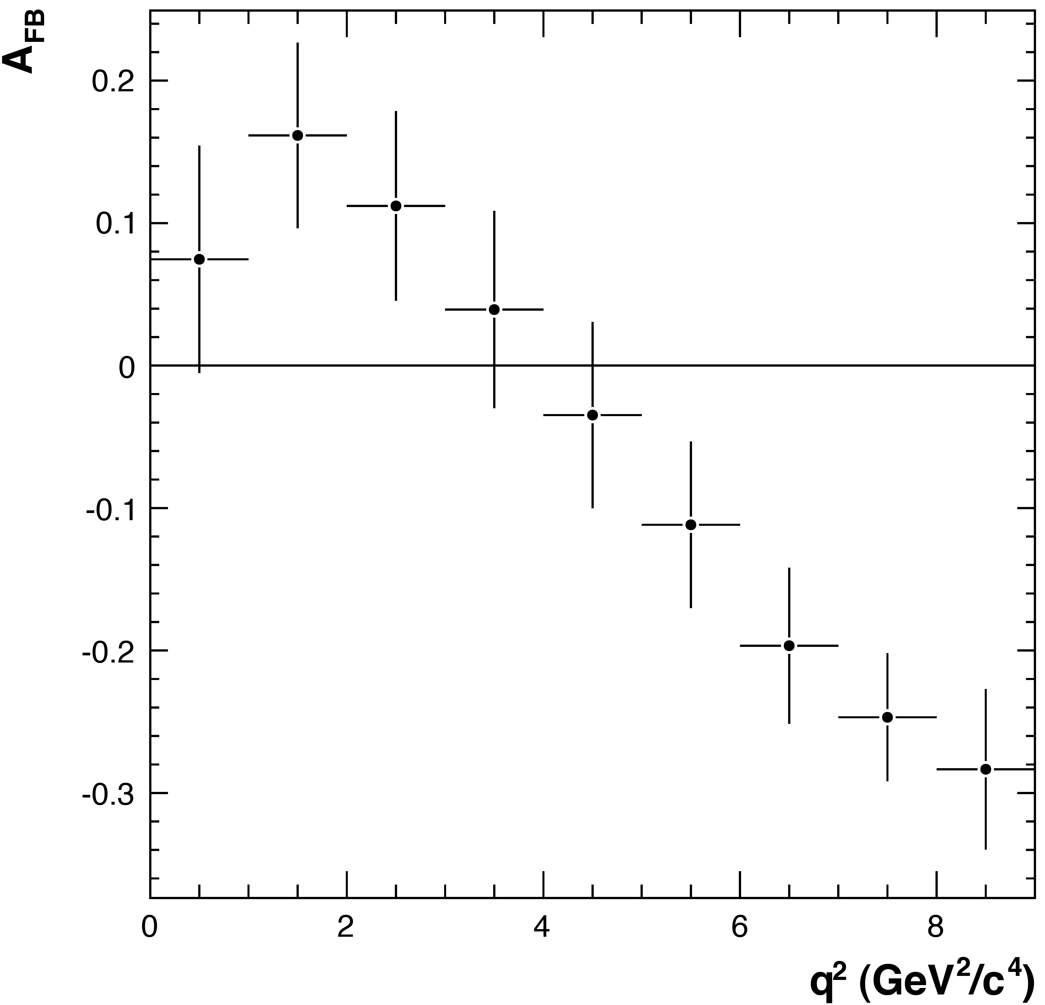
Distortion of acceptance function
Trigger and offline selection and the detector resolution affects the angular distribution θ_{l}.
  Zero-crossing point of A_{fb} stays intact!!
Parameterize the acceptance function
1. MC simulation: The momentum distribution of B_{d} needs to be accurately generated.
  Cross check with B⁰ -> J/ψ K*.
2. Control sample: B⁰ -> J/ψ K*: triggered and selected by the same filters as the signal -- but 20 times more statistics and no A_{fb} asymmetry.
2fb⁻¹:
Expected number of signal events: 4300
Precision on determining the
zero-crossing: ±0.5 GeV²
Statistical uncertainty on A_{fb}(q²): ~0.6 GeV²
BELLE has ~230 K*ll events (657M BB) [1]
CDF ~20 K*μμ events (0.9fb⁻¹) [2]
2fb⁻¹
[1] arXiv:0810.0335v1
[2] arXiv:0804.3908v1

Slide 13
Trigger performance on rare decays:
1.) B⁰ → K* μμ
2.) B_{s} → φγ .

Slide 14
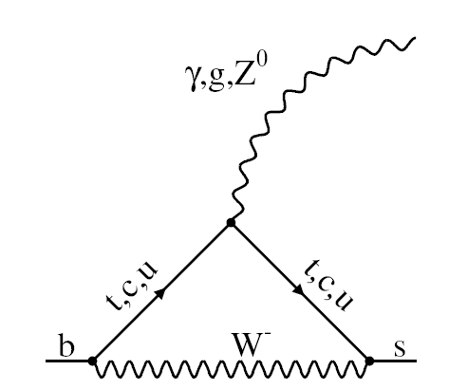
Probe New Physics in loop which would modify the
photon polarisation.
Measure the time-dependent decay rate:
Decay described by proper-time (t) but not by tagging
Reliable theoretical prediction at NNLO

Slide 15
Probe New Physics in loop which would modify the
photon polarisation.
Measure the time-dependent decay rate:
Decay described by proper-time (t) but not by tagging
Reliable theoretical prediction at NNLO

Slide 16
through the trigger: γ and hadron alley
Photon alley: eff*: ~72%
E_{T}(γ) > 2.3 GeV, E_{T}(e) > 2.6 GeV, E_{T}(π⁰)> 4.3 GeV
Hadron alley: E_{T} > 3.5 GeV eff*: ~36%
L0 efficiency: ~82%
Photon alley = photon + 1 or 2 track(s): eff*:~60%
fast p⁰/γ separator algorithm
track: requirements on p_{T}, IP distance, vertex quality
Hadron alley eff*:~15%
L0 x Hlt1 efficiency: ~60%
Exclusive B_{s} -> φγ line: eff*: ~88%
offline selection procedure with relaxed cuts
Inclusive phi alley: eff*: ~83%
P_{T} (K and φ) and PID, IP, mass window
L0 x Hlt1 x Hlt2 efficiency: ~57%
Level 0
Hlt 1
Hlt 2
∗ on offline selected events (which passed L0 (+ Hlt1) trigger)

Slide 17
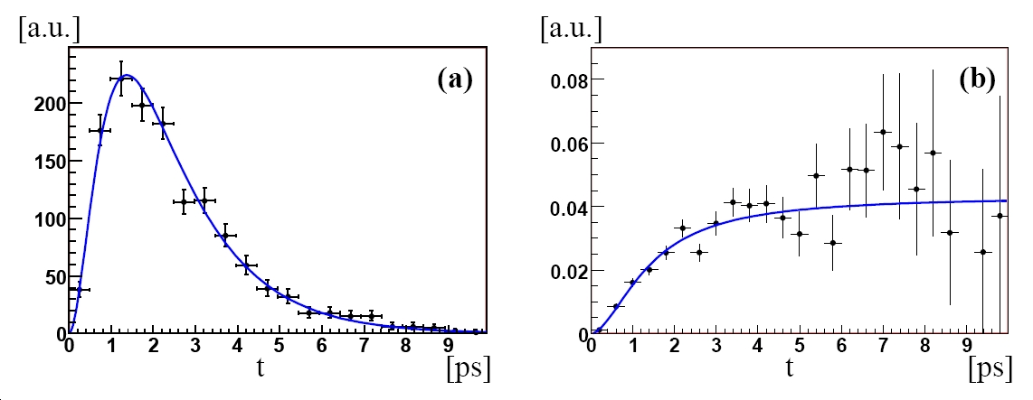
Distortion of the proper-time distribution
Both trigger selection and offline selection cut on IP distance of φ to reduce the prompt background.
Affects the B_{s} proper-time distribution
Acceptance function: ε=ε(t)
  Use control sample B⁰→K*(K⁺π⁻)γ
  Follows the same trigger flow
  as the signals.
    Statistics are ~factor 6 higher.
t
ε(t)
2 fb⁻¹
Expect 11x10³ selected signal events
stat. error on A^{Δ} = ~0.2
Belle [1]:
18⁺⁶₋₅ signal events on 24 fb⁻¹
BF (B_{s} →φγ)= 57⁺¹⁸₋₁₅(stat)⁺¹²₋₁₁(syst) 10⁻⁶
[1]PRL 100, 121801 (2008)

Slide 18
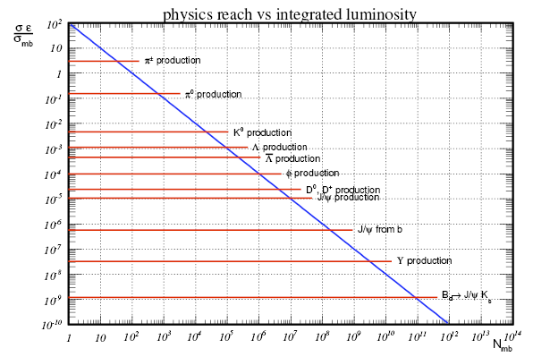
Trigger during first data
Trigger settings has to allow for trigger commissioning
Random event selector trigger
  Monitor the distributions at L0 entrance
L0 trigger + Random event selector in Hlt1:
  Monitor the distributions of variables we will cut on in Hlt
Events passing the full trigger:
  Monitor the online environment using offline reconstruction
  Trigger efficiencies vs. offline
First day(s) data collection
B-Trigger
needed
observation rate
100 signal evens
« Minibias statistics to perform a 10% measurement »

Slide 19
Summary
Critical aspect of LHCb is isolating rare decays in the LHC environment.
Trigger consist of
  a hardware trigger which search for high P_{T} events.
  and a software “High Level Trigger” based on software algorithms in a CPU farm.
Trigger efficiencies of 80% and 60% for B⁰→K*μμ and
B_{s} → φγ respectively are obtained.
With control samples we can study and correct for the introduced biases on acceptance function or lifetime distribution.
Finally strategy for trigger commissioning is discussed
We are ready for data...

Slide 20
Other LHCb talks at EPS
Commissioning and performance of LHCb vertex detector (T. Bowcock)
  IV Detectors & accelerators – Thursday 16th at 10h00
Measurements of CP violation and CKM matrix at LHCb (M. Calvi)
  II Flavour Physics – Thursday 16th at 11h30
New Physics sensitivity of the rare decay mode B->Kl⁻l⁺ (T. Hurth)
  II Flavour Physics – Friday 17th at 9h30
Search for New Physics at LHCb: CP violation in Charm sector and rare decays of B hadrons (M. H. Schune)
  II Flavour Physics – Friday 17th at 10h00
Nonleptonic charmless Bc decays and their search at LHCb (S. Descotes Genon)
  II Flavour Physics – Saturday 18th at 10h05
LHCb (A. Golutvin) –
  Plenary session – Wednesday 22nd at 14h30

