Slide 1
Charm production in high-energy p+A & A+A collisions
Cold nuclear matter effects from SPS to RHIC
Charm in heavy ion collisions
– Torsten Dahms –
CERN
EPS Conference on High Energy Physics
Kraków, July 16th, 2009

Slide 2
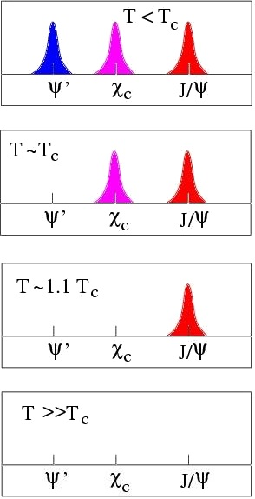
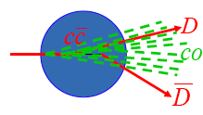
Motivation
Charm as a probe of the QGP
J/ψ suppression: golden signature of the QGP
Charmonia as thermometer
Open charm
Heavy quark energy loss in medium
Reference for charmonium suppression
Cold nuclear matter effects important for interpretation of HI measurements
Nuclear PDFs, initial state parton energy loss, final state absorption (σ_{abs}), etc.

Slide 3
1. Cold nuclear matter effects from SPS to RHIC

Slide 4
Charm production at E866…
Fixed target p-A collisions at 800 GeV
Broad rapidity coverage
σ_{pA} = σ_{pp} A^{α}
Mid-rapidity (y<0.5):
J/ψ strongly absorbed
No nuclear effects on open charm
→ At mid-rapidity, final state effects dominate the changes to the per-nucleon cross sections (and kinematics)
Forward rapidity:
Strong reduction of the J/ψ and open charm per-nucleon production cross sections
→ Strong indication of initial state effects
Nuclear modification of PDFs?
Initial state gluon energy loss?

Slide 5
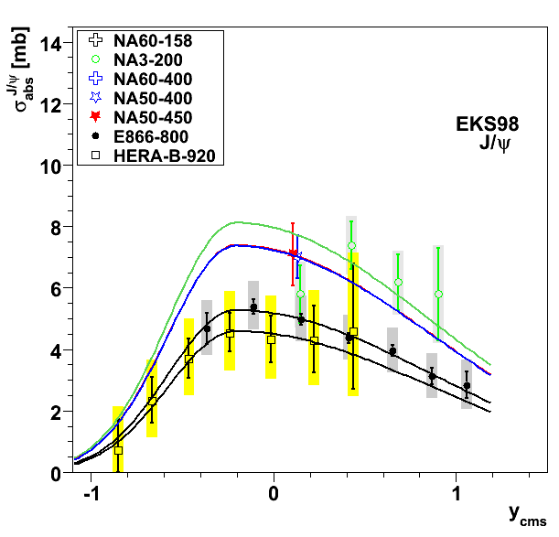
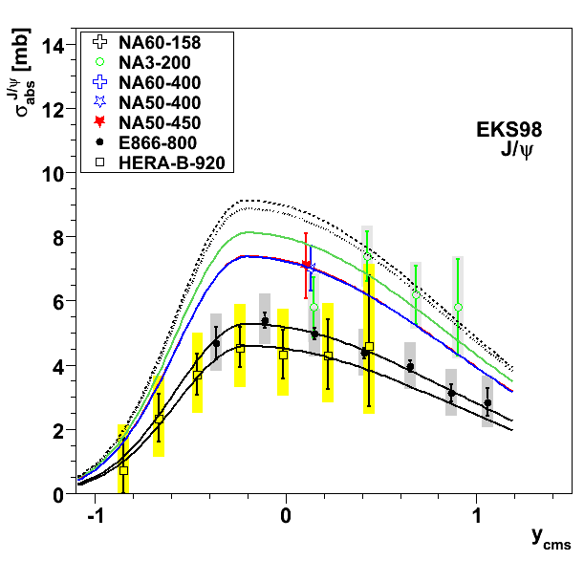
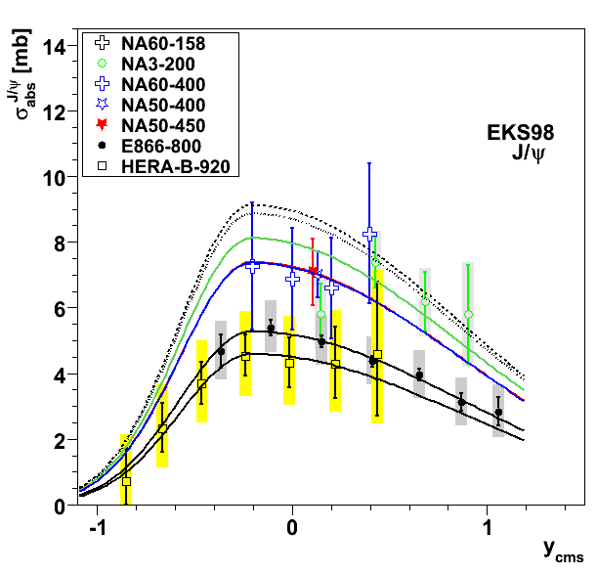
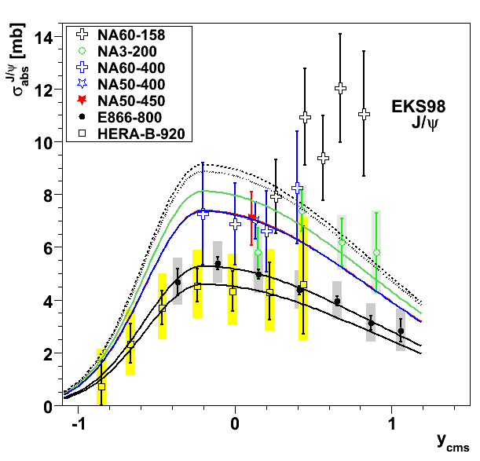
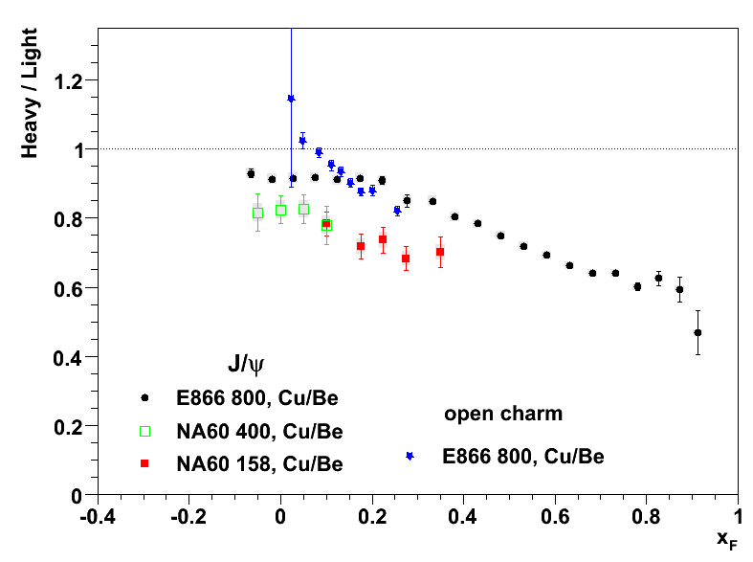
…at SPS and HERA-B…
JHEP 02 (2009) 014
NA3, NA50, E866, HERA-B (200, 400/450, 800, 920 GeV)
Similar J/ψ trend as E866 in p-A:
Changes with J/ψ rapidity & collision energy
How do new NA60 data at fit into the game?
Prediction for 158 GeV shown as black dotted line
NA60 data at 400 GeV agree well with previously established trend
NA60 data at 158 GeV are generally higher than expected (besides the first point)
Different physics at forward rapidity than just nuclear absorption?
But similar trend also observed for open charm, ergo initial state effects…?
Non-trivial cocktail of initial and final state effects
Cu/Be vs. x_{F}

Slide 6
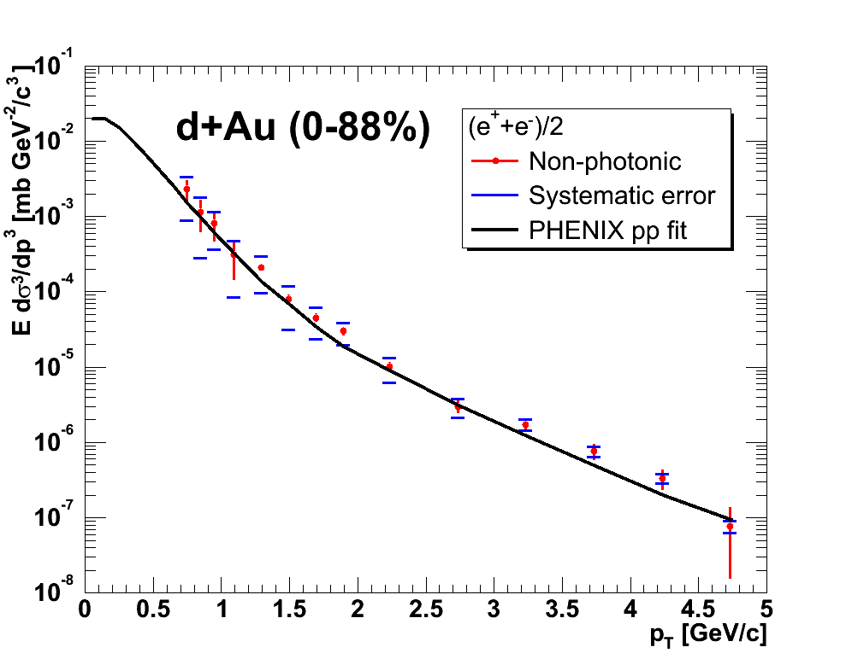
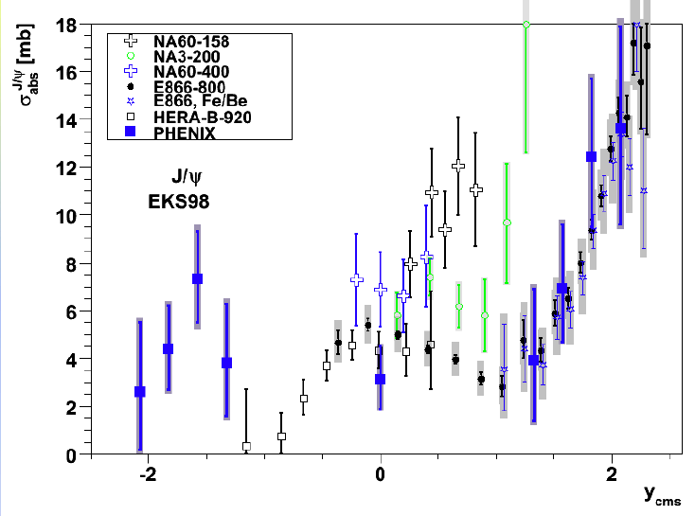
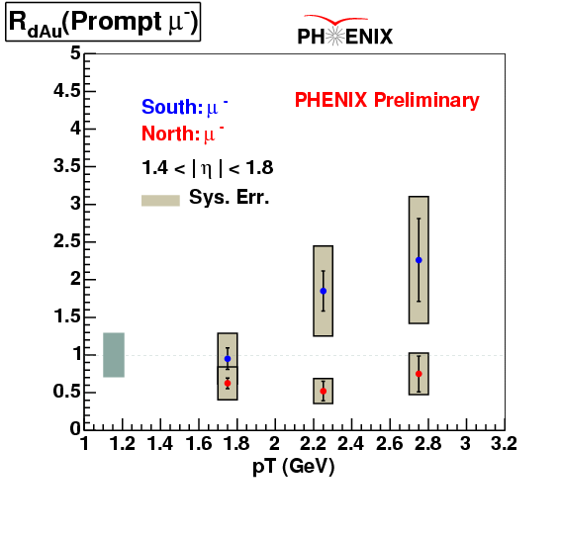
…and at RHIC?
Collider with √s = 200 GeV p+p, d+Au (+heavy ions)
J/ψ in d+Au central vs. peripheral shows significant increase of “absorption” at forward rapidity
As seen by E866, NA3, … → energy loss as well?
If so, should also affect open charm
Existing data of non-photonic leptons from semi-leptonic open charm decays have large uncertainties, but indicate the same trend
Should be seen in new data (Run 8) analysis is ongoing
|y|<0.35
PHENIX Preliminary
PHENIX Preliminary
RHIC 2008
d+Au at √s_{NN} = 200 GeV
y<0
y>0

Slide 7
2. Charm in heavy ion collisions

Slide 8
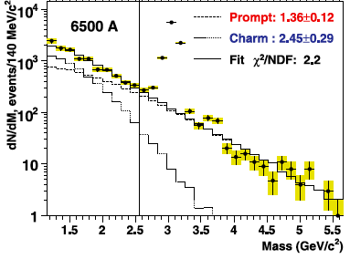
NA60: open charm in In-In
EPJ C 59 (2009) 607
NA60 measured dimuon continuum in In-In collisions at the SPS at 158 GeV
With vertexing able to distinguish non-prompt from prompt dimuons in the intermediate mass region (1.16–2.56 GeV)
Non-prompt:
From simultaneous semi-leptonic decays of charmed mesons
Two times larger charm cross section than the world average (based on fully reconstructed D → π K decays)
Open charm in p-p needed

Slide 9
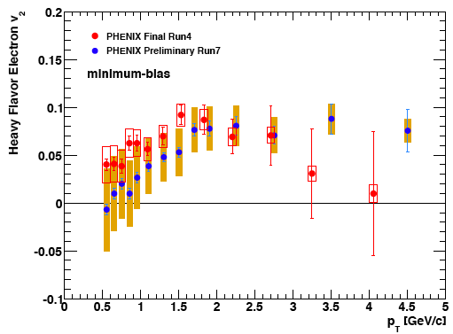
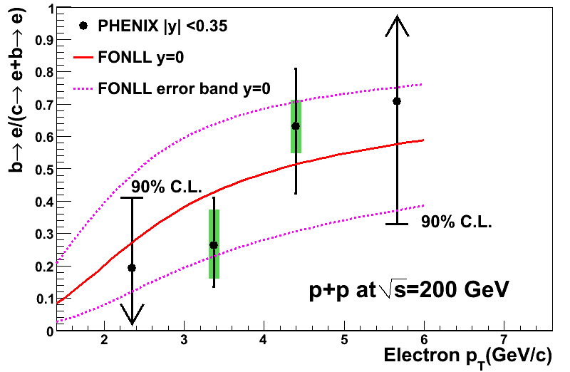
RHIC: open charm in Au+Au
PHENIX, PRL 98 (2007) 172301
STAR, PRL 98 (2007) 192301
PHENIX & STAR have measured non-photonic single electrons in p+p and Au+Au collisions at √s_{NN} = 200 GeV
STAR measures 2× larger open charm cross section than PHENIX both in p+p and Au+Au (cancels in R_{AA})
Both measure high p_{T} suppression of electrons from semi-leptonic open charm (& beauty?) decays
Significant elliptic flow
Final state effect: strong coupling of heavy quarks to the medium
Where does beauty become important?
b/(c+b) measured via e-h correlations in p+p
arXiv:0903.4851

Slide 10
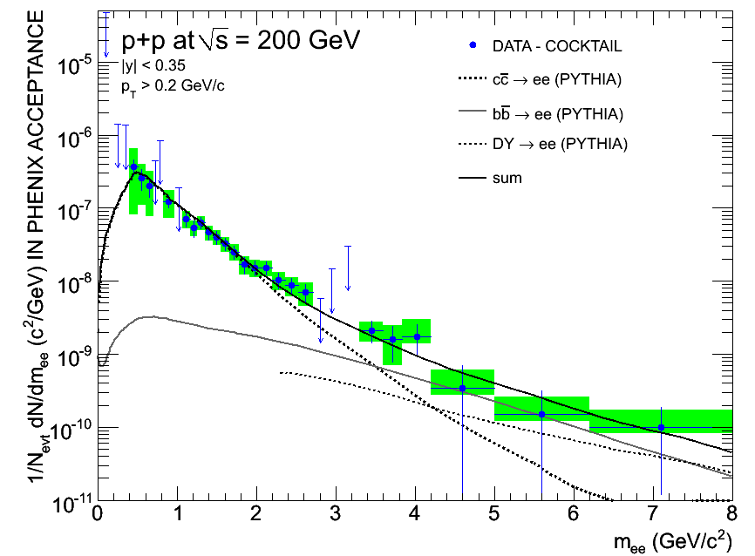
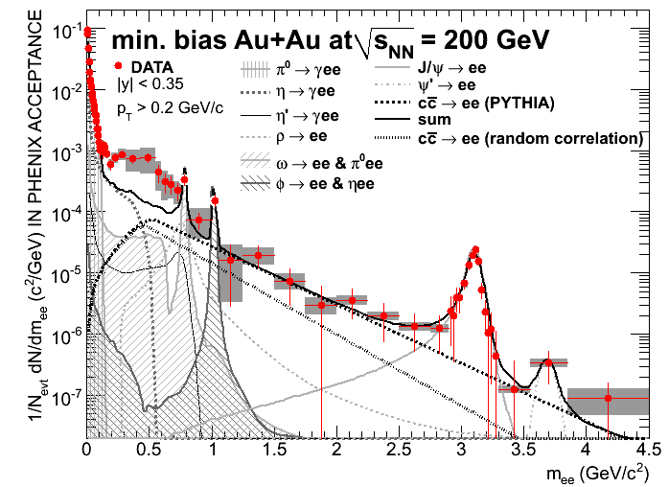
PHENIX: open charm in dielectrons
PHENIX has measured dielectrons in p+p and Au+Au collisions at √s_{NN} = 200 GeV
p+p:
IMR shape in excellent agreement with PYTHIA
Total charm and beauty cross section: σ_{cc} = 544 ± 39 (stat) ± 142 (syst) ± 200 (model) µb σ_{bb} = 3.9 ± 2.5 (stat) ⁺³₋₂ (syst) µb
In very good agreement with PHENIX result from non-photonic single electrons: σ_{cc} = 567± 57 (stat) ± 193 (syst) µb
Au+Au:
IMR in apparent agreement with PYTHIA scaled to total cross section of σ_{cc} = 567µb × N_{coll}
But we know that open charm is heavily modified
Toy model: randomized correlation of c and cbar is much softer
Would leave room for thermal photons from qqbar
We know they should be there, because PHENIX has measured thermal photons at very low mass from qg Compton scattering and NA60 (SPS) has seen them
PLB 670 (2009) 313
arXiv:0706.3034

Slide 11
Summary
Cold Nuclear Matter Effects
Charm production in p-A collisions at forward rapidity seems to probe initial state effects (similar behavior of closed and open charm)
Mid-rapidity different for open and closed charm
→ shows non-trivial cocktail of initial and final state effects
Charm in heavy ion collisions
Single electrons from semi-leptonic open charm decays suppressed at high p_{T} in Au+Au collisions at RHIC (+ significant elliptic flow) → attributed to heavy quark energy loss in the hot and dense medium
Dielectrons in IMR from correlated open charm decays in Au+Au collision consistent with no modification in shape with respect to p+p → a fortunate cancelation of modified open charm + thermal radiation from qqbar annihilation?

Slide 12
Outlook
RHIC II
Will provide increased luminosities to study rare processes with higher statistics
Detector upgrades in PHENIX and STAR will enable vertexing and improved beauty/charm separation
Will hopefully resolve factor 2 difference in charm cross section measurements by PHENIX and STAR
The LHC
Higher √s → even higher production rates of rare processes
Will allow quantitative measurements of the ϒ family
ALICE will measure hadronic decays of D mesons
CMS will measure beauty through displaced J/ψ over large y range
Open and closed charm and beauty measurements (J/ψ, ψ’, χ_{c}, ϒ(1S), ϒ(2S), ϒ(3S), and χ_{b}) will allow us to perform a more systematic study of heavy flavor production and suppression than ever before…

Slide 13
References
Lourenço, Vogt, Wöhri, “Energy dependence of J/ψ absorption in proton-nucleus collisions”, JHEP 02 (2009) 014
NA60, “Evidence for the production of thermal muon pairs with masses above 1 GeV/c² in 158 A GeV indium-indium collisions ”, EPJ C 59 (2009) 607
PHENIX, “Energy Loss and Flow of Heavy Quarks in Au+Au Collisions at √s_{NN} = 200 GeV ”, PRL 98 (2007) 172301
STAR, “Transverse Momentum and Centrality Dependence of High-p_{T} Nonphotonic Electron Suppression in Au+Au Collisions at √s_{NN} = 200 GeV”, PRL 98 (2007) 192301
PHENIX, “Measurement of Bottom versus Charm as a Function of Transverse Momentum with Electron-Hadron Correlations in p+p Collisions at √s = 200 GeV” (2009), arXiv:0903.4851
PHENIX, “Dilepton mass spectra in p+p collisions at √s = 200 GeV and the contribution from open charm”, PLB 670 (2009) 313
PHENIX, “Enhancement of the dielectron continuum in √s_{NN} = 200 GeV Au+Au collisions” (2007), arXiv:0706.3034
PHENIX, “Enhanced production of direct photons in Au+Au collision sat √s_{NN} = 200GeV” (2008), arXiv:0804.4168

Slide 14
Backup

Slide 15
PHENIX Open Charm (µ±)
PHENIX Preliminary

Slide 16
PHENIX Open Charm (e±)

Slide 17
STAR Open Charm (e±)

Slide 18
PHENIX Thermal Photons
arXiv:0804.4168

Slide 19
PHENIX J/ψ
PRL 96 (2006) 012304

