Slide 1


“QCD tests at NA48/2”
EPS_09 Krakow 16.7.2009
Gianluca Lamanna
Scuola Normale Superiore and INFN Pisa
On behalf of the NA48/2 collaboration:
Cambridge, CERN, Chicago, Dubna, Edimburgh, Ferrara, Florence,
Mainz, Northwestern, Perugia, Pisa, Saclay, Siegen,
Turin, Vienna

Slide 2
Outline
NA48/2 experimental setup
QCD tests
  ππ scattering lengths (Ke4 and Cusp) (preliminary!)
  K±→π±γγ : BR (preliminary!)
  K±→π±γe⁺e⁻ : BR and Shape (final!)
Conclusions
NA48
NA48/1
NA48/2
NA62
>2010 K->πνν

Slide 3
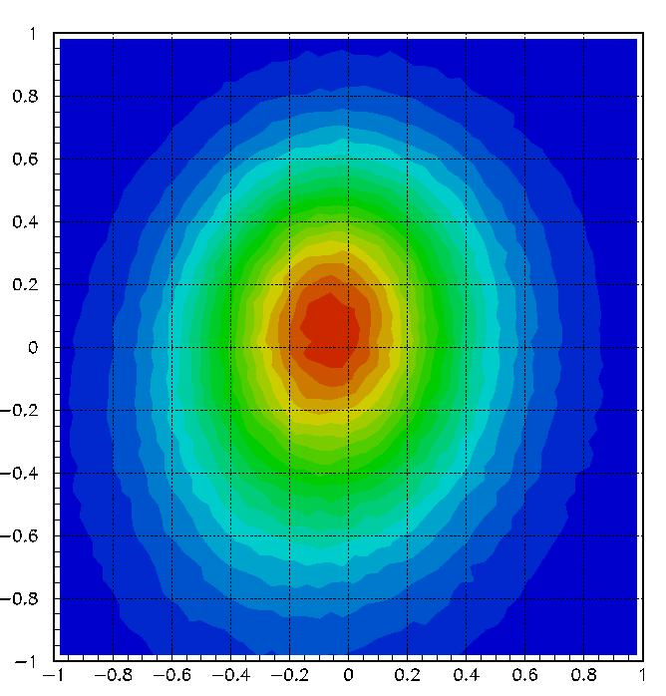
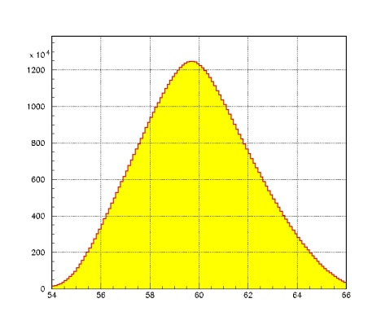
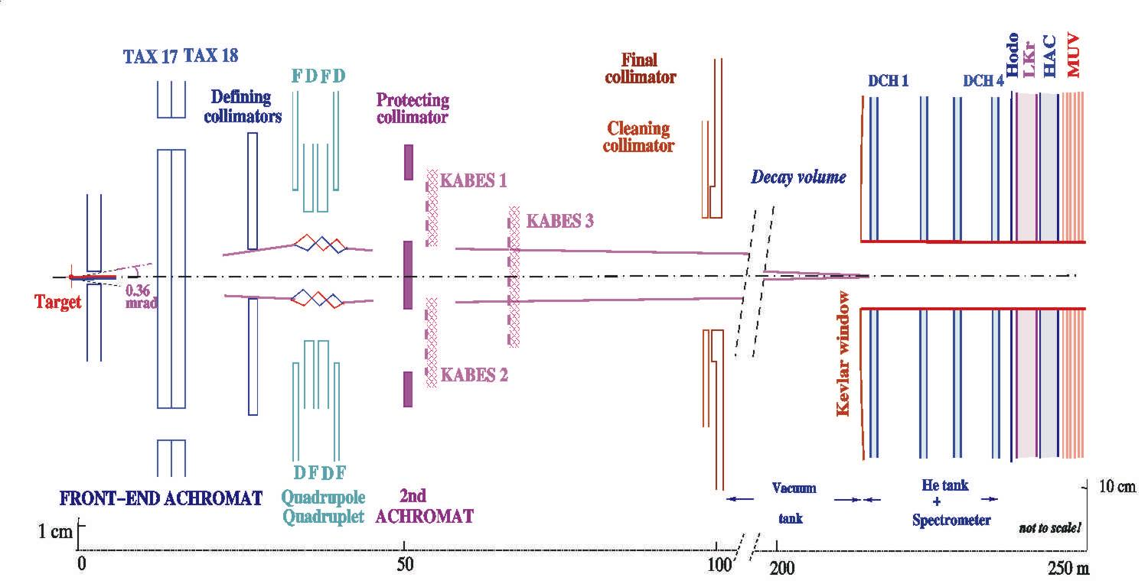
Beam Line
Width ~ 5mm
P_{K} spectra,
60±3 GeV/c
K+/K- ~ 1mm
54 60 66
K⁺
SPS protons @ 400 GeV
BM
K⁻
fixed target experiment at CERN-SPS
60±3 GeV/c kaon momentum (~7x10¹¹ ppp)
6.3 x 10⁷ particles per pulse in decay region
Simultaneous, unseparated, focused beams
Similar acceptance for K+ and K- decays
K+/K- ~ 1.8

Slide 4
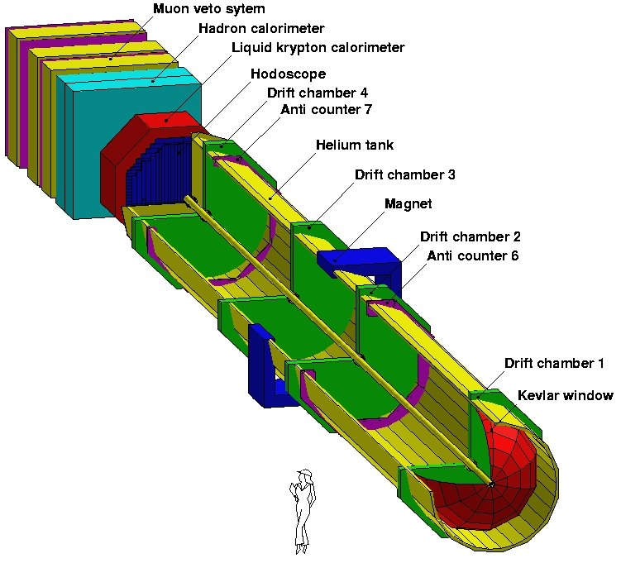
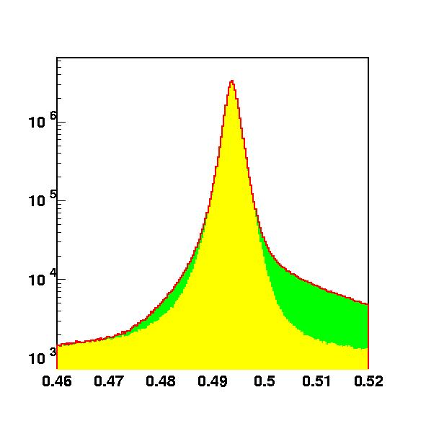
Detector
Spectrometer:
σ_{p}/p = 1.0% + 0.044% p [p in GeV/c]
LKR calorimeter:
σ_{E}/E = 3.2%/√E + 9%/E + 0.42% [E in GeV]
CHOD, HAC,MUV, vetos
Kabes
Beam Monitor
~100 m long decay region in vacuum
Triggers based on LKr peaks, CHOD hits and DCH multiplicity
Similar acceptance between K+ and K- beams checked reversing magnetics fields
Pion decay products, from the hadronic beam, remain into the beam pipe
Resolution:
0.9 MeV/c²
π→μ
contribution
π⁺π⁰π⁰ invariant mass, GeV/c²

Slide 5
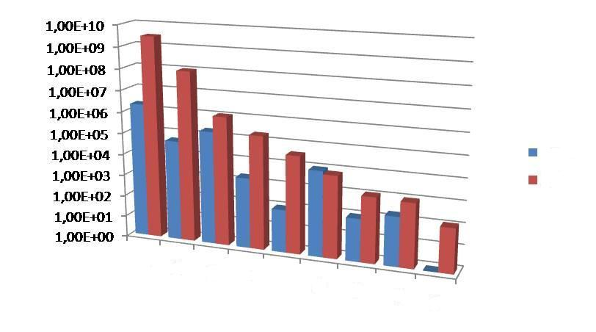
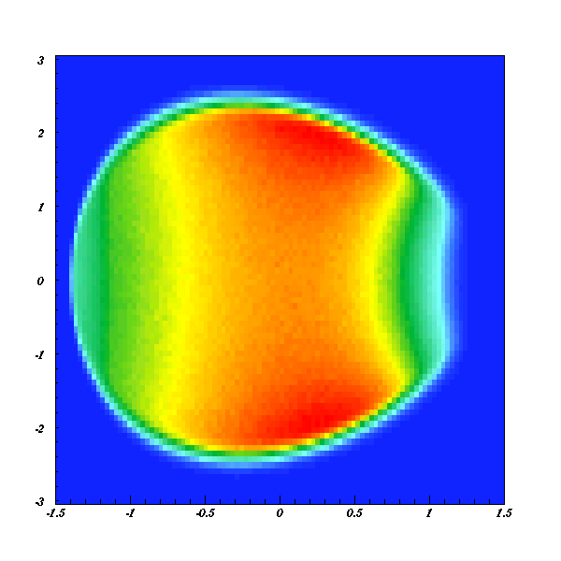
Data Taking
Detector and trigger optimized to collect 3 pions events
K±→π±π⁰π⁰: ~1·10⁸
K±→π±π⁺π⁻: ~3·10⁹
Before NA48/2
NA48/2
π±π⁺π⁻
π±π⁰π⁰
π±π^{ο}γ
Ke4
Ke4n
π±γγ
π±e⁺e⁻
π±μ⁺μ⁺
π±e⁺e⁻γ
v
Unprecedented statistics in many channels
Two years of data taking (2003+2004)
Main purpose was to measure direct CP violation in charged Kaon decays, through asymmetry in Dalitz plot distribution.
New limits on CP violation in charged kaon decays
A_{g}=(-1.5+1.5_{stat}+0.9_{trig}+1.1_{syst})·10⁻⁴
A_{g}⁰=(1.8+1.7_{stat}+0.5_{syst})·10⁻⁴
u
Phys.Lett.B 634:474 482,2006 Phys.Lett.B 638:22-29,2006 Eur.Phys.J C52:875-891,2007

Slide 6
Ke4: Formalism
The Ke4 (K±→π⁺π⁻ e±ν) dynamics is fully described by 5 (Cabibbo-Maksymovicz) variables: M_{ππ}², M_{eν}², cosθ_{π}, cosθ_{e} and φ
In the partial waves expansion the amplitude can be written using 2 axial and 1 vector form factors (the axial form factor R is suppressed in K_{e4} but accessible in K_{μ4}):
F=F_{s}e^{iδs}+F_{p}e^{iδp}cosθ_{π}
G=G_{p}e^{iδp}
H=H_{p}e^{iδp}
The q²=(M_{ππ}²/4m_{π}²)-1 dependence can be studied expanding the fitted form factors assuming isospin symmetry:
F_{s}=f_{s}+f_{s}’q²+f_{s}’’q⁴+f_{e}’(M_{eν}²/4m_{π}²)+...
F_{p}=f_{p}+f_{p}’q²+...
G_{p}=g_{p}+g_{p}’q²+...
H_{p}=h_{p}+h_{p}’q²+...
F (F_{p},F_{s}), G, H and δ=δ_{p}-δ_{s} will be used as fit parameters

Slide 7
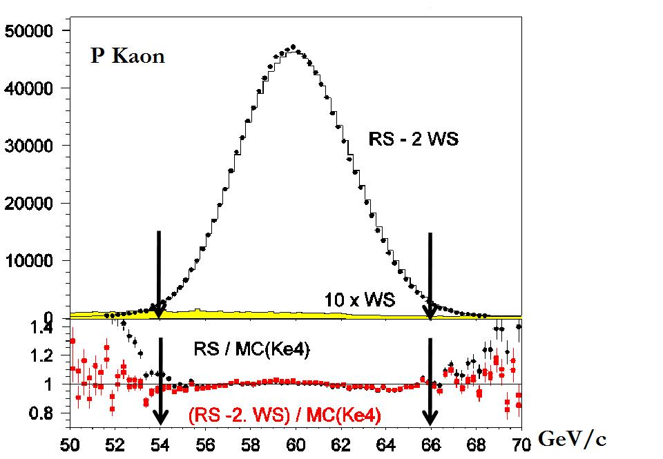
Ke4: Selection
Signal selection:
3 tracks on spectrometer, total charge ±1
Missing energy and missing Pt, compatible with ν
LKr/DCH used for electron PID
2 opposite sign pions
~1150000 decays
Main background sources:
πππ + π→eν
πππ with π misidentified
ππ⁰π⁰ or π⁰ + π⁰(Dalitz) +e misidentified and γs outside the LKr
The background is studied using the electron “wrong” sign (WS) events (we assume ΔQ=ΔS and total charge ±1) and cross check with MC. The total bkg is at level of 0.5%.

Slide 8
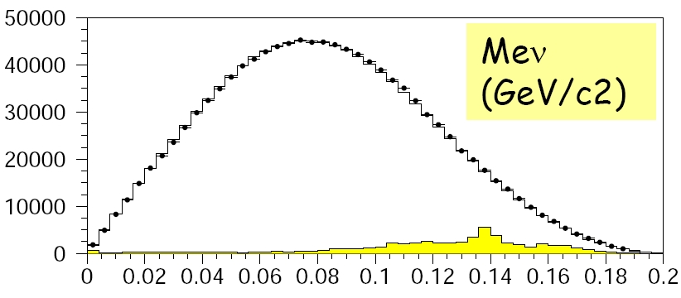
Ke4: Fitting procedure
Define 10(Mππ)x5(Meν)x5(cosθe)x5(cosθπ)x12(φ)=15000 iso-populated boxes
In each Mππ bin the F,G,H and δ form factors are extracted minimizing a log-likelihood estimator over the 1500 boxes
All the form factors are measured relatively to fs (no overall BR measured)
K+ and K- fitted separately, and then the fitted parameters are combined in each Mππ bin
The form factors structure is studied in 10 bins of q² (or M²_{ππ})
Agreement with published results (based on 2003 data) [Batley et al. EPJC 54-3 (2008) 411]
f’_{s}/f_{s} = 0.152±0.007±0.005
f’’_{s}/f_{s}= -0.073±0.007±0.006
f'_{e}/f_{s} = 0.068±0.006±0.007
f_{p}/f_{s} = -0.048±0.003±0.004
g_{p}/f_{s} = 0.868±0.010±0.010
g'p/f_{s} = 0.089±0.017±0.013
h_{p}/f_{s} = -0.398±0.015±0.008
(stat+syst error quoted)

Slide 9
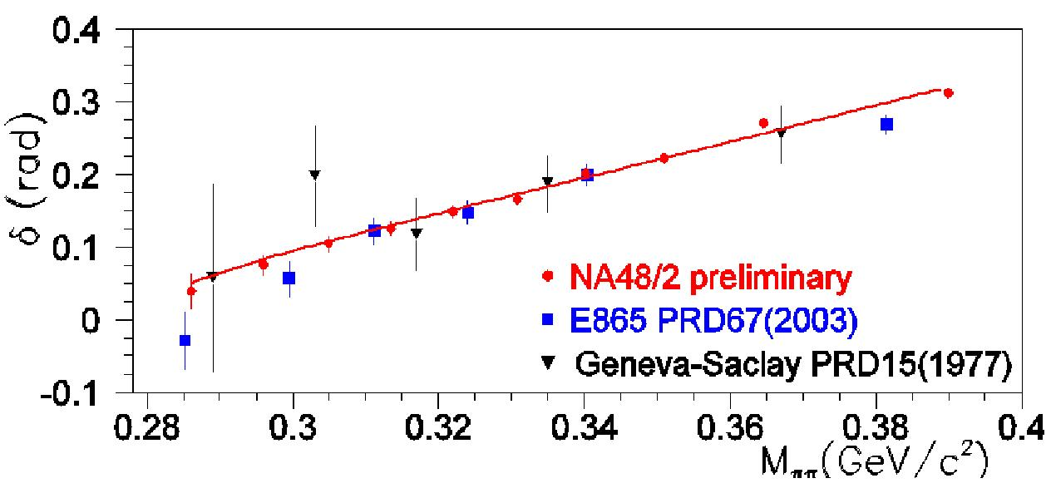
Ke4: Phase shift and ππ scattering length
Each point in the plot has been corrected for isospin effect: 10-15 mrad
The total error in each point is different for each experiment:
Geneva-Saclay: 40-50 mrad
E865: 15-20 mrad
NA48/2: 7-8 mrad
The extraction of pion scattering lengths from the fitted δ=δ_{s}-δ_{p} phase shift needs external theoretical and experimental inputs:
  The Roy equations provide the relation between δ and a0 and a2 near threshold (1) (2) (3)
  Extrapolating the data from the M_{ππ}>0.8 GeV it's possible to fit the result in the threshold region (the uncertainty from the experimental data defines the Universal Band)
Coulomb correction (Gamow factor) and real photons are included in simulation
Isospin correction prescription given by Gasser (4) results in 11 to 15 mrad in the fitted Mππ range
The isospin correction is slightly greater than the error on each point: can't be ignored!
  1)[Ananthanarayan,Colangelo,Gasser,Leutwyler Phys.Rept.353:207-279 (2001)]
  2)[Descotes-Genon, Fuchs, Girlanda,Stern Eur.Phys.J.C24:469-483,2002]
  3)[Kaminski, Pelaez, Yndurain Phys.Rev.D77 (2008)]
  4)[Gasser et al. Eur.Phys.J. C59:777,2009]

Slide 10
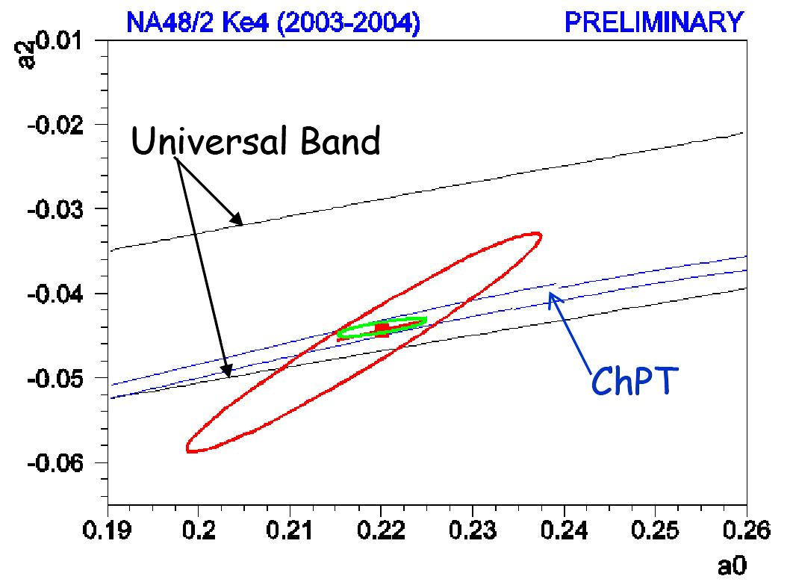
Ke4: a0 and a2 results
Theory prediction
Assuming ChPt and low energy constants
[Colangelo,Gasser,Leutwyler Nucl.Phys.B603,2001]
[Colangelo,Gasser,Leytwyler Phys.Rew.Lett.86,2001]:
a0 = 0.220 ±0.005
a2 = -0.0444 ±0.0008
1 par. Fit (ChPt) :
a0 = 0.2206 ±0.0049_{stat}±0.0018_{syst}±0.0064_{th}
2 par. Fit :
a0 = 0.2220 ±0.0128_{stat} ±0.0050_{syst}±0.0037_{th}
a2 = -0.0432 ±0.0086_{stat} ±0.0034_{syst}±0.0028_{th}
Theoretical error computed from isospin corrections and Roy equation inputs [Gasser et al. Eur.Phys.J. C59:777,209]
Using data (21 points) from the three experiments (dominated by NA48/2)
a0= 0.2199 ±0.0125_{exp}±0.0037_{th}
a2= -0.0430 ±0.0083_{exp} ±0.0028_{th}

Slide 11
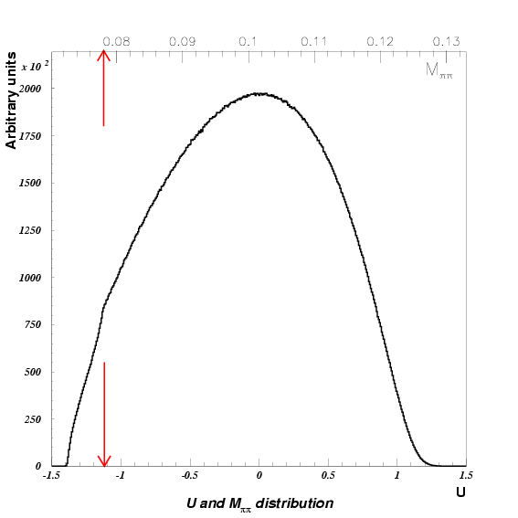
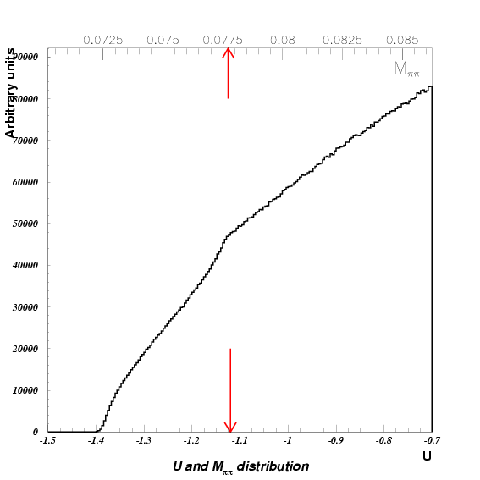
Cusp: Experimental evidence
In K±→π±π⁰π⁰ decay the matrix element is usually given as polynominal expansion as a function of the Dalitz variables U and V
M²_{ππ}
|M(u,v)|² ~1+gu+hu²+kv²+... u=(s₃-s₀)/m_{π}² s_{i}=(P_{K}-P_{π,i})²
Thanks to the big statistics collected by NA48/2 and the good energy resolution, for the first time a structure has been observed at the ππ threshold value [Batley et al.,Phys.Lett. B633:173-283,2006]
This structure has been interpreted by Cabibbo [Cabibbo Phys. Rev. Lett. 93, 121801 (2004)] as due to the strong ππ rescattering in the K±→π±π⁺π⁻ final state
M²_{ππ}
π±
π±
π±
K±
π⁰
=
K±
+
K±
π⁻
π⁰
π⁰
M
π⁰
M₀
π⁰
M₁
π⁺
π⁰

Slide 12
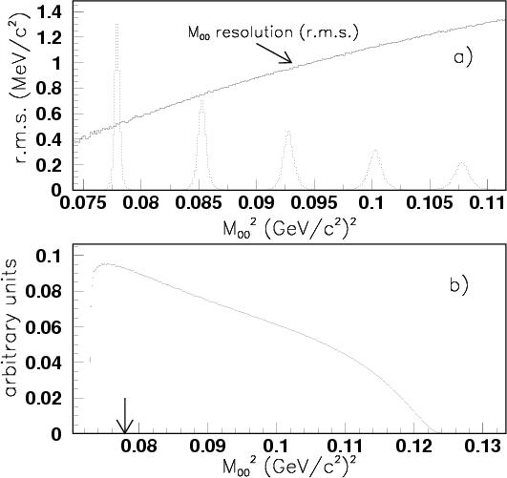
Cusp: K→3π selection
Online selection:
  (L1) one charged particle in CHOD and at least three peaks in at least one projection (x or y) of the LKr analog sum peak system.
  (L2) The opposite mass with respect to the charged tracks have to be far from one π⁰ mass.
Offline selection: among all the possible γ pairings, the couple for which χ² is smallest is selected
  the neutral vertex is obtained by imposing the π⁰ mass. The final vertex is obtained as average between the 2 vertices.
i
Very good acceptance and resolution in threshold region: high statistics and good opportunity to resolve tiny structures.
d_{ij}
Vertex
LKr
Z(i,j)
j
Z(k,l)
Δz

Slide 13
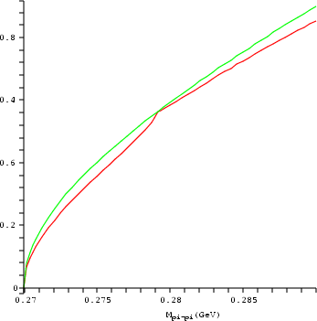

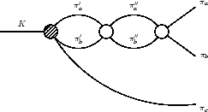
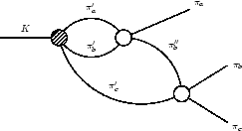
Cusp: Theoretical approach (Cabibbo-Isidori)
Fenomenological approach
The term M0 (no rescattering) is given by the standard PDG expansion
the first rescattering terms is real below threshold and immaginary above. Interference below threshold.
sub-leading effect
PDG param.
cusp
s_{ππ}>(2m_{π+} )²
M²=(M₀)²+|M₁|²
~13% leading effect
~13% leading effect
s_{ππ}<(2mπ₊ )²
M²=(M₀)²+(M₁)² +2M₀M₁
1– ( )²
M₁ = –2/3(a₀–a₂)m₊M₊
M₀₀
2m₊
The amplitude below threshold depends on (a0-a2)
Other 5 terms rise from two loops calculation (proportional to scattering lengths): effects below and above threshold
Theoretical error evaluated from the next level expansion (work in progress…)
Cabibbo,Isidori JHEP 0503 (2005) 21

Slide 14
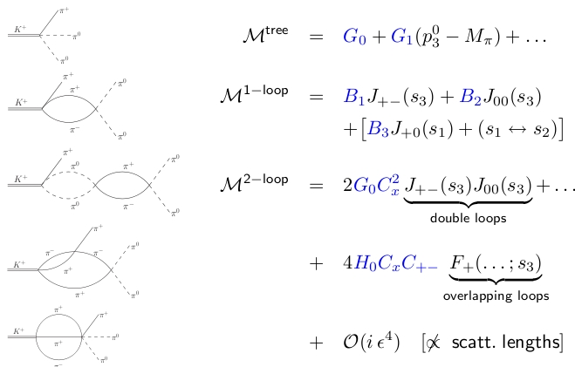
Cusp: theoretical approach (Bern-Bonn)
Different approach based on effective non-relativistic Lagrangian
The electromagnetic effects are naturally included in this approach (explicitly omitted in the CI work)
Different structure of the expansion (different correlation between the terms wrt the Cabibbo-Isidori expansion): kinetic energy and threshold parameter.
Simultaneus fitting of charged and neutral amplitude to exctract M+ slope parameters (modified with respect to the PDG parametrization)
Radiative correction, outside the cusp point, included in the BB model
[Colangelo, Gasser, Kubis, Rusetsky in Phys.Lett.B638:187-194,2006]
[Bissenger, Fuhrer, Gasser, Kubis, Rusetsky in Phys.Lett.B659:576,2008]
[Bissegger, Fuhrer, Gasser, Kubis, Rusetsky in NPH B806:178, 2009]

Slide 15
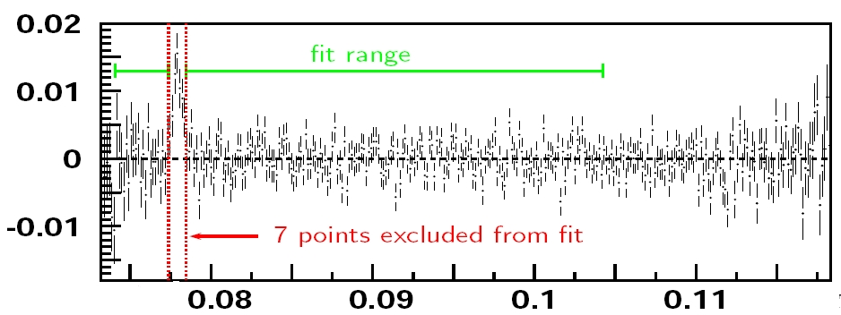
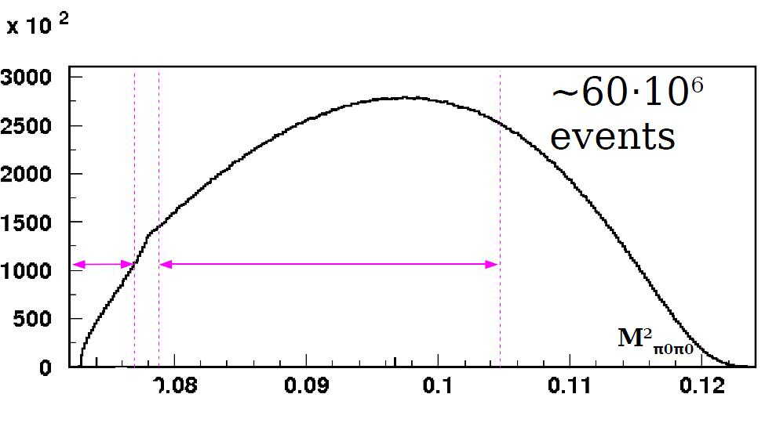
Cusp: fitting procedure
Resolution and detector response matrix obtained using accurate Geant3 based simulation
Both theories can be fitted with the same procedure (fit parameters: g, h, a₀-a₂ , a₂ , N)
The M+ terms appearing in the CI theory is fixed by the recent measured K±→π±π⁺π⁻ slope parameters [Batley et al. Phys.Lett.B649:349-358,2007]
In the BB the M+ term is obtained simultaneously fitting K±→π±π⁰π⁰ and K±→π±π⁺π⁻ Dalitz plot
Isospin effects included
7 bins around threshold excluded from the fit, upper limit to reduce the total error (226 bins)
The excess of events in the cusp position, R=(1.8±0.3)·10⁻⁵, can be explain by:
  pionium 0.8·10⁻⁵ [Silagadze, JETP Lett. 60 (1994) 689]
  unbound state with resonant structure [Gevorkian, Tarasov, Voskeresenskaya,Phys.Lett.B649:159,2007]
The numbers of “atoms” is used as free parameter in the fits

Slide 16
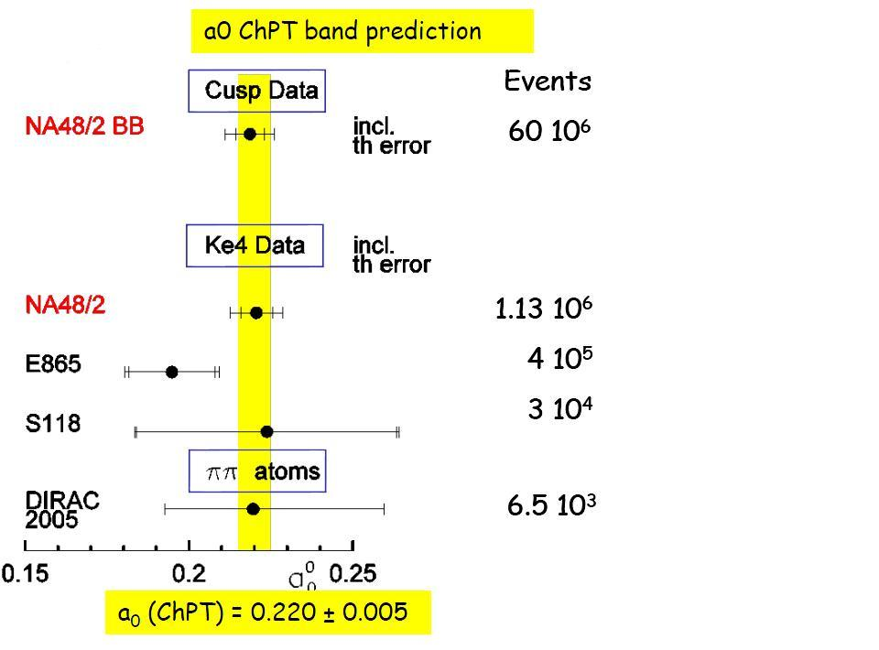
Cusp: Results
(a0–a2)m+= 0.2571 ± 0.0048stat. ± 0.0025syst. ± 0.0014ext.
a2m+= –0.024 ± 0.013stat. ± 0.009syst. ± 0.002ext.
2 par. Fit :
1 par. Fit (ChPT):
(a0–a2)m+= 0.2633 ± 0.0024stat. ± 0.0014syst. ± 0.0019ext.
Results based on BB model (better χ2, most complete theory)
Very good agreement between the two approches
Good agreement with ChPT prediction [Colangelo, Gasser, Leutwyler PRL 86 (2001) 5008]:
(a0-a2)m₊=0.265±0.004
Similar theoretical and experimental precision
Systematics error dominated by LKr non linearity and trigger efficiency

Slide 17
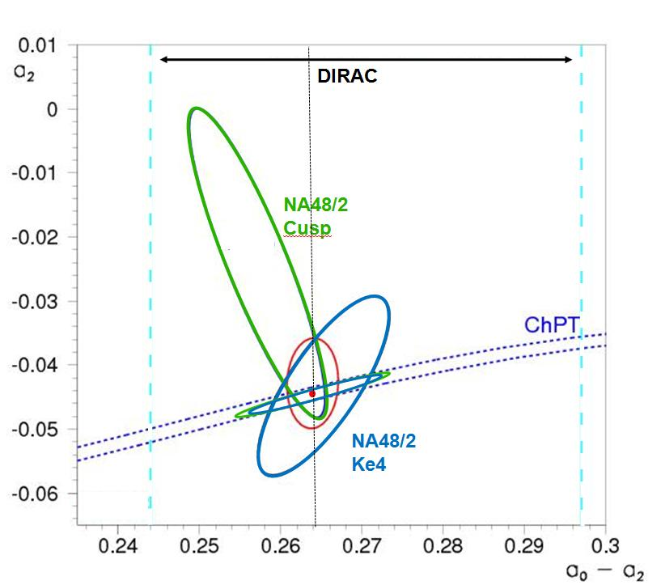
Cusp and Ke4: comparisons
Two independent measurements
  60 M K3p
  1.13 M Ke4
Different systematics
  Cusp: Calorimeter and trigger
  Ke4: electron misID and Background
Different theoretical inputs
  Cusp: rescattering in final state and ChPT expansion
  Ke4: Roy equation and isospin breaking correction
Combined results
(a0 -a2)m₊= 0.2639 ±0.0020 ±0.0004 ±0.0021
Using ChPT constraints:
(a0 -a2)m₊= 0.2640 ±0.0020 ±0.0017 ±0.0035
Very good agreement with ChPT prediction:
(a0-a2)m₊=0.265 ± 0.004

Slide 18
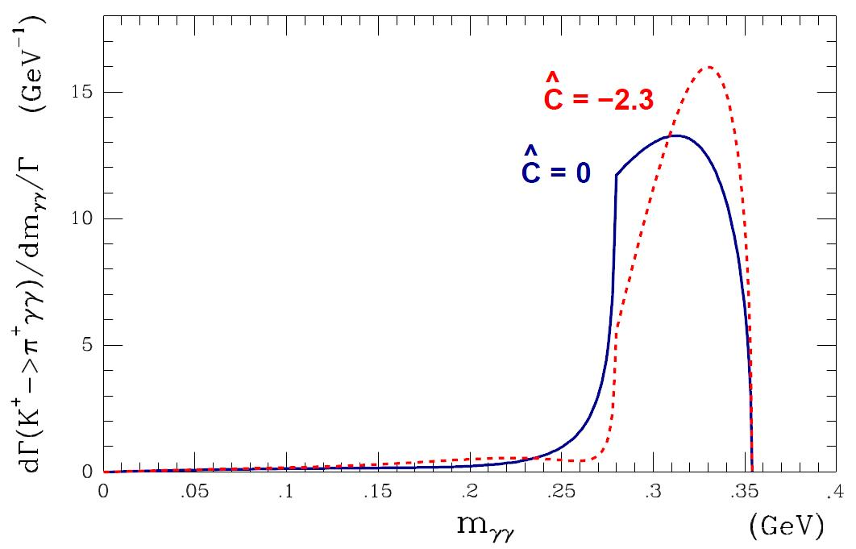
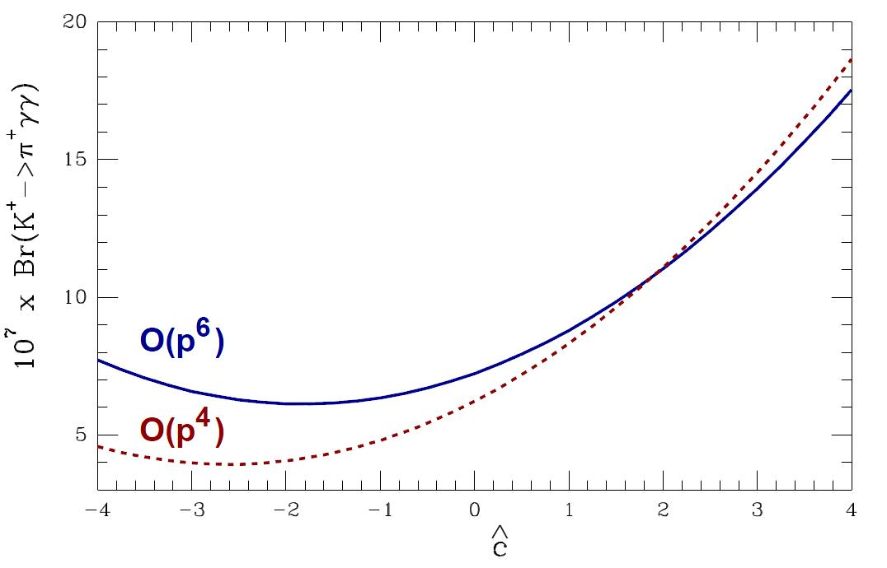
K→πγγ: Theory
At leading order, in the framework of ChPT, the K(p)→π(p1)γ(q2)γ(q3) differential rate is given by:
π(p1)
y=p(q₂-q₃)/m_{K}²
z=(q₂+q₃)/m_{K}²
K(p)
γ(q2)
γ(q3)
∂²Γ
m_{K}
=
z²(|A+B|²+|C|²)+(y²-1/4λ(1,z,r²_{π} ))² (|B|²+|D|²)
∂y∂z
(8π)³
At O(p4) the relevant contribution is given by A(z,ĉ) (loops) and C(z) (poles); B=D=0 at O(p4) and relevant at leading order only at low mγγ mass (1).
ĉ is O(1) and have to be extracted from data
Order O(p6) can be relevant (30%-40% enhanced in BR) (2).
(1) [Ecker, Pich, De Rafael, in Nucl.Phys.B303:665,1988]
(2) [D’Ambrosio, Portoles, in Nucl.Phys.B386:403,1996]

Slide 19
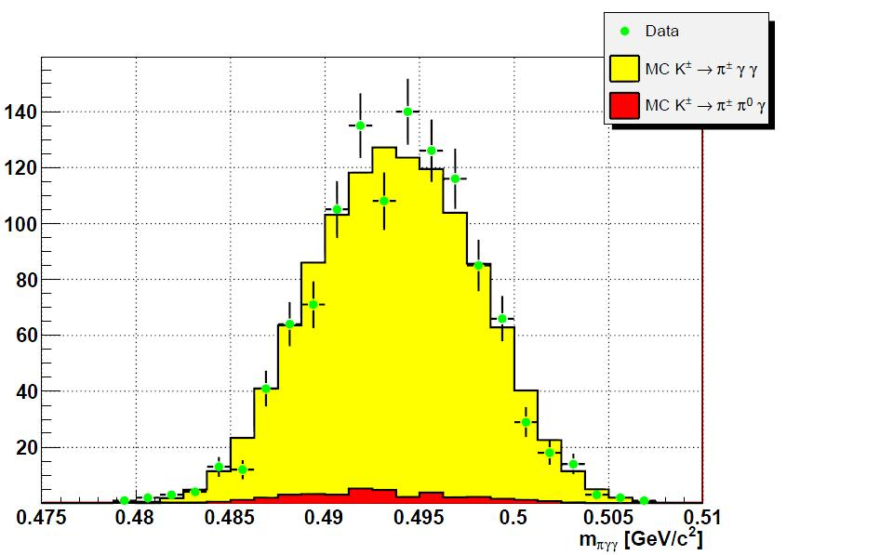
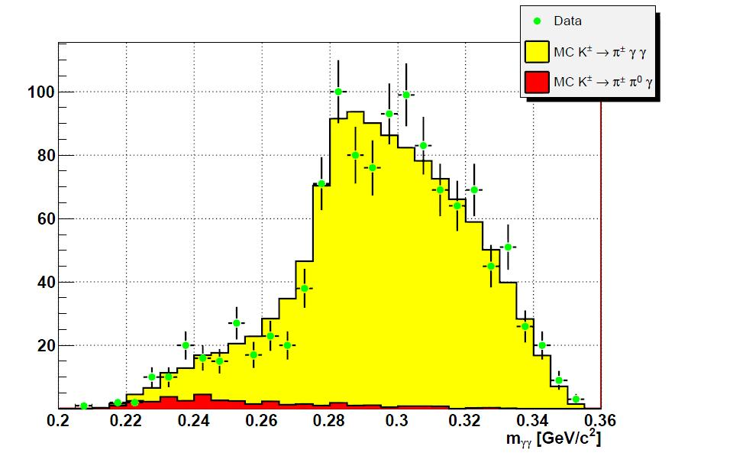
K→πγγ: Results
Analysis based on 40% of whole data set
1164 events found
main background: K⁺→π⁺π⁰γ ( 3.3%)
Main systematics from trigger efficency determination
Data shape (mγγ) follows ChPT description (ĉ=2 shown for qualitative comparison)
Assuming O(p6) and ĉ=2 the preliminary result on model dependent BR determination is
Br(K⁺→π⁺γ γ) = (1.07±0.04_{stat} ±0.08_{syst})·10⁻⁶
(model independent analysis on going)
Overtaken the previous result from E787 with 31 events candidates:
Br(K⁺→π⁺γ γ) = (1.10±0.32)·10⁻⁶

Slide 20
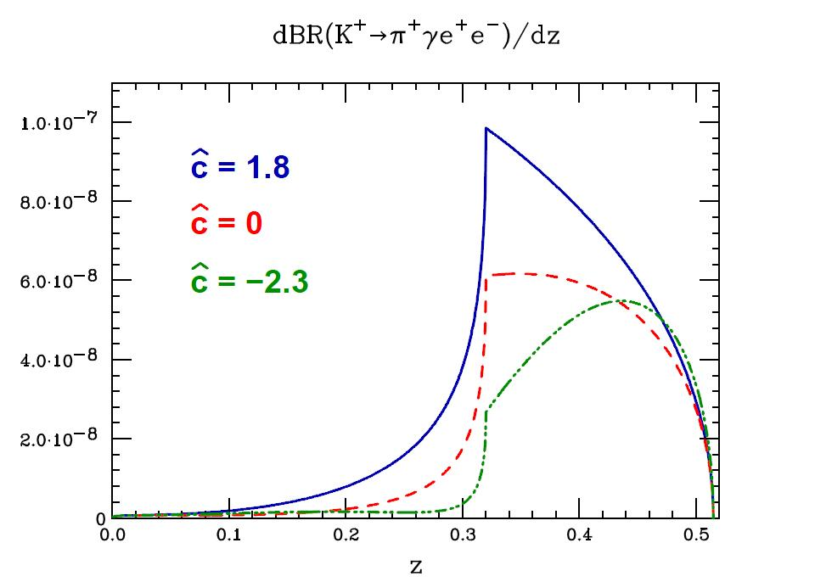
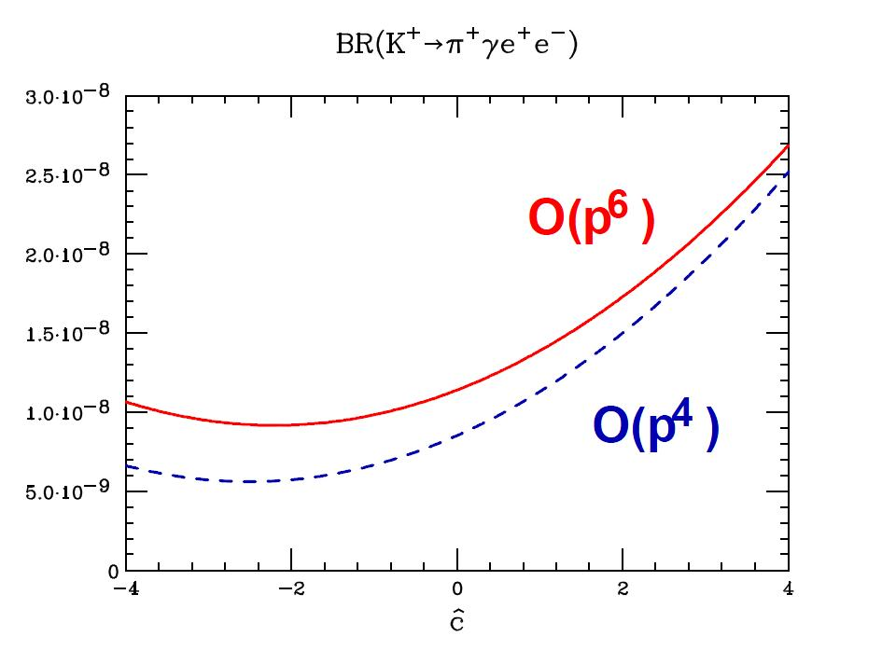
K→πγee: Theory
Similar with respect to K⁺→π⁺γ γ
Br and m_{eeγ} at order O(p4) determined by ĉ
O(p6) could enhance the BR by 30%-40%
Theoretical prediction at O(p6):
Br(K⁺→π⁺γ e+e-) = (0.9÷1.6)·10⁻⁸
[Gabbiani, in Phys.Rev.Lett.D59,1999]
Never observed before!

Slide 21
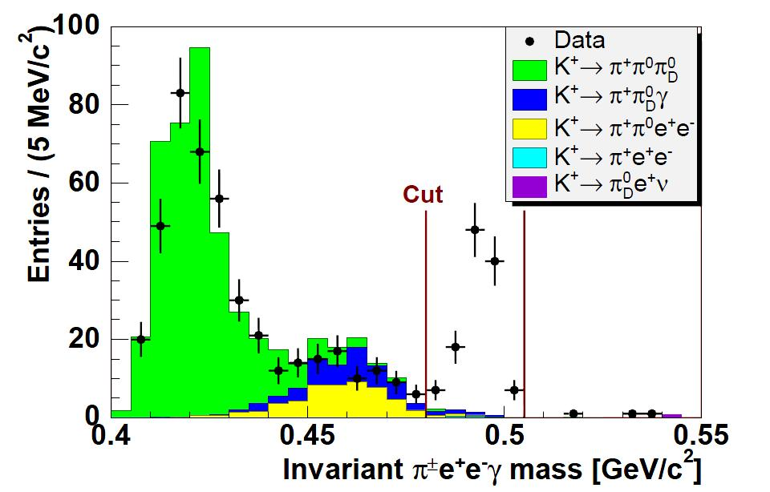
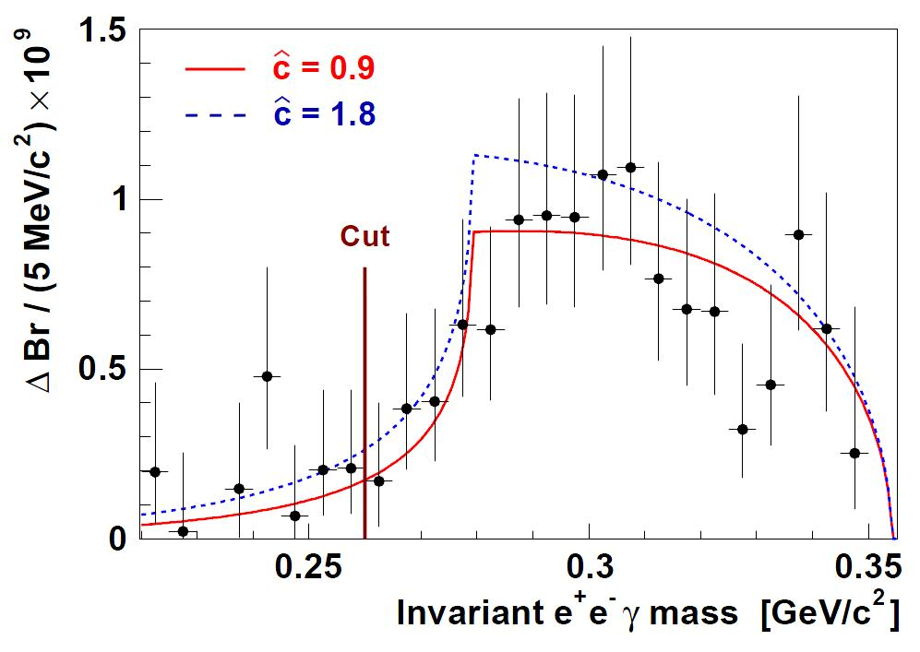
K→πγee : Results
120 events candidates
Background from K⁺→π⁺π⁰_{D}γ (6.1%)
BR computed in bins of m_{eeγ}
no assumption on m_{eeγ} (model independent measurement)
Cut on m_{eeγ} > 260 MeV/c²
BR(K± -> π±e⁺e⁻γ) = (1.19±0.12_{stat} ±0.04_{syst})·10⁻⁸
Assuming ChPT O(p6), the ĉ value is extracted from m_{eeγ} distribution
ĉ = (0.90 ± 0.45)
From this the model dependent ChPT BR is:
BR(K± -> π±e⁺e⁻γ) = (1.29±0.13_{exp} ±0.03_{ĉ})·10⁻⁸
[Batley et al. Phys.Lett.B659:493, 2008]

Slide 22
Conclusions
The kaon decays give the possibility to study the low energy hadronic interaction with good precision
Thanks to high statistics and high data quality, NA48/2 can check several ChPT predictions with very high accuracy
Three significative “examples” have been presented in this talk:
  ππ scattering lengths
  K±→π±γγ
  K±→π±γe⁺e⁻
The results obtained are compatible with the predictions
In particular the measurement of the ππ scattering lengths obtained in two different ways, with an experimental error comparable with the theoretical uncertainty, is a very strong test of the theory.

