Slide 1
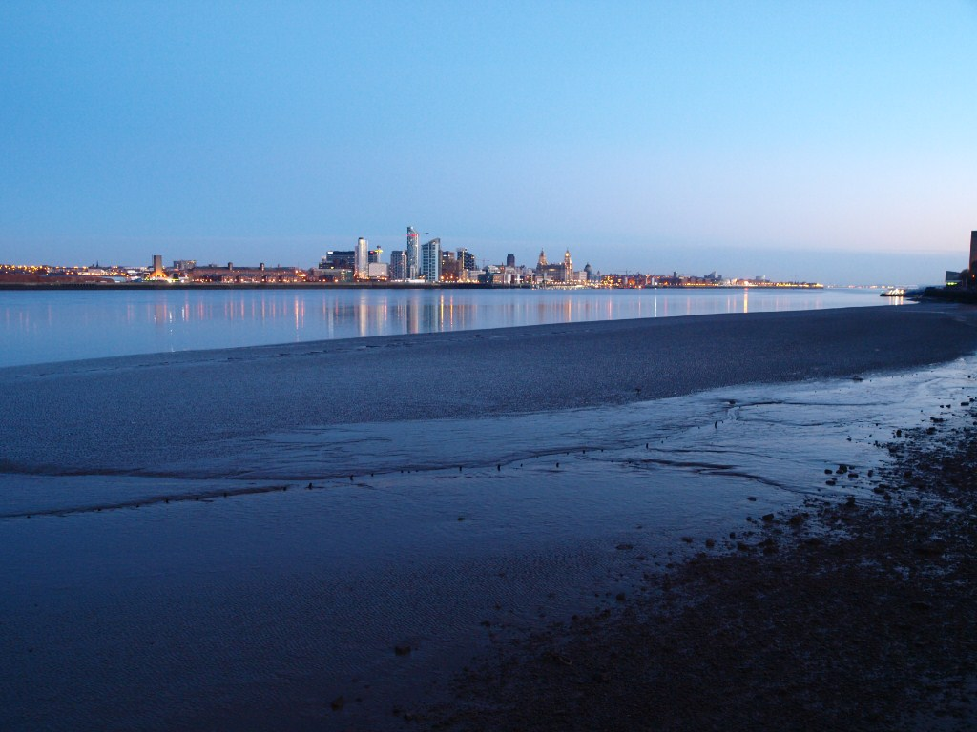

Themis Bowcock

Slide 2
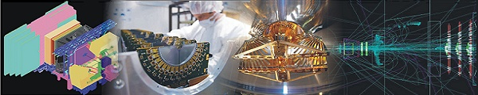
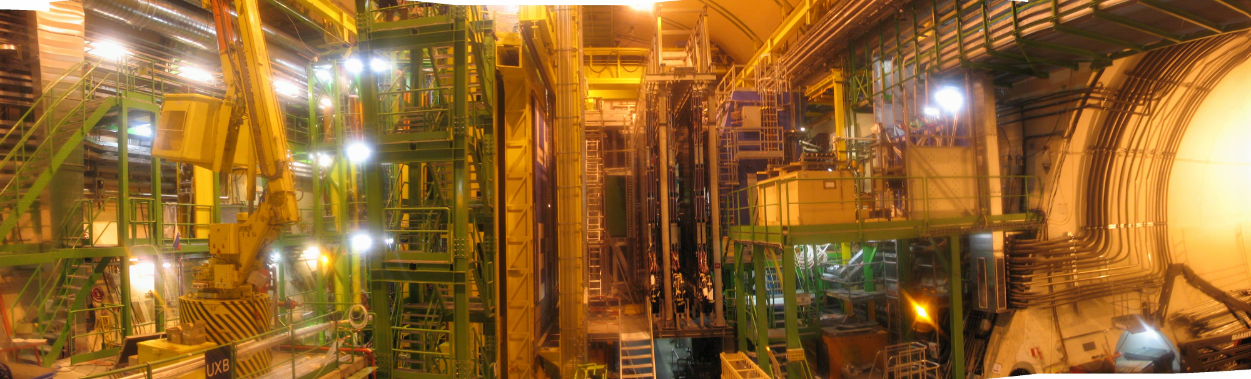
Commissioning the LHCb Vertex Detector
Themis Bowcock

Slide 3
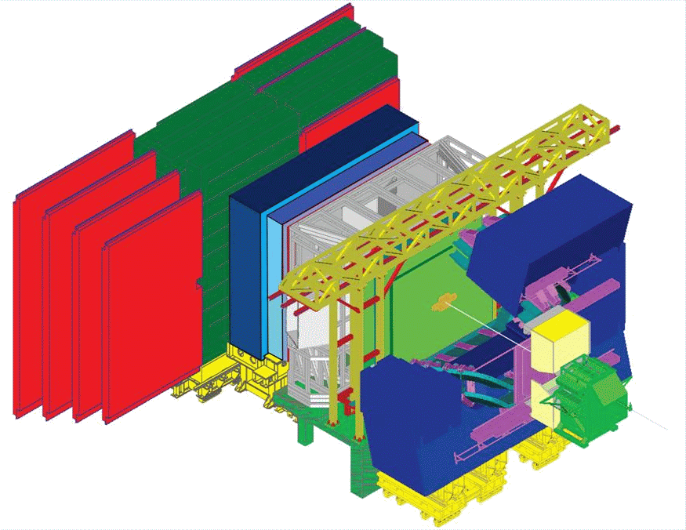
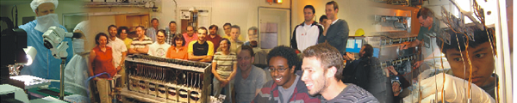
Overview
LHCb
Vertex Detector
Commissioning
Summary

Slide 4
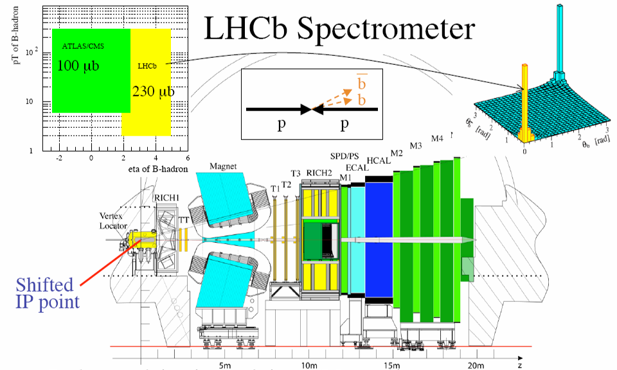
LHCb: Spectrometer
VVELO

Slide 5
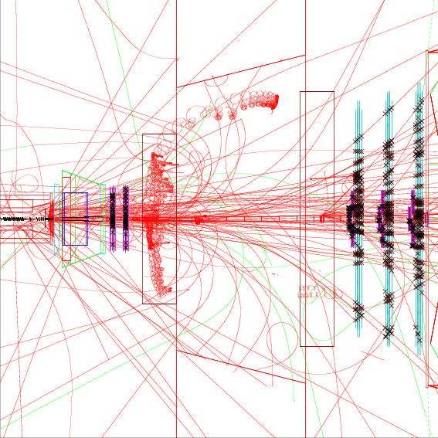
LHCb: Triggering on B’s
Write data to disk ~ 2kHz

Slide 6
Physics
Flavour
  CP violating phases
  CKM
New Physics
    Rare B Decays
    High Reach
    Exotics
SM
  W/Z In new regions
Quantum Excitations
measurements of amplitudes and phases

Slide 7
LHCb: VELO Requirements
Good vertexing
  Primary vertex <10microns
  IP parameter ~40μm (40fs time resolution)
    close to LHC beam (vacuum)
  high radiation levels <10¹⁵p/cm²
  Close to Beam = moving detectors
Tracking
2D trigger algorithm
  R-phi geometry
Low mass ~10% X₀

Slide 8
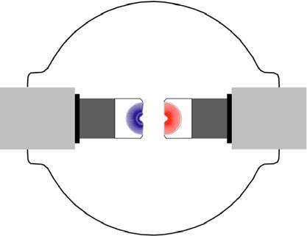
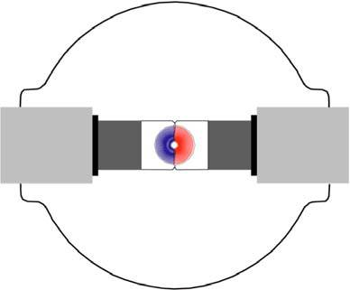
VELO: Mechanics Overview
y
x
injection
z
6 cm
y
LHC
vacuum
x
stable beams
module
RF box
ppartly overlapping_{sensors}
• 2 retractable detector halves
• 21 stations per half with an R and ϕ sensor

Slide 9
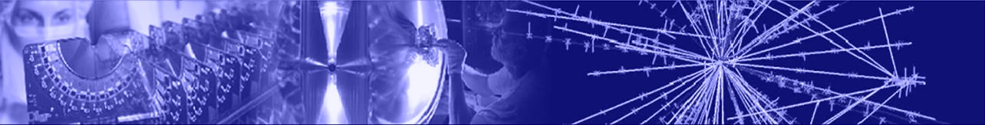
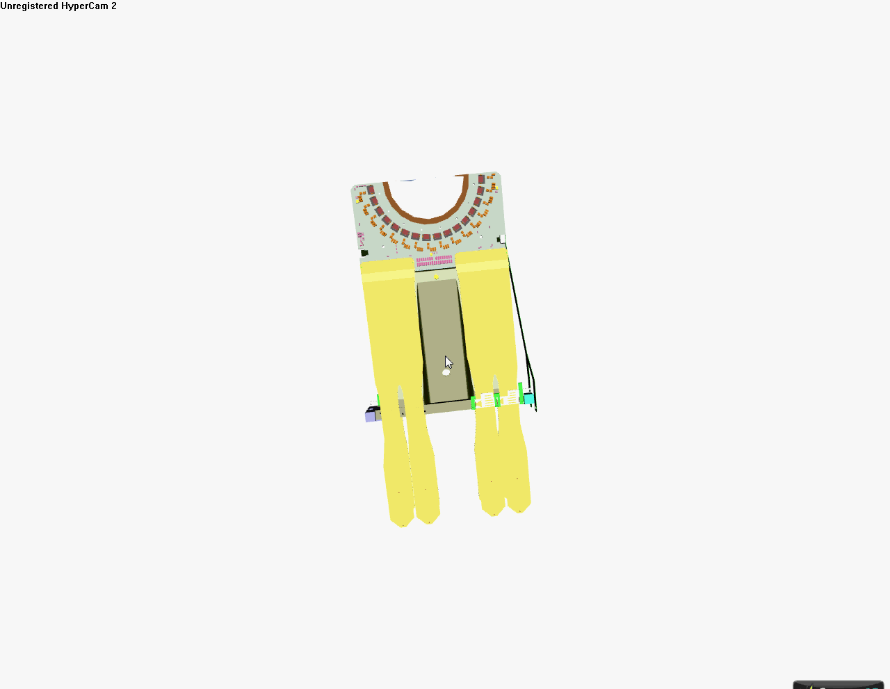
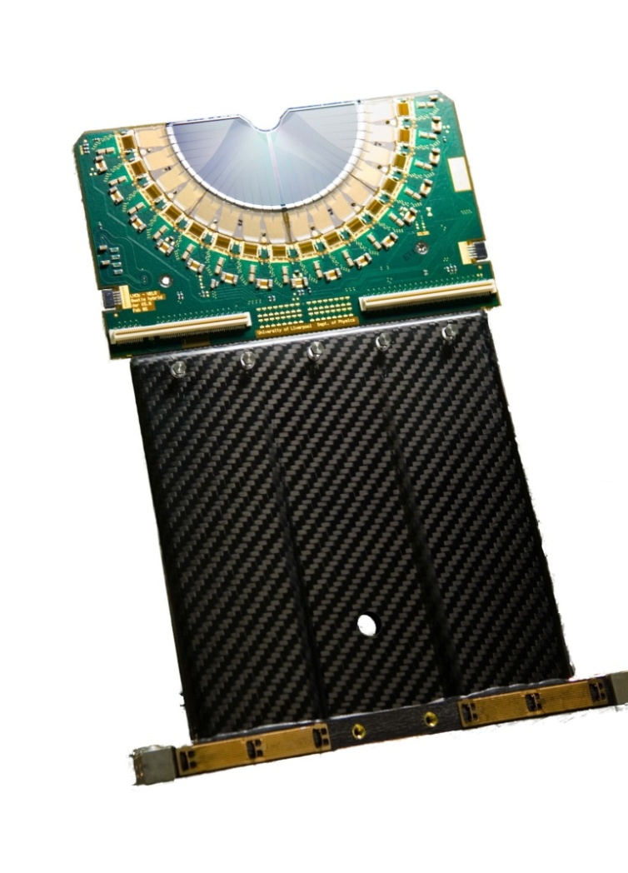

Module
Kraków - 16 July 2009
Themis Bowcock 9

Slide 10
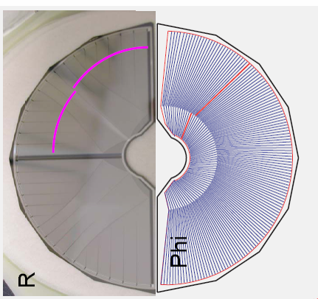
VELO: Sensors
highly segmented
n⁺n
double metal layer
2048 strips/sensor
Laser cut
Design operation
  T=-7°C
~40 micron inner pitch
~4cm

Slide 11
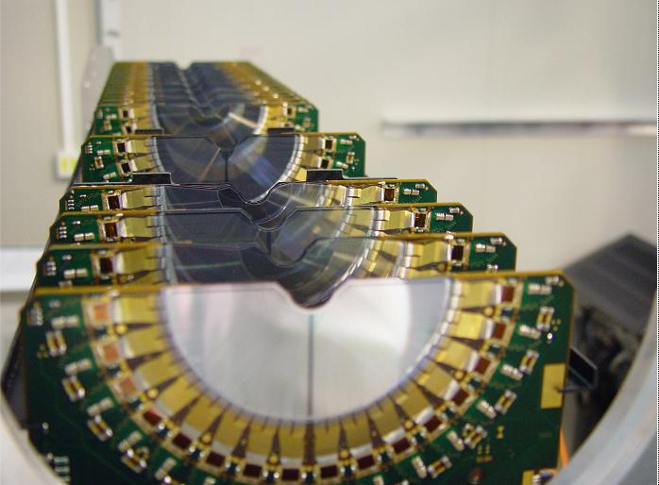
Modules: Complete halves

Slide 12
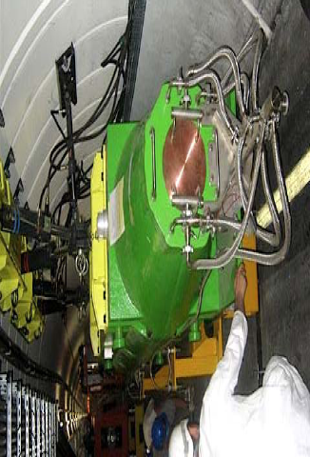

Timeline for Commissioning
Installed 2007
  Cannot use cosmics
2008 Tests
  Injection from SPS into LHC – “beam stopped”
  Particles injected from Muon chamber direction!
2009 Tests
  Timing
  High Rate R/O (1MHz)
  Operation under final conditions (vacuum & temp)
LHCb

Slide 13
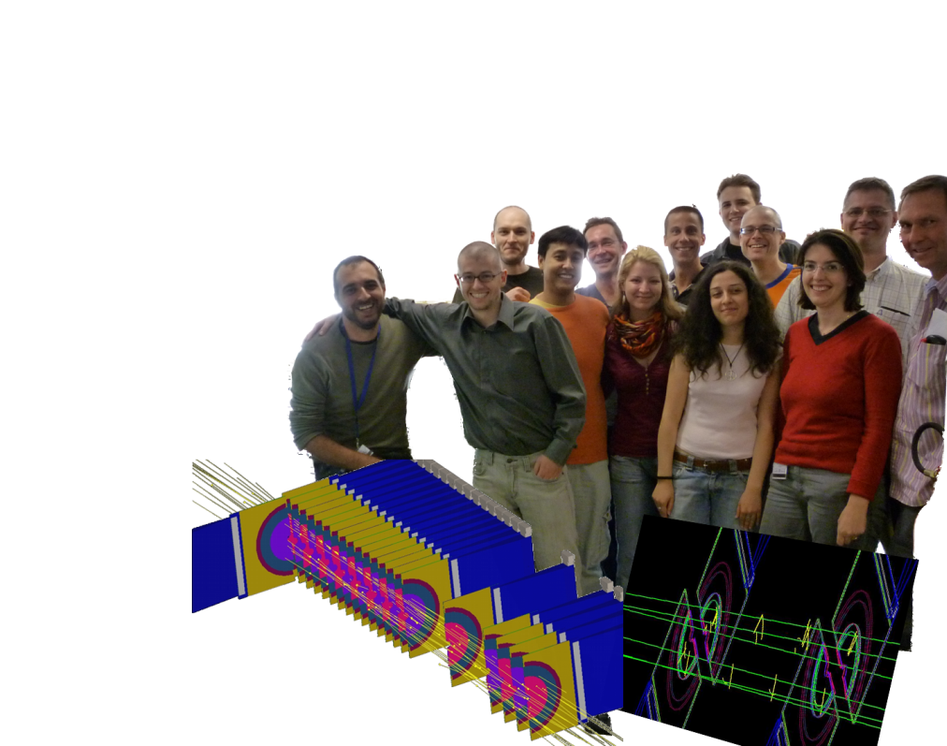
TED June 2009
Powered all HV channels
Very stable VELO operation
Single bunches every 48 s
  Multiple time sample for timing
Bunch trains 12 consecutive bunches 25ns spacing:
  Single time sample
  zero-suppressed (physics) data
50k Tracks collected
Resolution
Efficiency
Alignment *

Slide 14
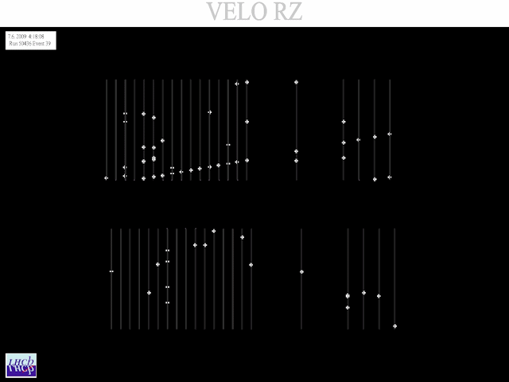
A few events…

Slide 15
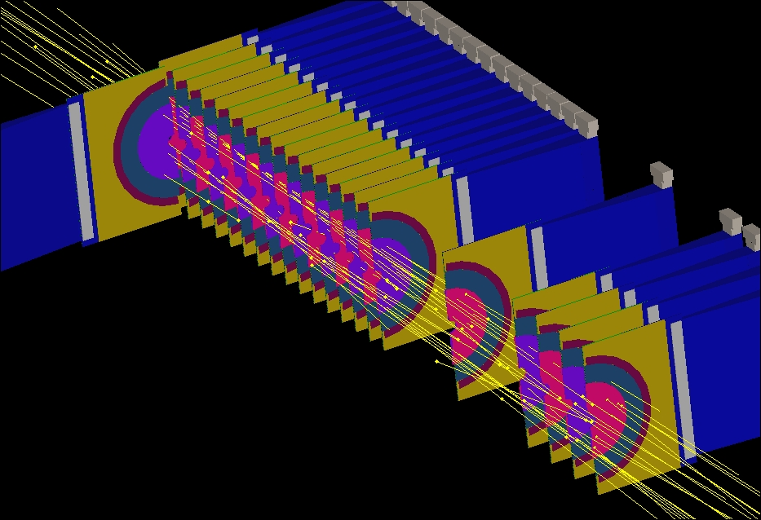
Event 2009

Slide 16
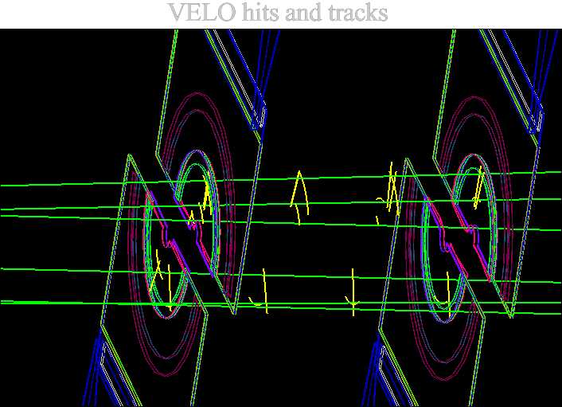
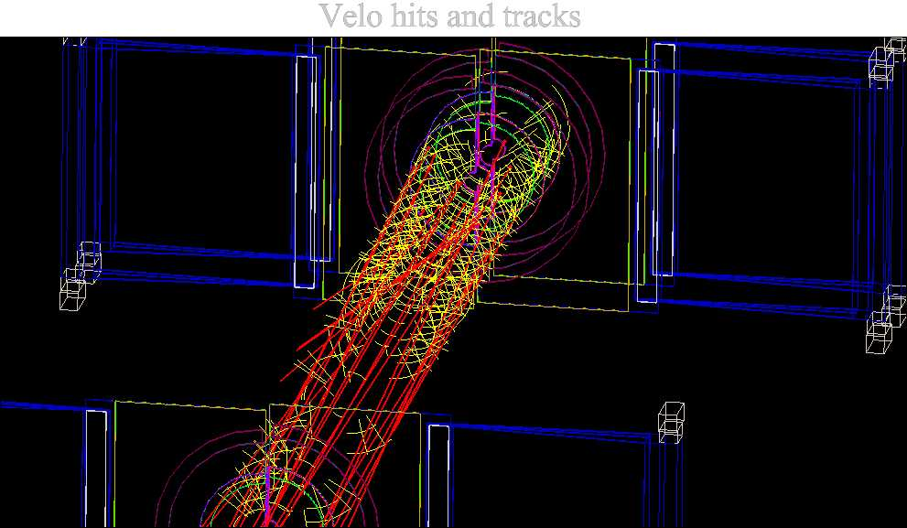
Low intensity
Higher intensity

Slide 17
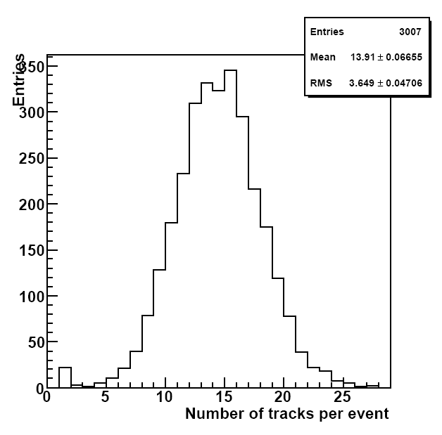
Number of tracks/event
Saturday 2-5 10⁹p
Sunday night ~1 10¹⁰ p
Av. 13.9
Av. 5.6

Slide 18
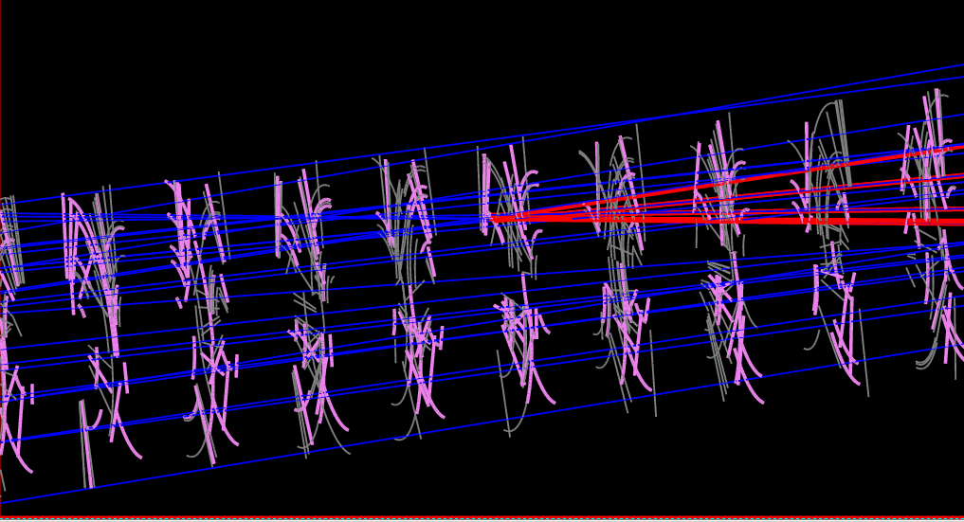
Searching for vertices

Slide 19
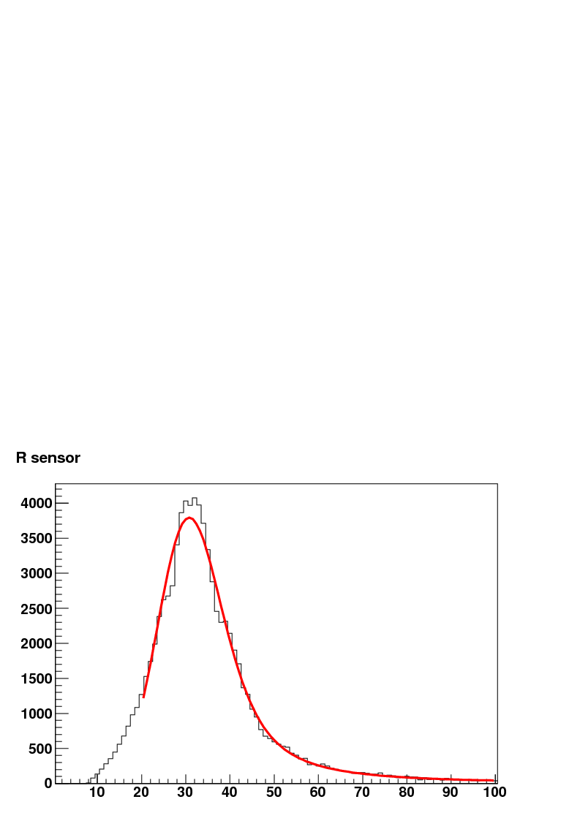
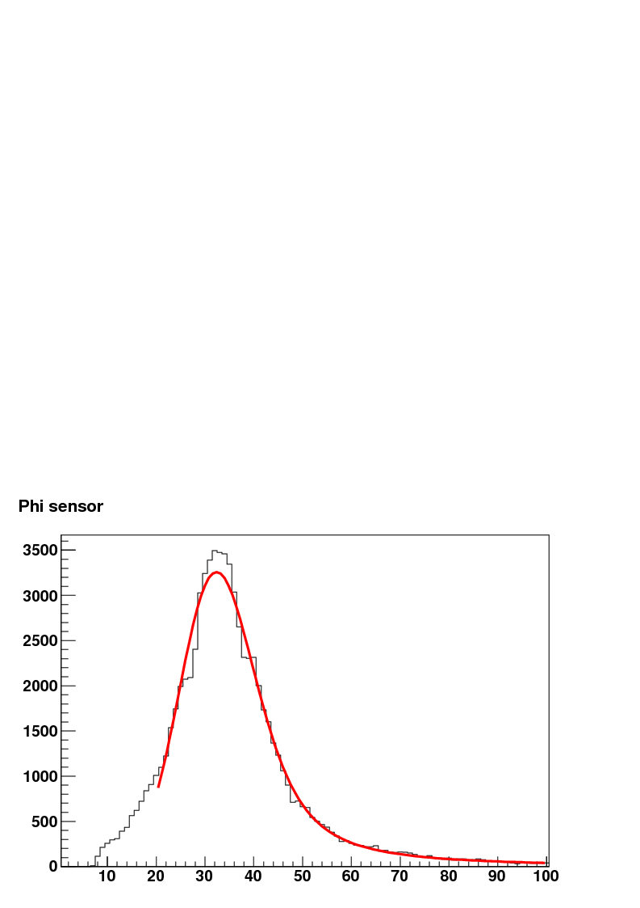
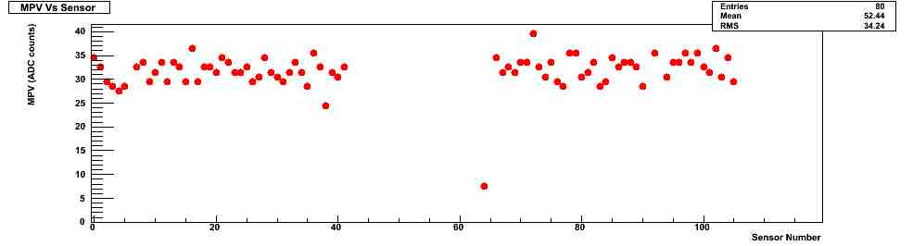
ADC sums (S/N) 2009
R Sensors
ϕ Sensors
Preliminary
ADC sum (ADC counts)
ADC sum (ADC counts)
R Sensors
ϕ Sensors

Slide 20
Signal and Resolution
S:N > 20:1
  Sensor types similar!
Physics Mode
  Zero Suppressed(ZS)
  Some non-NZS readout for diagnostics
Resolution
  TED ~“normal”
    Resolution ~ 80% * binary
  In Physics <θ>~8°
    Resolution expected from testbeam & simulation ~ 5-10μm at inner radius
  Under intense irradiation
    Resolution → binary

Slide 21
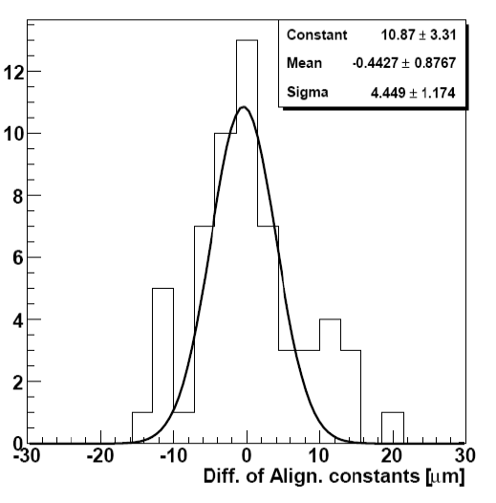
Alignment 2008
Detector Designed to be stable ΔT ~ 70°C
  0 CTE composites and module mechanics
  Aluminium support structure is thermally stabilized to ±1°C
2008 Alignment Performed with TED data
  Modules within 10μm of metrology
  Note: Si built to be within 10μm of nominal position
2009 –
  Alignment changed < 5μm

Slide 22
Alignment 2009
Detector open
High Statistics permitted checking ability to check how far apart the halves were using “traversing tracks”

Slide 23
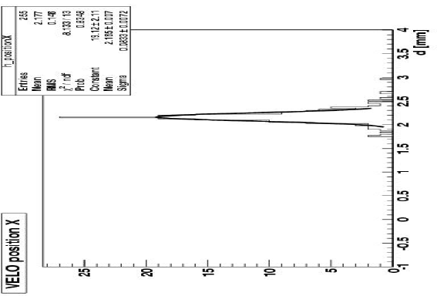
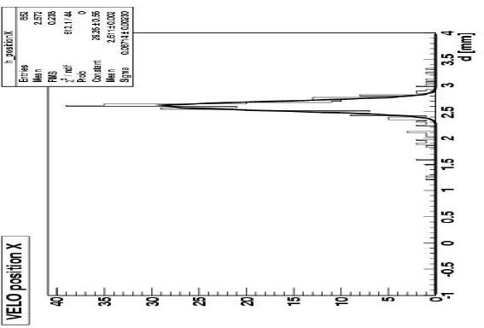
Detector half separation
Preliminary
Detector halves separated by 2.000mm and 2.450mm i.e. Δx = 450 μm
Analysis sees Δx = 445 ±10 μm (with only 1000 tracks!)

Slide 24
Summary
LHCb VELO has achieved required performance for physics
  Improvements always possible!
  Detector behaves according to design
Test in Aug 2009 of full system in final configuration
  vacuum
  T_{cool} ~ -30°C
Ready for Data Taking!

