Slide 1



Measurement of CP violation and CKM matrix in LHCb
EPS – HEP 09 Krakow 16-22 July 2009
Marta Calvi
University of Milano Bicocca and INFN

Slide 2
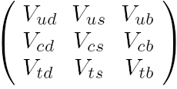
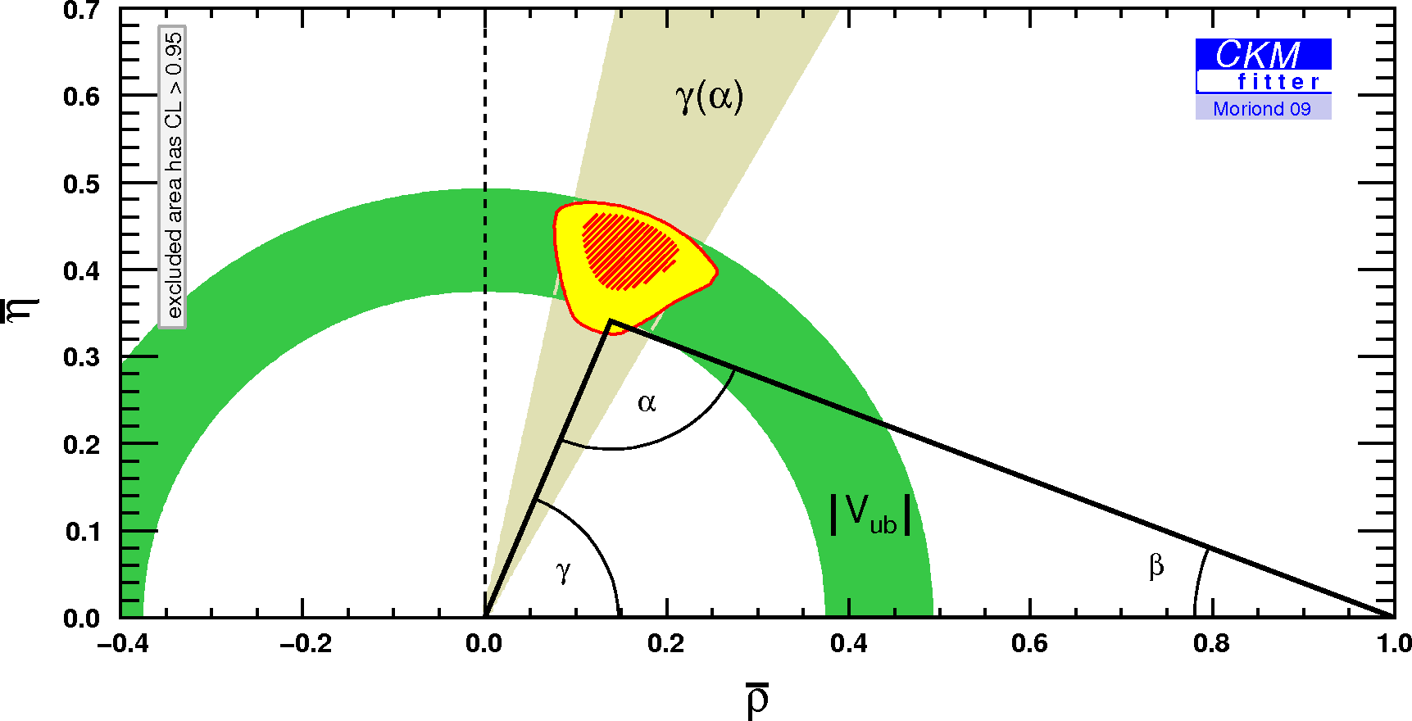
CP violation and CKM matrix
Current laboratory measurements of CPV are in agreement with
SM predictions, encoded in the CKM matrix, but
observation of universe requires much more.
Unitarity relations represented by triangles.
“db”
“sb”
Still space for finding effects due to NP in less constrained
elements like γ and β_{s} angles.
UT constraints from tree measurements only →

Slide 3
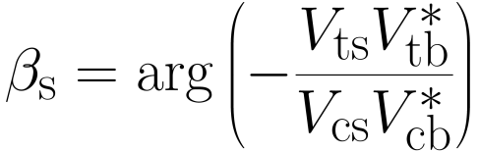
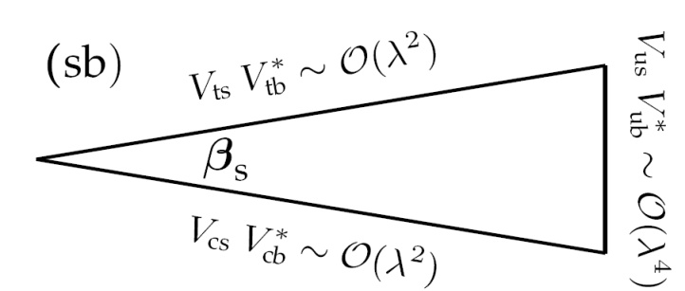
The B⁰_{s}B⁰_{s} mixing in B_{s}⁰→J/ψφ
A CP violating phase arises from interference between B_{s} decay to J/ψφ directly or via mixing
B_{s}
f =J/ψφ
B_{s}
In the SM:
B_{s} →J/ψφ is dominated by a single weak phase, well predicted:
          Φ_{J/ψφ}SM= -2β_{s} + δP Penguin contribution estimated ~10⁻⁴-10⁻³
  -2β_{s} = (-0.037±0.002) rad from UT fits

Slide 4
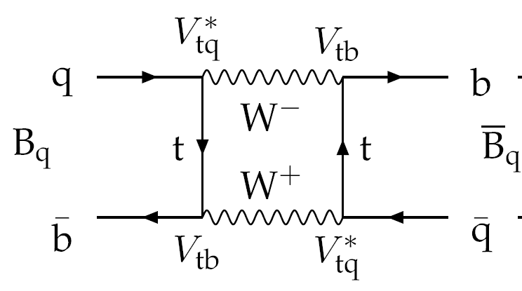
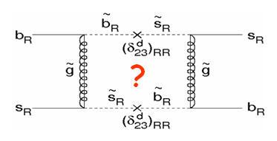
B⁰_{s}B⁰_{s} with New Physics
New particles could contribute to the B_{s}-B_{s} box diagram modifying the SM prediction, adding a new phase :
This new phase will also modify other measurements:
where:
is calculated in the SM:

Slide 5
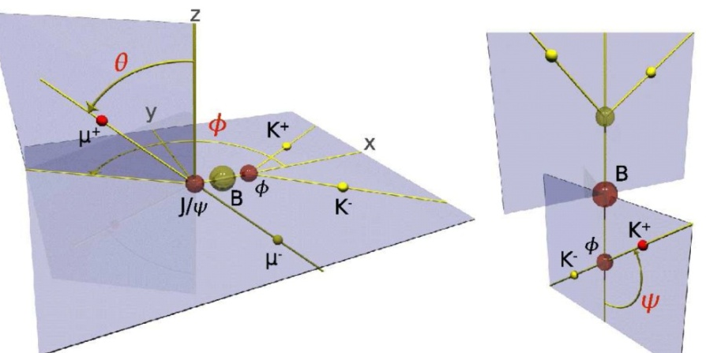
B_{s}⁰→J/ψ(μμ)φ(ΚΚ)
P→VV decay : mixture of CP-even
(ℓ=0,2) and CP odd (ℓ=1) final states.
An angular analysis allows to separate
statistically the decay amplitudes.
3 angles Ω=( θ,φ,ψ ) to describe the final decay products directions.
Differential decay rate:
Bs
Bs
A₀ (0) → CP even
A|| (0) → CP even
A⊥ (0) → CP odd

Slide 6
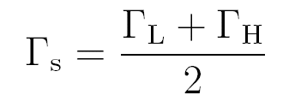

Time dependent decay amplitudes
High sensitivity
to small Φ values
when B/B initial
state is determined
by Flavour tagging
(Δm_{s} terms)
Depend on 8 physics parameters:
  Φ, Γ_{s}, ΔΓ_{s}, Δm_{s}, R┴, R||, δ┴, δ||
  From Tevatrons results:
  Δm_{s} well measured, hints
  of deviation from SM in Φ

Slide 7
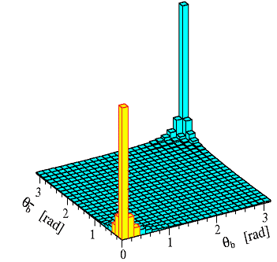
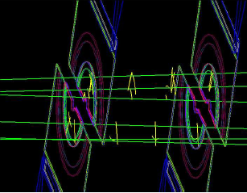
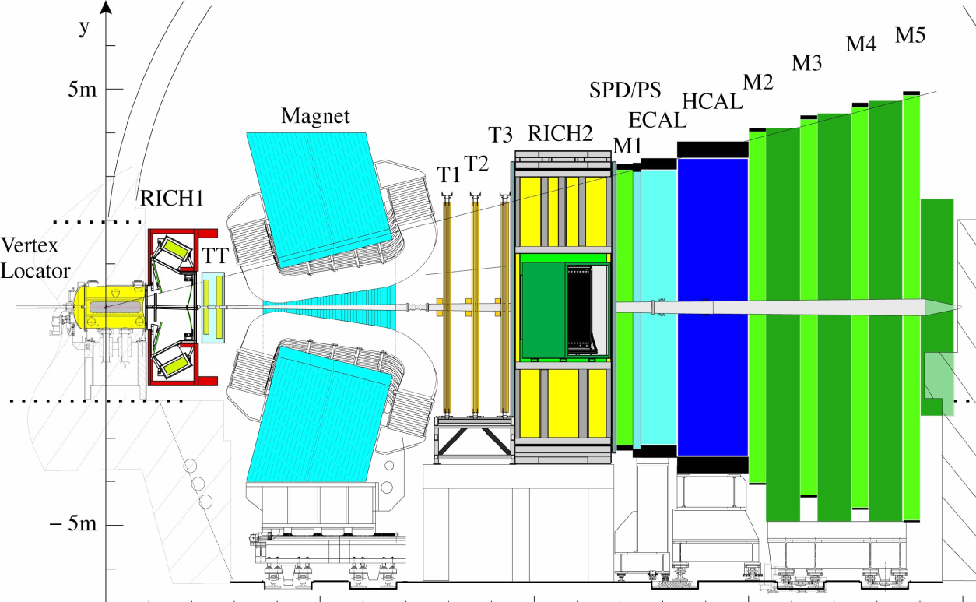
LHCb @ LHC
bb angular correlation in pp collisions at √s=14 TeV
High bb production in pp collisions at √s=14TeV
σ_{inel} = 80 mb
σ_{bb} = 500 μb → N ∼10¹² bb events in L_{int} = 2 fb⁻¹
        (1 nominal year 10⁷ s at 2x10³² cm⁻²s⁻¹)
~40% in the forward region
LHCb single arm forward detector
Detector ready and operational
TED data June 2009 (secondary particles downstream LHC beam stopper)

Slide 8
B_{s}⁰→J/ψ(μμ)φ(KK) reconstruction
Full MC: inclusive J/ψ(μμ)
Signal yield (2 fb⁻¹) | 117 k
B(long-lived) /S | 0.5
B(prompt J/ψ) /S | 1.6
Full MC simulation all trigger levels included:
High efficiency for di-muon trigger ε_{tot}~70%
Baseline event selection is lifetime-unbiased:
small proper time and angular acceptance corrections needed.
High background from prompt J/ψ: harmless in β_{s} fit, can allow the determination of proper time resolution.
Alternative analysis under study: higher statistic sensitivity.
Large use of control channels:
Measure resolution and acceptance for proper time and angular distributions. Flavour tagging
Channel | Yield (2 fb⁻¹) | B/S total
B_{d}→J/ψ K* | 490 k | 6.7
B_{u}→J/ψ K+ | 940 k | 1.9
B_{s}→D_{s}π | ~70k | 0.4

Slide 9
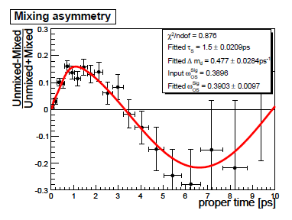
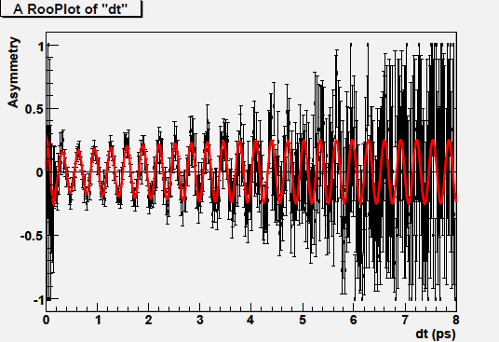
Flavour Tagging
From combination of several methods (electron, muon, kaon,
inclusive vertex, same side kaon)
μ⁻, e⁻
K–
Tagger | Tag eff. | mistag | ε(1−2ω)²
Opposite side | 45% | 36.5% | 3.3%
+ same side | 56% | 33.3% | 6.2%
Q_{vtx}
B–
B_{s}
_{PV}
K⁺
Calibration and validations on control channels
B⁰→J/ψ(μμ)K*(Kπ) oscillations for opposite side taggers
B_{s}→D_{s} (KKπ) π oscillations for same side tagger

Slide 10
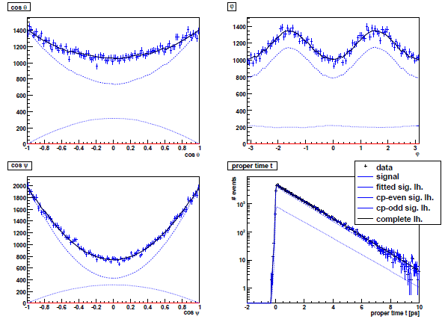
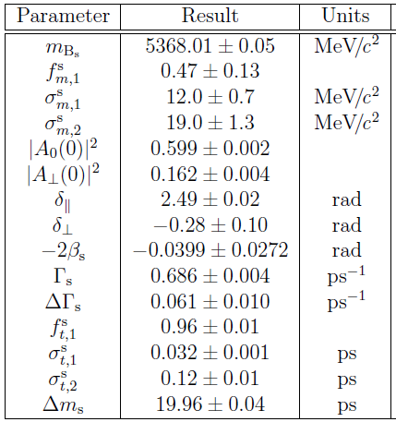
B_{s}⁰→J/ψφ : fits results
θ
φ
ψ
τ
Sensitivity studies with 2fb⁻¹ (one nominal year) : σ(2β_{s}) ~0.03
Good convergence for all physics parameters, all “detector parameters” can also be fitted.
Systematics: Angular distortions (± 5%) 7%
Proper time resolution (40 ± 4 fs) 5%
Mistag rate (0.34 ± 0.01) 7%
Ignoring a possible 5-10% S-wave contamination will introduce a ~15% bias on β_{s}.
Included in the fit will reduce the resolution ~20% but allows cos2β_{s} measurement
Δβ_{s}/β_{s}

Slide 11
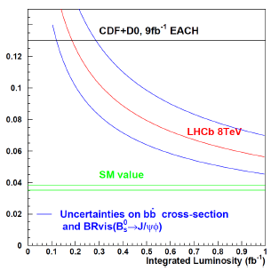
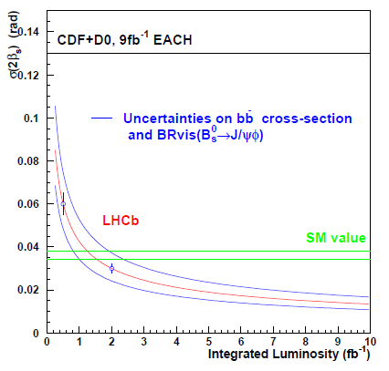
Sensitivity versus integrated Luminosity
First important results can come already from 2010 running.
Reduced LHC collision energy
√s=14TeV
If true β_{s} value is the current Tevatron measurement (NP-like)
we should measure it from B_{s}→J/ψ(μμ)φ with 200 pb⁻¹ !
With 10 fb⁻¹ > 3σ evidence of non-zero β_{s} even if only SM.
Other channels also under study: B_{s}→J/ψ(ee)φ, B_{s}→J/ψη, B_{s}→D_{s}⁺D_{s}⁻ …

Slide 12
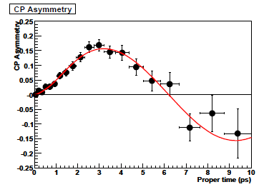
sin(2β) with B⁰→J/ψ(μμ)K_{S}(ππ)
Will be the first time dependent CP asymmetry measurement at LHCb:
with 200 pb⁻¹ expect σ(sin2β )~0.06
Channel | Signal yield (2 fb⁻¹) | B/S
B_{d}→J/ψ K_{S} | 94 k | 0.6
σ(sin2β )~0.020 in 2 fb⁻¹
With additional luminosity will give insight into possible NP contributions
to b→ccs. Will also constrain direct CP asymmetry.
NP from b→sss penguin decays
Good perspective at LHCb for B_{s}→φφ.
Time dependent analysis of angular distribution of flavour tagged events: σ_{stat} ( φ_{Bs → φφ}^{NP}) = 0.11 in 2 fb^{–1}
Channel | Yield (2 fb⁻¹) | B/S (90% CL)
B_{s} → φ φ | 3100 | < 0.8
B_{d} → φ K_{S} | 920 | < 1.1
From B_{d} →φK_{S} expect σ(sin2β_{eff}) ≈0.23

Slide 13
γ measurements
Many approaches to γ angle measurements. Most powerful through
‘B→DK’ strategies (charged and neutral B modes). D final state is
common to D⁰ and D⁰.
Many possibilities for D final states: Kπ, KK, ππ, Kπππ, K_{S}ππ ...
Opportunity for LHCb to make a contribution already with 200 pb⁻¹ :
expect ~10k events B→D(hh)K .
Dalitz plot analysis giving currently the single best γ results: LHCb will
reconstruct in B→D(K_{S}ππ)K ~6.800 events /2 fb⁻¹ with B/S<1.5 90%CL.
B_{s}→D_{s}K time dependent CP asymmetry is unique to LHCb: exploit good
PID for separation from B_{s}→D_{s}π and excellent proper time resolution.
Global fit to all measurements of γ from tree decays only :
σ(γ) ~ 4º with 2 fb^{–1}
More details in poster session: M. Gersabeck

Slide 14
Conclusions
LHCb detector is on place and operational, ready for data taking
at LHC start-up.
2β_{s} value could bring good news for NP: first LHCb results could
come already from 2010 running. Expected sensitivity ~0.03/ 2 fb⁻¹
Extensive LHCb program includes studies on many hadronic
channels for measurements on all CKM matrix parameters,
as well as searches for rare decays.
First year data will also provide a lot of inclusive measurements
and studies on control channels.
In the coming years LHCb results will finally provide a strong
improvement to flavour physics, in particular to the knowledge
of the B_{s} sector.

Slide 15
BACKUP

Slide 16
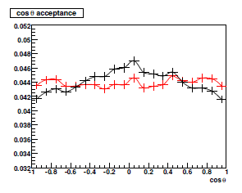
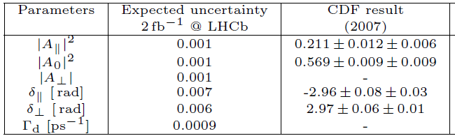

Angular acceptance checks with B⁰→J/ψK*
Measurement of polarization amplitudes and phases in the B⁰→J/ψK* decay from fit to time dependent angular distributions.
Comparison with existing results from B Factories and Tevatron will validate the use of simulated acceptance functions and allow estimation of systematic uncertainties to 2β_{s} related to angular acceptance.
θ
±5% modification
of acceptance
Strong constrain already for a ± 5% modified
angular acceptance .

