Slide 1



Measurements of Charmless B Decays related to α @ BaBar
Vincenzo Lombardo
INFN Milano (Italy)
On behalf of the BaBar Collaboration
E-mail: vincenzo.lombardo@mi.infn.it

Slide 2

Outline
Improved Measurements of B⁺ → ρ⁺ρ⁰
Determination of the Quark-Mixing Phase α in B → ρρ
Measurement of B decays to K₁(1270) π and K₁(1400) π
Observation of the neutral modes
Extraction of CKM angle α from the measurement B⁰ to a₁(1260) π
Measurement of Branching Fraction of B⁰ to a₁(1260)⁺ a₁(1260)⁻
First Observation of this decay mode
First polarization measurement of B → AA
In principle this mode can be used to measure α

Slide 3
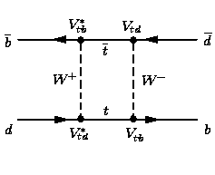
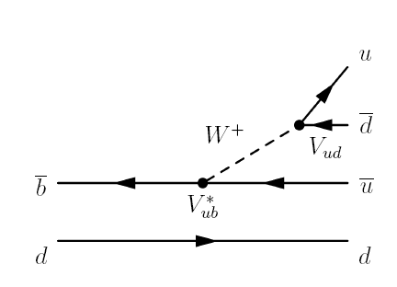


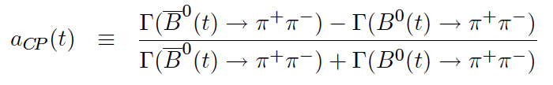
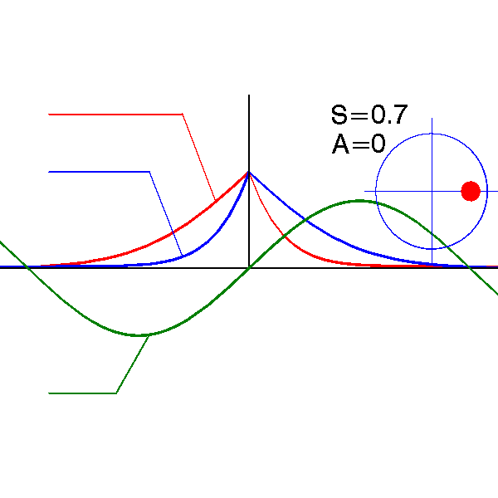
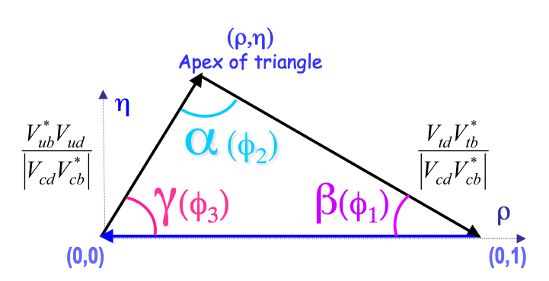
Measuring α_{eff}
B⁰-B⁰ mixing
Decay tree
If f is a CP eigenstate (π⁺π⁻ for instance) and if only one CKM amplitude contributes to the decay:
Γ_{Β}0(t)
_
SC
Γ_{Β}0(t)
= S sin(Δm_{d}t) – C cos(Δm_{d}t)
Time-dependent
asymmetry A_{CP}(t)
S=sin(2α), C=0

Slide 4

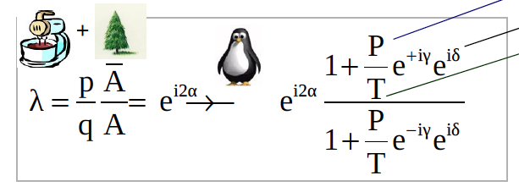

Measuring α_{eff}
In fact there are additional diagrams with a different CKM phase information...
Penguin
pollution?
(P) Penguin amplitude
(δ) strong phase
(T) Tree amplitude
q
_
p
α_{eff} is an effective value of α

Slide 5
Extraction of the angle α of the UT
The difficulty in extracting α is the presence of subleading penguin amplitudes with a different weak phase than that of the dominat tree amplitudes.
This difficulty can be overcome by using symmetries:
- isospin SU(2) Gronau, London PRL 65, 3381 (1990), Gronau, Zupan PRD 71, 074017 (2005)
- approx. flavour SU(3) Dighe, Gronau, Rosner PRD 57, 1783 (1998), Beneke et al., PLB 638, 68 (2006)
SU(2)
SU(3)
In ΔS =0 decays: T∼ V_{ub}V_{ud}* and P∼V_{cb}V_{cd}*
In ΔS=1 decays: T’∼ V_{ub}V_{us}* and P’∼V_{cb}V_{cs}*
thus P’/T’ is 1/λ² enhanced over P/T
⇒ can be used to bound P/T
h = π, ρ, a₁

Slide 6
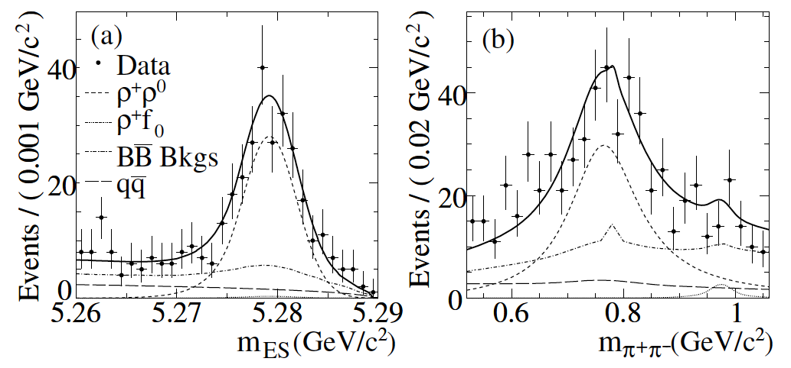
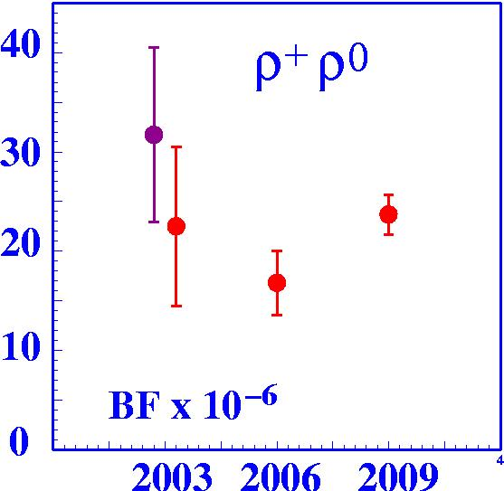


Improved Measurements of B⁺ → ρ⁺ρ⁰
_
465±5 M BB pairs
Improved methods (3D PDFs) to account for correlations in
the main (continuum & combinatoric BB) backgrounds
BaBar PRL102, 141802 (2009)
B(B⁺ → ρ⁺ρ⁰) = (23.7 ± 1.4 ± 1.4) x 10⁻⁶
f_{L} = 0.950 ± 0.015 ± 0.006

Slide 7
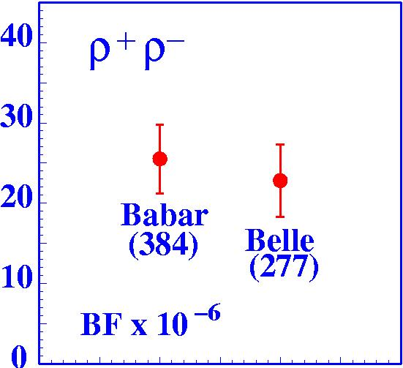
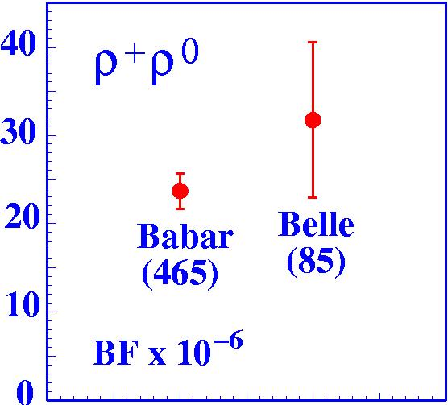
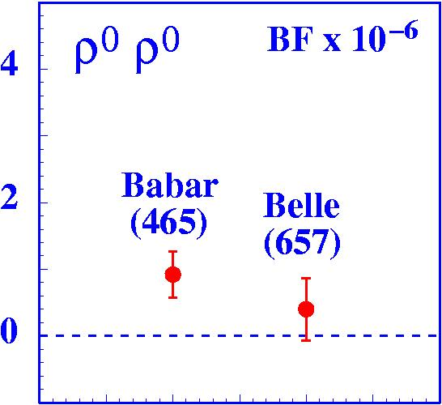
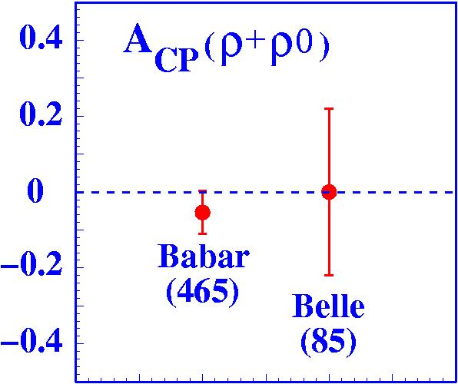
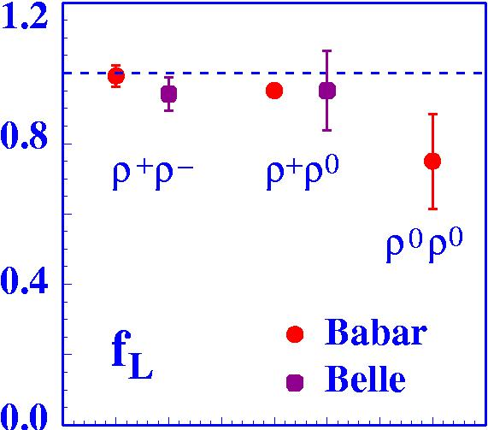
B → ρρ: Branching fractions and A_{CP}’s
Babar PRD76 (2007) 052007
Belle PRL96 (2006) 171801
Babar PRL102 (2009) 141802
Belle PRL91 (2003) 221801
Babar PRD78 (2008) 071104
Belle PRD78 (2008) 111102
BF(ρ⁰ρ⁰)/BF(ρ⁺ρ⁻)≈(3.6 ± 1.5)%
small penguin contribution
A_{CP}(ρ⁺ρ⁰)≈0
small EW penguin contribution
Babar PRL102 (2009) 141802
Belle PRL91 (2003) 221801

Slide 8
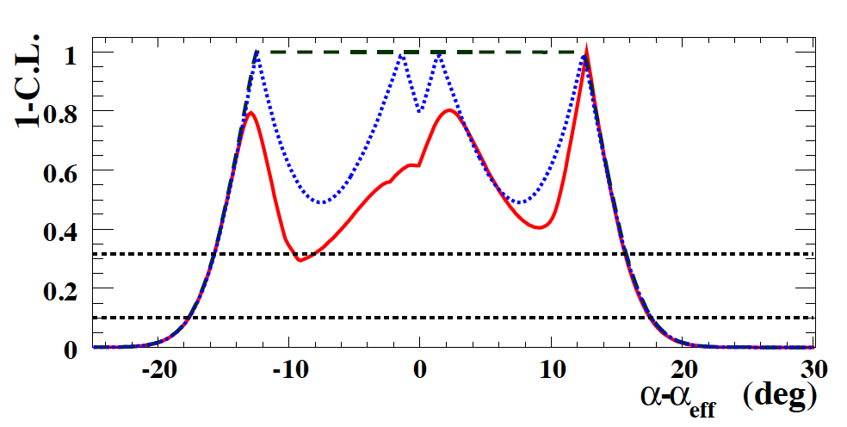
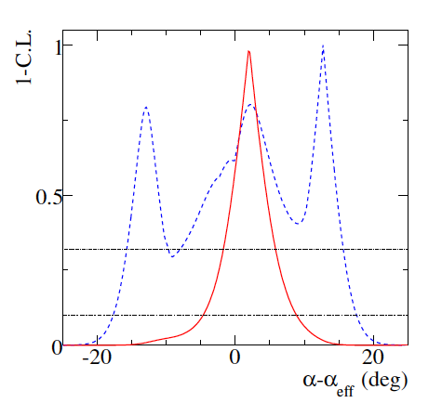
Isospin analysis B → (ρρ)_{Long}
10 inputs: 3 BF’s, 3 f_{L}’s, 2 S’s & 2 C’s
Perform α scan, minimize χ²
Impact of S⁰⁰ and C⁰⁰:
BaBar PRD78, 071104 (2008)
without S⁰⁰ or C⁰⁰
with only C⁰⁰
with S⁰⁰ and C⁰⁰
Impact of BF (B⁺ → ρ⁺ρ⁰ ):
BaBar PRL102, 141802 (2009)
with 2006 result
with 2009 result
α_{ρρ} = (92.4_{-6.5} ^{+6.0}) ° and -1.8°<Δα<6.7° @ 68% CL

Slide 9
Measurement of B decays to
K₁(1270) π and K₁(1400) π
Theoretical predictions for BF’s O(10⁻⁶)‏
- Laporta et al., PRD 74, 054035 (2006)‏
- Calderon et al., PRD 76, 094019 (2007)‏
- Cheng et al., PRD 76, 114020 (2007)
  ‏
From ARGUS Coll., PLB 254, 288 (1991):
B(B⁰->K₁(1400)⁺π⁻)< 1.1×10⁻³ @ 90% C.L.
B (B⁺->K₁(1400)⁰π⁺)< 2.6×10⁻³ @ 90% C.L.
    BaBar Preliminary result (ICHEP 2008)‏
    B (B⁰->K₁(1400)⁺π⁻ + K₁(1270)⁺π⁻) ~ O(10⁻⁵)

Slide 10
Measurement of B decays to K₁(1270) π and K₁(1400) π
K₁(1270) + K₁(1400) treated as a whole
  SU(3) octet states K_{1A} , K_{1B}:
  |K₁(1400)> = |K_{1A}> cosθ + |K_{1B}> sinθ θ=58°
  |K₁(1270)>= - |K_{1A}> sinθ + |K_{1B}> cosθ
  nearly equal masses
  same quantum numbers and final state (Kππ)
  interference effects
Most high-statistics data from WA3 exp. (K⁻p->K⁻π⁺π⁻p)
  ACCMOR Coll., NPB 187, 1 (1981)‏
  Kππ analyzed using a two-resonance, six channel K-matrix model
Cheng,Yang PRD76, 114020 (2007)

Slide 11
Measurement of B decays to K₁(1270) π and K₁(1400) π
Decay parameters fixed to the values extracted from a fit to WA3 data
Extended ML fit for BF
Fit variables: m_{ES}, ΔE, Fisher, m_{Kππ},|H|
Neutral modes (B⁰->K₁⁺π⁻)
  simultaneous fit to “K*” and “ρ” band
  signal, qq, K*(1410)π,K*ππ + ρKπ, a₁π, D_{Kππ}π
Charged modes (B⁺->K₁⁰π⁺)
  fit to “K*” band only
  signal, qq, K*(1410)π, K*ππ + ρK⁰π, K*ρ
BaBar
“K* band”
“ρ band”

Slide 12
Fit results - K₁π
_
454±5 M BB pairs
      BF(B⁰->K₁(1400)⁺π⁻ + K₁(1270)⁺π⁻)) = (3.1^{+0.8}_{-0.7})×10⁻⁵ S=7.5σ
      BF(B⁺->K₁(1400)⁰π⁺ + K₁(1270)⁰π⁺)) = (2.9^{+3.0}_{-1.7})×10⁻⁵ S=3.2σ
Neutral modes
Charged modes
    B (B⁰->K₁(1400)⁺π⁻)=(1.6^{+0.8}_{-0.9})×10⁻⁵
    B (B⁰->K₁(1270)⁺π⁻)=(1.6^{+0.9}_{-1.0})×10⁻⁵
    B (B⁰->K_{1A}⁺π⁻)=(1.4^{+0.9}_{-1.0})×10⁻⁵
    B (B⁺->K₁(1400)⁰π⁺)<3.9×10⁻⁵
    B (B⁺->K₁(1270)⁰π⁺)<4.0×10⁻⁵
    B (B⁺->K_{1A}⁰π⁺)<3.6×10⁻⁵
sPlots
Preliminary BaBar Results
“K*” band
“ρ” band
“K*” band
Neutral modes
Charged modes
m_{ES} (GeV)
ΔE (GeV)
M_{Kππ}(GeV/c²)

Slide 13
Bounds on α from CP-violation asymmetries in B⁰->a₁π
The BF's and the CP asymmetries needed to extract α from B⁰->a₁π using
flavor SU(3) are:
B → a₁π branching fraction PRL 97, 051802 (2006), BaBar Coll.
B → a₁π TD CPV asymmetries (S=sin2α_{eff}) PRL 98, 181803 (2007), BaBar Coll. ‏
B → a₁K branching fractions PRL 100, 051803 (2008), BaBar Coll.
B → K₁π branching fractions (to be submitted to PRD)
Gronau and Zupan, PRD 73, 057502 (2006)
We obtain |α_{eff}-α| <11° (13°) at 68% (90%) probability
The determination of α presents an eightfold ambiguity in the range [0°,180°].
Assuming that the relative strong phase between the relevant tree amplitudes is negligible → two-fold ambiguity (α_{eff} = 11°±7° and α_{eff} = 79°±7°).
We combine the solution near 90° with the bounds on |α_{eff}-α| and estimate the
weak phase:
α_{a1π} = 79°±7°±11°

Slide 14
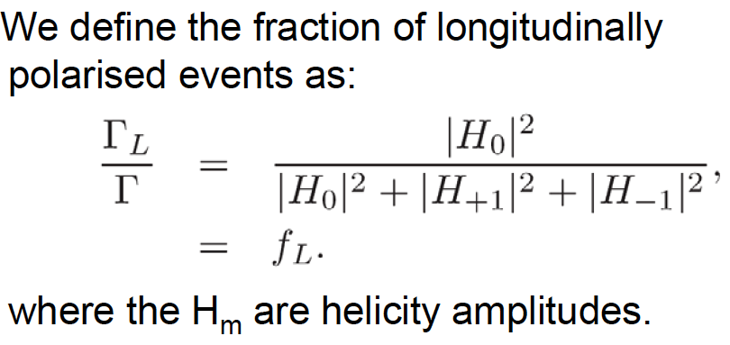
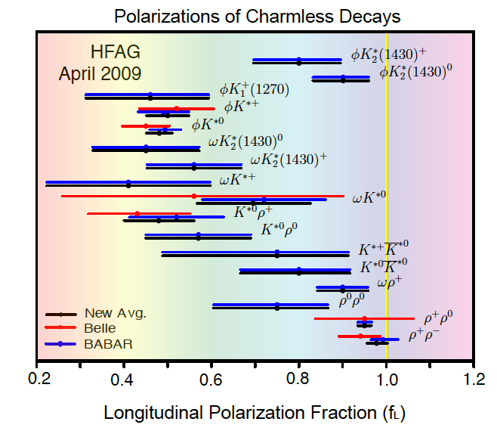
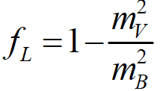
Polarization Puzzle
Considerable theoretical attention on charmless
B decays to final states involving Vector mesons
in the last few years
Significant progress in experimental constraints
on B→VV, VT, AV
B->ρρ decays fit the pattern
f_{L} large also for K^{*0}K^{*0}, ωρ⁺, φK₂^{*0}, ρK^{*+}
f_{L} ∼ 0.5 for some penguin dominated modes:
notably φK* and K^{*0}ρ⁺
Still puzzled by polarization: several non-trivial
polarization have been measured
Important to study polarization in new decays

Slide 15
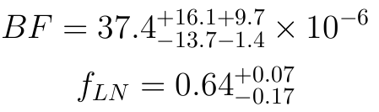
Observation and Polarization measurement of B⁰ to a₁(1260)⁺ a₁(1260)⁻ decay
Theoretical expectations for B⁰ → a₁(1260)⁺ a₁(1260)⁻
QCD Factorization framework
Branching Ratios and Polarization in B-> VV, VA and AA decays
H.Y.Cheng and K.C.Yang Phys. Rev. D 78, 094001 (2008)
Assume naive factorization + improved nonrelativistic
ISGW quark model for form factors B→A transitions
BF = 6.4 x 10⁻⁶
Nonleptonic two-body B-decays including axial-vector mesons in the final state
G. Calderon, J.H.Munoz and C.E.Vera Phys. Rev. D76, 094019 (2007)
BF upper limit of 2.8 x10⁻³@ 90% CL measured by CLEO (1989)

Slide 16
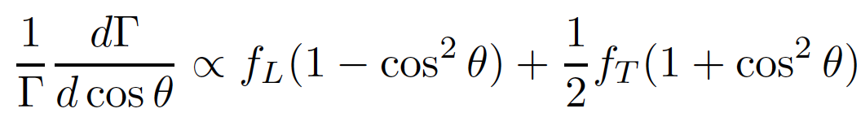

Observation and Polarization measurement of B⁰ to a₁(1260)⁺ a₁(1260)⁻ decay
First measurement of longitudinal polarization in this mode
Don’t separate the dominant P-wave (ππ)_{ρ} and S-wave (ππ)_{σ} in a₁→ 3π
(accounted for in systematics)
Limited number of signal to perform a full angular analysis
Using helicity formalism (after integrating over azimutal angle between decay planes
of the two a₁ mesons) we get:
longitudinal polarization fraction
where θ is the angle between the normal to the decay plane of the three pions of one
a₁and the flight direction of the other a₁, both calculated in the rest frame of the a₁

Slide 17
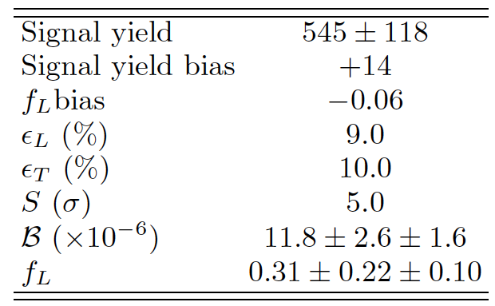
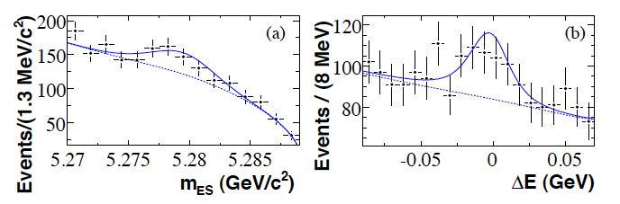
Observation and Polarization measurement of B⁰ to a₁(1260)⁺ a₁(1260)⁻ decay
_
465±5 M BB pairs
ML fit results
Projections
Specific component for charmless non-resonant backgrounds to 6 pions
5 sigma observation (f_{L} not defined in the zero signal hypotesis, taken into account )
Assuming BF(a₁⁺→π⁻π⁺π⁺) = BF(a₁⁻→π⁺π⁰π⁰) and BF(a₁⁺→(3π)⁺) =100%
B(B⁺→a₁⁺ a₁⁻) = (47.3± 10.5 ± 6.3) ·10⁻⁶
BF and f_{L} in general agreement with QCD Factorization
arXiv: 0907.1776

Slide 18
Conclusions
Improved Measurements of B⁺ → ρ⁺ρ⁰
Determination of the Quark-Mixing Phase α in B → ρρ
α = (92.4_{-6.5} ^{+6.0}) ° and -1.8°<Δα<6.7° @ 68% CL (substantial improvement)
CP asymmetries in B → ρ⁺ρ⁻ using full dataset will improve further this measurement!
Measurement of B decays to K₁(1270) π and K₁(1400) π
Observation of the neutral modes (7.5 σ)
First time extraction of CKM angle α from the measurement B⁰ to a₁(1260) π:
α = 79°±7°±11°
A new and independent measurement of α is now available!
a₁π join the “ππ/ρρ/ρπ” club for measuring α!
Measurement of Branching Fraction of B⁰ to a₁(1260)⁺ a₁(1260)⁻
First Observation of this decay mode (5.0 σ)
First polarization measurement of B → AA
BF and longitudinal polarization in general agreement with QCD factorization
Errors are too large to extract α with the available statistics

Slide 19
Backup Slides

Slide 20
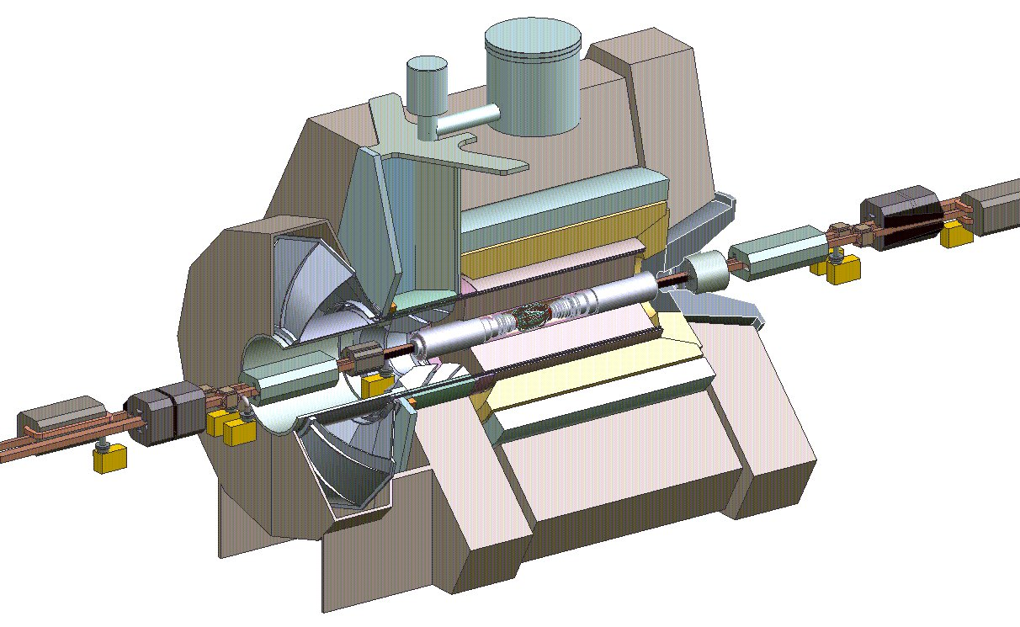











Babar Detector
EMC
6580 CsI(Tl) crystals
1.5T solenoid
e⁺ (3.1GeV)
DIRC (PID)
144 quartz bars
11000 PMs
Drift Chamber
40 layers
e⁻ (9GeV)
Silicon Vertex Tracker
5 layers, double sided strips
Instrumented Flux Return
Iron / Resistive Plate Chambers or Limited Streamer Tubes (muon / neutral hadrons)

Slide 21
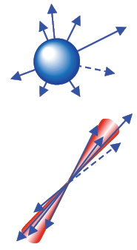
Physics Analysis with a Boosted ϒ(4S)
- Kinematics:
  Beam energy
  substituted mass
  Energy difference
- Topology:
spherical BB events
“jetty” qq events
Event-shape variables combined
in a neural network or Fisher
discriminant to suppress jet-like
continuum events.
- Hadron ID ⇒ separation π/K

Slide 22
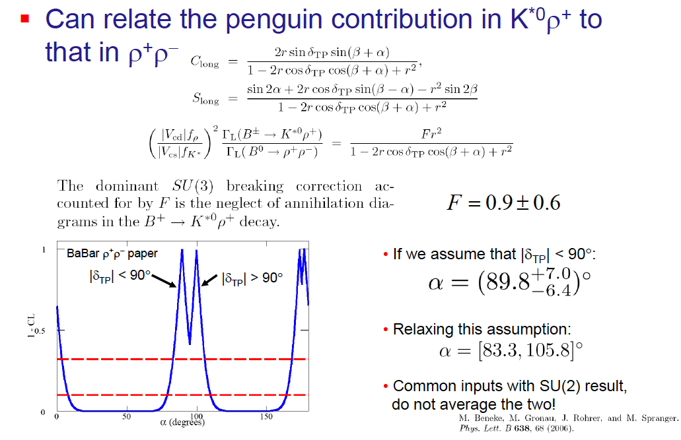
SU(3) : ρρ

Slide 23
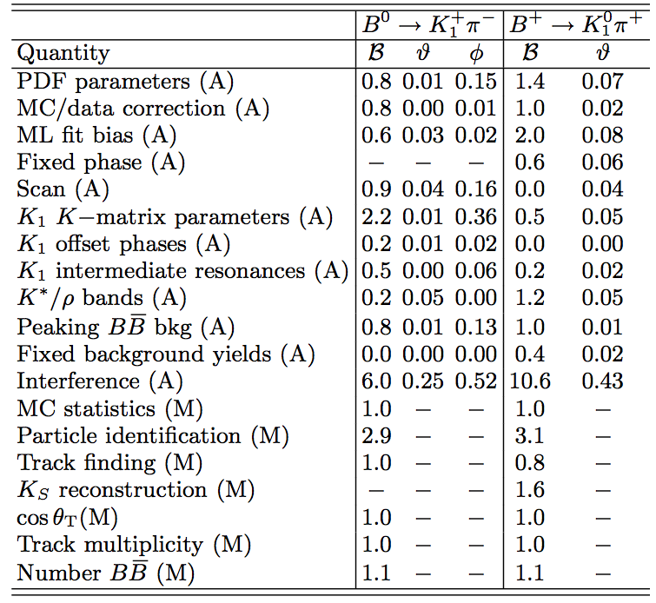
Systematics: B⁰ to K₁π

Slide 24
Approx SU(3) flavour symmetry: a₁π

Slide 25
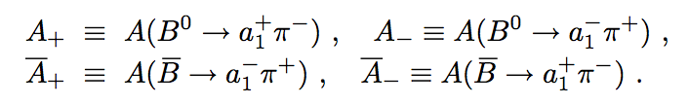
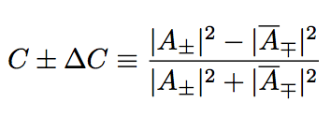
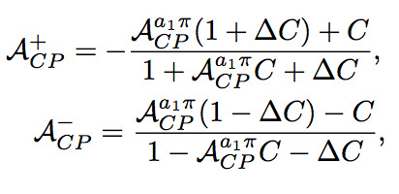
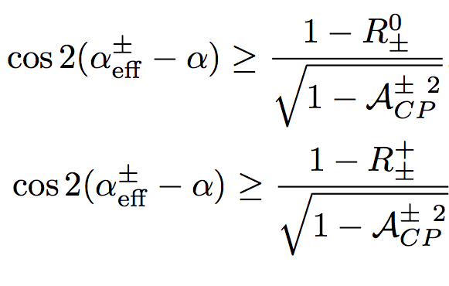
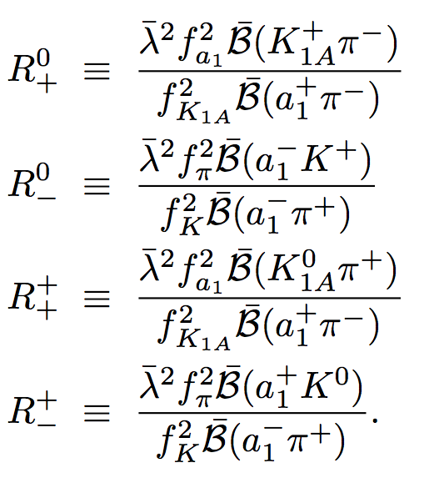
Bounds on α from CP-violation asymmetries in B⁰->a₁π
A_{CP} are time- and flavor- integrated
charge asymmetry in B⁰→a₁π
SU(3) relations result in:
where
|Δα| = (|α_{eff}⁺-α|+|α_{eff}⁻-α|)/2
get |α_{eff}^{+,-}-α|by solving the system
Metod works much better if smaller penguin/tree
‏
Gronau and Zupan, PRD 73, 057502 (2006)

Slide 26
BF and Polarization measurement of B⁰ to a₁(1260)⁺ a₁(1260)⁻ decay
Selection - ML fit
Reconstruct a₁⁺→π⁺π⁻π⁺ with 2π to form a ρ⁰ candidate
0.87 < a₁ mass <1.75 GeV/c²
PID for pions
Vetos to suppress charm bkg
Best candidate from highest B vertex χ² probability
5 hypoteses in the likelihood model:
signal, continuum bkg, charmless, generic charm and peaking charm bkg
charmless non-resonant decays (6 pions in the final state) taken into account

Slide 27
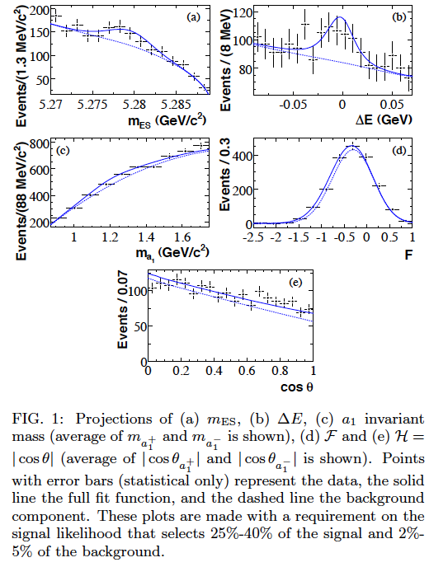
Projections: B⁰ to a₁(1260)⁺ a₁(1260)⁻ decay

Slide 28
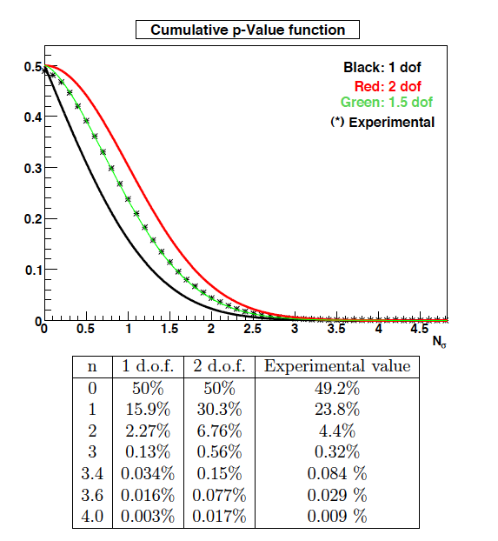
Significance: B⁰ to a₁(1260)⁺ a₁(1260)⁻ decay

Slide 29
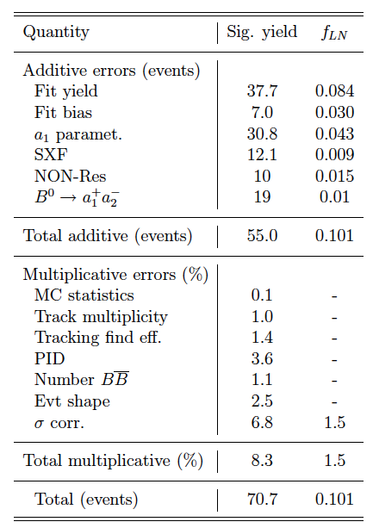
Systematics: B⁰ to a₁(1260)⁺ a₁(1260)⁻ decay

