Slide 1
Cosmology and Dark
Energy
V. Mukhanov
Sektion Physik, LMU, München

Slide 3
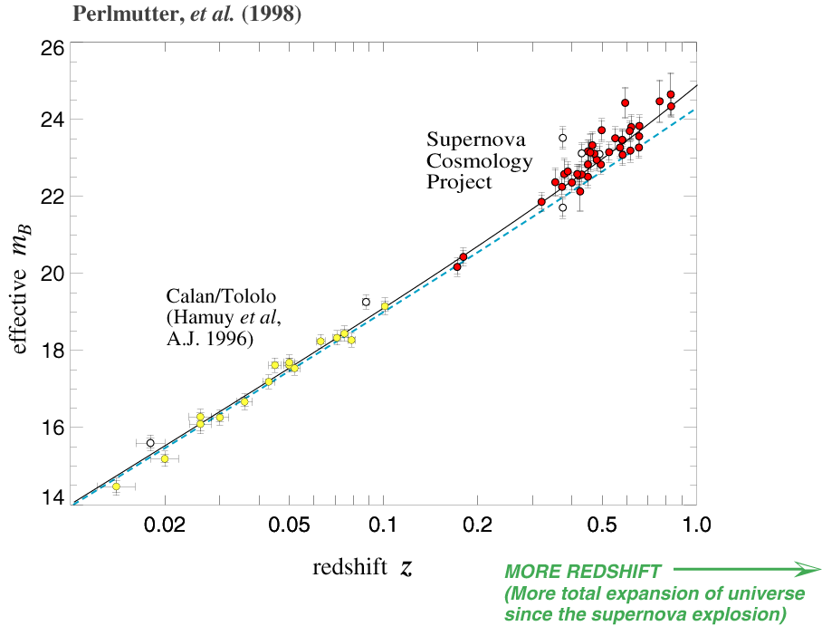
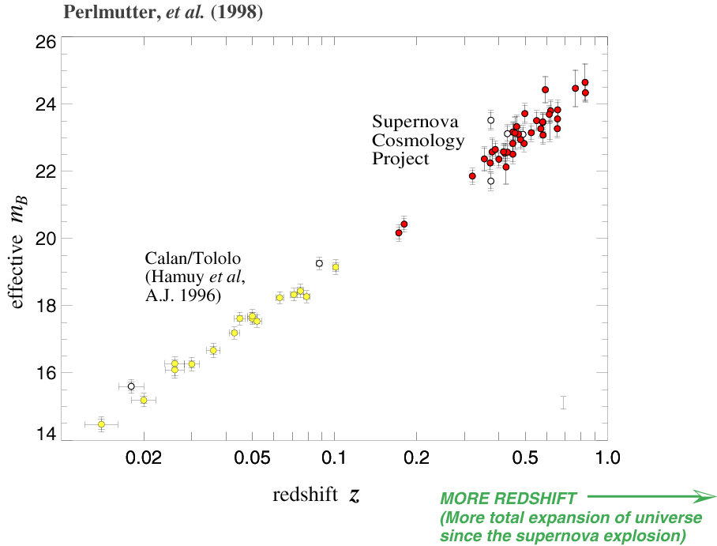
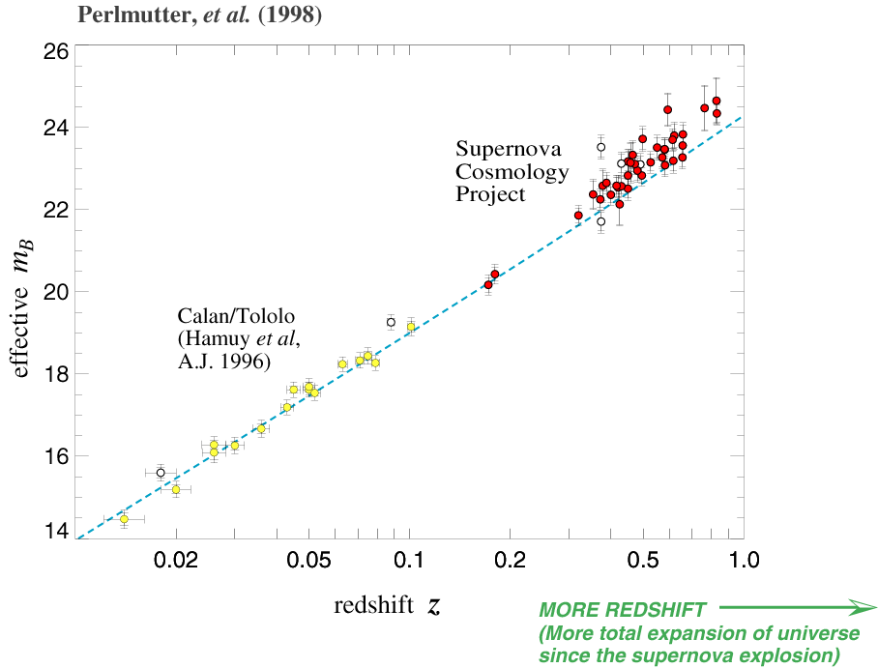

Slide 5
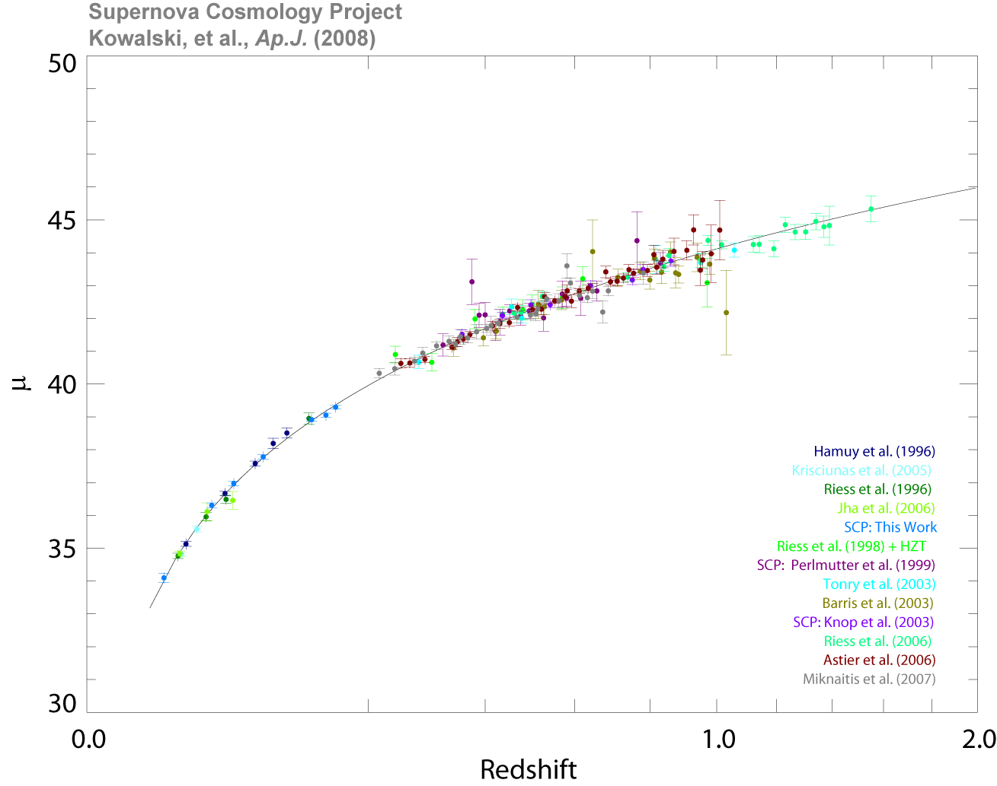

Slide 6
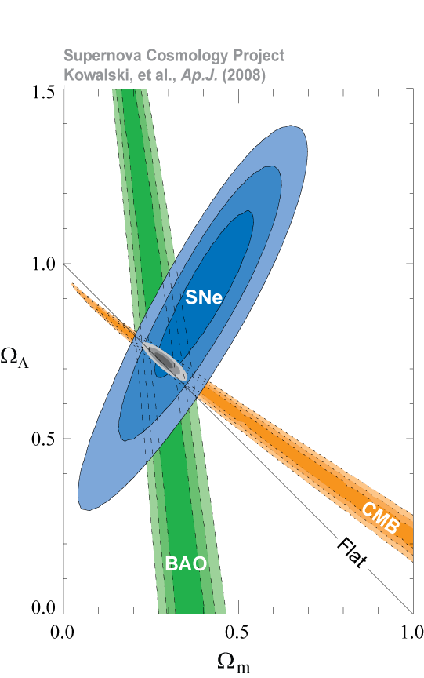

Slide 7
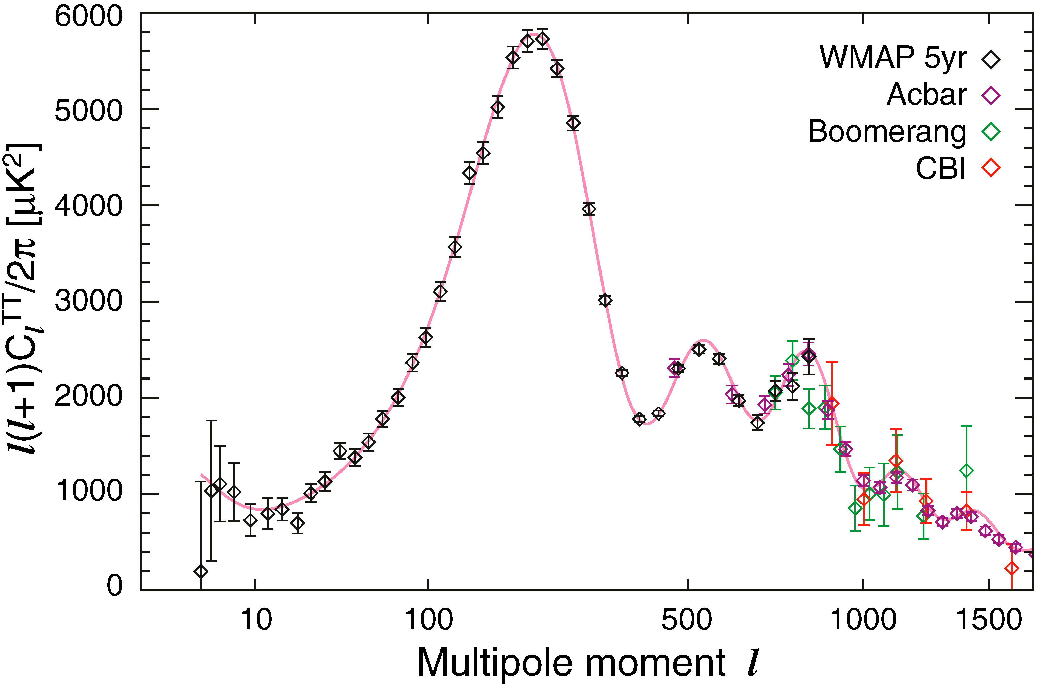

Slide 10
6
5
3.5
4
3
2.5
3
2
1.5
1
2
0.5
200
400
600
800
1000
1200
1400
l
1
200
400
600
800
1000
1200
1400
l
2
2
1.5
1
1
0.5
0
200
400
600
800
1000
1200
1400
0
l
200
400
600
800
1000
1200
1400
-1
l
-0.5
-1

Slide 11
6
5
4
3
2
1
200
400
600
800
1000
1200
1400
l

