Slide 1



eRHIC and LHeC
Vladimir N. Litvinenko
Brookhaven National Laboratory, Upton, NY, USA
Stony Brook University, Stony Brook, NY, USA
Center for Accelerator Science and Education
Why we need electron-hadron colliders?
eRHIC
LHeC
Conclusions
This talk is focused on possible designs and predicted performance if two proposed high-energy, high-luminosity electron-hadron colliders: eRHIC at BNL and and LHeC at CERN.
Both the eRHIC and the LHeC will add polarized electrons to the list of colliding species in these versatile hadron colliders: 10-20 GeV electrons to 250 GeV RHIC and 50-100 GeV electrons to 7 TeV LHC. Both colliders plan to operate in electron-proton (in RHIC case protons are polarized as well) and electron-ion collider modes. These two colliders are complimentary both in the energy range and in the physics goals.
I will discuss possible choices of the accelerator technology for the electron part of the collider for both eRHIC and LHeC, and will present predicted performance for the colliders. In addition, possible staging scenarios for these collider will be discussed.
V.N. Litvinenko, Europhysics HEP Conference, Krakow, July 17, 2009

Slide 2
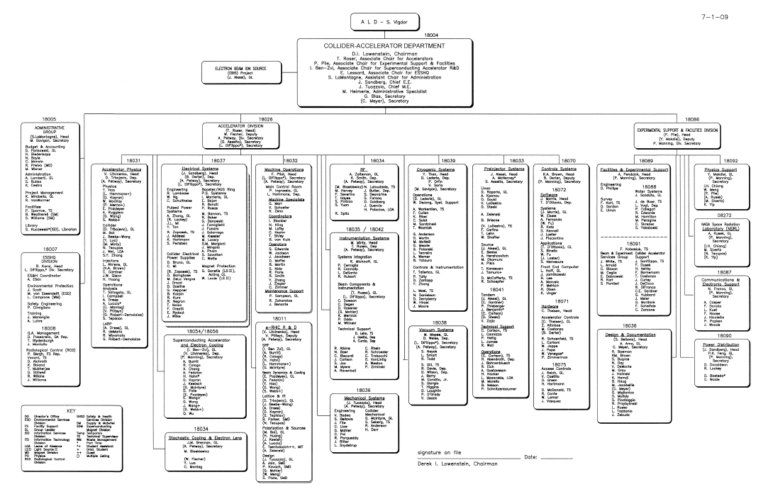
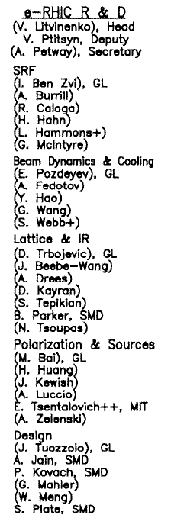
Materials are from eRHIC R&D group at C-AD, BNL and LHeC Co
F. Zimmermann, F. Bordry, H.-H. Braun, O.S. Brüning, H. Burkhardt, A. Eide, A. de Roeck, R. Garoby, B. Holzer, J.M. Jowett, T. Linnecar, K.-H. Mess, J. Osborne, L. Rinolfi, D. Schulte, R. Tomas, J. Tückmantel, A. Vivoli, CERN
S.Chattopadhyay, J. Dainton, Cockcroft Inst., Warringto, M. Klein, U.Liverpool, UK
A.K. Ciftci, Ankara U.; H. Aksakal, U. Nigde; S. Sultansoy, TOBB ETU, Ankara, Turkey
T. Omori, J. Urakawa, KEK, Japan,
F. Willeke, BNL, U.S.A.
www.bnl.gov/cad/eRhic/
Inputs on Physics from BNL EIC task force
lead by E.-C. Aschenauer, T. Ulrich,
A.Cadwell, A.Deshpande, R. Ent, T. Horn, H. Kowalsky,
M. Lamont, T.W. Ludlam, R. Milner, B. Surrow,
S.Vigdor, R. Venugopalan, W.Vogelsang, ….
http://www.eic.bnl.gov/taskforce.html,
http://hbu.home.cern.ch/hbu/LHeC.html
http://www.ep.ph.bham.ac.uk/exp/LHeC/
EIC activity & meetings are at http://web.mit.edu/eicc/
V.N. Litvinenko, Europhysics HEP Conference, Krakow, July 17, 2009

Slide 3
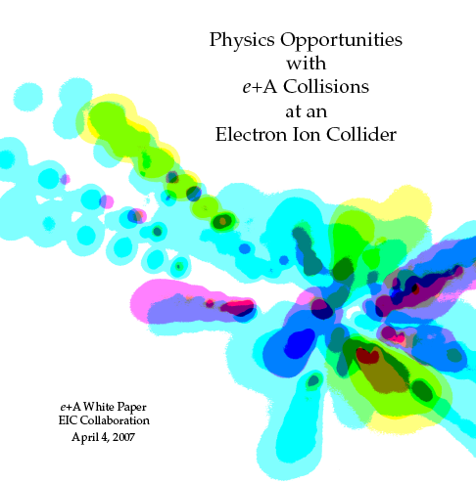
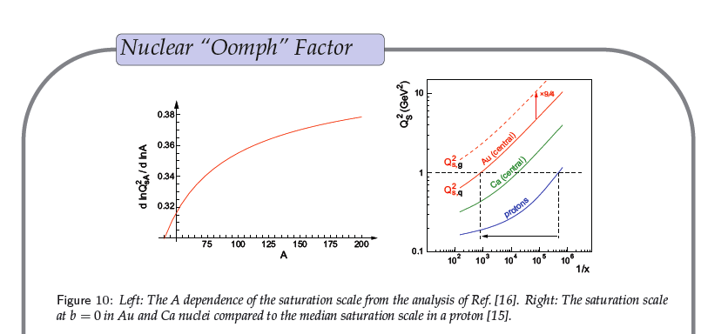
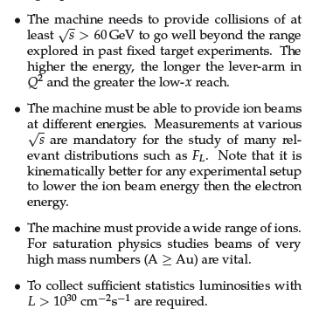
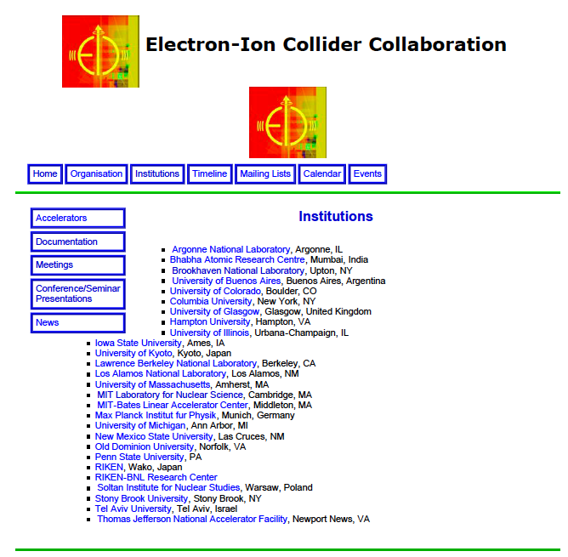
Position paper on eA collider by Thomas Ullrich at al.
Condense matter physics of strong force
20 GeV
electrons
100 GeV/u Au, U
e⁻
Physics Requirements circa 2003
To provide electron-proton and electron-ion collisions.Should be able to provide the beams in following energy ranges: 5-10 GeV (changed to 20-30 GeV) polarized electrons OR 10 GeV polarized positrons
50-250 GeV polarized protons OR 100 GeV/u gold ions
Luminosities in 10³² - 10³⁴ cm⁻²s⁻¹ region for e-p in 10³⁰ - 10³³ cm⁻²s⁻¹ region for e-Au collisions
70% polarization degree for both lepton and proton beams.
Longitudinal polarization in the collision point for both lepton and proton beams.
Further information on physics part of the project at www.bnl.gov/eic

Slide 4
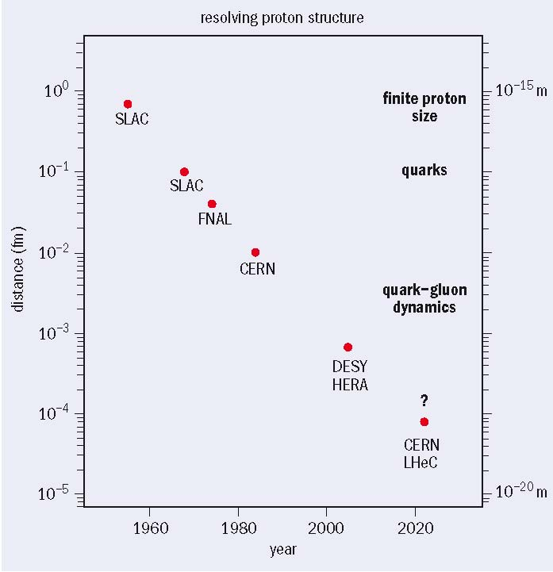
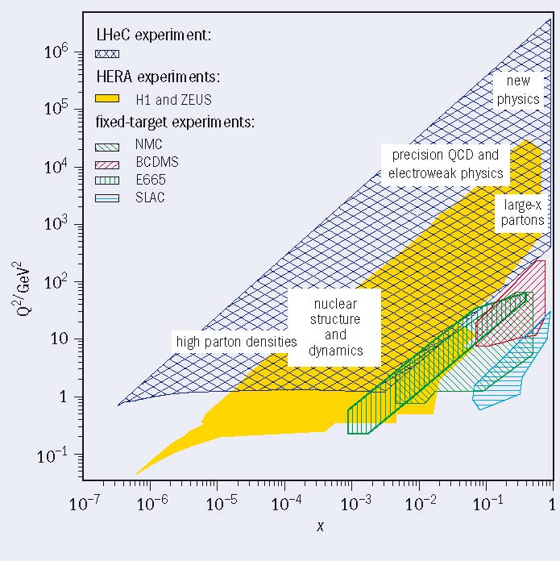
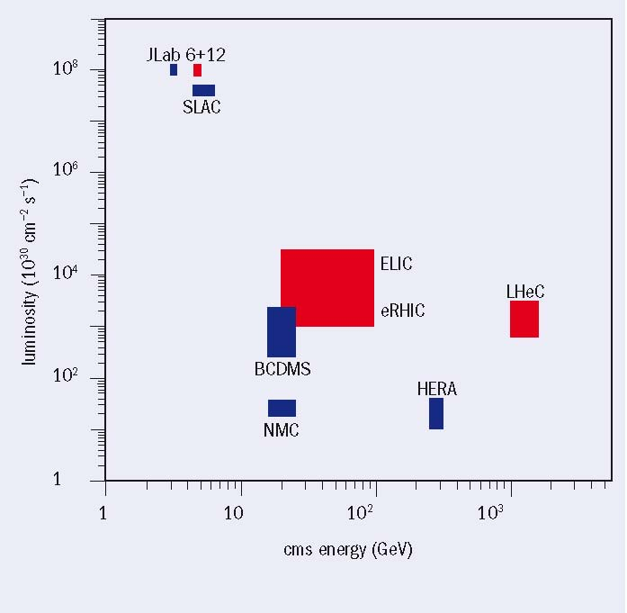
LHeC physics motivation
Distance scales resolved in lepton-hadron scattering experiments since 1950s, and some of the new physics revealed
Kinematic plane in Bjorken-x and resolving power Q², showing the coverage of fixed target experiments, HERA and LHeC
> 10x
Energies and luminosities of existing and proposed future lepton-proton colliders
Electron energy up to 60-140 GeV, Luminosity ~10³³ cm⁻²s⁻¹
>5x HERA c.m. energy
>>10x HERA luminosity
Particle physicists request both e⁻p & e⁺p collisions;
lepton polarization is
also “very much desired”
© Max Klein & Paul Newman, CERN Courier April 2009

Slide 5
Many common features
eRHIC
LHeC
Add 10-30 GeV polarized electron machine to RHIC with 250 GeV polarized protons and 100 GeV/u ions
CM energy 15-200 GeV
Luminosity L~10³² ⁻10³⁴ is based on demonstrated hadron beam parameters
First eRHIC paper, 1999, I. Ben. Zvi et al.,
First BNL Workshop on eRHIC, EPIC workshop at Indiana University, 1999.
“eRHIC Zeroth-Order Design Report” and cost estimate, BNL 2004
2007 – after detailed studies we found that linac-ring has 5-10 fold higher luminosity – it became the main option
March 2008 – first staging option of eRHIC
2009 – focus on 4 GeV MeRHIC technical design, staging and cost estimates, first release – Fall 2009
Regular semiannual EIC collaboration meeting (together with ELIC) since 2004 and EICAC (advisory committee) meetings starting Feb. 2009
Add 50-150 GeV polarized electron machine to 7 TeV protons and 3 TeV/u ions
CM energy 0.5-2 TeV
Luminosity L~10³² ⁻10³⁴ is based on LHC hadron beam parameters
First LHeC paper in 1997 - E. Keil, “LHC ep option”, LHC-Project-Report-093, CERN Geneva 1997
First LHeC workshop – 2008
Pursues both ring-ring and linac-ring options
The 2nd LHeC workshop will take place on 1-3 September, 2009 at Divonne
Two workshops (2008 and 2009) under the auspices of ECFA with the goal of having a Conceptual Design Report on the accelerator, the experiment and the physics.
A Technical Design report will then follow if appropriate
V.N. Litvinenko, ENC/EIC workshop, GSI, May 28 2009

Slide 6
eRHIC Scope -QCD Factory
RHIC
Electron accelerator
p
Polarized protons
₂₅↓ 50-250 (325) GeV
Unpolarized and
polarized leptons
4-20 (30) GeV
e⁻
e⁻
Light ions (d,Si,Cu)
Heavy ions (Au,U)
50-100 (130) GeV/u
e⁺
70% beam polarization goal
Positrons at low intensities
Polarized light ions (He³) 215 GeV/u
Center mass energy range: 15-200 GeV
eA program for eRHIC needs as high as possible energies of electron beams even with a trade-off for the luminosity.
20 GeV is absolutely essential and 30 GeV is strongly desirable
Potential of future upgrading RHIC energy to 800 GeV
V.N. Litvinenko, Europhysics HEP Conference, Krakow, July 17, 2009

Slide 7
2007 Choosing the focus:
ERL or ring for electrons?
Two main design options for eRHIC:
  Ring-ring:
  Linac-ring:
Electron storage ring
RHIC
✔
Electron linear accelerator
RHIC
L x 10
V.N. Litvinenko, Europhysics HEP Conference, Krakow, July 17, 2009

Slide 8
2008: Staging of eRHIC
MeRHIC: Medium Energy eRHIC
  Both Accelerator and Detector are located at IP2 of RHIC
  4 GeV e⁻ x 250 GeV p (45 or 63 GeV c.m.), L ~ 10³²-10³³ cm⁻² sec ⁻¹
  90% of hardware will be used for HE eRHIC
eRHIC, High energy and luminosity phase, inside RHIC tunnel
Full energy, nominal luminosity
  Polarized 20 GeV e⁻ x 325 GeV p (160 GeV c.m), L ~ 10³³-10³⁴ cm⁻² sec ⁻¹
  30 GeV e x 120 GeV/n Au (120 GeV c.m.), ~1/5 of full luminosity
  and 20 GeV e x 120 GeV/n Au (120 GeV c.m.), full liminosity
eRHIC up-grades – if needed, inside RHIC tunnel
Higher luminosity at reduced energy
    Polarized 10 GeV e⁻ x 325 GeV p, L ~ 10³⁵ cm⁻² sec ⁻¹
  Or Higher energy operation with one new 800 GeV RHIC ring
    Polarized 20 GeV e⁻ x 800 GeV p (~300 GeV c.m), L ~ 10³⁴ cm⁻² sec ⁻¹
    30 GeV e x 300 GeV/n Au (~200 GeV c.m.), L ~ 10³² cm⁻² sec ⁻¹
V.N. Litvinenko, Europhysics HEP Conference, Krakow, July 17, 2009

Slide 9
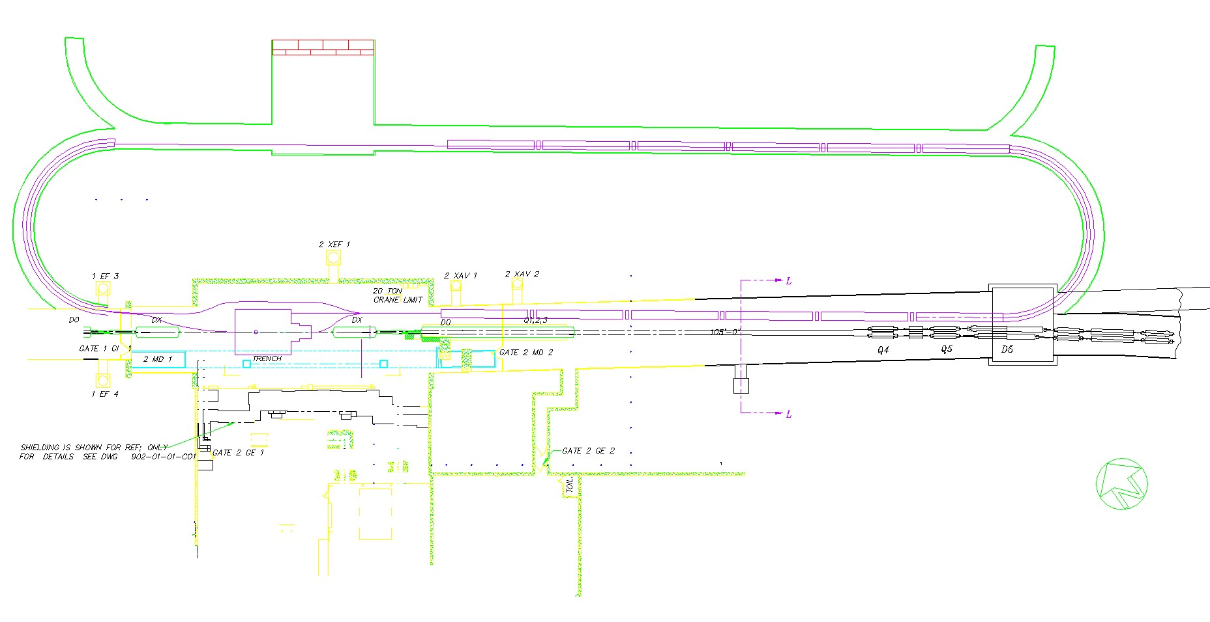
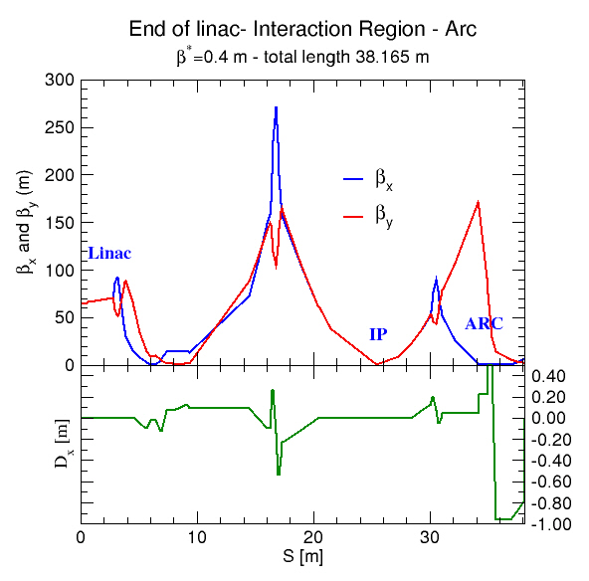
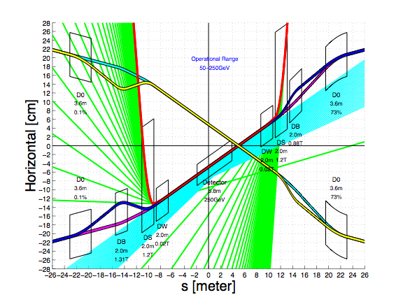
MeRHIC with 4 GeV ERL at 2 o’clock IR of RHIC
Lattice and IR by D.Trbojevic, D.Kayran
Linac 1
Linac 1
Linac 2
© J.Bebee-Wang
(April 09)
V.N. Litvinenko, Europhysics HEP Conference, Krakow, July 17, 2009

Slide 10

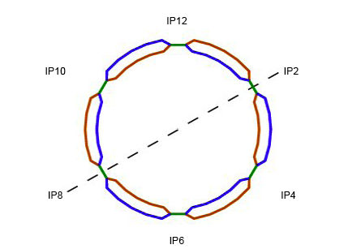


4 GeV e x 250 GeV p – 100 GeV/u Au
MeRHIC
2 x 60 m SRF linac
3 passes, 1.3 GeV/pass
Polarized
e-gun
Beam
dump
3 pass 4 GeV ERL
PHENIX
STAR
V.N. Litvinenko, Europhysics HEP Conference, Krakow, July 17, 2009

Slide 11
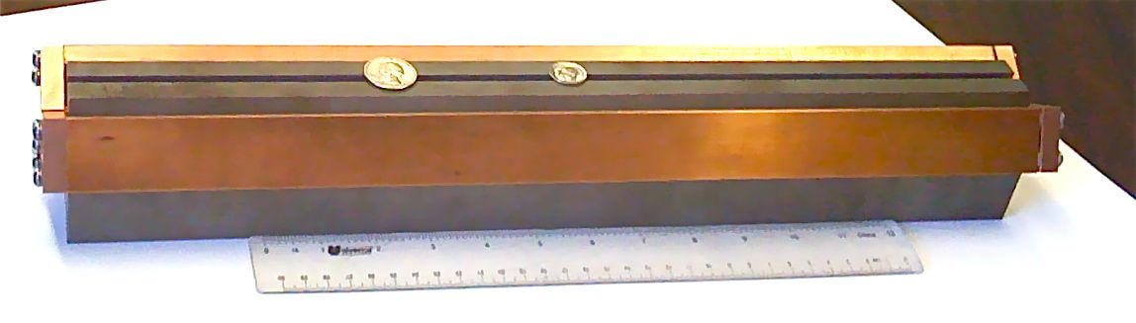
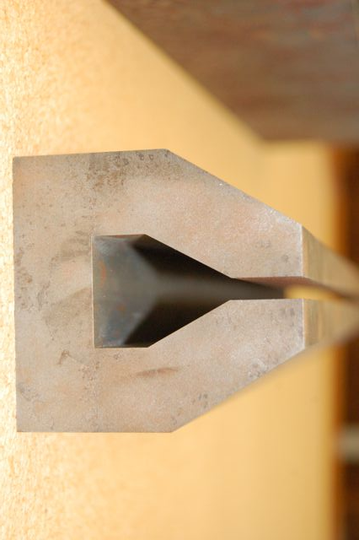
20 GeV e x 325 GeV p – 130 GeV/u Au
eRHIC
2 x 200 m SRF linac
4 (5) GeV per pass
5 (4) passes
Gap 5 mm total
0.3 T for 30 GeV
Polarized
e-gun
Beam
dump
Coherent
e-cooler
20 GeV
e-beam
5 mm
16 GeV
e-beam
Common vacuum chamber
5 mm
Possibility of 30 GeV low current
operation
12 GeV
e-beam
PHENIX
8 GeV
e-beam
5 mm
5 mm
4 to 5 vertically separated
recirculating passes
STAR
V.N. Litvinenko, Europhysics HEP Conference, Krakow, July 17, 2009

Slide 12
20 GeV e x 800 GeV p – 320 GeV/u U
eRHIC II
2 x 200 m SRF linac
4 (5) GeV per pass
5 (4) passes
Up-grade:
New LHC-class SC magnets
in Blue ring
Polarized
e-gun
Beam
dump
Coherent
e-cooler
20 GeV
e-beam
5 mm
16 GeV
e-beam
Common vacuum chamber
5 mm
Possibility of 30 GeV low current
operation
12 GeV
e-beam
(e)PHENIX
8 GeV
e-beam
5 mm
Yellow ring serves as
200 GeV injector into upgraded
Blue ring
5 mm
4 to 5 vertically separated
recirculating passes
(e)STAR
V.N. Litvinenko, Europhysics HEP Conference, Krakow, July 17, 2009

Slide 13
eRHIC parameters
 | MeRHIC |  | eRHIC with CeC |  | eRHIC II 8T RHIC
 | p (A) | e | p (A) | e | p/A | e
Energy, GeV | 250 (100) | 4 | 325 (125) | 20 <30> | 800 (300) | 20 <30>
Number of bunches | 111 |  | 166 |  | 166
Bunch intensity (u) , 10¹¹ | 2.0 | 0.31 | 2.0 (3) | 0.24 | 2.0 (3) | 0.24
Bunch charge, nC | 32 | 5 | 32 | 4 | 32 | 4
Beam current, mA | 320 | 50 | 420 | 50 <5> | 420 | 50 <5>
Normalized emittance, 1e-6 m, 95% for p / rms for e | 15 | 73 | 1.2 | 18 | 1 | 10
Polarization, % | 70 | 80 | 70 | 80 | 70 (?) | 80
rms bunch length, cm | 20 | 0.2 | 4.9 | 0.2 | 4.5 | 0.2
β*, cm | 50 | 50 | 25 (5) | 25 (5) | 25 (5) | 25 (5)
Luminosity, x 10³³, cm⁻²s⁻¹ | 0.1 -> 1 with CeC |  | 2.8 (14) |  | 6 (30)
< Luminosity for 30 GeV e-beam operation will be at 10% level>
V.N. Litvinenko, Europhysics HEP Conference, Krakow, July 17, 2009

Slide 14
LHeC Scope
LHC
Electron accelerator
p
Protons up to 7 TeV
Unpolarized and
polarized leptons
60-140 GeV
e⁻
e⁻
Heavy ions
3 TeV/u
e⁺
Other ions?
Center mass energy range: 0.5– 2 TeV
V.N. Litvinenko, Europhysics HEP Conference, Krakow, July 17, 2009

Slide 15
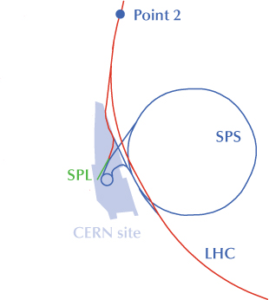
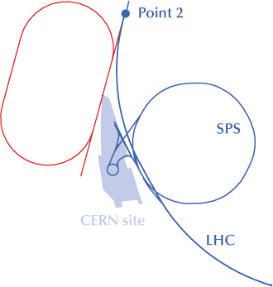
Option 1: “ring-ring” (RR)
e-/e+ ring in LHC tunnel
Option 2: “ring-linac” (RL)
LHeC
s.c.
linac
up to 70 GeV: option for cw operation
and recirculation with energy recovery;
> 70 GeV: pulsed operation at higher
gradient ; g-hadron option
SPL, operating with leptons,
as injector for the ring,
possibly with recirculation
© F. Zimmermann
V.N. Litvinenko, Europhysics HEP Conference, Krakow, July 17, 2009

Slide 16
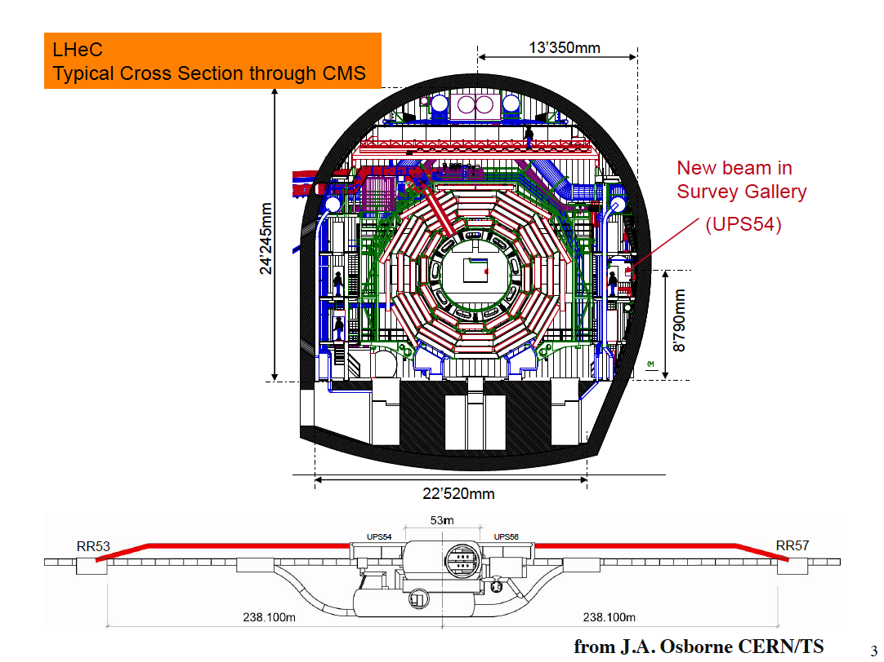
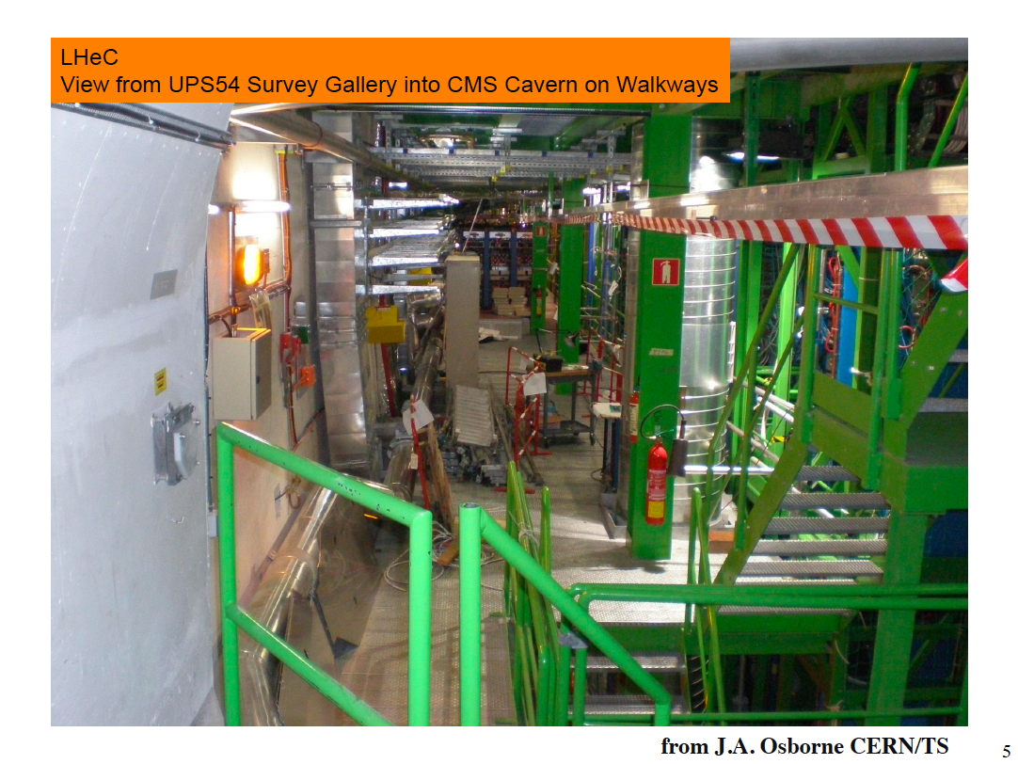
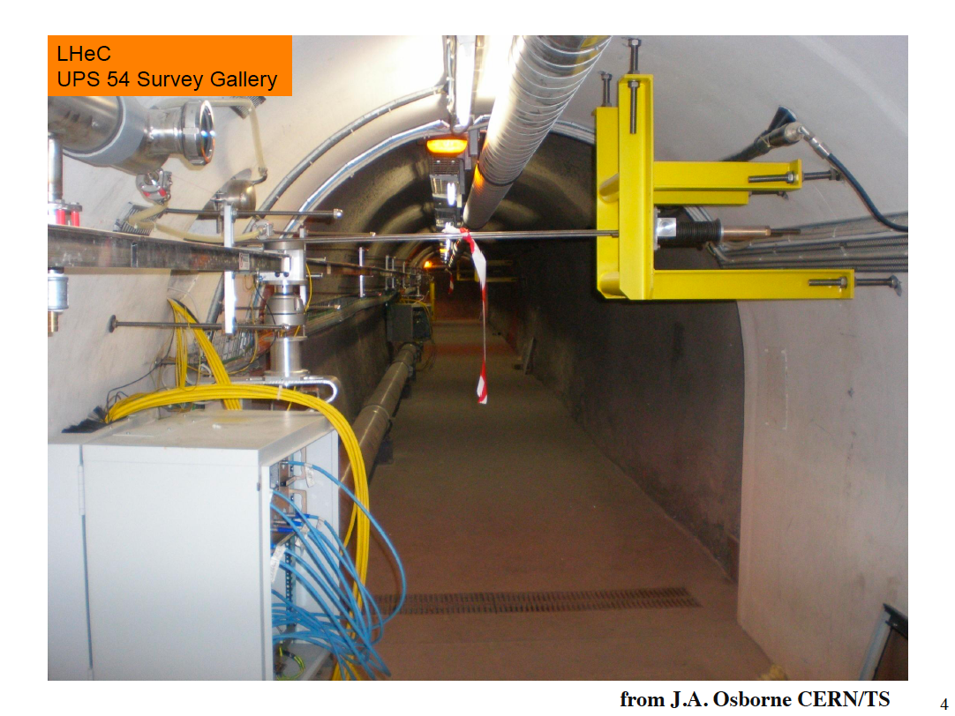
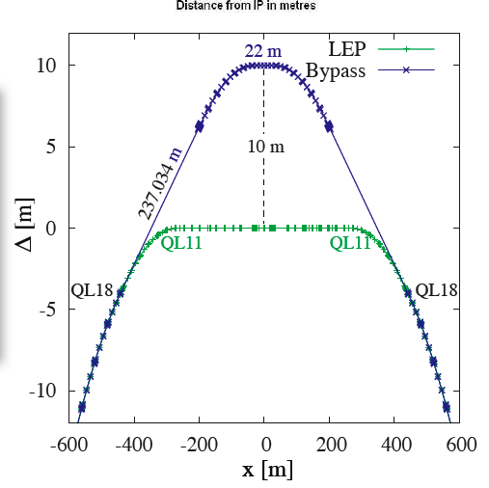
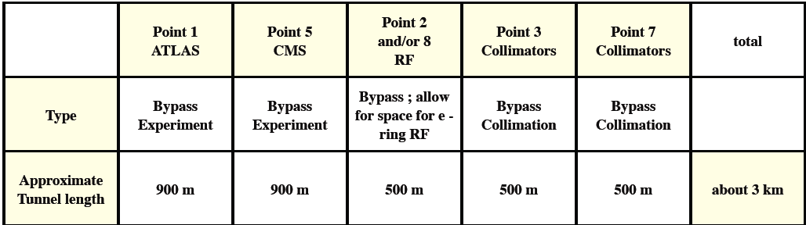
Geometry constrains: circular machines have to go around LHC detectors
© H.Burkhard
V.N. Litvinenko, Europhysics HEP Conference, Krakow, July 17, 2009

Slide 17
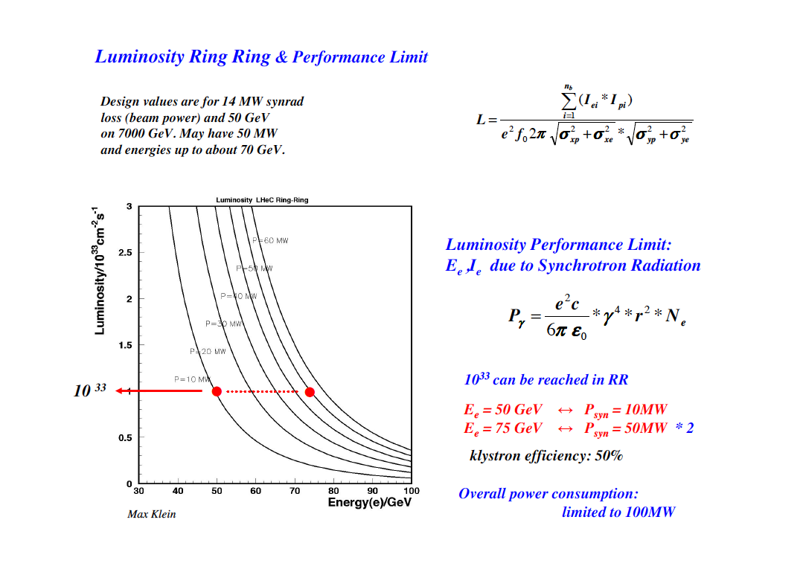
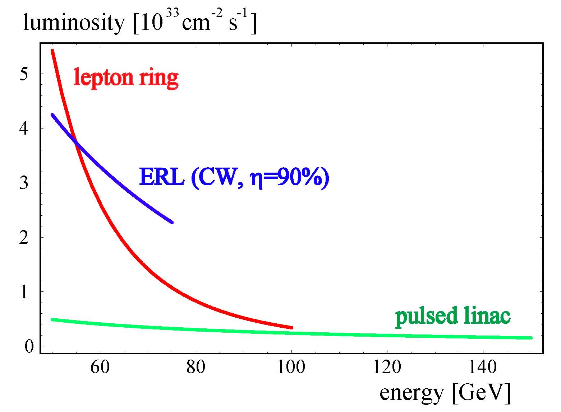
Luminosity vs e-beam energy
for AC-plug power consumption set at 100 MW
 | N_{b,p} | T_{sep} | ε_{p}γ_{p} | β*_{p,min}
LHC phase-I upgrade | 1.7x10¹¹ | 25 ns | 3.75 μm | 0.25 m
LHC phase-II upgrade (“LPA”) | 5x10¹¹ | 50 ns | 3.75 μm | 0.10 m
© F. Zimmermann
Ring SR power = Linac beam power & cryo power
= electrical power set to 100 MW
linac has much lower current
© Bernhard Holzer
V.N. Litvinenko, Europhysics HEP Conference, Krakow, July 17, 2009

Slide 18
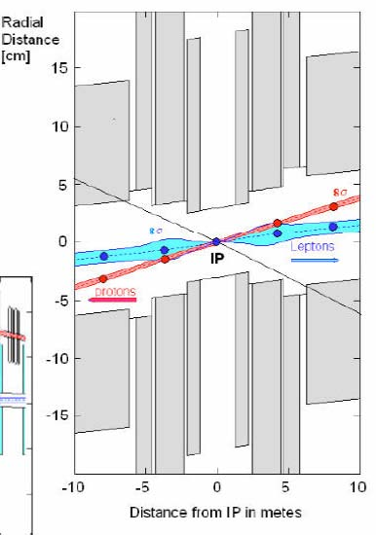
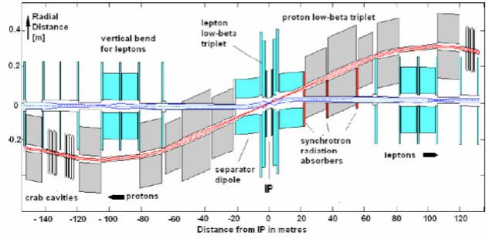
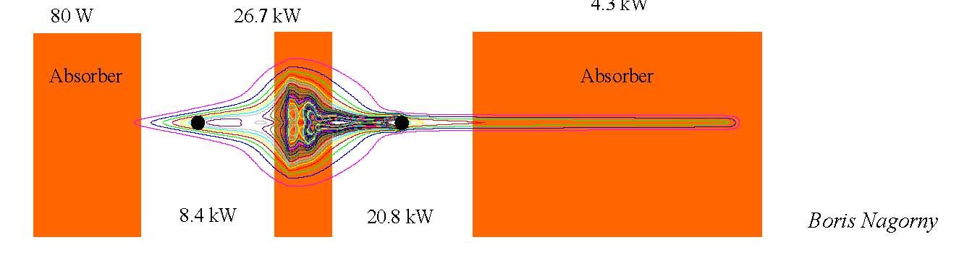
IR layout & crab crossing (for RR)
©Bernhard Holzer
1-2 mrad crossing angle for early separation
Proton crab cavities: 15-30 MV at 800 MHz
SC half quadrupoles
synchrotron radiation
V.N. Litvinenko, Europhysics HEP Conference, Krakow, July 17, 2009

Slide 19
Positrons
Ring
A rebuilt conventional e⁺ source would suffice
Linac
True challenge: 10x more e⁺ than ILC!
Large # bunches → damping ring difficult
Candidate e⁺ sources under study :
- ERL Compton source for CW operation
e.g. 100 mA ERL w. 10 optical cavities
- undulator source using spent e- beam
- Linac-Compton source for pulsed operation
Complementary options: collimate to shrink emittance,
extremely fast damping in laser cooling ring?,
recycle e+ together with recovering their energy?
T. Omori, J. Urakawa, et al
V.N. Litvinenko, Europhysics HEP Conference, Krakow, July 17, 2009

Slide 20
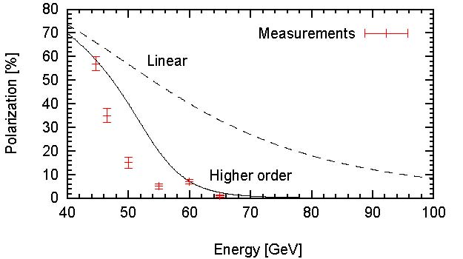
Polarization
Ring
LEP polarization vs. energy
Sokolov-Ternov polarization time
decreases from 5 hr at 46 GeV
to ½ hr at 70 GeV
but depolarizing rate
Increases faster
LHeC physics scenario
© R. Assmann, D. Barber
R. Assmann,
Chamonix 1999,
& Spin2000
Linac
e- : from polarized dc gun with ~90% polarization,
10-100 mm normalized emittance
e+: up to ~60% from undulator or Compton-based source
© F. Zimmermann
V.N. Litvinenko, Europhysics HEP Conference, Krakow, July 17, 2009

Slide 21
Conclusions
eRHIC designs provide for both polarized e-p and unpolarized eA collisions with high luminosity ~ 10³³-10³⁴cm⁻²sec⁻¹ (L_{eRHIC}>>L_{HERA})
  eRHIC choice of ERL for electron acceleration provides higher luminosity compared with ring-ring scenario
  eRHIC’s ERL has a natural staging strategy with increasing the energy of of the ERL is increasing length of linacs and the number of passes
  if physics justify the cost – RHIC could be upgraded to 800 GeV by replacing magnets in one of its rings with LHC-class
  MeRHIC technical design and cost estimate are progressing with plan to complete first release in Fall 2009
LHeC could provide high-energy high-luminosity e±p & e±A collisions
  two major designs under study:
    ring-ring option with 10³³cm⁻²s⁻¹ and e-beam up to 80 GeV
    Optics design for ring-ring is in very advanced stage
    linac-ring option can deliver similar luminosity only using energy recovery, possible extension to 140 GeV with lower luminoity
Both colliders provide for intriguing accelerator-physics R&D on ERLs, polarized guns, e+ production, crab cavities, polarization and advanced cooling techniques
V.N. Litvinenko, Europhysics HEP Conference, Krakow, July 17, 2009

Slide 22
Back up

Slide 23
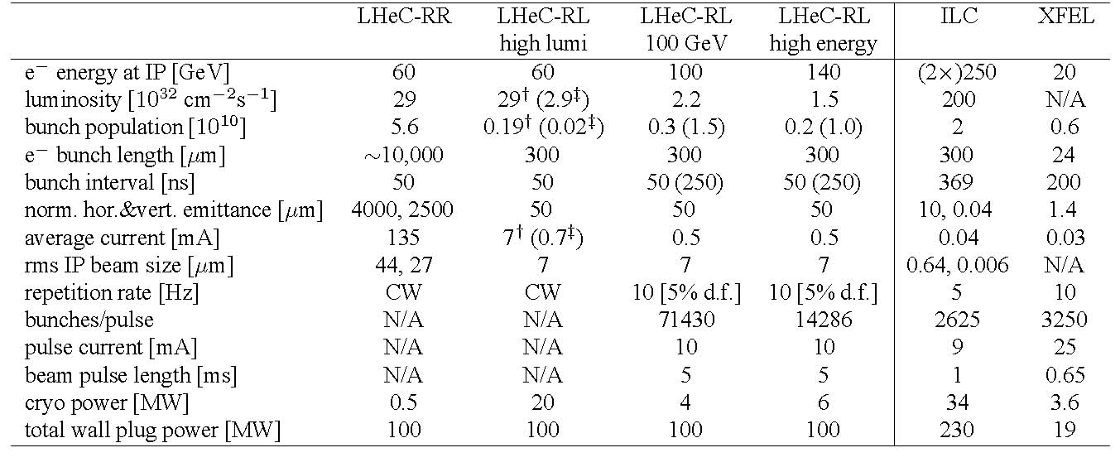
Example Parameters
Example LHeC-RR and RL parameters. Numbers for LHeC-RL high-luminosity option marked by `†' assume energy recovery with η_{ER}=90%; those with `‡’ refer to η_{ER}=0%. ILC and XFEL numbers are included for comparison. Note that optimization of the RR luminosity for different LHC beam assumptions leads to similar luminosity values of about 10³³cm⁻²s⁻¹
V.N. Litvinenko, Europhysics HEP Conference, Krakow, July 17, 2009

Slide 24
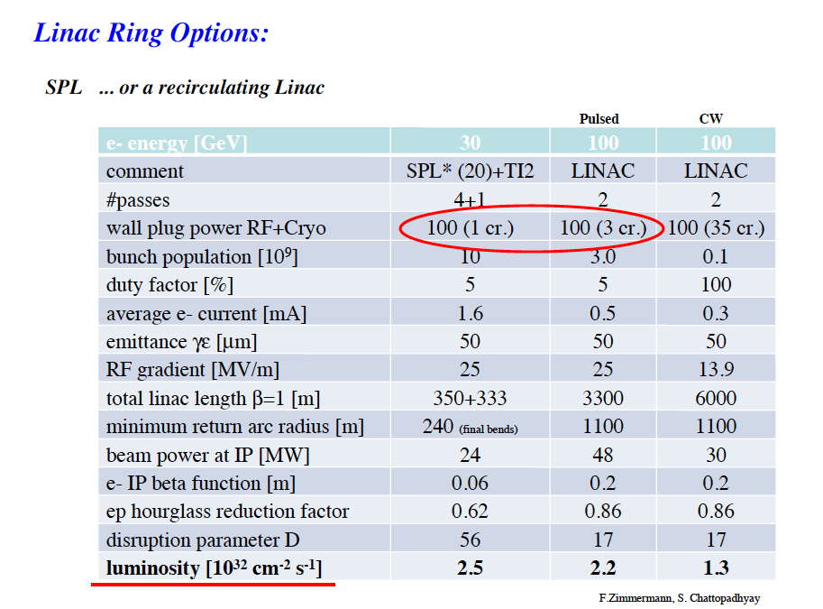

Slide 25
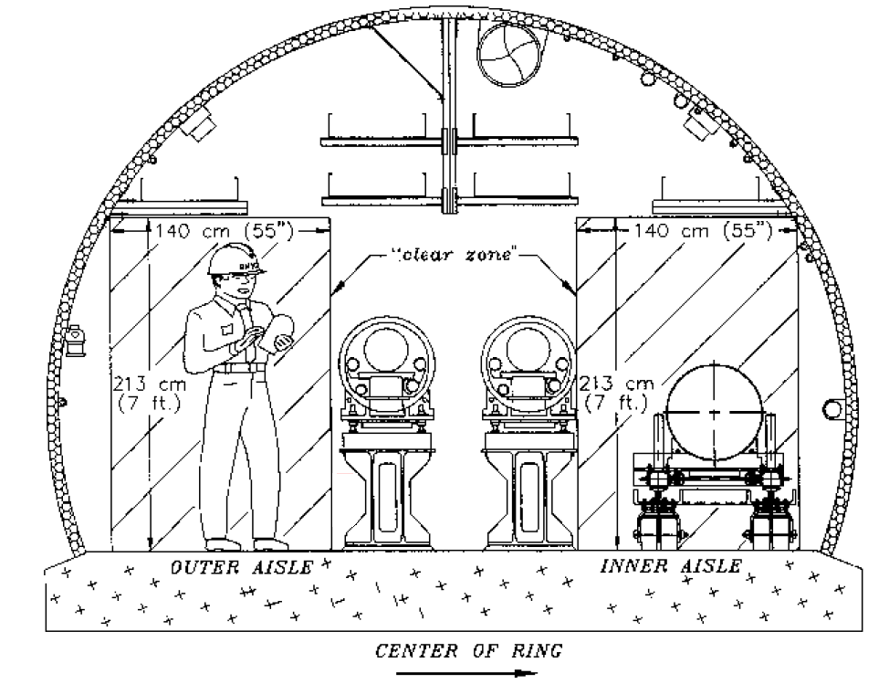
eRHIC loop magnets: LDRD project
Small gap provides for low current, low power consumption magnets
  -> low cost eRHIC
Gap 5 mm total
0.3 T for 30 GeV
eRHIC
20 GeV
e-beam
5 mm
5 mm
16 GeV
e-beam
Common vacuum chamber
5 mm
C-Quad
12 GeV
e-beam
5 mm
8 GeV
e-beam
5 mm
25 cm
5 mm
C- Dipole
V.N. Litvinenko, Europhysics HEP Conference, Krakow, July 17, 2009

Slide 26
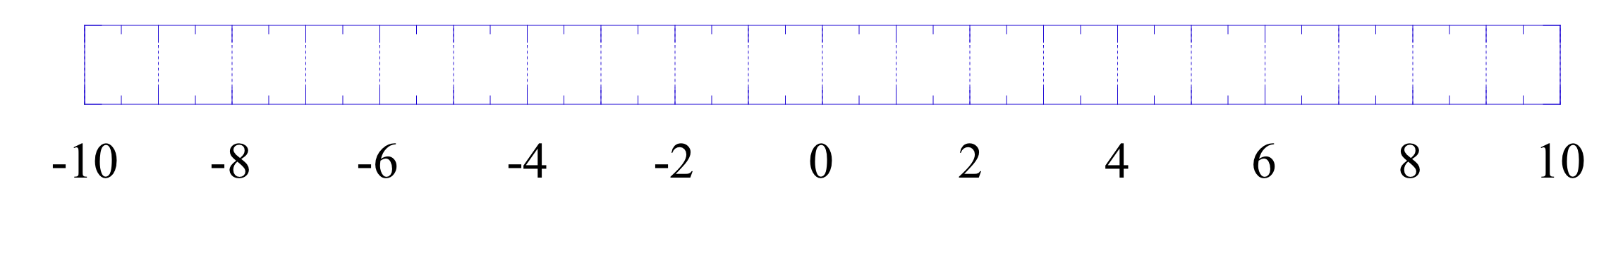
Detector field layout
MeRHIC 4 GeV e x 250 GeV p/100 GeV Au
Remove Dxes – 40 m to detect particles scattered at small angles
DX
1T, 3m
dipole
1T, 3m
dipole
DX
e
Solenoid, 4 T
p, Au
To provide effective SR protection:
-soft bend (~0.05T) is used for final bending of electron beam
Solenoid (4T)
Dipole
~3Tm
© J.Bebee-Wang
© E. Aschenauer
V.N. Litvinenko, Europhysics HEP Conference, Krakow, July 17, 2009

Slide 27
ERL spin transparency at all energies
Bargman, Mitchel,Telegdi equation
n passes
Total angle
Has solution
for all
energies!
n=2
Gun

Slide 28
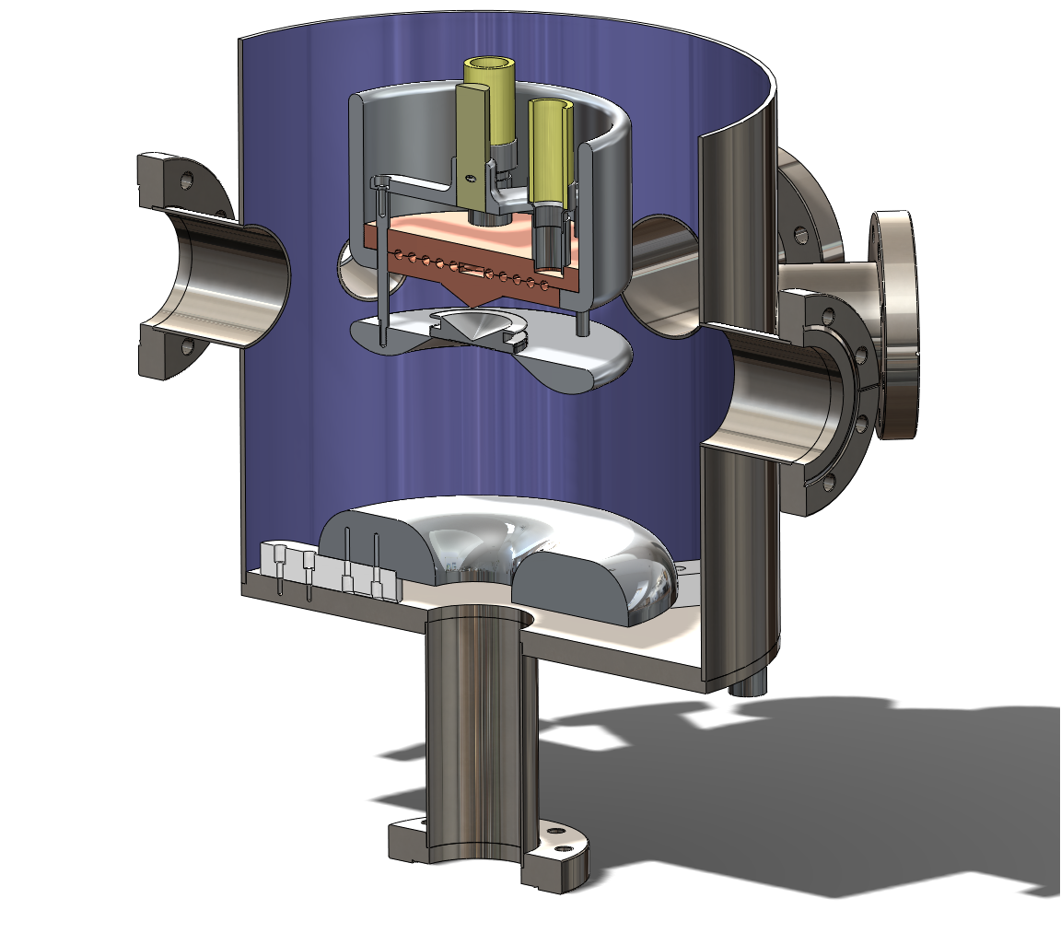
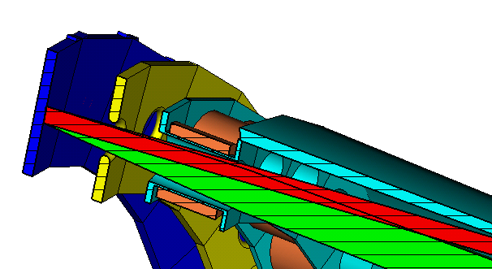
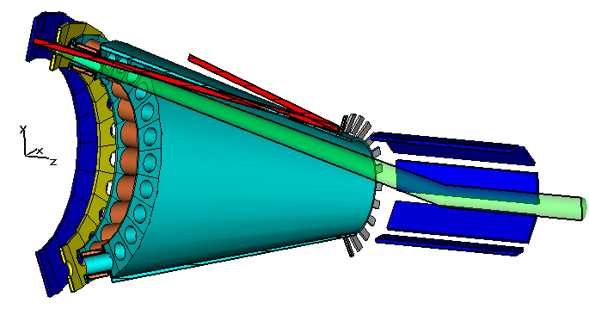
Main technical challenge is 50 mA
CW polarized gun: we are building it
3rd harmonic cavity
Single cathode DC gun
Solenoids
Spin rotator (Wien)
Cathodes
0.6m
Bunching optics
Booster linac (112MHz)
Combiner
0.7m
4m
0.5m
0.5m
DC gun
with 24 cathodes
Based on demonstrated
current technology developed at JLab
© X.Chang
© E.Tsentalovich, MIT
V.N. Litvinenko, Europhysics HEP Conference, Krakow, July 17, 2009

Slide 29
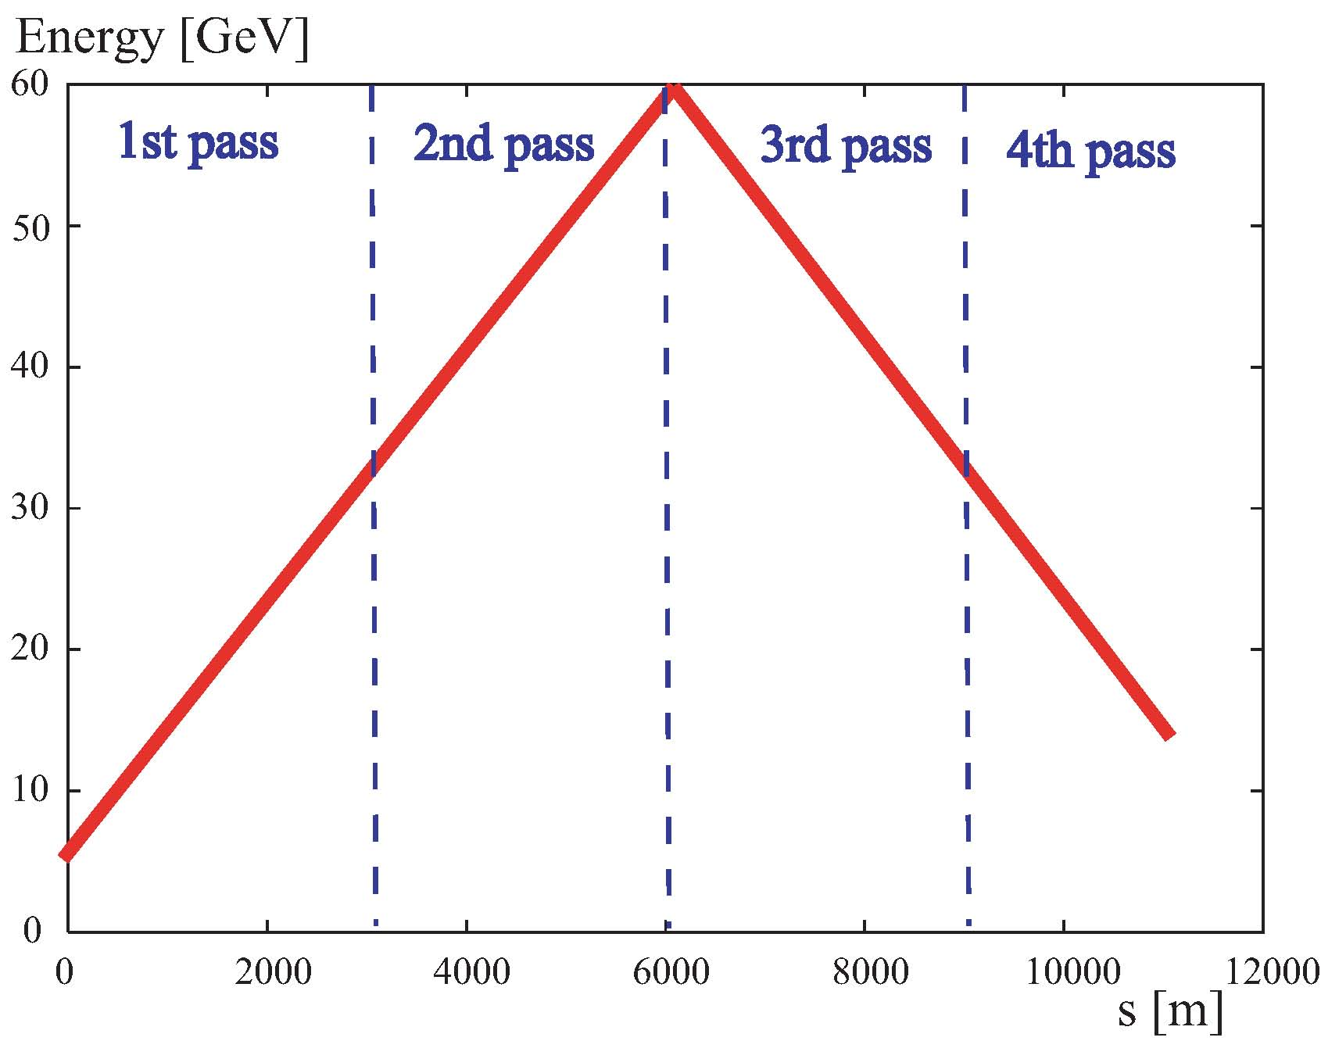
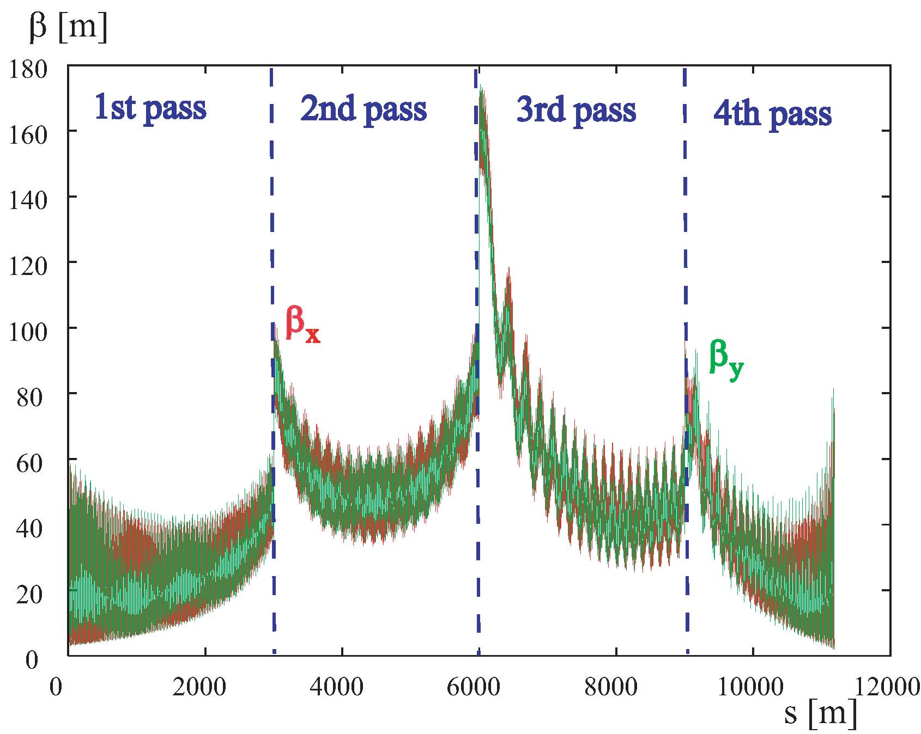
example linac optics for 4-pass ERL option
Anders Eide
V.N. Litvinenko, Europhysics HEP Conference, Krakow, July 17, 2009

Slide 30
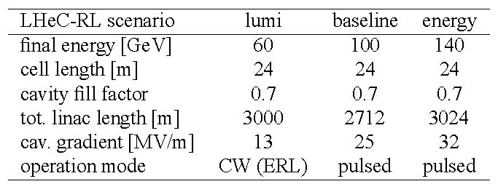
tentative SC linac parameters for RL
4 passes
2 passes
RF frequency: ~700 MHz
Anders Eide
V.N. Litvinenko, Europhysics HEP Conference, Krakow, July 17, 2009

Slide 31
Challenges and Advantages
Main Challenge –
50 mA polarized gun for e-p program
Main advantage – RHIC
  Unique set of species from d to U
  The only high energy polarized proton collider
  Large size of RHIC tunnel (3.8 km)
Main disadvantage is caused by nature
  Ion cloud limitation of the hadron beam intensity
V.N. Litvinenko, Europhysics HEP Conference, Krakow, July 17, 2009

Slide 32
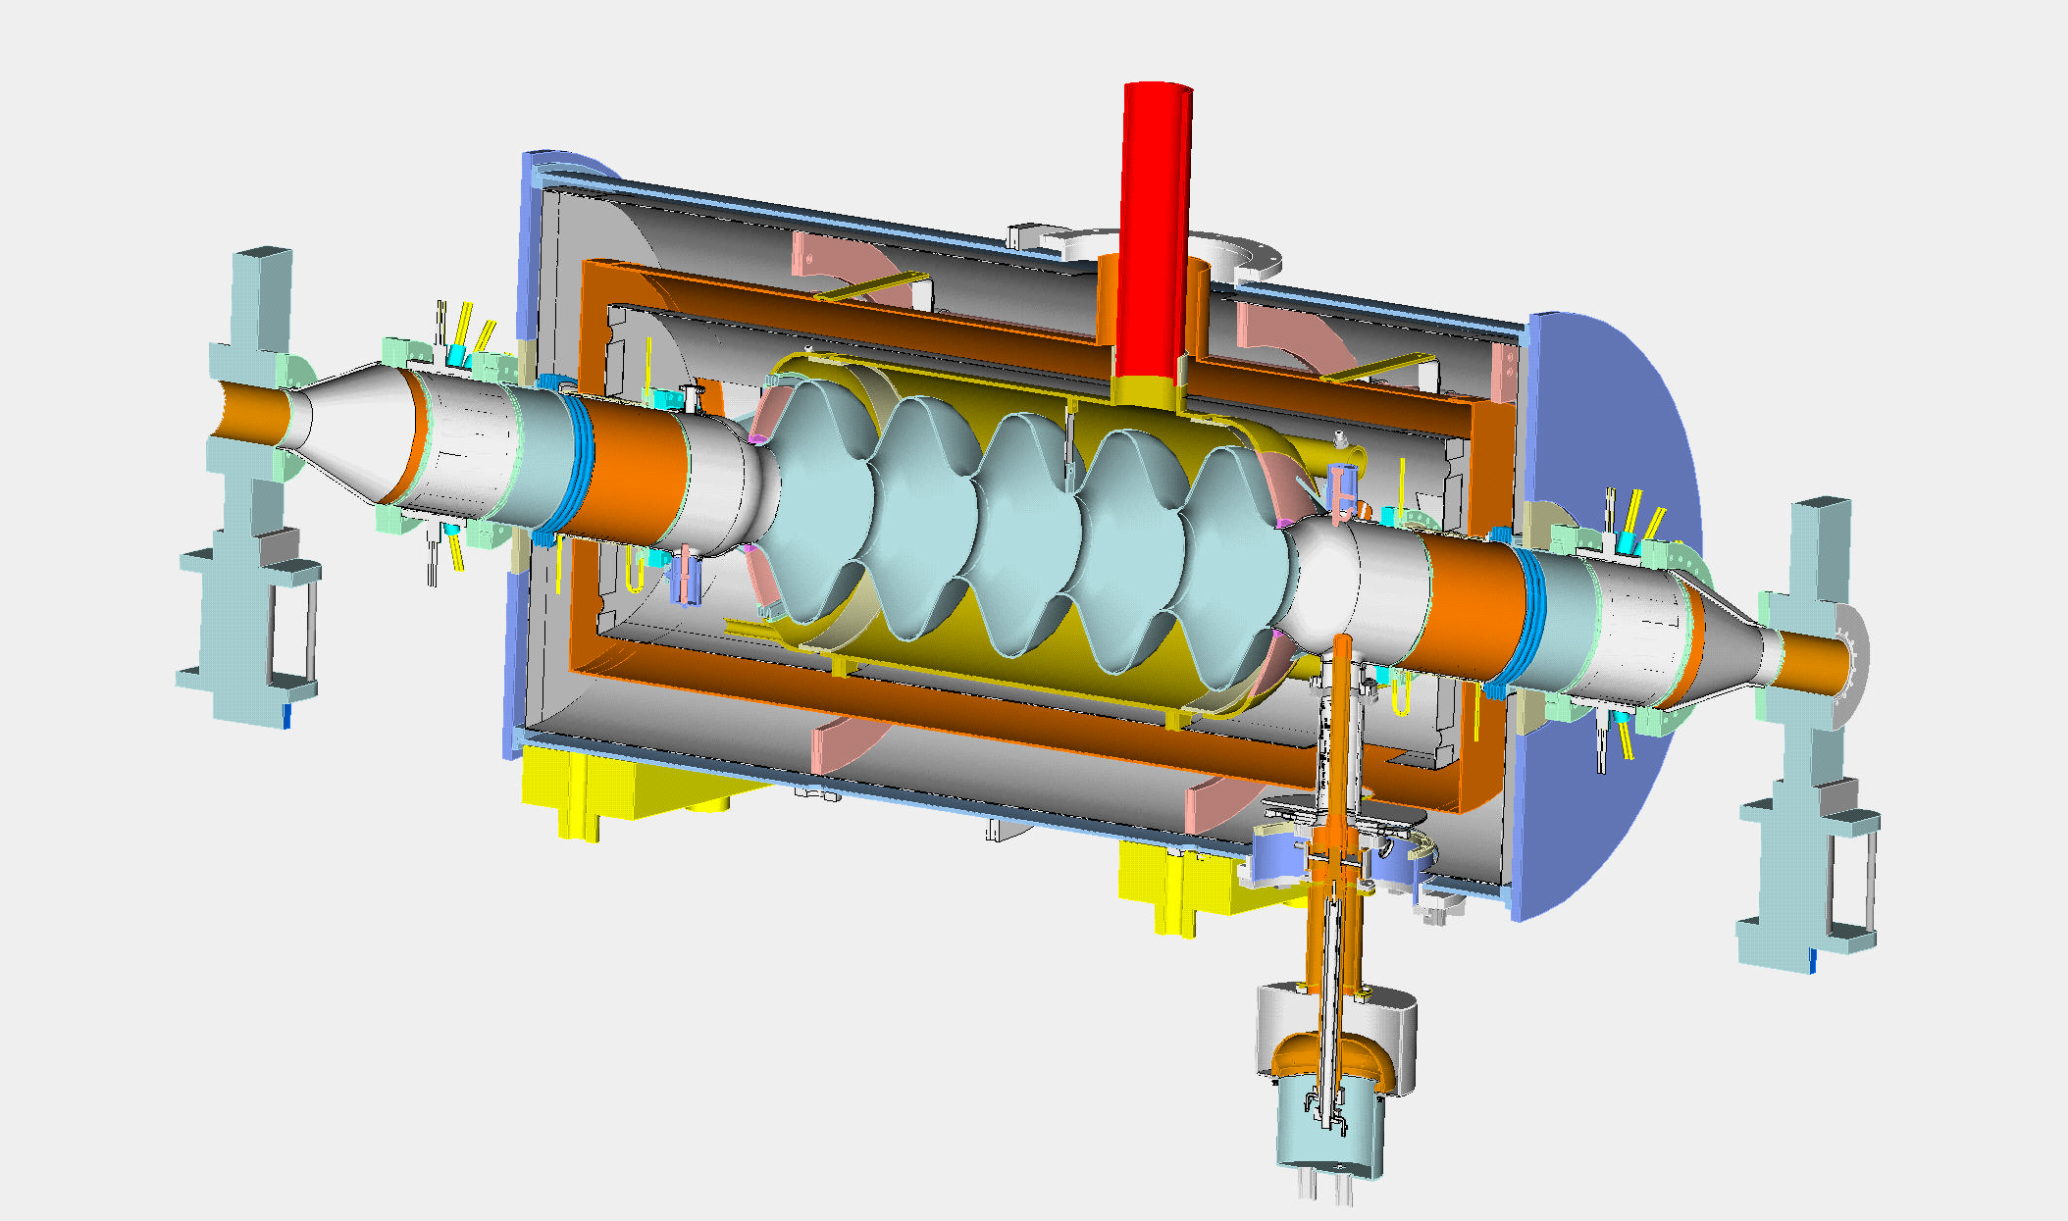
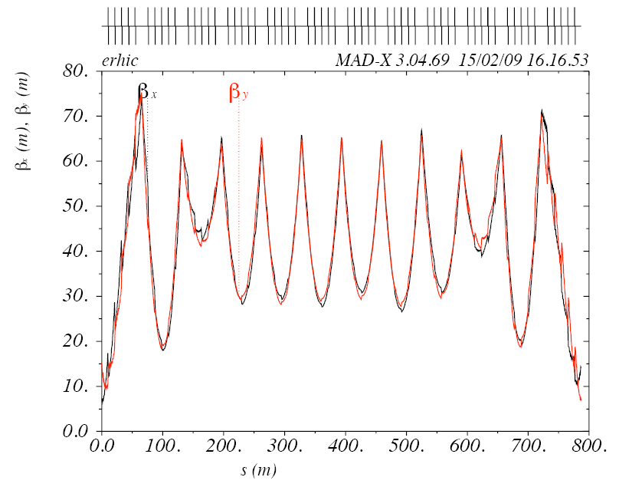
MeRHIC Linac Design
703.75 MHz
1.6 m long
Drift
1.5 m long
Based on revolutionary BNL SRF cavity with
fully suppressed HOMs – reached design parameters last week
Critical for high current multi-pass ERL
65m total linac length
All cold: no warm-to-cold transition
100 MeV
4 GeV
100 MeV
Current breakdown of the linac
N cavities = 6 (per module)
N modules per linac = 6
N linacs = 2
L module = 9.6m
L period = 10.6 m
E_{f} = 18.0 MeV/m
⟨dE/ds⟩ = 10.2 MeV/m
E.Pozdeyev
V.N. Litvinenko, Europhysics HEP Conference, Krakow, July 17, 2009

Slide 33

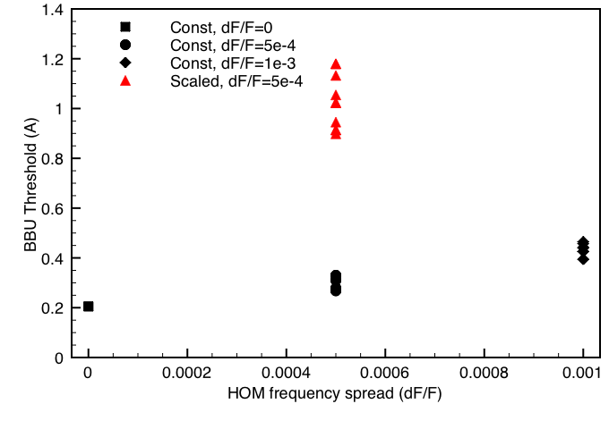
TBBU stability (©E. Pozdeyev)
HOMs based on R. Calaga’s simulations/measurements
70 dipole HOM’s to 2.7 GHz in each cavity
Polarization either 0 or 90°
6 different random seeds
HOM Frequency spread 0-0.001
Simulated BBU threshold (GBBU) vs. HOM frequency spread.
Beam current 50 mA
Excitation process of transverse HOM
F (GHz) | R/Q (Ω) | Q | (R/Q)Q
0.8892 | 57.2 | 600 | 3.4e4
0.8916 | 57.2 | 750 | 4.3e4
1.7773 | 3.4 | 7084 | 2.4e4
1.7774 | 3.4 | 7167 | 2.4e4
1.7827 | 1.7 | 9899 | 1.7e4
1.7828 | 1.7 | 8967 | 1.5e4
1.7847 | 5.1 | 4200 | 2.1e4
1.7848 | 5.1 | 4200 | 2.1e4
eRHIC
Threshold significantly exceeds the beam current,
especially for the scaled gradient solution.
V.N. Litvinenko, Europhysics HEP Conference, Krakow, July 17, 2009

Slide 34
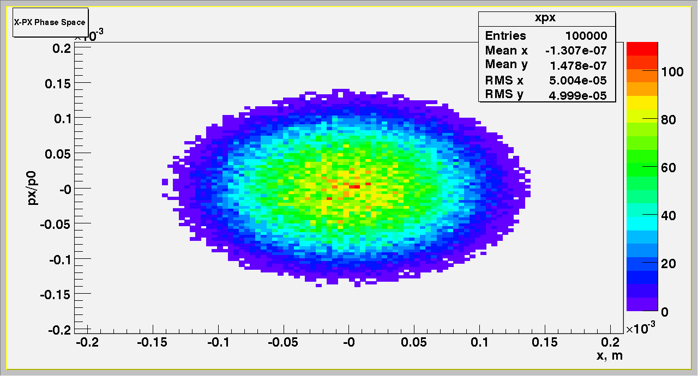
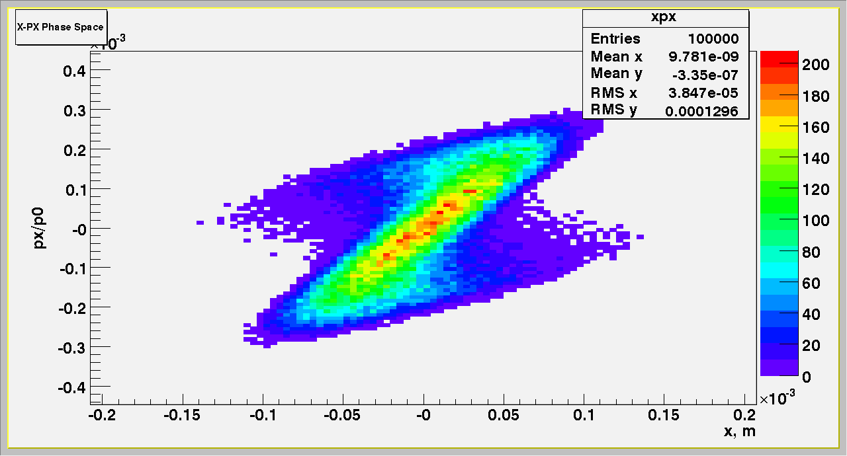
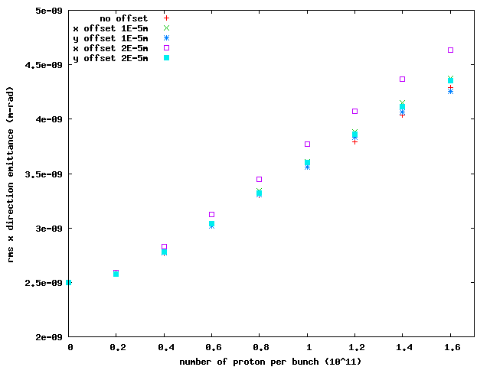
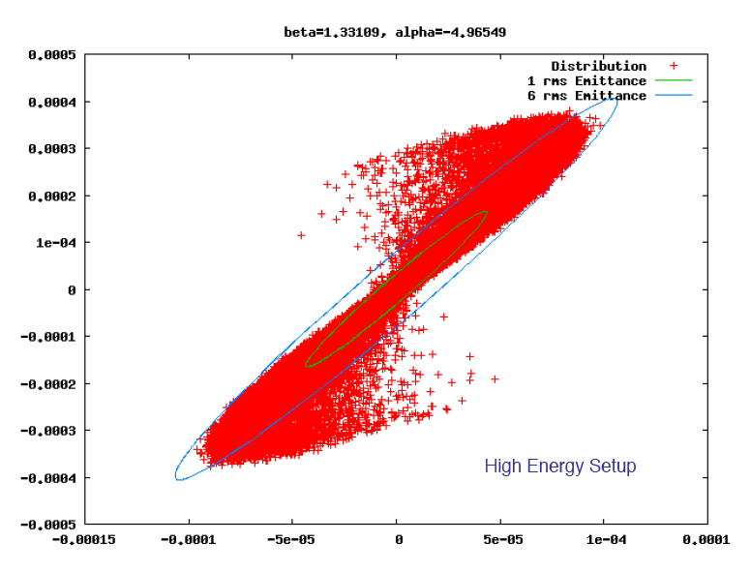
Beam Disruption
protons
e
Interaction
Optimized
©Y. Hao
V.N. Litvinenko, Europhysics HEP Conference, Krakow, July 17, 2009

Slide 35
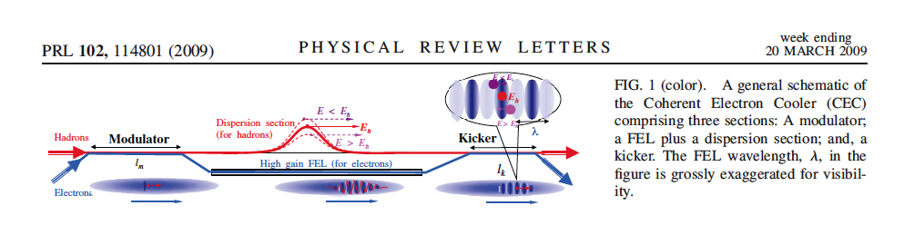
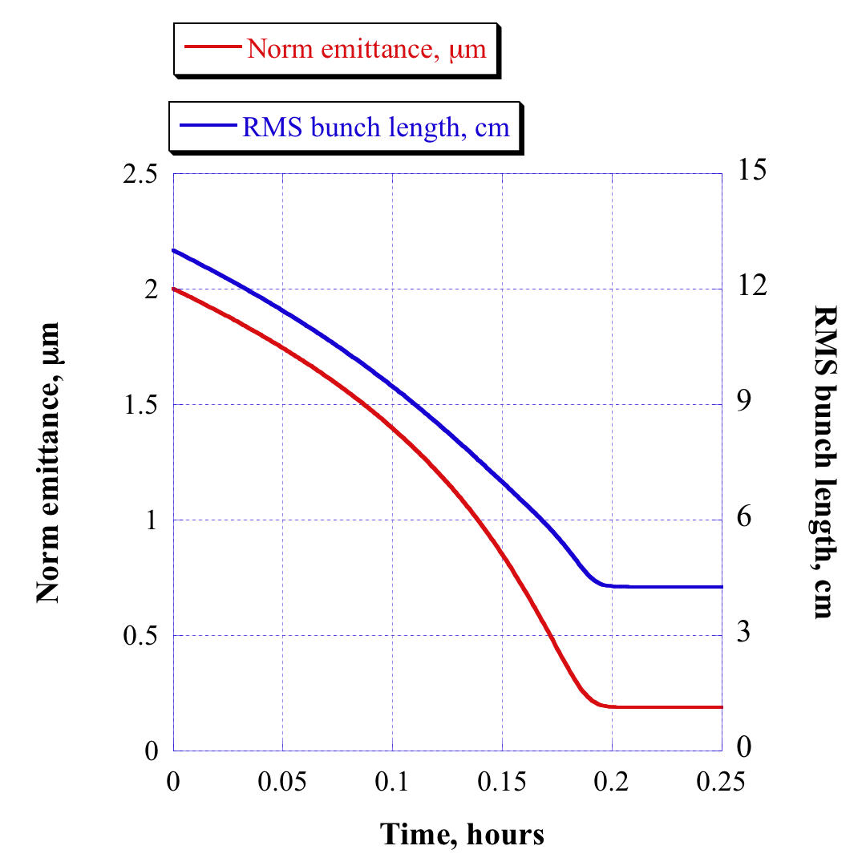
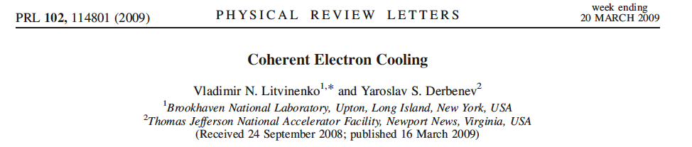
Gains from coherent e-cooling:
Coherent Electron Cooling vs. IBS
IBS in RHIC for
eRHIC, 250 GeV, N_{p}=2.10¹¹
Beta-cool, ©A.Fedotov
Dynamics:
Takes 12 mins
to reach
stationary
point
This allows
keep the luminosity as it is
reduce polarized beam current down to 25 mA (5 mA for e-I)
increase electron beam energy to 20 GeV (30 GeV for e-I)
increase luminosity by reducing β* from 25 cm down to 5 cm
V.N. Litvinenko, Europhysics HEP Conference, Krakow, July 17, 2009

Slide 36
Compact spreaders/combiners
25 cm
20 GeV
4 GeV
Using SQ-quadrupoles to
match vertical dispersion
with horizontal dispersion
in the arc
~10 m
This concept allows to use most of the RHIC straight sections for SF linacs and to use part of the arcs for matching
V.N. Litvinenko, Europhysics HEP Conference, Krakow, July 17, 2009

Slide 37
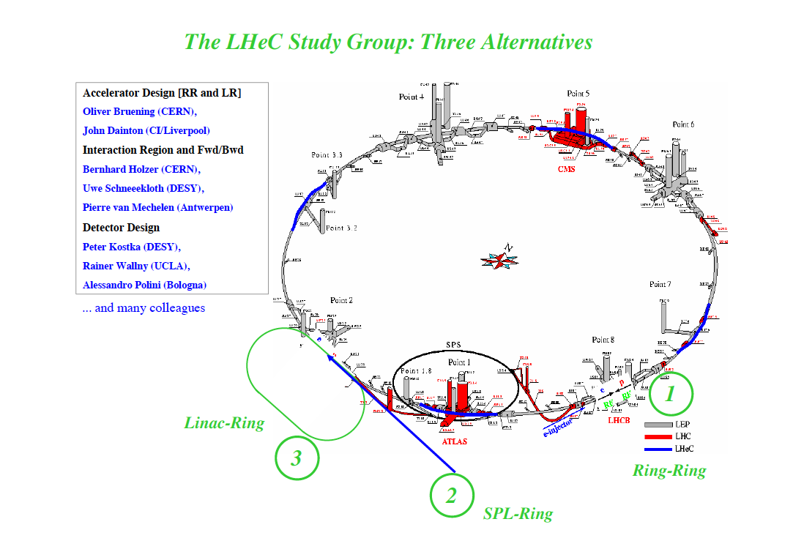
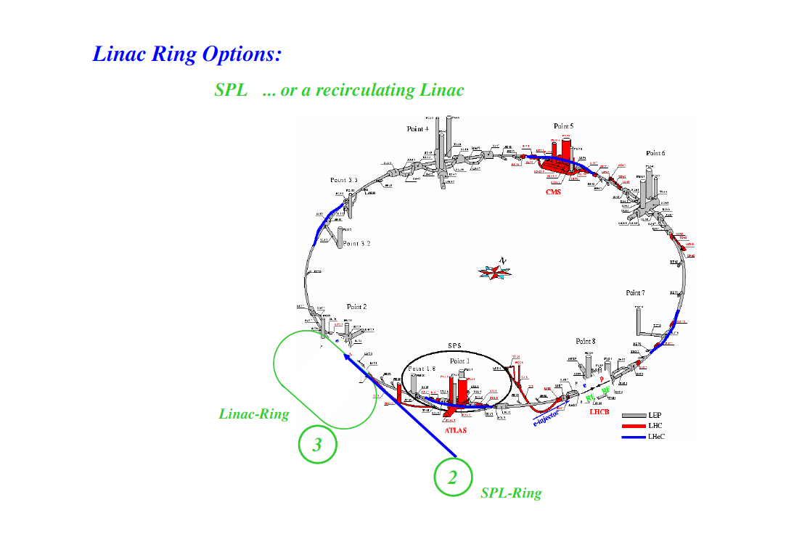


LHeC
layouts
© H.Burkhard, B.Holzer
Ring-ring

Slide 38
eRHIC timeline
BNL & MIT
Add 10 GeV electron machine to RHIC with 250 GeV polarized protons and 100 GeV/n ions
Luminosity is based on hadron beam parameters demonstrated in RHIC complex
First paper and workshop on eRHIC – 1999
“eRHIC Zeroth-Order Design Report” and cost estimate, BNL 2004
  Ring-ring (e-ring designed by MIT) was the main option, L~10³²
  70+ page appendix on Linac (ERL) – Ring as back-up, L~10³³
2007 – after detailed studies we found that linac-ring has 5-10 fold higher luminosity – it became the main option
eA group made a case that 20 (or even 30 GeV) electrons are needed
March 2008 – first staging option of eRHIC of all-in-the tunnel ERL with 2(4) GeV as the first stage, with 10 GeV and 20 GeV as next steps
  there is potential for increase of RHIC energy to 800 GeV if physics justifies the cost
2009 – we plan to release first release of Design Report on MeRHIC (Medium energy eRHIC)
V.N. Litvinenko, Europhysics HEP Conference, Krakow, July 17, 2009

Slide 39
Staging of eRHIC:
Re-use, Beams and Energetics
MeRHIC: Medium Energy electron-Ion Collider
  90% of ERL hardware will be use for full energy eRHIC
  Possible use of the detector in eRHIC operation
eRHIC – High energy and luminosity phase
  Based on present RHIC beam intensities
  With coherent electron cooling requirements on the electron beam current is 50 mA
  20 GeV, 50 mA electron beam losses 4 MW total for synchrotron radiation.
  30 GeV, 10 mA electron beam loses 4 MW for synchrotron radiation
  Power density is <2 kW/meter and is well within B-factory limits (8 kW/m)
eRHIC upgrade(s)
  High luminosity, low energy requires crab cavities, new injections, Cu-coating of RHIC vacuum chambers, new level of intensities in RHIC
    Polarized electron source current of 400 mA at10 GeV, losses 2 MW total for synchrotron radiation, power density is 1 kW/meter
  High energy option requires replacing one of RHIC ring with 8 T magnets
V.N. Litvinenko, Europhysics HEP Conference, Krakow, July 17, 2009

Slide 40

ERL-based eRHIC Design
  10 GeV electron design energy.
  Possible upgrade to 20 GeV by
  doubling main linac length.
  5 recirculation passes ( 4 of them in the RHIC tunnel)
  Multiple electron-hadron interaction points (IPs) and detectors;
  Full polarization transparency at all energies for the electron beam;
  Ability to take full advantage of transverse cooling of the hadron beams;
  Possible options to include polarized positrons: compact storage ring; compton backscattered; undulator-based. Though at lower luminosity.
e-ion detector
Possible locations
for additional e-ion
detectors
eRHIC
PHENIX
Main ERL
(1.9 GeV)
Beam
dump
STAR
Low energy
recirculation pass
Four recirculation passes
Electron
source

Slide 41
Advantages & Challenges of ERL based eRHIC
Allows use of RHIC tunnel for the return passes and thus allow much higher (2-3 fold) energy of electrons compared with the storage ring.
High luminosity up to 10³⁴ cm⁻² sec⁻¹
Allows multiple IPs
Allows higher range of CM-energies with high luminosities
Full spin transparency at all energies
No machine elements inside detector(s)
No significant limitation on the lengths of detectors
Energy of ERL is simply upgradeable
Novel technology
Need R&D on polarized gun
May need a dedicated ring positrons (if ever required?)

Slide 42

View from 2004: How eRHIC can be realized?
  Ring-ring:
  Linac (ERL)-ring:
Electron storage ring
RHIC
Electron linear accelerator
RHIC
Advantages & Challenges of ERL based eRHIC
Allows use of RHIC tunnel
2-3 fold higher energy of electrons
Higher luminosity up to 10³⁴ cm⁻² sec⁻¹
Multiple IPs
Higher range of CM-energies + high luminosities
Full spin transparency at all energies
No machine elements inside detector(s)
No significant limitation on the lengths of detectors
ERL is simply upgradeable
eRHIC can be staged
Novel technology
Need R&D on polarized gun
May need a dedicated ring positrons
3x250
10x250
3x50
10x50
5x250
5x50
In Ring-ring luminosity reduces 10-fold for 30 GeV CME.
Required norm.emittance (for 50 GeV protons) ~3 mm*mrad
http://www.agsrhichome.bnl.gov/eRHIC/

Slide 43
Advantages & Disadvantages
Ring-Ring
Linac-Ring
Proven technology (B-factory)
Supports both electron and positron (!) beams options
Requires significant (3-fold) increase to reach L=0.8^{x}10³³ cm⁻² sec⁻¹ but with very short (±1 m) detector
Reasonable detector length (±3 m) reduces luminosity for present proton/ion intensities in RHIC below or about 10³² cm⁻² sec⁻¹
Polarization is not available in forbidden energy zones
Single IP (period).
Machine element inside detector
Luminosity plummets at lower E_{cm}
High luminosity up to 10³⁴ cm⁻² sec⁻¹
Satisfy eRHIC physics goal with present proton/ion intensities in RHIC (L>10³³ cm⁻² sec⁻¹)
Allows multiple IPs
No machine elements inside detector(s)
No significant limitation on the lengths of detectors
Allows wider range of CM-energies with high luminosities
Full spin transparency at all energies
Energy of ERL is simply upgradeable
Novel technology
Need R&D on polarized gun
Needs a dedicated ring positrons (if required)

Slide 44
Luminosity with e-cooling
Calculations for 360 bunch mode and 250 Gev(p) x 10 Gev(e) setup; 10¹¹ p/bunch
Linac-ring with 2 x 10¹¹ p/bunch
Linac-ring eRHIC takes full advantage of electron and stochastic cooling
0.5A, 5πμm
Linac-ring
cooled beam
0.5A,7.5 πμm
0.5A, 15 πμm
Ring-ring, with cooling
0.5A
Ring-ring, no cooling
1A
0.5A
ξ_{p}
Markers show electron current and (for linac-ring) normalized proton emittance.
In dedicated mode (only e-p collision): maximum ξ_{p}~0.018;
Transverse cooling can be used to improve luminosity or to ease requirements
on electron source current in linac-ring option.
V. Ptitsyn

Slide 45

Luminosity dependence on CME with cooling
L_{@Ee/En}/L_{@10/250}
2-250
E_{cm}=45 GeV
5-250
E_{cm}=70 GeV
10-250
E_{cm}=100 GeV
linac-ring
ring-ring
10-50
E_{cm}=45 GeV
5-250
E_{cm}=70 GeV
5-50
E_{cm}=32 GeV
Luminosity reduction is 20-fold in ring-ring at 5GeV-50GeV set-up compared to 10GeV-250GeV (E_{cm} 100 GeV -> 32 GeV).
Required norm.emittance ~3π mm*mrad
For ring-ring the cooling improves luminosities for low energy proton modes. The optimal curve is: 10-250-> 10-50 -> 5-50
For linac-ring operation absence of tune shift limit on electron beam allows to maintain luminosity by keeping energy of hadron beam and reducing energy of electron beam
Linac-ring takes full advantage of the cooling (which also reduces requirements on electron beam current).
The optimal curve is for linac-ring : 10-250-> 5-250 -> 2-250->2-X
V. Ptitsyn

Slide 46
Advantages & Challenges of ERL based eRHIC
High luminosity up to 10³⁴ cm⁻² sec⁻¹
Allows multiple IPs
No machine elements inside detector(s)
No significant limitation on the lengths of detectors
Allows higher range of CM-energies with high luminosities
Full spin transparency at all energies
Energy of ERL is simply upgradeable
Novel technology
Need R&D on polarized gun
Needs a dedicated ring positrons (if required)

Slide 47
MeRHIC parameters for e-p collisions
© V.Ptitsyn
 | not cooled |  | With cooling
 | p | e | p | e
Energy, GeV | 250 | 4 | 250 | 4
Number of bunches | 111 |  | 111
Bunch intensity, 10¹¹ | 2.0 | 0.31 | 2.0 | 0.31
Bunch charge/current, nC/mA | 32/320 | 5/50 | 32/320 | 5/50
Normalized emittance, 1e-6 m, 95% for p / rms for e | 15 | 73 | 1.5 | 7.3
rms emittance, nm | 9.4 | 9.4 | 0.94 | 0.94
beta*, cm | 50 | 50 | 50 | 50
rms bunch length, cm | 20 | 0.2 | 5 | 0.2
beam-beam for p /disruption for e | 1.5e-3 | 3.1 | 0.015 | 7.7
Peak Luminosity, 1e32, cm⁻²s⁻¹ | 0.93 |  | 9.3
Luminosity for light and heavy ions
is the same as for e-p if measured per nucleon!
V.N. Litvinenko, Europhysics HEP Conference, Krakow, July 17, 2009

Slide 48
Parameters for pulsed Linacs for 140 GeV, 10³²cm⁻²s⁻¹
SC technology
NC technology
 | X FEL 20 GeV | LHeC 140 GeV, 10³²cm⁻²s⁻¹ | LHeC 140 GeV, 10³²cm⁻²s⁻¹
I_{Beam} during pulse | 5 mA | 11.4 mA | 0.4 A
N_{E} | 0.624⋅10¹⁰ | 5.79⋅10¹⁰ | 6.2⋅10¹⁰
Bunch spacing | 0.2 μs | 0.8 μs | 25 ns
Pulse duration | 0.65 ms | 1.0 ms | 4.2 μs
Repetition rate | 10 Hz | 10 Hz | 100 Hz
G | 23.6MV/m | 23.6MV/m | 20.0 MV/m
Total Length | 1.27 km | 8.72 km | 8.76 km
P_{Beam} | 0.65 MW | 16.8 MW | 16.8 MW
Grid power for RF plant | 4 MW | 59 MW | 96 MW
Grid power for Cryoplant | 3 MW | 20 MW | -
P_{Beam}/P_{AC} | 10% | 21% | 18%

Slide 49


